Slide 1

Using to Build Resilient Applications
With Erik Muir

Slide 2
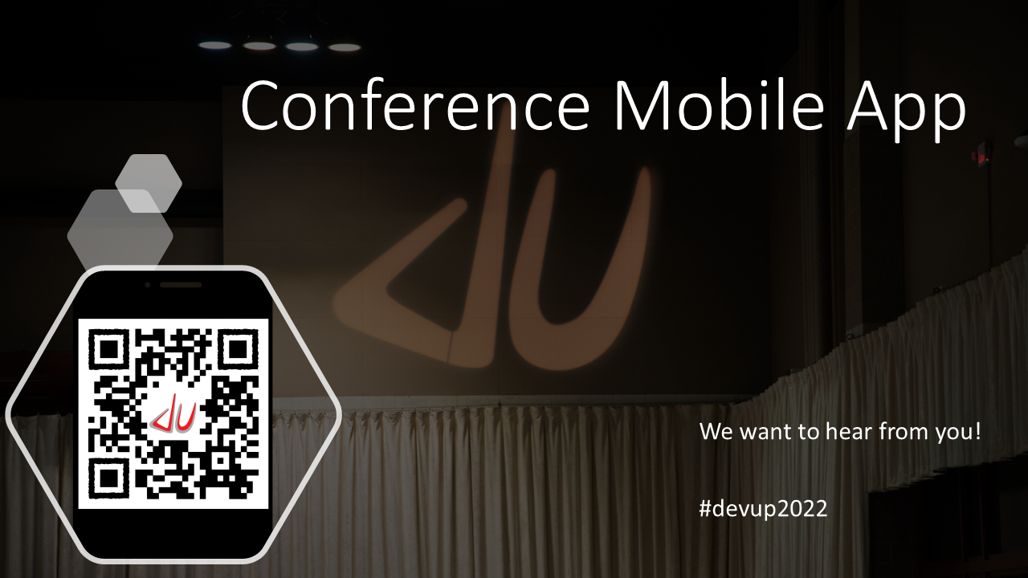

Slide 3
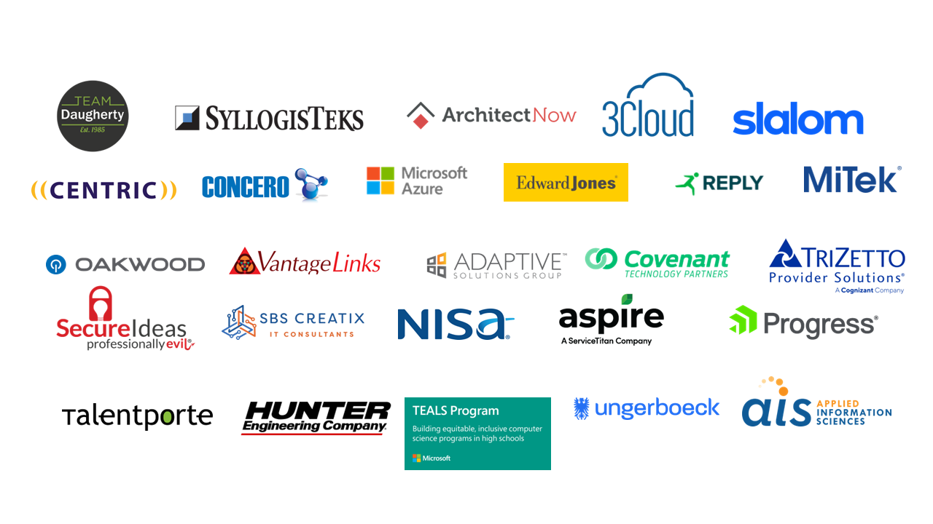

Slide 4








A Web3 Managed Service Provider
Inquire
Search
Sentinel
Notify
Deduce
Analytics
Replay
Develop
Perceive Metrics
Explore
Accelerating enterprise adoption of public ledgers
Hedera
Hashgraph
™

Slide 5


My code is perfect!
Readable
Maintainable
SOLID
DRY
TDD / Code coverage
Appropriate logging
Observability

Slide 6


So what’s the problem?
Networks aren’t perfect
Third Party APIs aren’t perfect
Databases aren’t perfect
Microservices aren’t perfect
Clouds aren’t perfect

Slide 7


Slide 8

What is Polly?
Polly is a .NET resilience and transient-fault-handling library that allows developers to express policies in a fluent and thread-safe manner.

Slide 9
Policy Types
Reactive
Proactive
Other
Retry
Circuit Breaker
Fallback
Timeout
Bulkhead Isolation
Caching
Policy Wrap
Policy Registry
NoOp

Slide 10
All Polly policies are fully thread-safe. You can safely re-use policies at multiple call sites and execute through them concurrently on different threads.
if delegates you execute through the policy
are not thread-safe, they remain not thread-safe.

Slide 11

Retry Policy Family
Premise
How does the policy mitigate?
Many faults are transient and may self-correct after a short delay.
“Maybe it’s just a blip”
Allows configuring automatic retries.
Retry n times
Retry forever (until success)
Wait and retry
Wait and retry forever (until success)
onRetry delegate
DEMO

Slide 12

Timeout Policy
Premise
How does the policy mitigate?
Beyond a certain wait, a success result is unlikely.
Guarantees the caller won't have to wait beyond a custom defined timeout.
Fun Fact
The default timeout of the .NET HttpClient is 100,000 milliseconds (100 seconds).
DEMO

Slide 13

Fallback Policy
Premise
Things will still fail - plan what you will do when it happens.
How does the policy mitigate?
Defines an alternative value to be returned (or action to be executed) on failure.
DEMO

Slide 14

Policy Wrap
Premise
Different faults require different strategies – resilience means using a combination.
How does the policy mitigate?
Allows any of the previous policies to be combined flexibly.
DEMO

Slide 15
Circuit Breaker Policy
Premise
How does the policy mitigate?
When a system is seriously struggling, failing fast is better than making users/callers wait. Protecting a faulting system from overload can help it recover faster.
Breaks the circuit (blocks executions) for a period, when faults exceed some pre-configured threshold.
Normal – triggered by a specific count of consecutive failures
Advanced – triggered by a percentage of failures over time

Slide 16
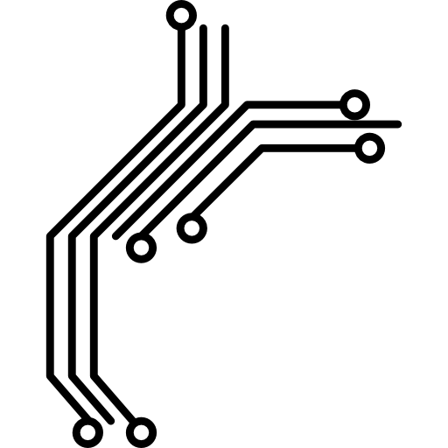
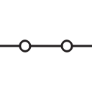
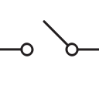
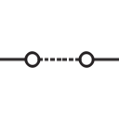
Circuit Breaker States
closed
open
half-open
DEMO

Slide 17
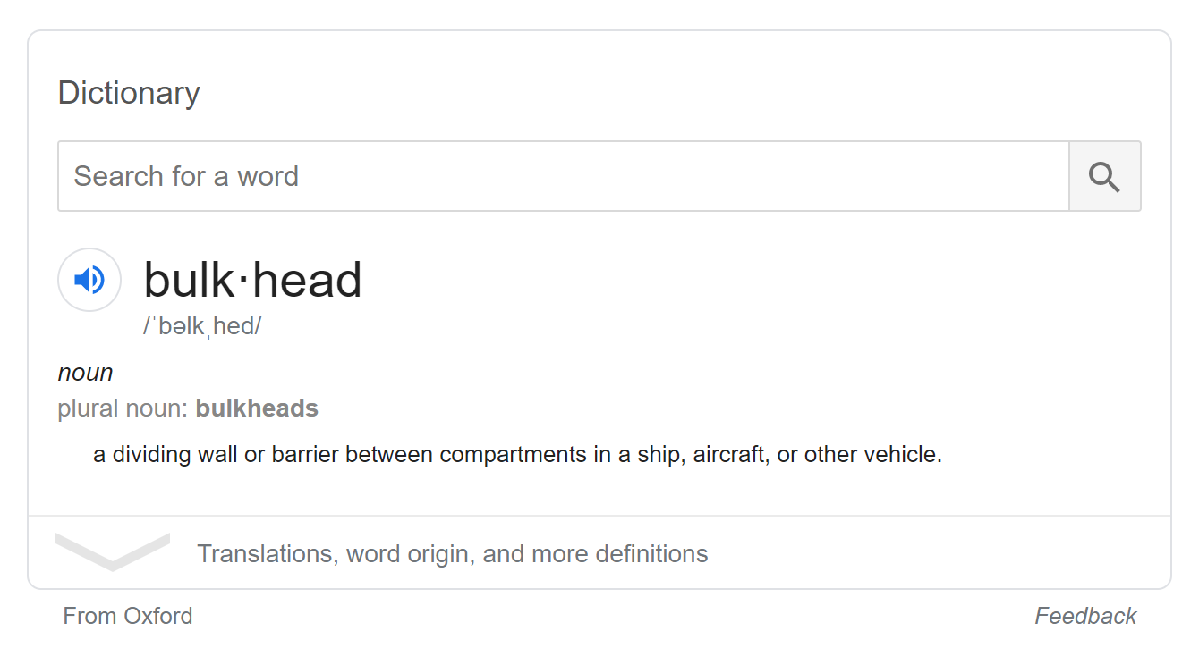
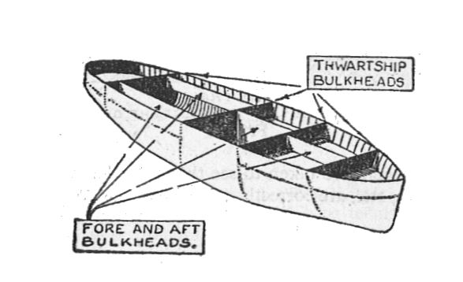
What is a bulkhead?

Slide 18
Bulkhead Isolation Policy
Premise
How does the policy mitigate?
Multiple failing calls backing up can easily swamp host resources (e.g. threads/CPU), bringing down a wider system.
“One fault shouldn’t sink the whole ship.”
Constrains the governed actions to a fixed-size resource pool, isolating their potential to affect others.
DEMO

Slide 19
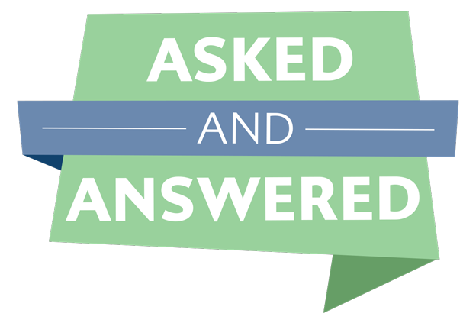
Cache Policy
Premise
Some proportion of requests may be similar.
"You've asked that one before"
How does the policy mitigate?
Provides a response from cache if known. Stores responses automatically in cache, when first retrieved.

Slide 20
Policy Registry
PolicyRegistry provides a dictionary-like registry for storing configured policy instances and retrieving them later for use.
This promotes separation of policy definition and usage, enabling common patterns such as defining policies centrally on start-up, and accessing them at point-of-use as an injected dependency.

Slide 21

Thank you!
email
twitter
blog
repo
erikdmuir@gmail.com
@erikdmuir
muirdev.com
github.com/ErikMuir/PollyDemo

