Slide 1
CAPSTONE 1 | DATA STORYTELLING, EXCEL & SQL
Texas In-Store Sales Analysis
EmporiUm · South region · January 2022 – December 2025 · Prepared by: [Erik Murillo]
$3.42M
Texas in-store revenue
42.7%
of South region revenue
+51%
growth in 2025
Notes:
Hi everyone! My name is Erik Murillo, and this is my Capstone 1 project. For this project, I analyzed EmporiUm’s Texas in-store sales from 2022 through 2025.
I used SQL in MySQL Workbench to analyze the sales data, Excel to create my PivotTable and PivotChart, and GitHub to organize and publish my project.
Today, I’ll walk you through my analysis, explain what I discovered, and share my recommendations for where management should focus next quarter.

Slide 2
Today's roadmap
Whole-database summary
Comparative analysis
Texas trend
Relationship analysis
1
2
3
4
5
6
7
8
9
Scenario
Texas summary
Company trend
Trend analysis
Findings & recommendations
About 10 minutes, with the SQL behind each answer
Notes:
Here’s what I’ll be covering today.
I’ll start by explaining the business scenario and looking at the company’s overall performance.
Then I’ll narrow the analysis down to Texas, compare Texas with the South region and the rest of the company, and examine revenue trends.
After that, I’ll explore relationships between transactions and revenue before finishing with my key findings and recommendations.

Slide 3
The question
01
“How is Texas performing, and where should the sales manager focus next quarter?”
EmporiUm is a student bookstore chain selling textbooks, technology, art supplies and more. My territory: Texas in-store sales, South region.
1
Revenue & period
2
Trends & region
3
Categories & stores
4
Next-quarter focus
Notes:
EmporiUm is a student bookstore chain that sells products such as textbooks, technology, art supplies, and merchandise.
The company operates in different states and divides its sales into regions and territories.
I focused on Texas in-store sales, which falls under the South region.
The main question I wanted to answer was:
How is Texas performing, and where should the sales manager focus next quarter?
To answer that, I looked at revenue, trends, categories, store performance, and opportunities for improvement.

Slide 4
How I answered it
01
Store_Sales one row per sale
Excel
Exported query results to CSV and built a PivotTable and PivotChart.
MySQL Workbench
JOIN, WHERE State = 'Texas', SUM, COUNT, AVG, GROUP BY.
GitHub
SQL script, Excel file and README, committed daily.
Store_Locations store → state
Management state → region
Products → Categories product → category
Notes:
To perform my analysis, I started with MySQL Workbench.
My main table was Store_Sales, which contains the individual sales transactions.
I used JOIN statements to connect it to other tables. Store_Locations helped me identify the state associated with each store, Management helped identify the region, and Products and Inventory_Categories helped me identify the product categories.
I also used WHERE to filter for Texas and functions such as SUM, COUNT, and AVG, along with GROUP BY, to summarize the data.
After completing my SQL analysis, I exported query results into Excel, where I created a PivotTable and PivotChart.
Finally, I saved my SQL script, Excel workbook, and README file in my Capstone_1 GitHub repository.

Slide 5
The whole company
02
$45.37M
in-store revenue, 2022–2025
Northeast $24.2M
335,129
transactions
$8.0M
South region
South $8.0M
East $6.7M
$135.38
average sale
West $6.4M
111
stores in 10 states
Notes:
Before focusing on Texas, I wanted to understand how the entire company was performing.
Across all stores, EmporiUm generated approximately $45.37 million in in-store revenue from 335,129 transactions.
The average sale was approximately $135, and the company operated 111 stores across 10 states.
When I grouped revenue by region, the Northeast generated the most revenue at approximately $24.2 million.
The South region came in second with approximately $8 million.
This gave me a company-wide benchmark to compare Texas against.

Slide 6
Technology is 70% of company revenue
02
Technology $31.9M
Textbooks $8.0M
Apparel $2.0M
70%
Technology
Art supplies $1.7M
Books $1.1M
Stationery $0.7M
Stationery has the most transactions (69,176) but the least revenue. Online sales ($68.0M) are a separate table, outside this in-store analysis.
Notes:
Next, I looked at revenue by product category across the entire company.
Technology and Accessories was the strongest category, generating approximately $31.9 million, or about 70% of total in-store revenue.
Textbooks came in second at approximately $8 million.
One interesting finding was that Stationery had the highest number of transactions, with 69,176 sales, but generated the least revenue.
This shows that having more transactions does not necessarily mean generating more revenue.
I also found that online sales were stored separately, so I excluded them from my in-store analysis.

Slide 7
Texas at a glance
03
$3.42M
Texas in-store revenue
Technology
Textbooks
24,212
transactions
72%
Technology
Apparel
Art supplies
Books
$141.16
average sale (company: $135)
Stationery
11
stores
Notes:
Now let’s narrow the analysis down to Texas.
Texas generated approximately $3.42 million in in-store revenue from 24,212 transactions across 11 stores.
The average sale was approximately $141, which was slightly higher than the company’s average of $135.
I also examined revenue by product category.
Technology and Accessories generated approximately $2.45 million, accounting for about 72% of Texas revenue.
Textbooks came in second at approximately $597,000.
This tells us that technology is especially important to Texas’s overall sales performance.

Slide 8
Store ranking: Beaumont leads
03
Notes:
Next, I wanted to understand how individual stores were performing.
I grouped revenue by store and sorted the results from highest to lowest.
Beaumont ranked first, generating approximately $638,000 in revenue.
Fort Worth came in second at approximately $352,000, followed by DeSoto at approximately $331,000.
Most of the remaining stores generated between approximately $270,000 and $350,000.
Dallas ranked last, generating approximately $54,000 from only 430 transactions.
This stood out to me because Dallas is performing considerably below the other Texas stores, making it worth investigating.

Slide 9
How Texas compares
04
7th
of 10 states by revenue
42.7%
of the South
7.5%
of the company
9.9%
of the stores (11 of 111)
$311K
per store, 9th of 10 states
Notes:
After examining Texas individually, I wanted to see how it compared with the South region and the entire company.
Texas generated approximately 42.7% of the South region’s revenue.
Compared with the entire company, Texas contributed about 7.5% of total in-store revenue while representing approximately 9.9% of the company’s stores.
Texas ranked seventh out of 10 states in total revenue.
It also ranked ninth out of 10 states in revenue per store, averaging approximately $311,000 per location.
This suggests that there may be opportunities to improve the performance of individual Texas stores.

Slide 10
Company revenue doubled
05
2.0×
2025 vs. 2022
+47%
2024 → 2025
Flat
2023 ≈ 2024
Notes:
Next, I examined how the entire company’s revenue changed over time.
I grouped in-store revenue by year to identify the overall trend.
Revenue increased from approximately $7.8 million in 2022 to $15.9 million in 2025.
That’s approximately double the revenue over the period.
I also noticed that 2023 and 2024 were relatively flat, with revenue around $10.8 million.
However, in 2025, revenue increased by approximately 47% compared with 2024.
This gave me a useful benchmark for understanding whether Texas followed the same pattern.

Slide 11
Texas grew slightly faster
06
2.1×
2025 vs. 2022
+51%
2024 → 2025 (company +47%)
Flat
2023 ≈ 2024 ($808K)
Notes:
When I performed the same yearly analysis for Texas, I found a similar pattern.
Texas revenue increased from approximately $580,000 in 2022 to approximately $1.22 million in 2025.
That’s about 2.1 times the revenue from 2022.
Revenue was relatively flat in 2023 and 2024, at approximately $808,000.
Then, in 2025, Texas revenue increased by approximately 51%.
This was slightly higher than the company’s overall growth of 47%.
So Texas followed the company’s general growth pattern but grew a little faster in 2025.

Slide 12
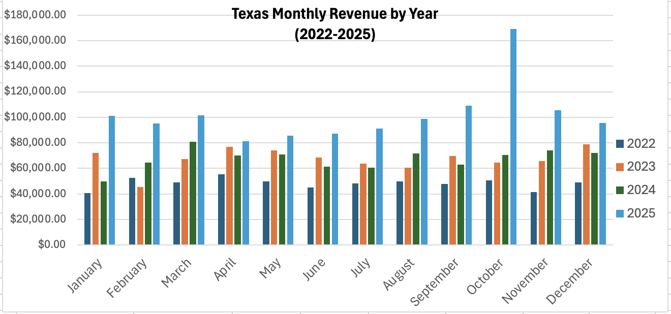
Texas month by month
06
$169K
best month: Oct 2025
48
months, all with sales
$3.42M
Grand Total
Notes:
Now I wanted to take a closer look at how Texas revenue changed from month to month.
This is where I used my Excel PivotTable and PivotChart.
I organized the data by month and year, allowing me to compare the same months across all four years.
Each color represents a different year: 2022, 2023, 2024, and 2025.
One thing that stands out is October 2025, which generated approximately $169,000, making it the highest-revenue month in the dataset.
I also found that all 48 months had recorded sales.
An important step was checking my PivotTable’s Grand Total against my SQL results. Both showed approximately $3.42 million.
This helped me confirm that my Excel analysis matched my SQL analysis.

Slide 13
What drove 2025?
07
More customers, smaller baskets.
Transactions: about 5,400 → 9,500.
Average sale: $150 → $129.
The whole company shows the same pattern.
Notes:
After seeing the increase in revenue during 2025, I wanted to understand what was driving that growth.
I separated revenue into two measurements: the number of transactions and the average sale.
In Texas, transactions increased from approximately 5,400 in 2024 to almost 9,500 in 2025.
That’s an increase of approximately 75%.
However, the average sale decreased from approximately $150 to $129, which was a decline of about 14%.
This suggests that revenue growth was driven by a higher volume of transactions rather than larger average purchases.
I also found that the company showed a similar pattern.

Slide 14
October peaks every year
07
$88.6K
average October
+24%
vs. a typical month
Feb
slowest (~$64K)
Notes:
I also wanted to see whether certain months consistently performed better than others.
To do this, I grouped revenue by calendar month and calculated the average across the four years.
October was the strongest month, averaging approximately $88,600 in revenue.
That’s about 24% higher than a typical month.
February was the slowest month, averaging approximately $64,000.
This suggests that there may be a seasonal pattern in sales, potentially connected to the academic calendar and student purchasing habits.
This is something management could consider when planning inventory and marketing campaigns.

Slide 15
More transactions, more revenue
08
0.98
correlation
4,403
Beaumont transactions (~2× others)
$127–183
average sale: similar everywhere
Notes:
Next, I wanted to understand the relationship between store transactions and revenue.
I compared the number of transactions at each Texas store with that store’s total revenue.
The correlation was approximately 0.98, which indicates a very strong positive relationship.
In simple terms, stores with more transactions generally generated more revenue.
Beaumont stood out with approximately 4,403 transactions, nearly twice as many as most other Texas stores.
Its average sale was relatively similar to the other locations.
This suggests that Beaumont’s strong revenue performance is associated more with its higher transaction volume than unusually large average purchases.

Slide 16
Volume is not value
08
Stationery
5,396 sales × ~$10
Technology
5,219 sales × ~$469
Textbooks
3,423 sales × ~$174
Notes:
I also examined the relationship between transaction volume and average sale across product categories.
Stationery had the highest transaction count, with approximately 5,396 sales, but its average sale was only about $10.
Technology had approximately 5,219 transactions, with an average sale of about $469.
Textbooks had approximately 3,423 transactions and an average sale of approximately $174.
This helps explain why Technology generates such a large portion of Texas revenue.
The main takeaway is that transaction volume and average sale both matter. A category can have many transactions without generating the most revenue.

Slide 17
Key findings
09
$3.42M Texas revenue: 42.7% of the South, 7.5% of the company
+51% 2025 growth, slightly ahead of the company's +47%
+75% / −14% 2025 transactions up, average sale down
72% of Texas revenue from Technology
0.98 store revenue tracks store traffic; Beaumont leads
October peak month every year
Notes:
Let’s bring everything together.
First, Texas generated approximately $3.42 million in in-store revenue, representing 42.7% of the South region and 7.5% of the company.
Second, Texas revenue increased by 51% in 2025, slightly faster than the company’s overall growth of 47%.
Third, transactions increased by 75%, while the average sale decreased by 14%.
Fourth, Technology and Accessories accounted for approximately 72% of Texas revenue.
I also found a strong relationship between store transactions and revenue, with Beaumont leading the Texas stores.
Finally, October was consistently the strongest month across the four years.
These findings helped me identify three areas where management could focus next quarter.

Slide 18
Recommendations
09
1
Prioritize Technology
Keep high-demand tech in stock and focus marketing on the category earning 72% of revenue.
2
Grow the average sale
Volume is up but the average sale fell 14%; bundle accessories with laptops and tablets.
3
Drive store traffic
Revenue follows traffic: learn from Beaumont and investigate Dallas (only 430 sales).
Caution: revenue is not profit; check margins and inventory costs before moving budget.
Notes:
Based on my analysis, I have three recommendations for the sales manager.
First, prioritize Technology and Accessories.
Since this category generates approximately 72% of Texas revenue, I recommend keeping high-demand technology products in stock and focusing marketing efforts on this category.
Second, work on increasing the average sale.
Even though transactions increased by 75% in 2025, the average sale decreased by 14%.
One opportunity could be bundling accessories, such as cases and chargers, with laptops and tablets to encourage customers to purchase additional products.
Third, focus on driving store traffic.
My analysis showed a strong relationship between transactions and revenue.
I recommend studying what makes Beaumont successful and investigating why Dallas has significantly fewer transactions than the other Texas locations.
One important consideration is that this analysis measures revenue, not profit. Before making major inventory or marketing decisions, management should also examine profit margins and inventory costs.

Slide 19
Thank you
SQL script, Excel PivotChart and README: Capstone_1 repository on GitHub
Notes:
That concludes my Texas in-store sales analysis.
Throughout this project, I used SQL to analyze the sales data, Excel to build my PivotTable and PivotChart, and GitHub to organize and publish my work.
My analysis helped identify Texas’s overall performance, its strongest revenue categories, trends over time, and opportunities for improvement.
Thank you for watching, and I appreciate your time.

