Slide 1
CAPSTONE 1 | DATA STORYTELLING, EXCEL & SQL
Texas In-Store Sales Analysis
EmporiUm · South region · January 2022 – December 2025 · Prepared by: [Erik Murillo]
$3.42M
Texas in-store revenue
42.7%
of South region revenue
+51%
growth in 2025
Notes:
Hi everyone. Today I'll walk you through my analysis of Texas in-store sales for EmporiUm, from January 2022 to December 2025.

Slide 2
Today's roadmap
Whole-database summary
Comparative analysis
Texas trend
Relationship analysis
1
2
3
4
5
6
7
8
9
Scenario
Texas summary
Company trend
Trend analysis
Findings & recommendations
Notes:
Here's my plan: the scenario, summary numbers for the company and for Texas, a comparison, trends, one relationship, and my recommendations.

Slide 3
The question
01
“How is Texas performing, and where should the sales manager focus next quarter?”
EmporiUm is a student bookstore chain selling textbooks, technology, art supplies and more. My territory: Texas in-store sales, South region.
1
Revenue & period
2
Trends & region
3
Categories & stores
4
Next-quarter focus
Notes:
EmporiUm is a student bookstore chain. My territory is Texas in-store sales, in the South region. The sales manager wants to know how Texas is doing and where to focus next quarter.

Slide 4
The whole company
02
$45.37M
in-store revenue, 2022–2025
Northeast $24.2M
335,129
transactions
$8.0M
South region
South $8.0M
East $6.7M
$135.38
average sale
West $6.4M
111
stores in 10 states
Notes:
Across all stores, EmporiUm made $45.37 million in-store from 335,129 sales, about $135 per sale, in 111 stores. The South is the #2 region at $8.0 million.

Slide 5
Texas at a glance
03
$3.42M
Texas in-store revenue
Technology
Textbooks
24,212
transactions
72%
Technology
Apparel
Art supplies
Books
$141.16
average sale (company: $135)
Stationery
11
stores
Notes:
Texas made $3.42 million from 24,212 sales in 11 stores, about $141 per sale. Technology is 72% of Texas revenue.

Slide 6
How Texas compares
04
7th
of 10 states by revenue
42.7%
of the South
7.5%
of the company
9.9%
of the stores (11 of 111)
#2
in the South, behind Florida
Notes:
Texas earns 42.7% of the South region's revenue and 7.5% of the whole company. It's 7th of 10 states.

Slide 7
Company revenue doubled
05
2.0×
2025 vs. 2022
+47%
2024 → 2025
Flat
2023 ≈ 2024
Notes:
The whole company doubled its in-store revenue from $7.8 million in 2022 to $15.9 million in 2025, with a 47% jump in 2025.

Slide 8
Texas grew slightly faster
06
2.1×
2025 vs. 2022
+51%
2024 → 2025 (company +47%)
Flat
2023 ≈ 2024 ($808K)
Notes:
Texas grew the same way: from $580 thousand to $1.22 million, and up 51% in 2025, slightly faster than the company.

Slide 9
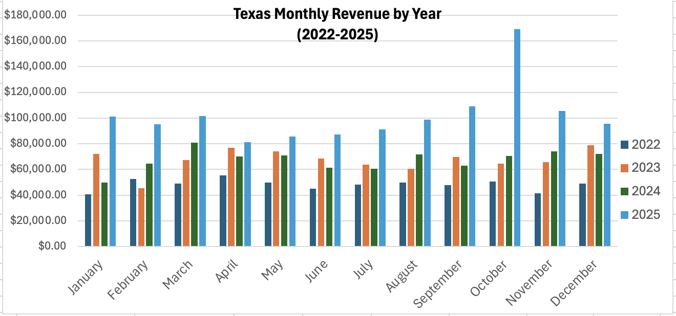
Texas Month by Month
October 2025
Transaction Peak of
1,088
Technology &
Accessories:
$468.50 average
sale
$169K
best month: Oct 2025
48
months, all with sales
$3.42M
Grand Total

Slide 10
What drove 2025?
07
More customers, smaller baskets.
Transactions: about 5,400 → 9,500.
Average sale: $150 → $129.
The whole company shows the same pattern.
Notes:
Why did 2025 grow? Texas had 75% more transactions, but the average sale dropped from about $150 to $129. So the growth came from more customers, not bigger purchases.

Slide 11
More transactions, more revenue
08
0.98
correlation
4,403
Beaumont transactions (~2× others)
$127–183
average sale: similar everywhere
Notes:
Each dot is a store. Stores with more transactions earn more, almost in a straight line. Beaumont wins because it has about twice the customers, not bigger purchases.

Slide 12
Findings & recommendations
09
Texas: $3.42M · 42.7% of the South · +51% in 2025 · Technology = 72% of revenue
1
Prioritize Technology
Keep high-demand tech in stock and focus marketing on the category earning 72% of revenue.
2
Grow the average sale
Volume is up but the average sale fell 14%; bundle accessories with laptops and tablets.
3
Drive store traffic
Revenue follows traffic: learn from Beaumont and investigate Dallas (only 430 sales).
Caution: revenue is not profit; check margins and inventory costs before moving budget.
Notes:
To sum up: Texas is strong and growing. My recommendations: one, prioritize Technology; two, raise the average sale with bundles, since it dropped 14%; three, drive store traffic, learning from Beaumont and fixing Dallas. One caution: revenue isn't profit. Thank you! Any questions?

