Slide 1
Relational & JSON Data Entity Framework Core

Slide 2

Erik Noren
Solutions Architect Software Developer 20+ Years Software Tinkerer Since Commodore 64 Hardware Hobbyist
Twitter: @ErikNoren GitHub: ErikNoren

Slide 3
Relational & JSON Data Entity Framework Core
SQL Server JSON Support

Slide 4
SQL Server JSON Pros
No new column type; leverages NVARCHAR(MAX)
Tooling and libraries don’t require updates to use JSON
In multi-server environment, only the query server needs JSON support
Computed Columns can extract data from JSON document
Support legacy systems that need relational data
Create indexes to make queries involving JSON data faster
Indexing has special consideration for JSON data exposed this way
Can convert JSON data to table format
Can convert table data to JSON format

Slide 5
SQL Server JSON Cons
No new column type; leverages NVARCHAR(MAX)
Tooling and queries can’t intuit the column contains JSON data
Requires adding a constraint to the database column to enforce valid JSON
SQL can go from JSON to Table and Table to JSON but…
JSON generated from SQL might not match application’s expected schema
Going from JSON to Table to JSON could result in a schema that’s not recognized by an application; let your application make the updates
Exception: the JSON is not provided to applications, only exposed as tables

Slide 6
Relational & JSON Data Entity Framework Core
Simple Pass-Through Storage

Slide 7
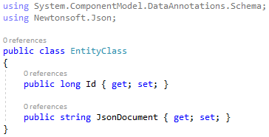
Pass-Through Storage
If the application server-side logic never needs to manipulate objects based on information in the JSON data, there’s no need to create classes and de/serialize. A string property in an entity will map to an NVARCHAR(MAX) column by default.
This is best for applications which are pure API calls taking and serving JSON data for a front-end containing the logic to manipulate the structure. Only the front-end code needs to be aware of the schema.

Slide 8
Relational & JSON Data Entity Framework Core
Automatic De/Serialization

Slide 9
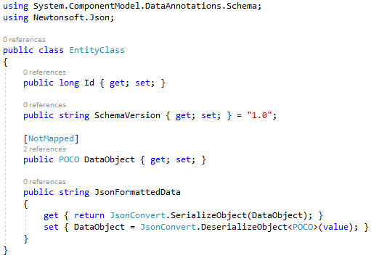
Automatic De/Serialization
The POCO object is part of the entity referenced by your EF DB Context but is marked [NotMapped] to tell EF to ignore the property.
Use a string property with a getter that returns a JSON serialized representation of the POCO object and a setter which sets the POCO object with JSON deserialized string.
Add error handling! Handle exceptions in the Get and Set calls to prevent them from breaking EF calls.

Slide 10
Relational & JSON Data Entity Framework Core
On Demand De/Serialization

Slide 11
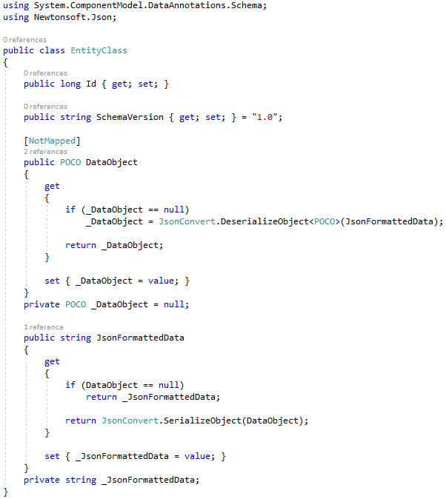
On Demand, Lazy De/Serialization
The POCO object is part of the entity referenced by your EF DB Context but is marked [NotMapped] to tell EF to ignore the property. A private backing field is used to keep track of whether the property has been accessed during the life of the Entity.
The string property likewise uses a backing field to keep track of the database-returned version of the object in case the POCO property is not accessed so it can be saved back as part of the update (or ignored if EF detects no change).

Slide 12
Relational & JSON Data Entity Framework Core
SQL Server Query Support

Slide 13
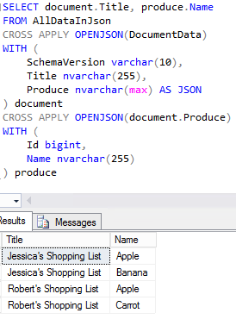
SQL Server Query Support
SQL Server might not support all the fringe case features of JSON.NET but it is very flexible.
JSON properties can be extracted in a query and treated as if they were column data from a normal table.

Slide 14
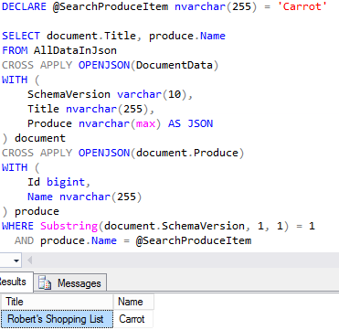
SQL Server Query Support
SQL functions and methods can be used on data that’s been extracted from JSON just like it were data from tables.

Slide 15
Relational & JSON Data Entity Framework Core
Entity Framework Core Demo

Slide 16
QUESTIONS?
Erik Noren Solutions Architect Software Developer 20+ Years Software Tinkerer Since Commodore 64 Hardware Hobbyist
Twitter: @ErikNoren GitHub: ErikNoren

Slide 17
Resources
Demo Code – GitHub
Angular Forms – https://angular.io/guide/forms
EF Core – https://docs.microsoft.com/en-us/ef/core/
SQL Server JSON Support (SQL Server 2016 or higher) – https://docs.microsoft.com/en-us/sql/relational-databases/json/json-data-sql-server
Mock Data Generator – https://www.mockaroo.com/

