Slide 1
A Look at .NET Core
Erik Noren
Solutions Architect
Notes:
DEMOS: https://github.com/Microsoft/InsiderDevTour18-PWA
Important point to land: For .NET or Win32 developers, native applications are the best path forwards. For those developers invested in web technologies, PWA is a great option, enabling you to distribute through the Microsoft Store and access Windows 10 APIs.

Slide 2
Comparison with .NET Framework
.NET Framework
.NET Core
Runtime (Common Language Runtime)
Four versions (1.0, 1.1, 2.0, 4)
Windows Only (x86, x64, *ARM)
Class Libraries (NETFX)
Globally installed (system wide)
Eight versions; some can be installed together
Very large
First released in 2002 (v4 released in 2010)
Slow release cadence
Effectively closed source
Runtime (Core CLR)
Four major versions (27 including minor versions)
Cross Platform (Win, Linux, Mac, x64, *x86, *ARM)
Class Libraries (CoreFX)
Global or App-Local installation options
Multiple versions; all can be installed together
Comparatively much smaller
First released in 2016
Rapid release cadence
Open source with community contributions

Slide 3
What is .NET Standard?
Portable Class Library (PCL)
.NET Standard
Defines APIs that can be used for code sharing
Represents Microsoft platforms
“Profile-based” PCL
APIs determined by intersection of platforms
Developers target the platforms they want to support and discover which APIs they can use.
If a developer omits a platform because it lacks necessary APIs and it is later updated to support those APIs, the library has to be retargeted, rebuilt and republished.
Defines APIs that can be used for code sharing
Platform agnostic
“.NET Standard-based” PCL
APIs determined by .NET Standard version
Developers target the minimum version that has all the APIs they need.
If a platform is initially excluded because it does not support the necessary .NET Standard version and it is later updated to support it, the library can be used without any effort from the developer.

Slide 4


.NET Core
2
.NET Core is perfectly suited for the requirements of cloud-native, cross-platform workloads
WEB
CLOUD
.NET CORE
LIBRARIES
INFRASTRUCTURE
RUNTIME COMPONENTS
COMPILERS
LANGUAGES

Slide 5
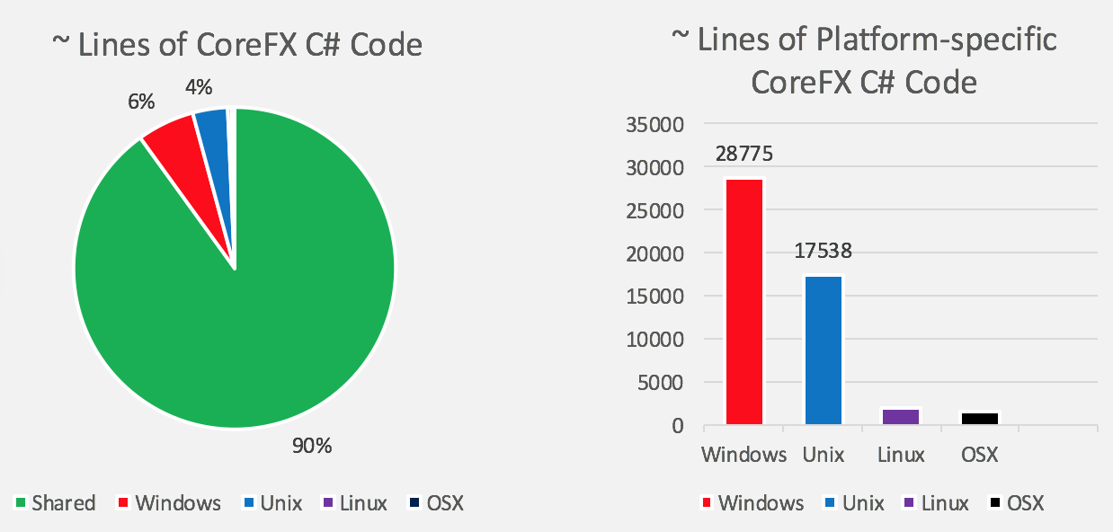
Core CLR Source Makeup

Slide 6
Cross Platform Demo

Slide 7



.NET Core
3 (coming next year)
2
Why Windows Desktop on .NET Core?
Side by side
Machine global or app local framework
Core runtime and API improvements
New .csproj project system
.NET Core is perfectly suited for the requirements of cloud-native, cross-platform workloads
WEB
CLOUD
AI
IoT
DESKTOP
.NET CORE
.NET CORE 3
LIBRARIES
INFRASTRUCTURE
RUNTIME COMPONENTS
COMPILERS
LANGUAGES

Slide 8
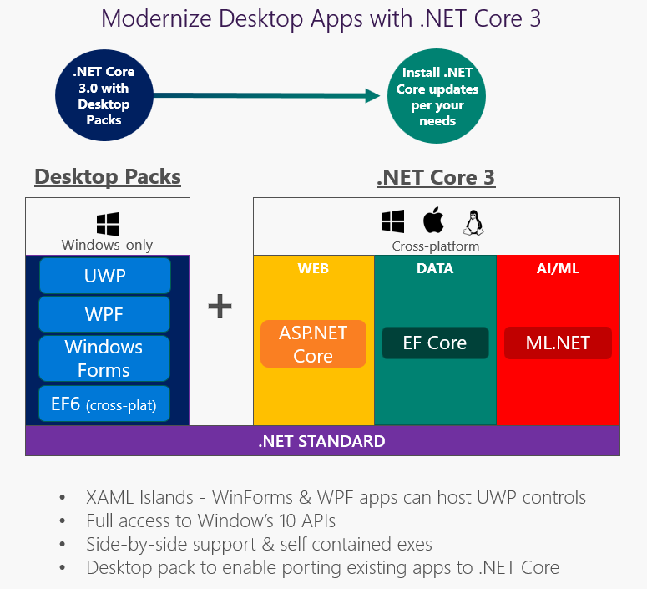

Slide 9
.NET Core 3 Desktop Improvements
.NET Core 3 supports WinForms and WPF frameworks
XAML Controls – WinForms & WPF browser and media UWP controls
XAML Islands - WinForms & WPF can host UWP
High DPI fixes for WinForms
.NET Core support for all the Windows 10 API’s
.NET Core App Bundler
Precompiled, fast startup
Small apps by removing unused dependencies, link away unused IL
Single self-contained .EXE

Slide 10
Highlights
.NET Core offers more flexible build and publishing options
.NET Core Runtime, the base libraries, and .NET Standard are all cross platform
.NET Core’s development isn’t restricted to only those things which can be done on all platforms
Desktop Packs bring new features for Windows hosts while the Core CLR itself remains cross platform
.NET Core is open source and has benefitted greatly from community contributions
Performance improvements
New features
Bug fixes

Slide 11


Slide 13
Slide palette info
The PowerPoint palette for this template has been built for you and is shown below.
Avoid using too many colors in your presentation.
PowerPoint Theme Accent colors
Accent 1
Accent 2
Accent 3
Accent 4
Accent 5
Accent 6
Use Accent 1 as the main accent color.
Use Accent 2 and Accent 3 only when additional colors are needed.
Use Accents 4-6 sparingly

