Slide 1
DATA Quantization
K-Means clustering, k-modes clustering, RGB quantization, and applying it to fraud detection
Erik Pantoja

Slide 2
Creating k-Means clustering
Experimented and created programs to use color quantization on the Lena image.
Experimented using Black/White (gray-scale) Quantization
Experimented with 3, 5, 16 Cluster centers to create an RGB image(Red, Green, Blue)
Updated Cluster Centers by using Euclidean Distance (compares distances from each assigned point and recalculates the center of the cluster)
First 16 centers picked as first 16 (unique) pixels

Slide 3
Applying K – means clustering
K- means Clustering can be used to detect outliers within data sets to observe transactions that appear suspicious
K – means is limited to quantitative sets of data including unit quantity, unit pricing, total sales cost, due to using Euclidean Distance and optimizing for minimum variance within clusters
Applying k-means Clustering to RGB image quantization can be used with the numerical portion of RGB which would be the number associated with the color hues

Slide 4
Types of Data Points used in sales, and data groups
Nominal – Meaningful numbers such as quantity, amount, cost
Ordinal – A data point that can be ordered with meaning, such as education level(high school, associates, bachelors, masters), economic status(low income, middle income, high income), priority (low, medium, high)
Categorical – choices that can be assigned numbers not directly meaningful to the data, such as geographic region and gender (no set order)

Slide 5
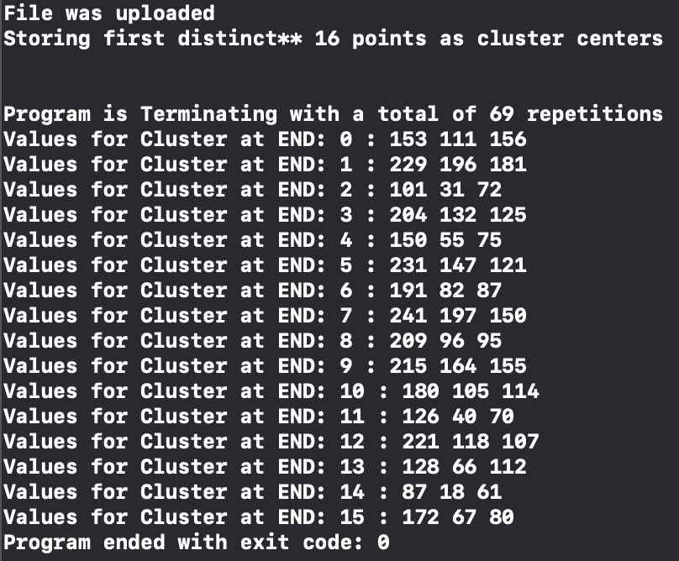
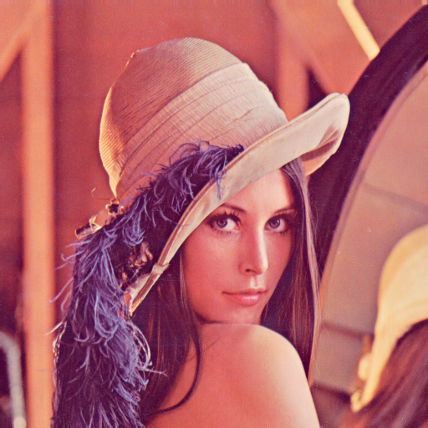
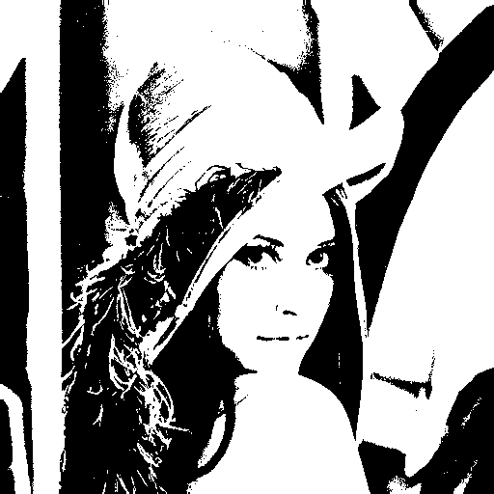

Results from k-means research
K-Means Clustering of Image using Gray Scale 16 Clusters
K-Means Clustering of Image into 16 colors from the 16 clusters
Typically takes k-Means implementation 69 repetitions before Cluster center values stop changing

Slide 6
Clustering using categories K - Mode Clustering
K-Modes clustering algorithm is used similarly to K-means using modes of data points, rather then means
K-Modes runs quicker then k-means clustering as it adds up the modes of each data point and compares to calculate the new modes, rather then distortion or Euclidean distance

Slide 7
Creating k-Modes using perceptual classification J(d)
I sampled input to provide what is known as J(d) of perception. I created a sample image of pixel brightness jumping from 5 pixels at a time. To collect input on this perception I gathered input of brightness(very bright, bright, neutral, dark, very dark) from 5 individuals
Averages in pixel colors were considered as 35 as very dark, 55 as dark, 140 as neutral, 225 as bright, and 245 as very bright
This data was converted in the program to classify based off brightness level, assigning a 1-5 based off these classifications. One completed the program returned the original pixel values to create the image.

Slide 8
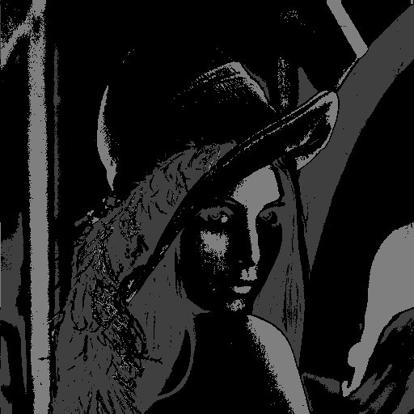
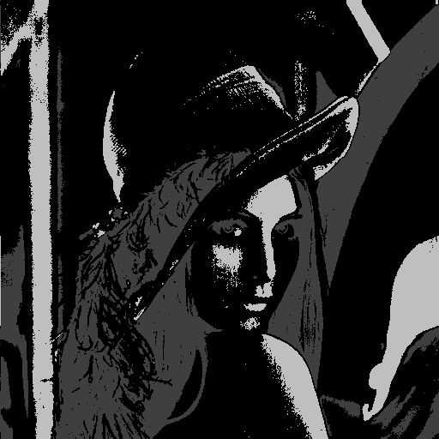
K-modes clustering Results
K - Modes with 3 Centers
K - Modes with 5 Centers

Slide 9
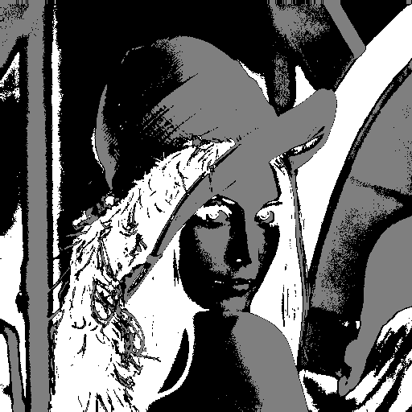
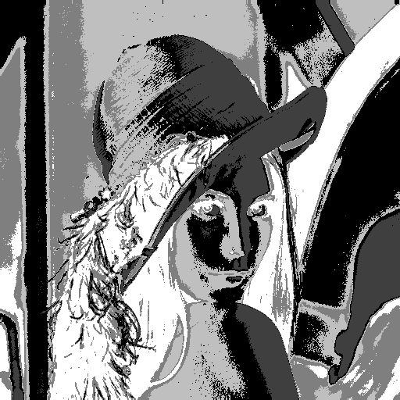
Comparing results between k-means and k-modes
K-means, 3 and 5 Centers K-Modes, 3 and 5 centers

Slide 10
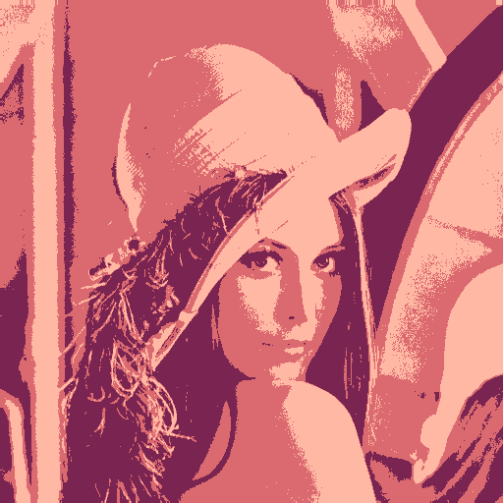
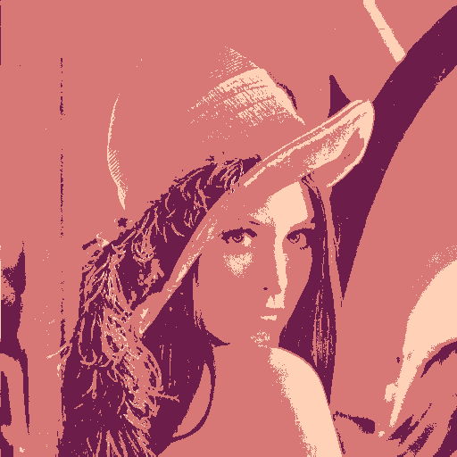
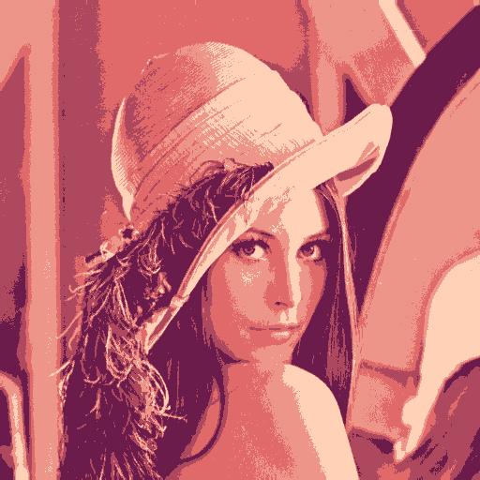
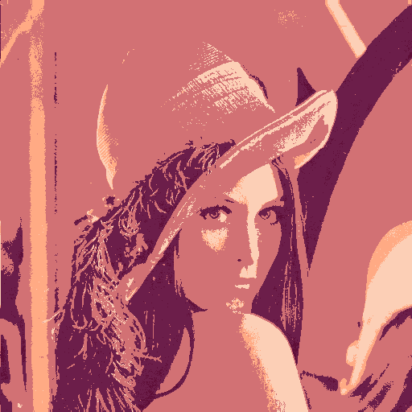
Color Quantization Comparison between k-means and k-modes with J(d) perception
K-Means 3 – Clusters K-Modes 3 - Clusters
K-Means 5 – Clusters K-Modes 5-Clusters

Slide 11
conclusion
K-means and K-Modes could potentially be combined to evaluate data sets.
Would be able to measure numerical data points using – k-means algorithm
Would be able to evaluate the nominal data using k-modes algorithm
Categorial data can be used to slice the quantitative data
No conclusion was made on conducting these algorithms with fraud data

