Slide 1
DATA Quantization
Using K-Means clustering, k-modes clustering, RGB quantization, and applying it to fraud detection
Erik Pantoja

Slide 2
Creating k-Means clustering
Experimented and created programs to use RGB quantization from Lena image.
Experimented using Black/White (gray-scale) Quantization
Experimented with 16 ,5, 3 Cluster centers to create an RGB image
Update Cluster Centers by using Euclidean Distance (compares distances from each assigned point and recalculates the center of the cluster)
First 16 centers picked as first 16 (unique) pixels

Slide 3
Applying K - means to Fraud detection
K- means Clustering can be used to detect outliers within data sets to observe which points may be the most risky
K – means is limited to quantitative sets of data including unit quantity, unit pricing, total sales cost, due to using Euclidean Distance
K – means works quickly , and effectively

Slide 4
Types of Data Points used in sales
Nominal – Meaningful numbers in themselves, such as quantity, amount, cost
Ordinal – A data point that can be ordered with meaning, such as education level(high school, associates, bachelors, masters), economic status(low income, middle income, high income), priority(low, medium, high)
Categorical – Categorical choices that can be assigned numbers not directly meaningful to the data, such as type, color, gender (no set order)

Slide 5
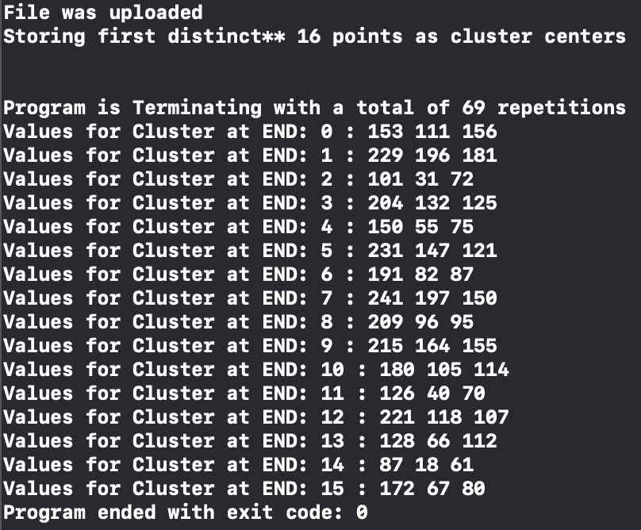
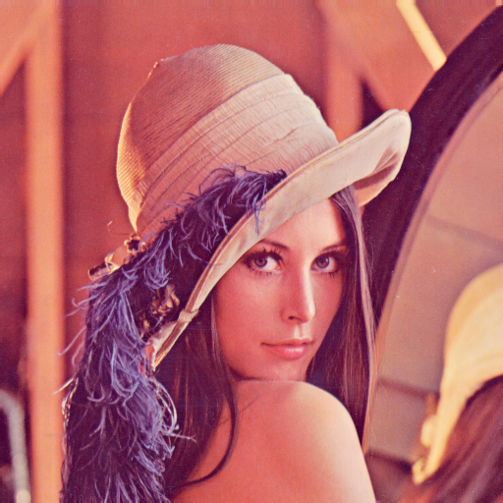
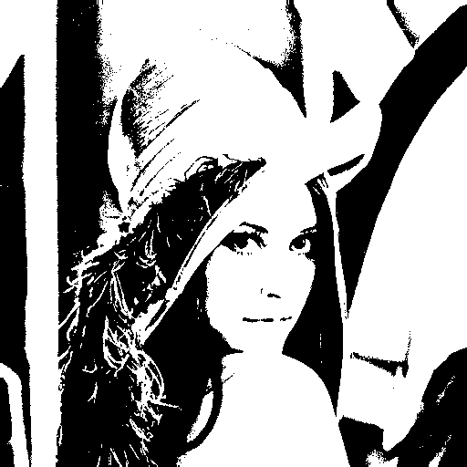

Results from k-means research
K-Means Clustering of Image using Gray Scale 16 Clusters
K-Means Clustering of Image into 16 colors from the 16 clusters
Typically takes k-Means implementation 69 repetitions before Cluster center values stop changing

Slide 6
Clustering using categories K - Mode Clustering
K-Modes clustering algorithm is used similarly to K-means using modes of data points, rather then means
K-Modes works efficiently on categorial data points such as a type, color, etc
K-Modes runs quicker then k-means clustering as it adds up the modes of each data point and compares to calculate the new mode, rather then distortion or Euclidean distance
Calculated K-modes based off perception of brightness sampled from 5 individuals for color pixels

Slide 7
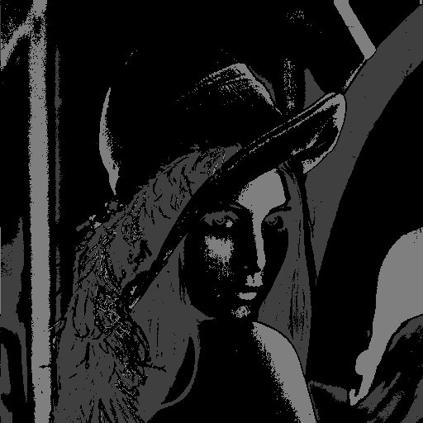
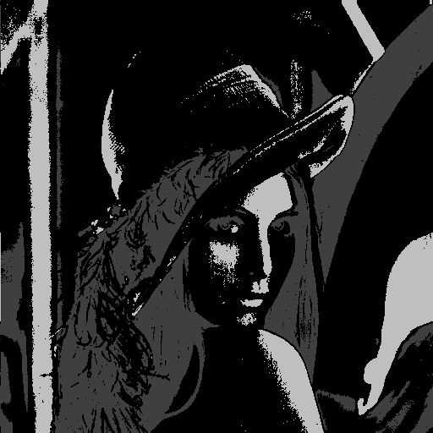
K-modes clustering Results
K - Modes with 3 Centers
K - Modes with 5 Centers

Slide 8
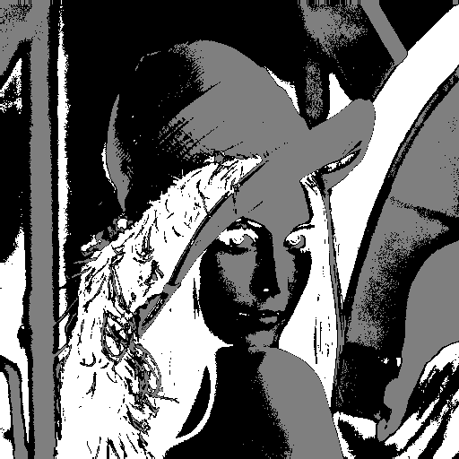
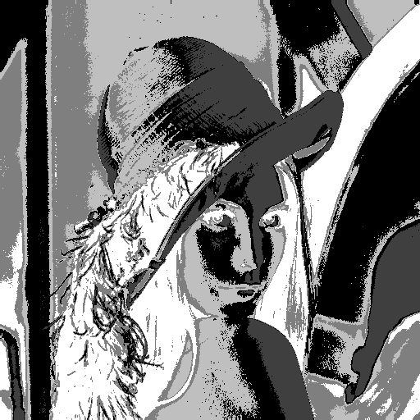
Comparing results between k-means and k-modes
K-means, 3 and 5 Centers K-Modes, 3 and 5 centers

Slide 9
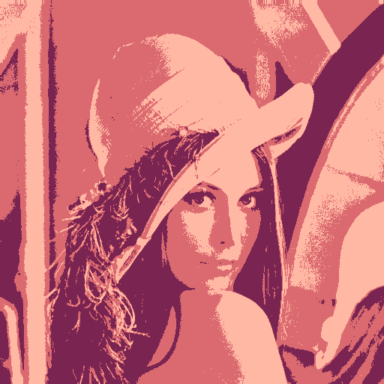

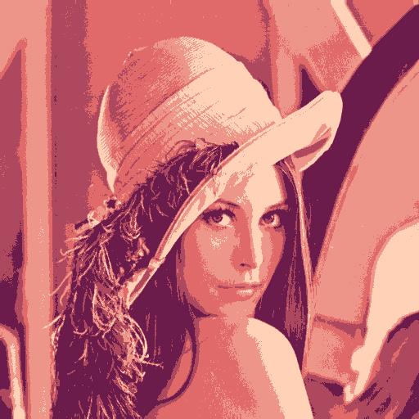
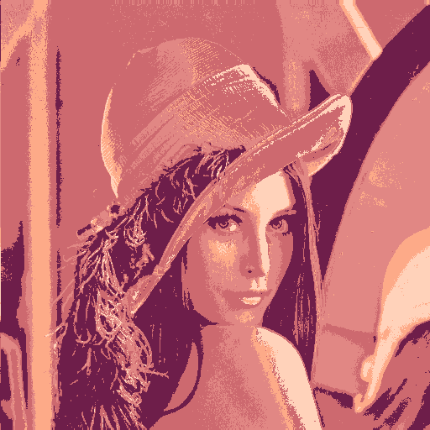
Color Quantization Comparison
K-Means 3 – Clusters K-Modes 3 - Clusters
K-Means 5 – Clusters K-Modes 5-Clusters

Slide 10
Overall
K-means and K-Modes can be combined to evaluate fraud data together
Would be able to measure numerical data points using – k-means algorithm
Would then be able to evaluate the categorial data from transactions using k-modes algorithm

