Slide 1
/events/read_split [rosbag2_interfaces/msg/ReadSplitEvent]
/parameter_events [rcl_interfaces/msg/ParameterEvent]
/rosout [rcl_interfaces/msg/Log]
/tf [tf2_msgs/msg/TFMessage]
/tf_static [tf2_msgs/msg/TFMessage]
/wrapper/psdk_ros2/acceleration_body_fused [geometry_msgs/msg/AccelStamped]
/wrapper/psdk_ros2/acceleration_body_raw [geometry_msgs/msg/AccelStamped]
/wrapper/psdk_ros2/acceleration_ground_fused [geometry_msgs/msg/AccelStamped]
/wrapper/psdk_ros2/altitude_barometric [std_msgs/msg/Float32]
/wrapper/psdk_ros2/altitude_sea_level [std_msgs/msg/Float32]
/wrapper/psdk_ros2/angular_rate_body_raw [geometry_msgs/msg/Vector3Stamped]
/wrapper/psdk_ros2/angular_rate_ground_fused [geometry_msgs/msg/Vector3Stamped]
/wrapper/psdk_ros2/attitude [geometry_msgs/msg/QuaternionStamped]
/wrapper/psdk_ros2/battery [sensor_msgs/msg/BatteryState]
/wrapper/psdk_ros2/control_mode [psdk_interfaces/msg/ControlMode]
/wrapper/psdk_ros2/display_mode [psdk_interfaces/msg/DisplayMode]
/wrapper/psdk_ros2/esc_data [psdk_interfaces/msg/EscData]
/wrapper/psdk_ros2/flight_anomaly [psdk_interfaces/msg/FlightAnomaly]
/wrapper/psdk_ros2/flight_status [psdk_interfaces/msg/FlightStatus]
/wrapper/psdk_ros2/gimbal_angles [geometry_msgs/msg/Vector3Stamped]
/wrapper/psdk_ros2/gimbal_status [psdk_interfaces/msg/GimbalStatus]
/wrapper/psdk_ros2/gps_details [psdk_interfaces/msg/GPSDetails]
/wrapper/psdk_ros2/gps_position [sensor_msgs/msg/NavSatFix]
/wrapper/psdk_ros2/gps_position_fused [sensor_msgs/msg/NavSatFix]
/wrapper/psdk_ros2/gps_signal_level [std_msgs/msg/UInt8]
/wrapper/psdk_ros2/gps_velocity [geometry_msgs/msg/TwistStamped]
/wrapper/psdk_ros2/height_above_ground [std_msgs/msg/Float32]
/wrapper/psdk_ros2/hms_info_table [psdk_interfaces/msg/HmsInfoTable]
/wrapper/psdk_ros2/home_point [sensor_msgs/msg/NavSatFix]
/wrapper/psdk_ros2/home_point_altitude [std_msgs/msg/Float32]
/wrapper/psdk_ros2/home_point_status [std_msgs/msg/Bool]
/wrapper/psdk_ros2/imu [sensor_msgs/msg/Imu]
/wrapper/psdk_ros2/landing_gear_status [std_msgs/msg/UInt8]
/wrapper/psdk_ros2/magnetic_field [sensor_msgs/msg/MagneticField]
/wrapper/psdk_ros2/motor_start_error [std_msgs/msg/UInt16]
/wrapper/psdk_ros2/position_fused [psdk_interfaces/msg/PositionFused]
/wrapper/psdk_ros2/rc [sensor_msgs/msg/Joy]
/wrapper/psdk_ros2/rc_connection_status [psdk_interfaces/msg/RCConnectionStatus]
/wrapper/psdk_ros2/relative_obstacle_info [psdk_interfaces/msg/RelativeObstacleInfo]
/wrapper/psdk_ros2/rtk_connection_status [std_msgs/msg/UInt16]
/wrapper/psdk_ros2/rtk_position [sensor_msgs/msg/NavSatFix]
/wrapper/psdk_ros2/rtk_position_info [std_msgs/msg/UInt8]
/wrapper/psdk_ros2/rtk_velocity [geometry_msgs/msg/TwistStamped]
/wrapper/psdk_ros2/rtk_yaw [psdk_interfaces/msg/RTKYaw]
/wrapper/psdk_ros2/rtk_yaw_info [std_msgs/msg/UInt8]
/wrapper/psdk_ros2/single_battery_index1 [psdk_interfaces/msg/SingleBatteryInfo]
/wrapper/psdk_ros2/single_battery_index2 [psdk_interfaces/msg/SingleBatteryInfo]
/wrapper/psdk_ros2/velocity_ground_fused [geometry_msgs/msg/Vector3Stamped]

Slide 2
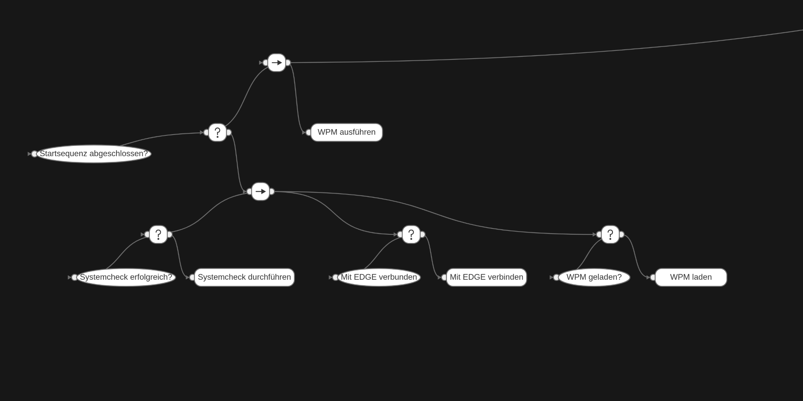








Sequenz mit Datacheck von allen Sensoren und Onboardsystemen
Node die ping schickt und wenn der zurück kommt success
Node die ping schickt und wenn der zurück kommt success
-psdk_ros2/battery (Wert abfragen)
-psdk_ros2/rc (RC-Connection )
-psdk_ros2/home_point_status (sethomefromgps als fallback)
-psdk_ros2/hms_info_table(muss none sein)
-Externe Sensoren ungleich none

Slide 3
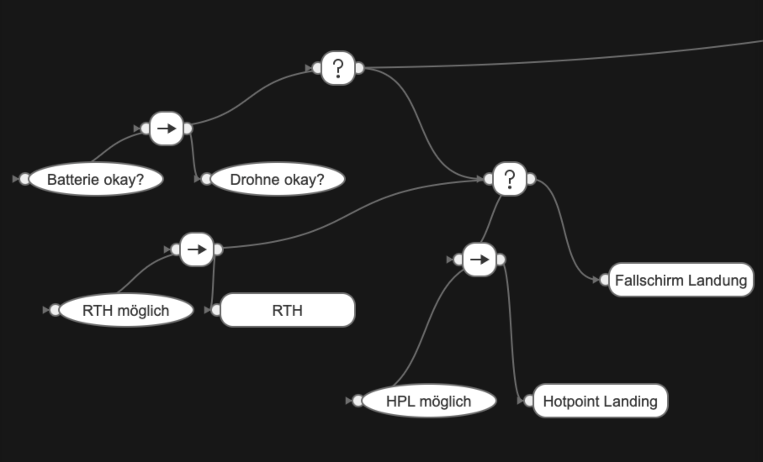
psdk_ros2/battery (status)
psdk_ros2/hms_info_table
-psdk_ros2/battery (Status und Zustand)
-psdk_ros2/hms_info_table
-

Slide 4
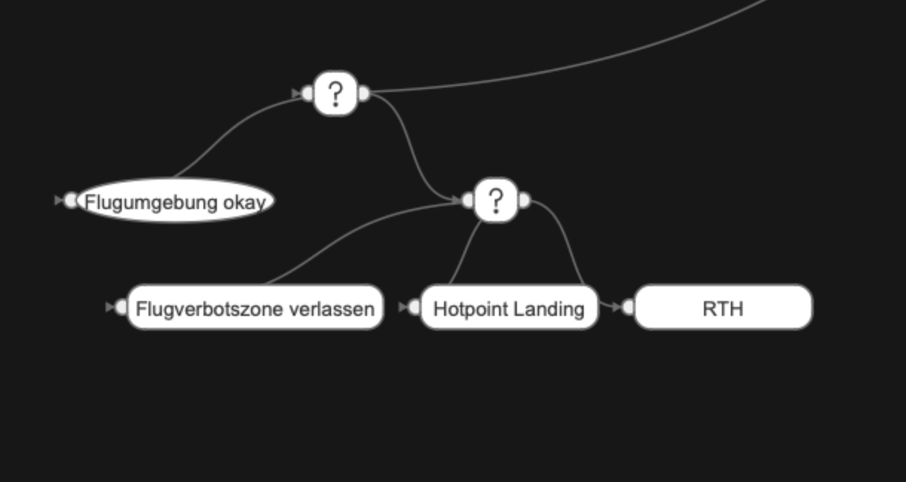
psdk_ros2/flight_anomaly(alles muss 0 sein)

Slide 5
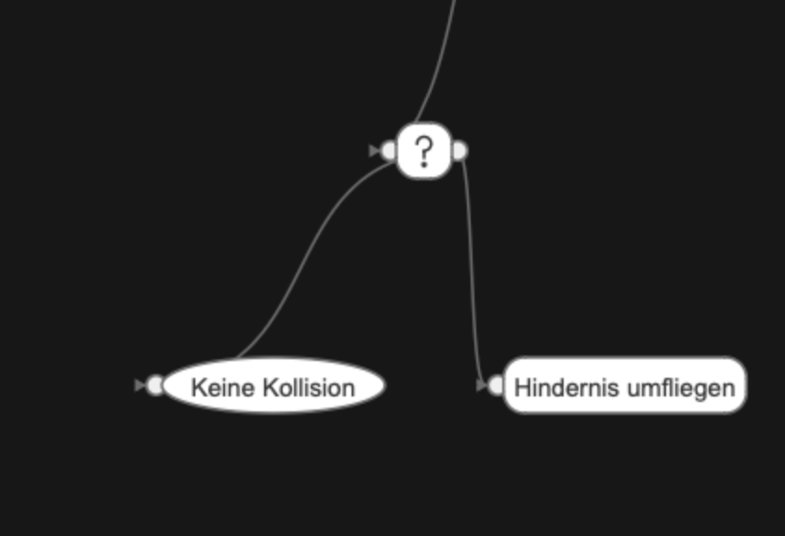
Relativeobsticleinfo alles größer 2

Slide 6
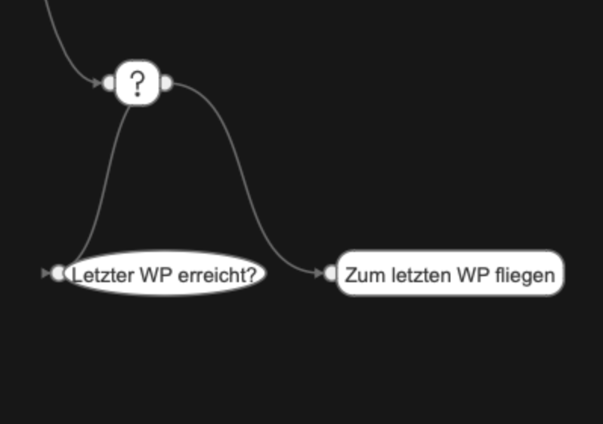

Slide 7
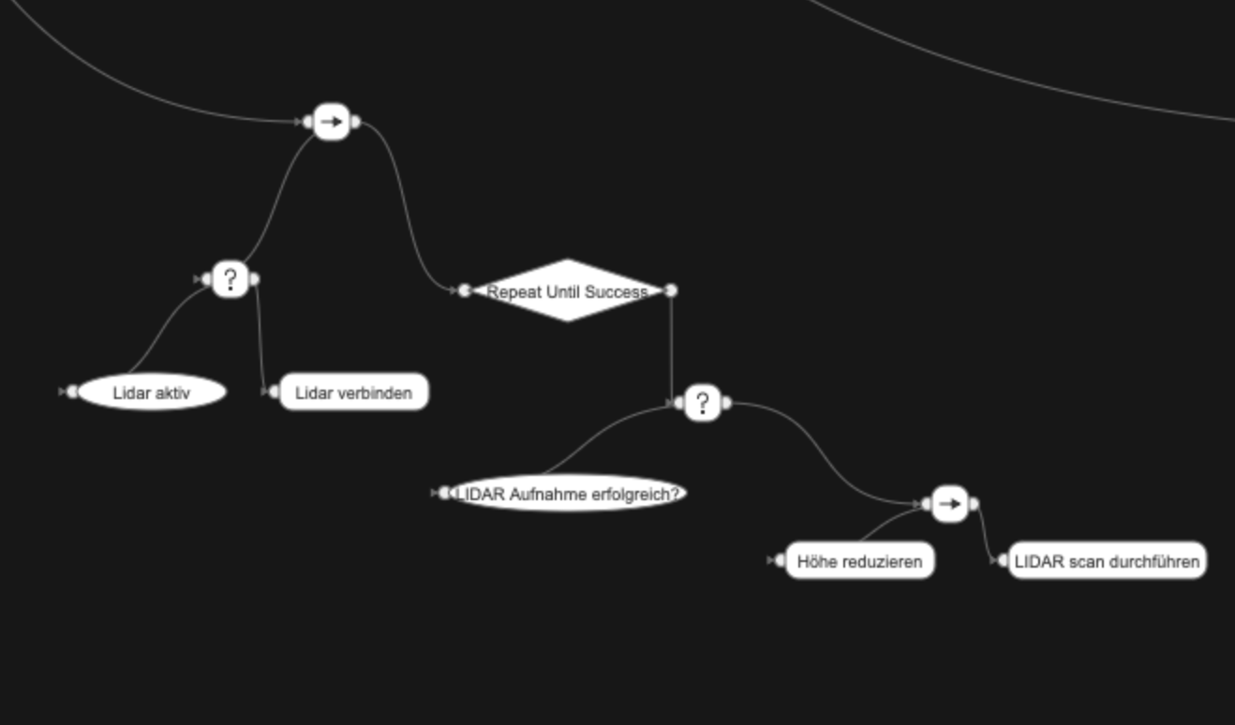

Slide 8
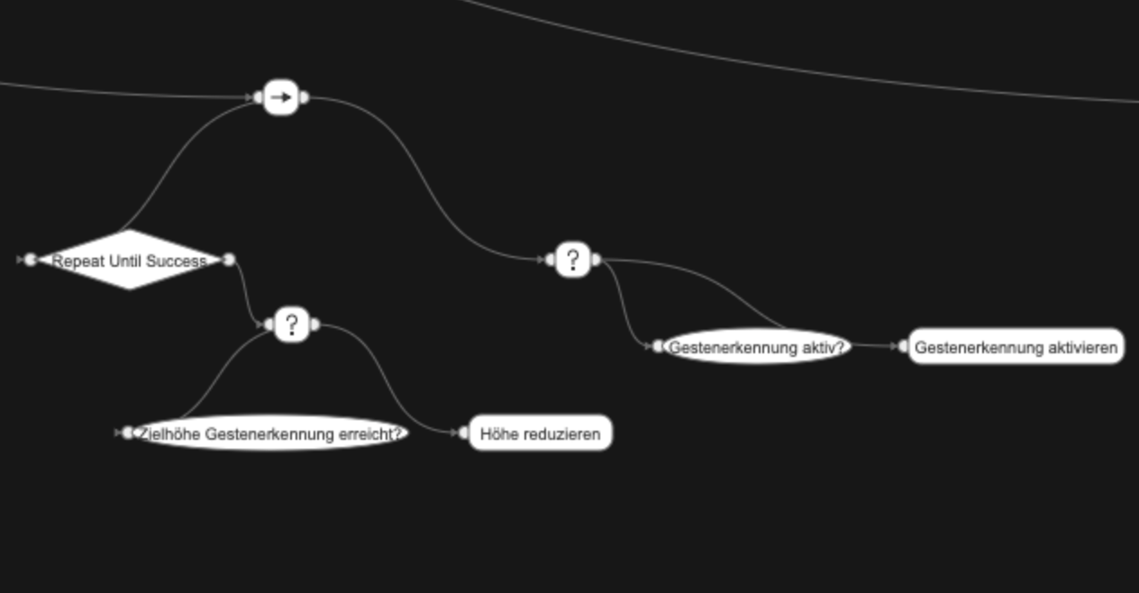

Slide 9
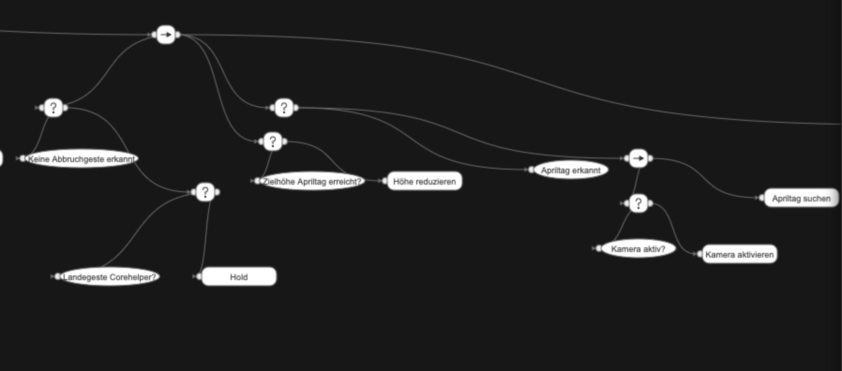

Slide 10
