Slide 1
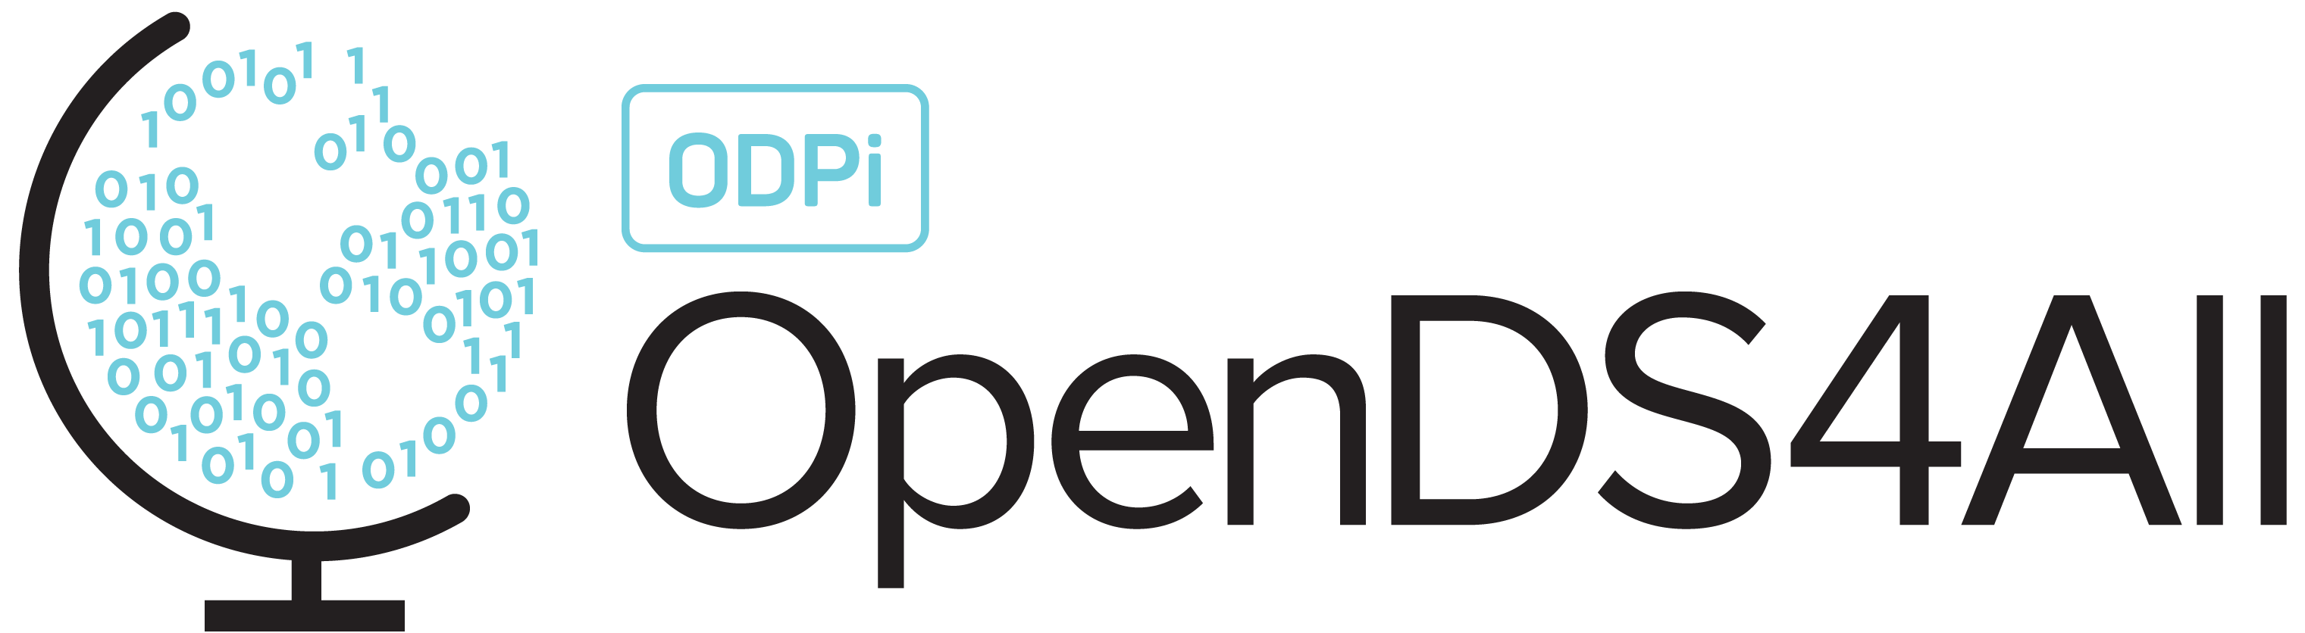
Natural Language Processing: Deep learning for text and sequences

Slide 2
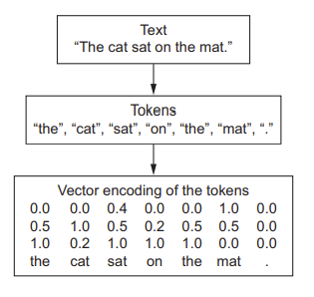
Working with text
Segment text into words, and transform each word into a vector
Segment text into characters, and transform each character into a vector
Extract n-grams of word or characters, and transform each n-gram into a vector

Slide 3
Tokenization
The different units into which you can break down text (words, characters, or n-grams) are called tokens
Breaking text into such tokens is called tokenization.

Slide 4

What is n-grams
“The cat sat on the mat”
2-grams
The term bag here refers to the fact that you’re dealing with a set of tokens rather than a list or sequence: the tokens have no specific order. This family of tokenization methods is called bag-of-words.

Slide 5
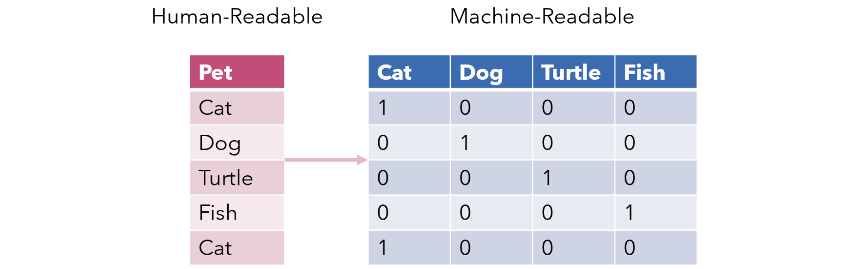
One-hot encoding of words and characters
Most common, most basic way to turn a token into a vector
It consists of associating a unique integer index with every word
and then turning this integer index i into a binary vector of size N (the size of the
vocabulary); the vector is all zeros except for the i-th entry, which is 1.

Slide 6
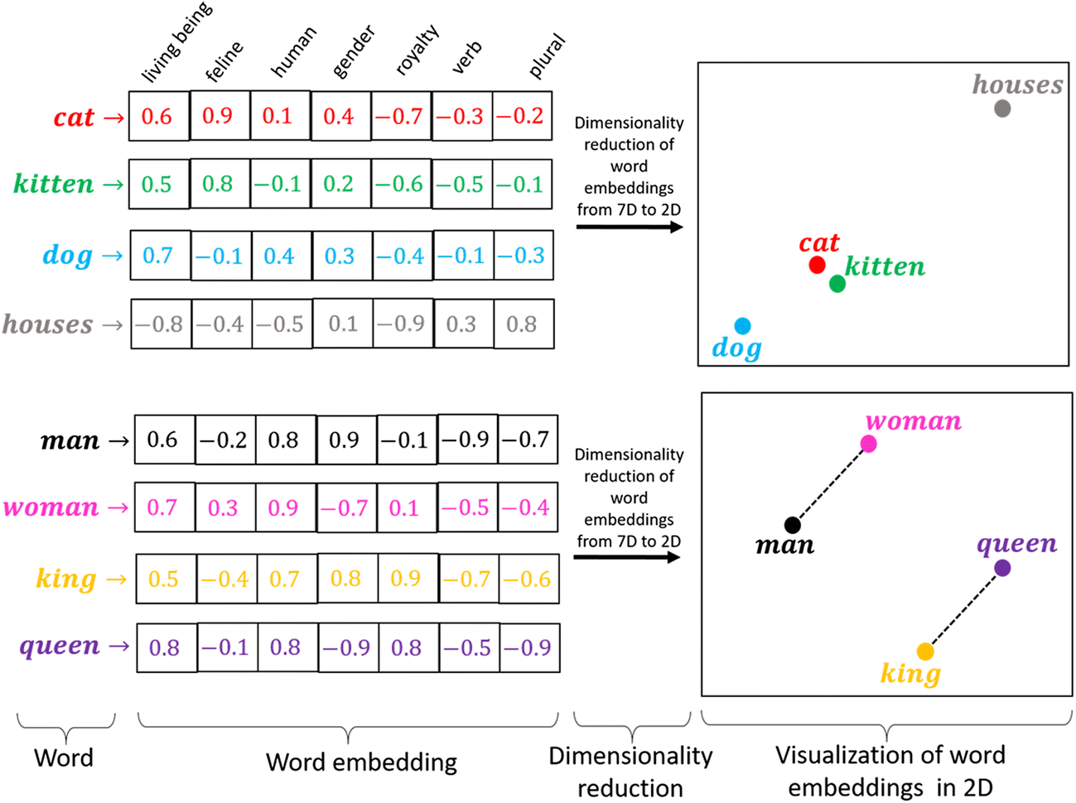
Word Embedding
A word embedding is a learned representation for text where words that have the same meaning have a similar representation.
Map human language into a geometric space
Geometric relationships between word vectors reflect the semantic relationships between words

Slide 7
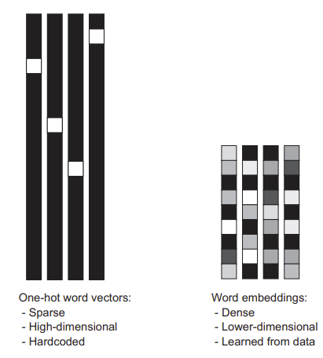
One-hot vs. Word embeddings
One-hot:
High-dimensional and sparser
Don’t have the ability to generalize.
Program will be only able to consider features that have seen during training
Word embedding:
Low-dimensional, dense and computationally efficient
Word embeddings can generalize, due to semantically similar words having similar vectors.
Semantically similar words will create features, and will lead to similar classification

Slide 8
Text Preprocessing
As we know Machine Learning needs data in the numeric form. We basically used encoding technique (BagOfWord, Bi-gram,n-gram, TF-IDF, Word2Vec) to encode text into numeric vector. But before encoding we first need to clean the text data and this process to prepare(or clean) text data before encoding is called text preprocessing, this is the very first step to solve the NLP problems.
Import the dataset & Libraries
Labeling the Dataset
Data Cleaning and text preprocessing

Slide 9
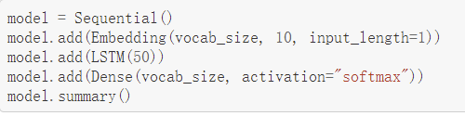
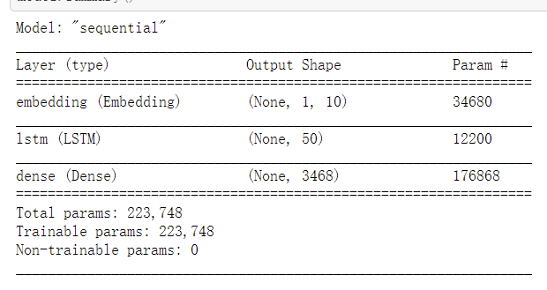
Build the Model

Slide 10
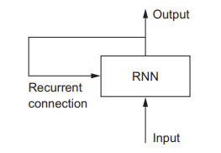
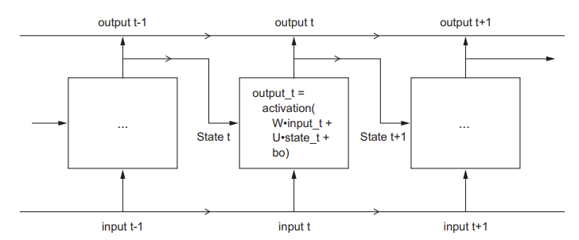
RNN：Recurrent Neural Networks

Slide 11
A recurrent layer in Keras

Slide 12
LSTM

Slide 13
Data Analysis

Slide 14
Post-Processing

