Slide 1

homestead
Project 3 - DATA INF1A
Jessica verhaar erik van berk
Niels verwoert denise van den berg - maes
Sibren van ek

Slide 2
iNDEX
IDEA
DEVELOPMENT
DEMONSTRATION
COLLABORATION

Slide 3
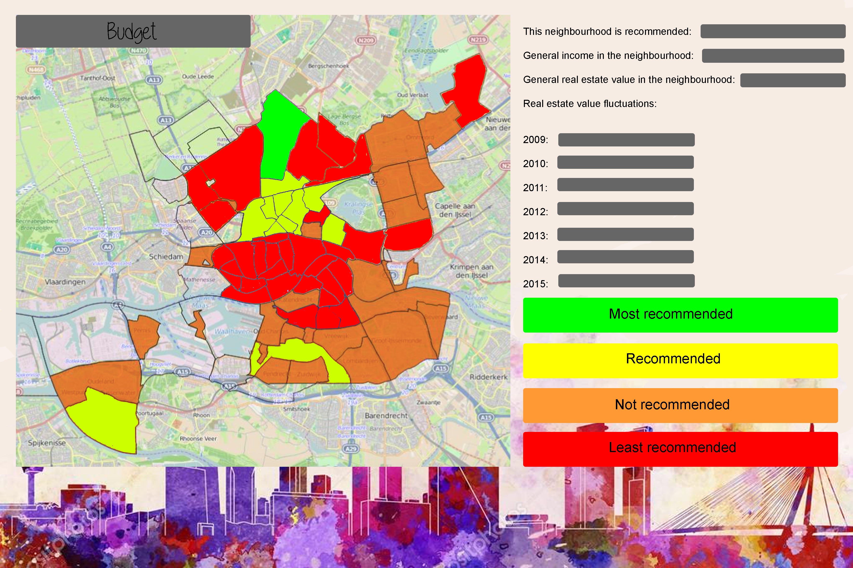
Idea
Explanation
Usefulness
Questions

Slide 4
DEVELOPMENT
Datasets
Real Estate Values
Income
Family size
Satisfaction Rating
Resources
Rotterdam Open Data
Centraal Bureau Statistiek
Database
Visual Studio Database
Timestamp
Years 2009 - 2015
GUI filter

Slide 5
demonstration
Answers to our questions

Slide 6
COLLABORATION
How did it go?
Github

