Slide 1


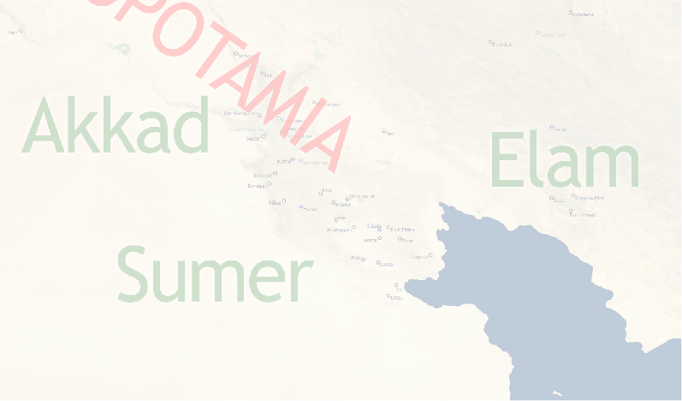

REPLACE THIS BOX WITH YOUR ORGANIZATION’S
HIGH RESOLUTION LOGO
Phylogenetic Analysis of Ancient Lexical Lists
REPLACE THIS BOX WITH YOUR ORGANIZATION’S
HIGH RESOLUTION LOGO
Erin Becker, Software Carpentry and Niek Veldhuis, UC Berkeley, Department of Near Eastern Studies
Introduction (Lexical Texts)
Introduction (Phylogenetics)
Analysis
Lexical lists:
Lists of Sumerian words, documenting a dead language
Written in cuneiform on clay tablets
Used in scribal education
Often thematic (lists of trees, wooden objects, animals, foods)
Versions:
Lists continuously change: insertions, deletions, reorganization
Chronology:
Old Babylonian (1900-1600BCE)
Middle Babylonian (1500-1200BCE)
Geography:
Old Babylonian: Babylonia (Southern Iraq)
Middle Babylonian: Babylonia; Syria; and Anatolia
Lists of trees, wooden objects, animals, meat cuts, professions, metal objects, etc. were transmitted over many centuries. Like genomes, these lists continuously changed by adding new entries, omitting entries, or by changing the order of entries. Lists are organized in sections; each section includes related words (for instance: parts of a chariot). The order of sections also changes over time.
Scholars will asses the relationship between two versions of a lexical text by looking at presence/absence of entries; order of entries within a section and order of sections within the entire text.
Data Acquisition and Formatting
Results and Future Work
Lexical lists and other cuneiform texts are published in transliteration on ORACC (Open Richly Annotated Cuneiform Corpus; http://oracc.org).
Cuneiform:
Transliteration {ŋeš}taškarin
Translation boxwood
Lemmatized data made available by ORACC in JSON format is used in the analysis. Data consist of ca. 135 exemplars of the list of trees and wooden objects, ranging from 2 to 750 lines in length. The data is arranged in a DTM (Document-Term Matrix) for comparison of the documents.
Lemmatization taškarin[boxwood]N
Doc/lemma | taškarin[boxwood]N | ŋešnu[sandalwood]N | ŋeštin[vine]N | ŋeškin[birch]N
Exempl 1 | 0 | 1 | 1 | 0
Exempl 2 | 0 | 0 | 0 | 0
Exempl 3 | 1 | 1 | 1 | 0
Contact
References
<your name>
<your organization>
Email:
Website:
Phone:

