Slide 1

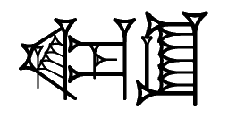
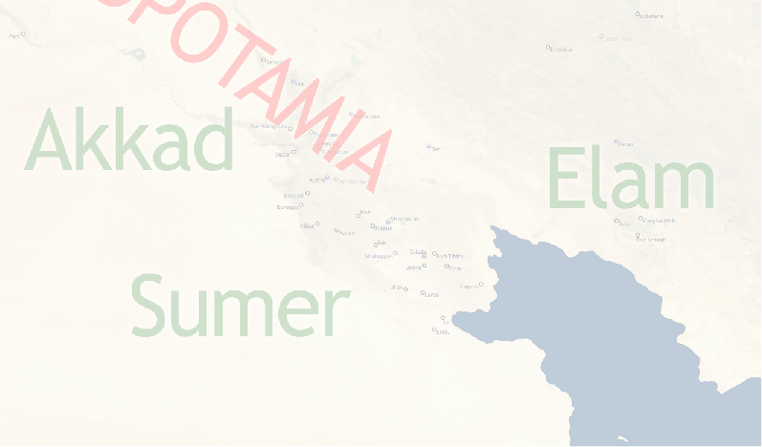

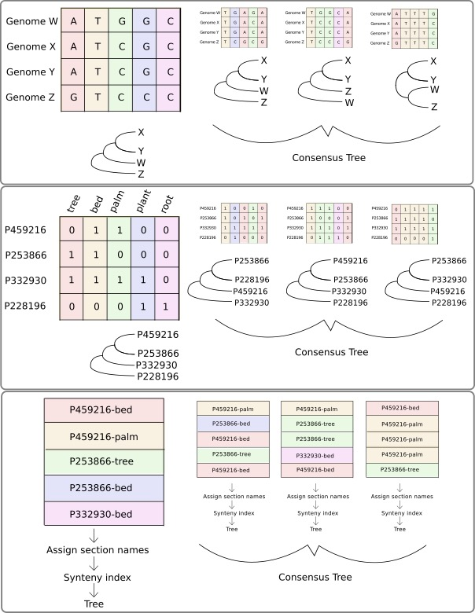
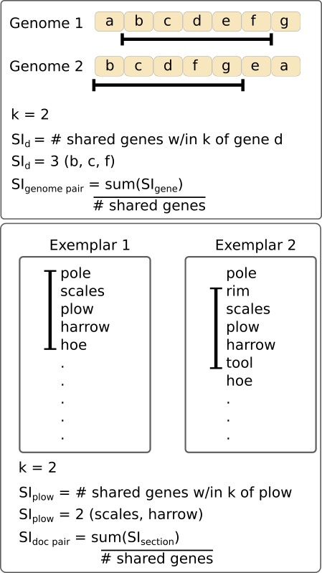
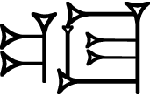
Phylogenetic Analysis of Ancient Lexical Lists
Erin Becker, Associate Director, The Carpentries & Niek Veldhuis, Professor of Assyriology, UC Berkeley, Department of Near Eastern Studies
Introduction (Lexical Texts)
Introduction (Phylogenetics)
Analysis
Lexical lists:
Lists of Sumerian words, documenting a dead language
Written in cuneiform on clay tablets
Used in scribal education
Often thematic (lists of trees, wooden objects, animals, foods)
Where and When?
- Ancient Mesopotamia (present-day Iraq); ca 1900-1200 BCE
Lists of trees, wooden objects, animals, meat cuts, professions, metal objects, etc. were transmitted over many centuries. Like genomes, these lists continuously changed by adding new entries, omitting entries, or by changing the order of entries. Lists are organized in sections; each section includes related words (for instance: parts of a chariot). The order of sections also changes over time.
Scholars will assess the relationship between two versions of a lexical text by looking at presence/absence of entries, order of entries within a section, and order of sections within the entire text.
Lexical lists and other cuneiform texts are published in transliteration and translation with lemmatization on ORACC (Open Richly Annotated Cuneiform Corpus; http://oracc.org).
Cuneiform:
Transliteration {ŋeš}taškarin
Translation boxwood
Four representations of a Sumerian word
Phylogenetics is a field of evolutionary biology which uses patterns of similarity and difference among organisms to make hypotheses about relatedness. Hypothesized relationships are displayed as trees where more closely related organisms are separated by fewer branching points and/or shorter total branch length.
Species X is most closely related to Species Y. Both are next most closely related to Species W and most distantly related to Species Z.
Patterns in DNA sequences, protein sequences, gene order, morphological characters, or others can be used to make phylogenetic hypotheses.
Similarity based on entry presence/absence. A document term matrix was constructed and 1000 bootstrap replicates were taken. Individual trees were built using Neighbor Joining and a consensus tree was built using Maximum Clade Credibility.
Shared Issues
Lexical lists and genomic data share characteristics making similar approaches appropriate.
Texts with ordered information
Broken/fragmented texts
Texts copied with changes
Incomplete collection of exemplars
Similarity based on section order. One thousand bootstrap replicates were taken of the corpus. Section names were assigned based on sections in the Nippur version (Q000039). For each replicate, the synteny index for each document pair was calculated and used to construct a distance matrix. Individual trees were built using Neighbor Joining and a consensus tree was built using Maximum Clade Credibility.
Lemmatization taškarin[boxwood]N
Data Acquisition and Formatting
Lemmatized data, made available by ORACC in JSON format, is used in our analyses. Data consist of ca. 135 exemplars of the list of trees and wooden objects, ranging from 2 to 750 lines in length. The data is arranged in a DTM (Document-Term Matrix) for comparison of the documents on presence/absence of entries.
Results and Future Work
Doc/lemma | ŋeškin[birch]N | ŋešnu[sandalwood]N | ŋeštin[vine]N | taškarin[boxwood]N
Exemplar 1 | 0 | 1 | 1 | 0
Exemplar 2 | 0 | 0 | 0 | 0
Exemplar 3 | 0 | 1 | 1 | 1
Entry presence/absence turns out to be a rather bad predictor for dependency among tablets. Two duplicating tablets from Old Babylonian Isin (P459216 and P459217) end up in different branches of the tree, presumably because they are broken at different places. The tree does correctly identify four tablets that have little to do with the rest: P250736, Q000001, P492330, and P228196 (at the bottom of the tree)
The “section order” tree closely aligns P346714 (from Ur) with P250364 (unknown provenance). P250364 certainly does not come from Ur but may well descend from the Ur version. The Old Babylonian Isin texts P459216 and P459217 align with two exemplars from Ugarit (P332934 and P429503), which are several centuries later. The Ugarit version is unlikely to derive directly from Isin – but Isin may well have been a station on the way.
Future work:
order of entries within a section
applying the method on other groups of lexical texts
For the analysis of section order each item in each text is assigned to a section. Sections are defined through the best preserved text: the Nippur version. Consecutive lemmas that share a sequence of least three characters (k-mer with k=3) belong to the same section
pana[bow]N
epana[quiver]N
gagpana[arrow]N
gagsisa[arrow]N
gagsieš[arrow]N
=============
ešad[trap]N
Synteny is a measure of similarity in order of items across exemplars. In phylogenetics, synteny is the conservation of gene order across genomes. In our analysis, it is the conservation of section order across exemplars.
The section “bow” is defined by a sequence of lemmas that share a sequence of at least 3 characters either in the Sumerian Citation Form or in the English guide word. Square brackets and part of speech are ignored. The word for “trap” is the beginning of a new section
Bootstrapping is a method of assessing how sensitive results are to changes in the data. A large number of replicates are produced by sampling with replacement and the analysis is carried out on each replicate. If the results are robust, most replicates will be similar.
Contact
Erin Becker
Associate Director, The Carpentries
Email: ebecker@carpentries.org
Website: https://github.com/ErinBecker/digital-humanities-phylogenetics
Niek Veldhuis
Professor of Assyriology, Dept. of Near Eastern Studies, UC Berkeley
Email: veldhuis@berkeley.edu
Website: http://oracc.org/dcclt

