Slide 1

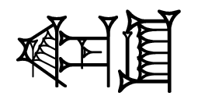
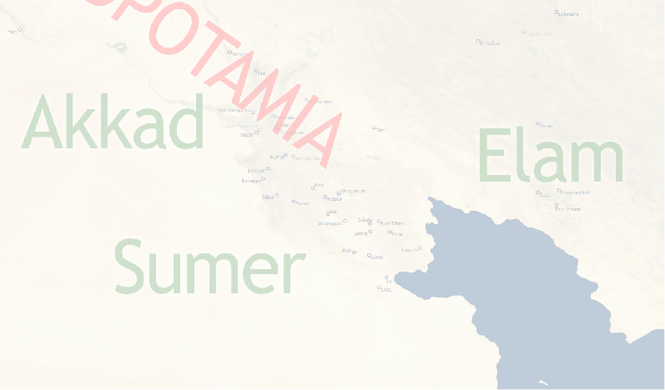
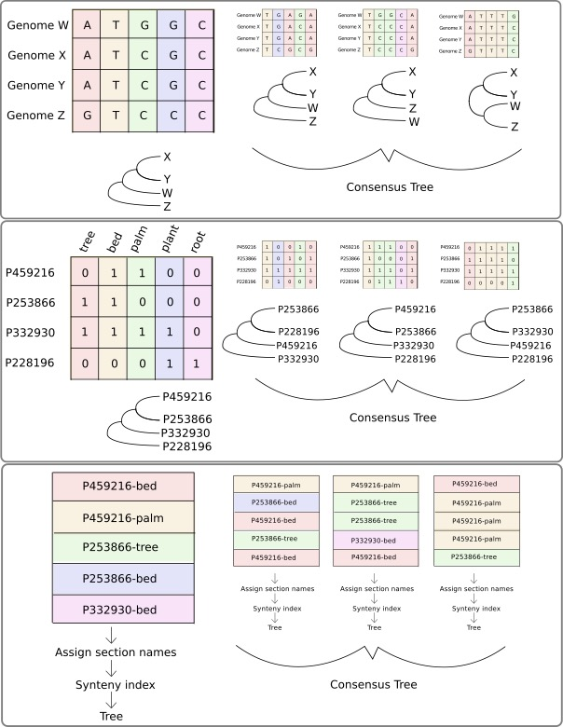

REPLACE THIS BOX WITH YOUR ORGANIZATION’S
HIGH RESOLUTION LOGO
Phylogenetic Analysis of Ancient Lexical Lists
REPLACE THIS BOX WITH YOUR ORGANIZATION’S
HIGH RESOLUTION LOGO
Erin Becker, Associate Director, The Carpentries and Niek Veldhuis, Professor of Assyriology, UC Berkeley, Department of Near Eastern Studies
Introduction (Lexical Texts)
Introduction (Phylogenetics)
Analysis
Lexical lists:
Lists of Sumerian words, documenting a dead language
Written in cuneiform on clay tablets
Used in scribal education
Often thematic (lists of trees, wooden objects, animals, foods)
Where and When?
- Ancient Mesopotamia (present-day Iraq); ca 1900-1200 BCE
Lists of trees, wooden objects, animals, meat cuts, professions, metal objects, etc. were transmitted over many centuries. Like genomes, these lists continuously changed by adding new entries, omitting entries, or by changing the order of entries. Lists are organized in sections; each section includes related words (for instance: parts of a chariot). The order of sections also changes over time.
Scholars will asses the relationship between two versions of a lexical text by looking at presence/absence of entries; order of entries within a section and order of sections within the entire text.
Lexical lists and other cuneiform texts are published in transliteration and translation with lemmatization on ORACC (Open Richly Annotated Cuneiform Corpus; http://oracc.org).
Cuneiform:
Transliteration {ŋeš}taškarin
Translation boxwood
Four representations of a Sumerian word
Lemmatization taškarin[boxwood]N
Data Acquisition and Formatting
Results and Future Work
Lemmatized data, made available by ORACC in JSON format, is used in the analysis. Data consist of ca. 135 exemplars of the list of trees and wooden objects, ranging from 2 to 750 lines in length. The data is arranged in a DTM (Document-Term Matrix) for comparison of the documents on presence/absence of entries.
Doc/lemma | ŋeškin[birch]N | ŋešnu[sandalwood]N | ŋeštin[vine]N | taškarin[boxwood]N
Exemplar 1 | 0 | 1 | 1 | 0
Exemplar 2 | 0 | 0 | 0 | 0
Exemplar 3 | 0 | 1 | 1 | 1
For the analysis of section order each item in each text is assigned to a section. Sections are defined through the best preserved text: the Nippur version. Consecutive lemmas that share a sequence of least three characters (k-mer with k=3) belong to the same section
pana[bow]N
epana[quiver]N
gagpana[arrow]N
gagsisa[arrow]N
gagsieš[arrow]N
=============
ešad[trap]N
The section “bow” is defined by a sequence of lemmas that share a sequence of at least 3 characters either in the Sumerian Citation Form or in the English Guide Word. Square brackets and Part of Speech are ignored. The word for “trap” is the beginning of a new section
Contact
References
<your name>
<your organization>
Email:
Website:
Phone:

