Slide 1
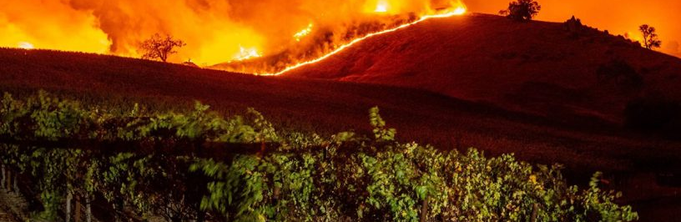

California Wildfire Study
Chang Woon Jang, Erin Buday, Mattew Hill, Muhammad Malik

Slide 2
Motivation
Wildfires pose significant threat immediately threatening life, property, and air quality, and have long-term impacts on the state’s water. Knowing location and extent of wildfire events that effect California may help scientists and resource managers predict and manage potential impacts burns may have upon California’s water quality, availability, and movement.
Our study focuses on identifying a cause of wildfires using several datasets.

Slide 3
Key Questions

Slide 4
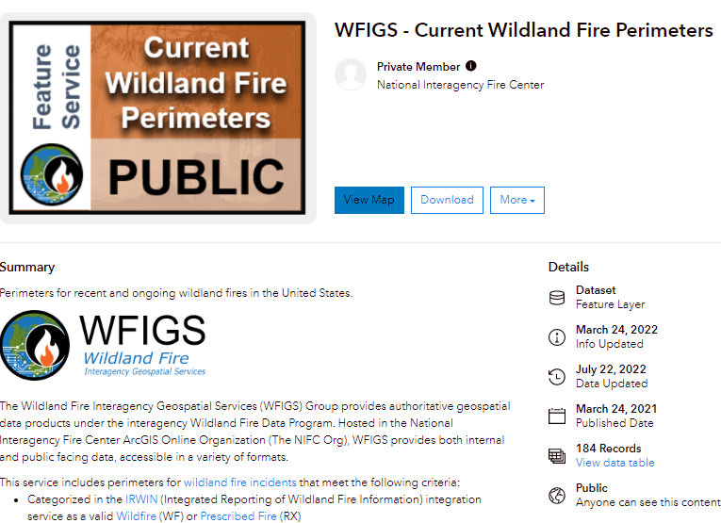
Where are datasets from?

Slide 5
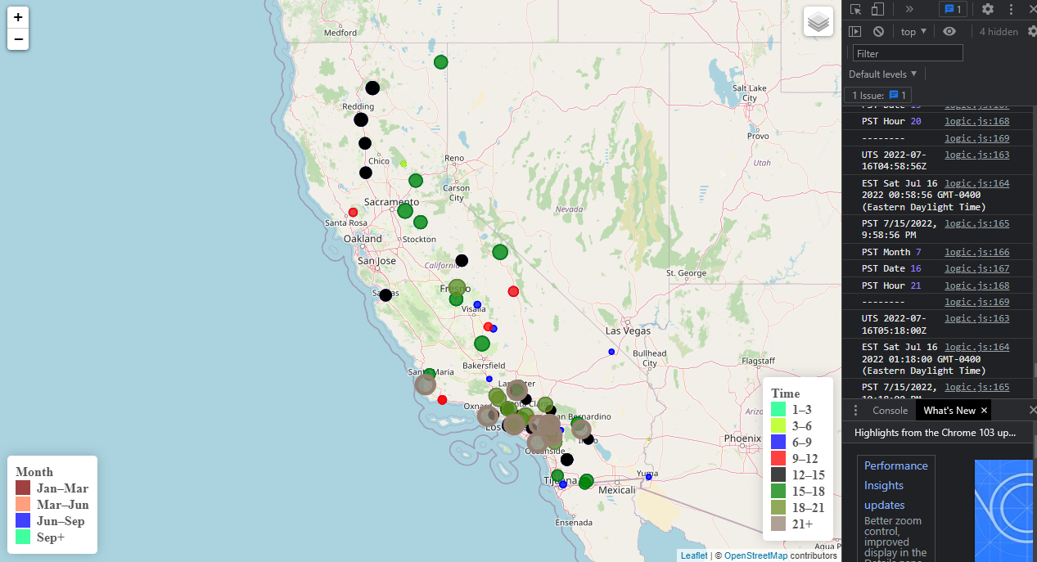
Visualization for California wildfire on map
(Leaflet Javascript)

Slide 6
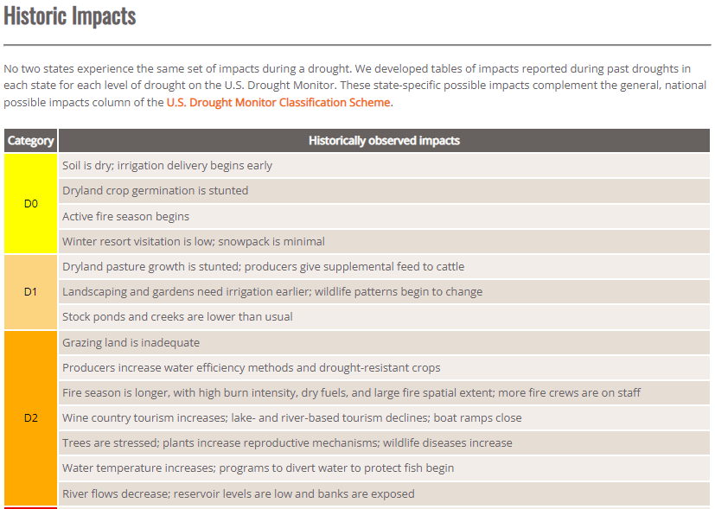
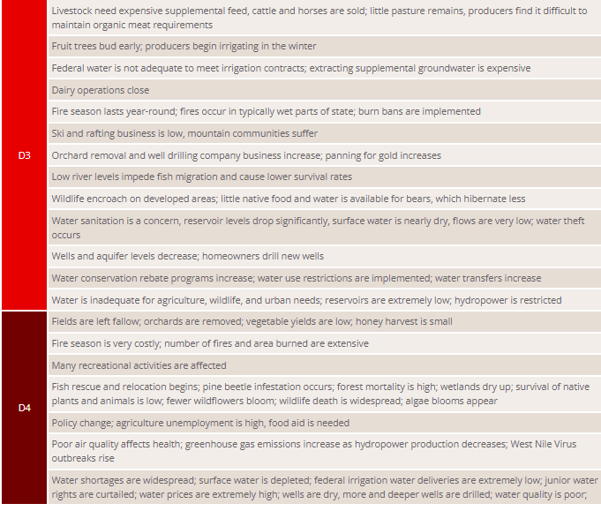
Drought Effect on Wildfires?

Slide 7
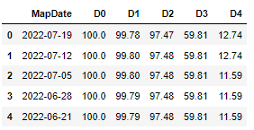

Snapshot of the California drought data
Source: USDM-california.csv

Slide 8
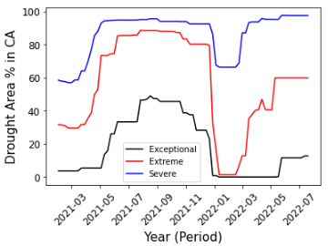
Drought area of the California in a year

Slide 9
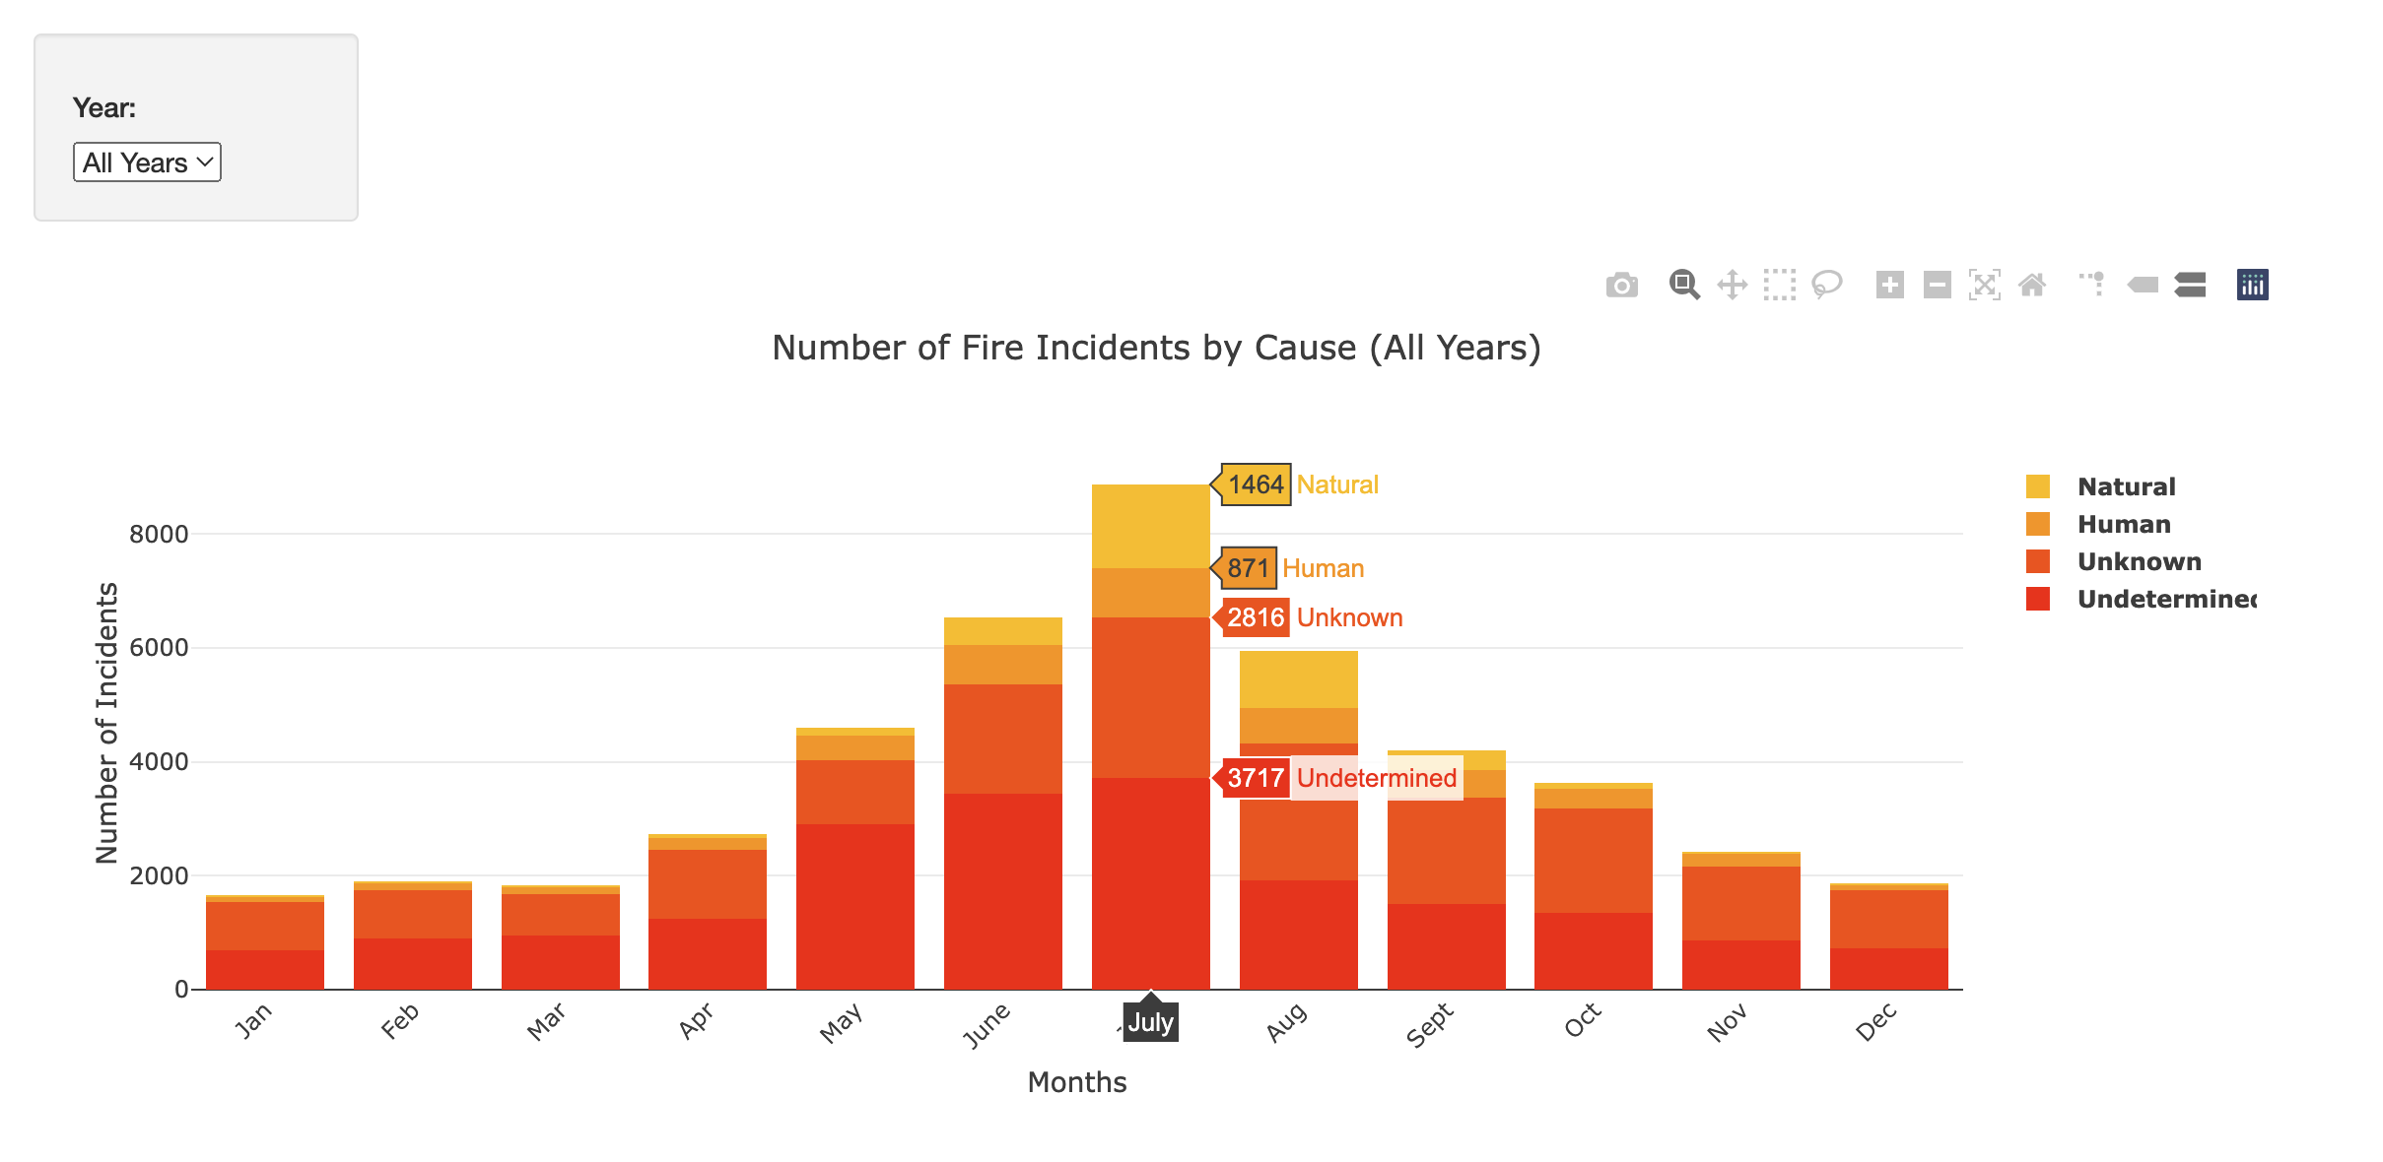

Slide 10
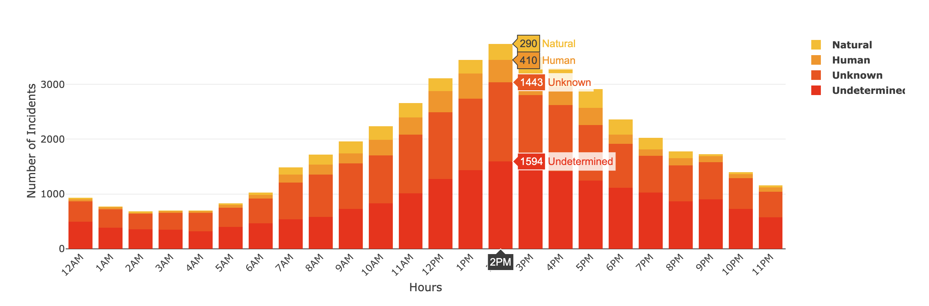

Slide 11
