Slide 1
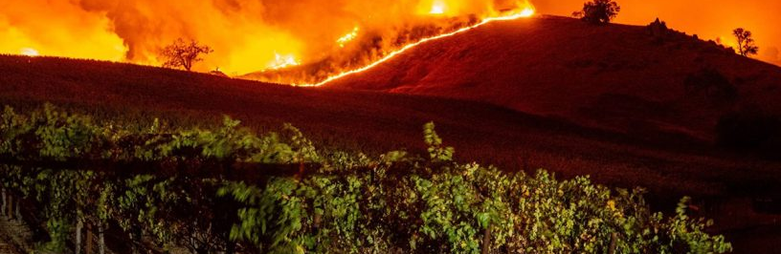

California Wildfires
Chang Woon Jang, Erin Buday, Matthew Hill, Muhammad Malik

Slide 2
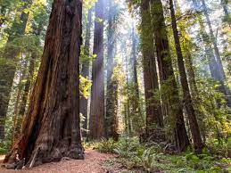
California wildfires pose significant danger immediately threatening life, property, and air quality with long-term impacts on the state’s water supply. Tracking fire locations and the extent of the events that effect the area may help with predicting and managing potential impacts fires will have upon the state’s water supply, air quality, land availability and livability as well as many other resources that will begin to become limited.
Wildfires in California from 2012 to date exploring the number of fires per year, burn length and location using several datasets.
PROJECT FOCUS:

Slide 3
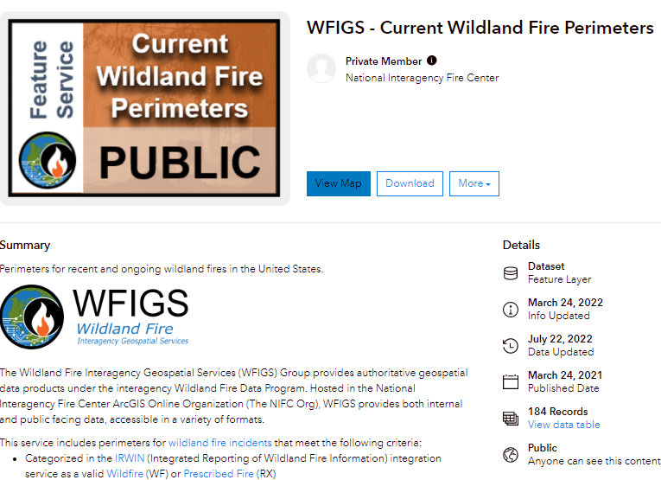
Dataset Resources:

Slide 4
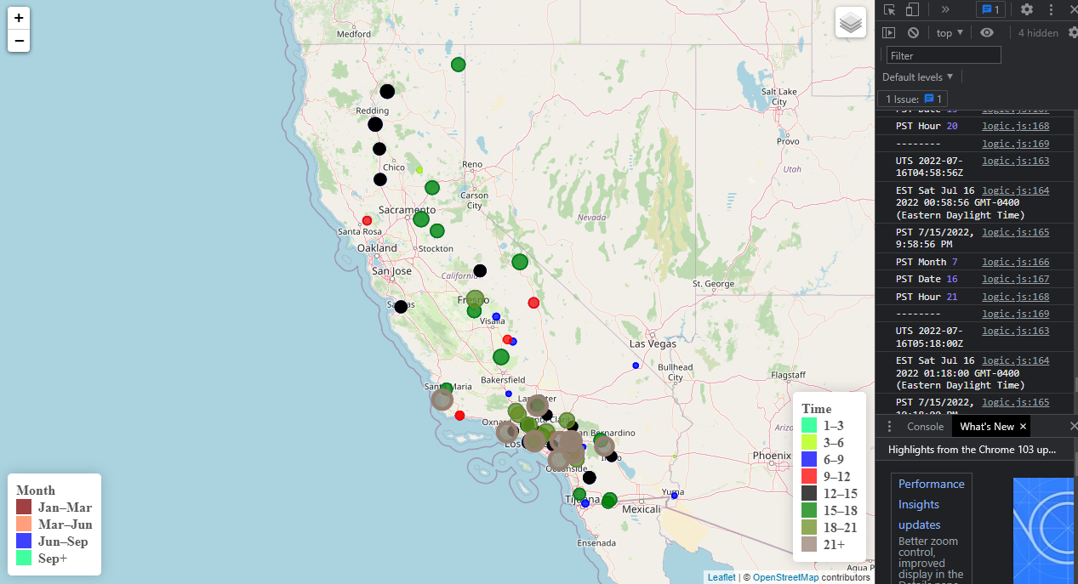
California Wildfire Locations
(Leaflet Javascript)

Slide 5
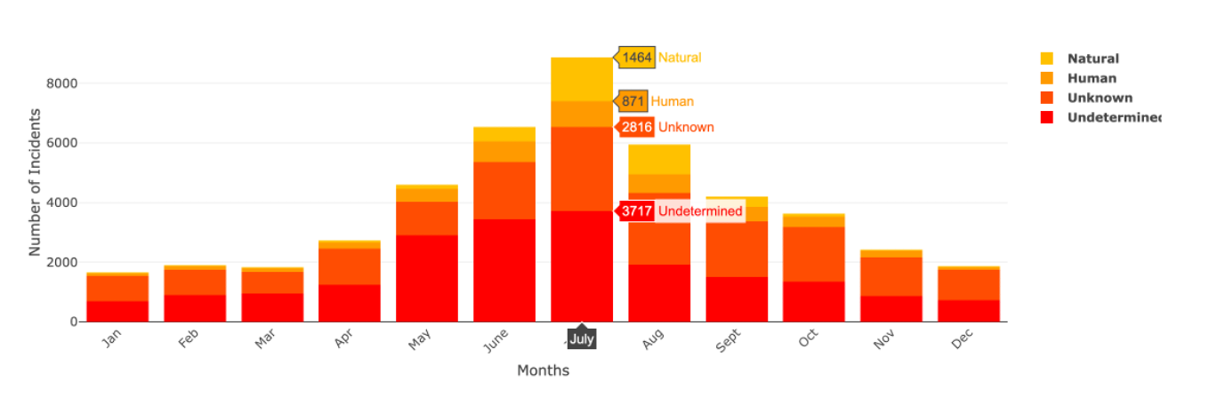
Number of Fire Incidents by Cause
FREQUENCY OF FIRES PER MONTH IN A GIVEN YEAR

Slide 6
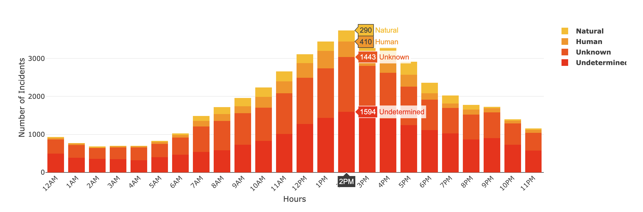
FREQUENCY OF FIRES PER HOUR FOR A GIVEN DAY

Slide 7
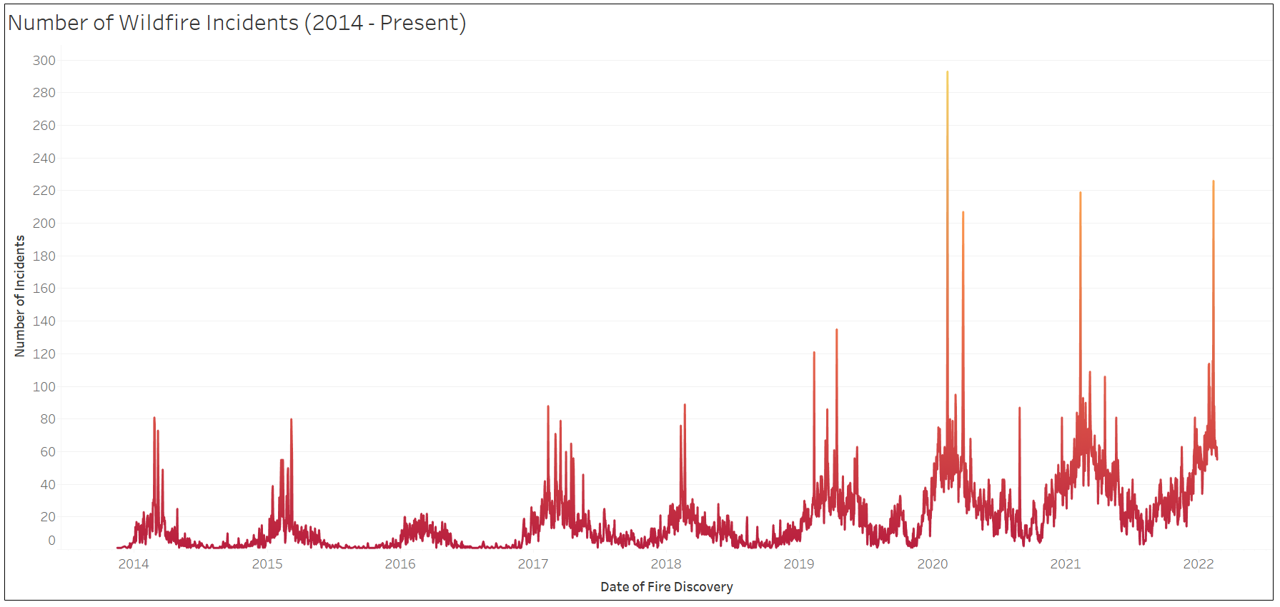

Slide 8
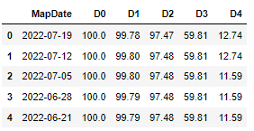

Snapshot of California Drought Data
Source: USDM-california.csv

Slide 9
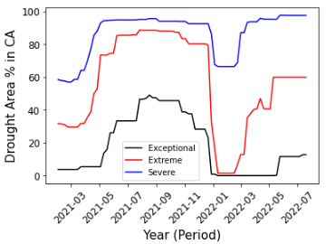
Current Drought Area % in California

Slide 10
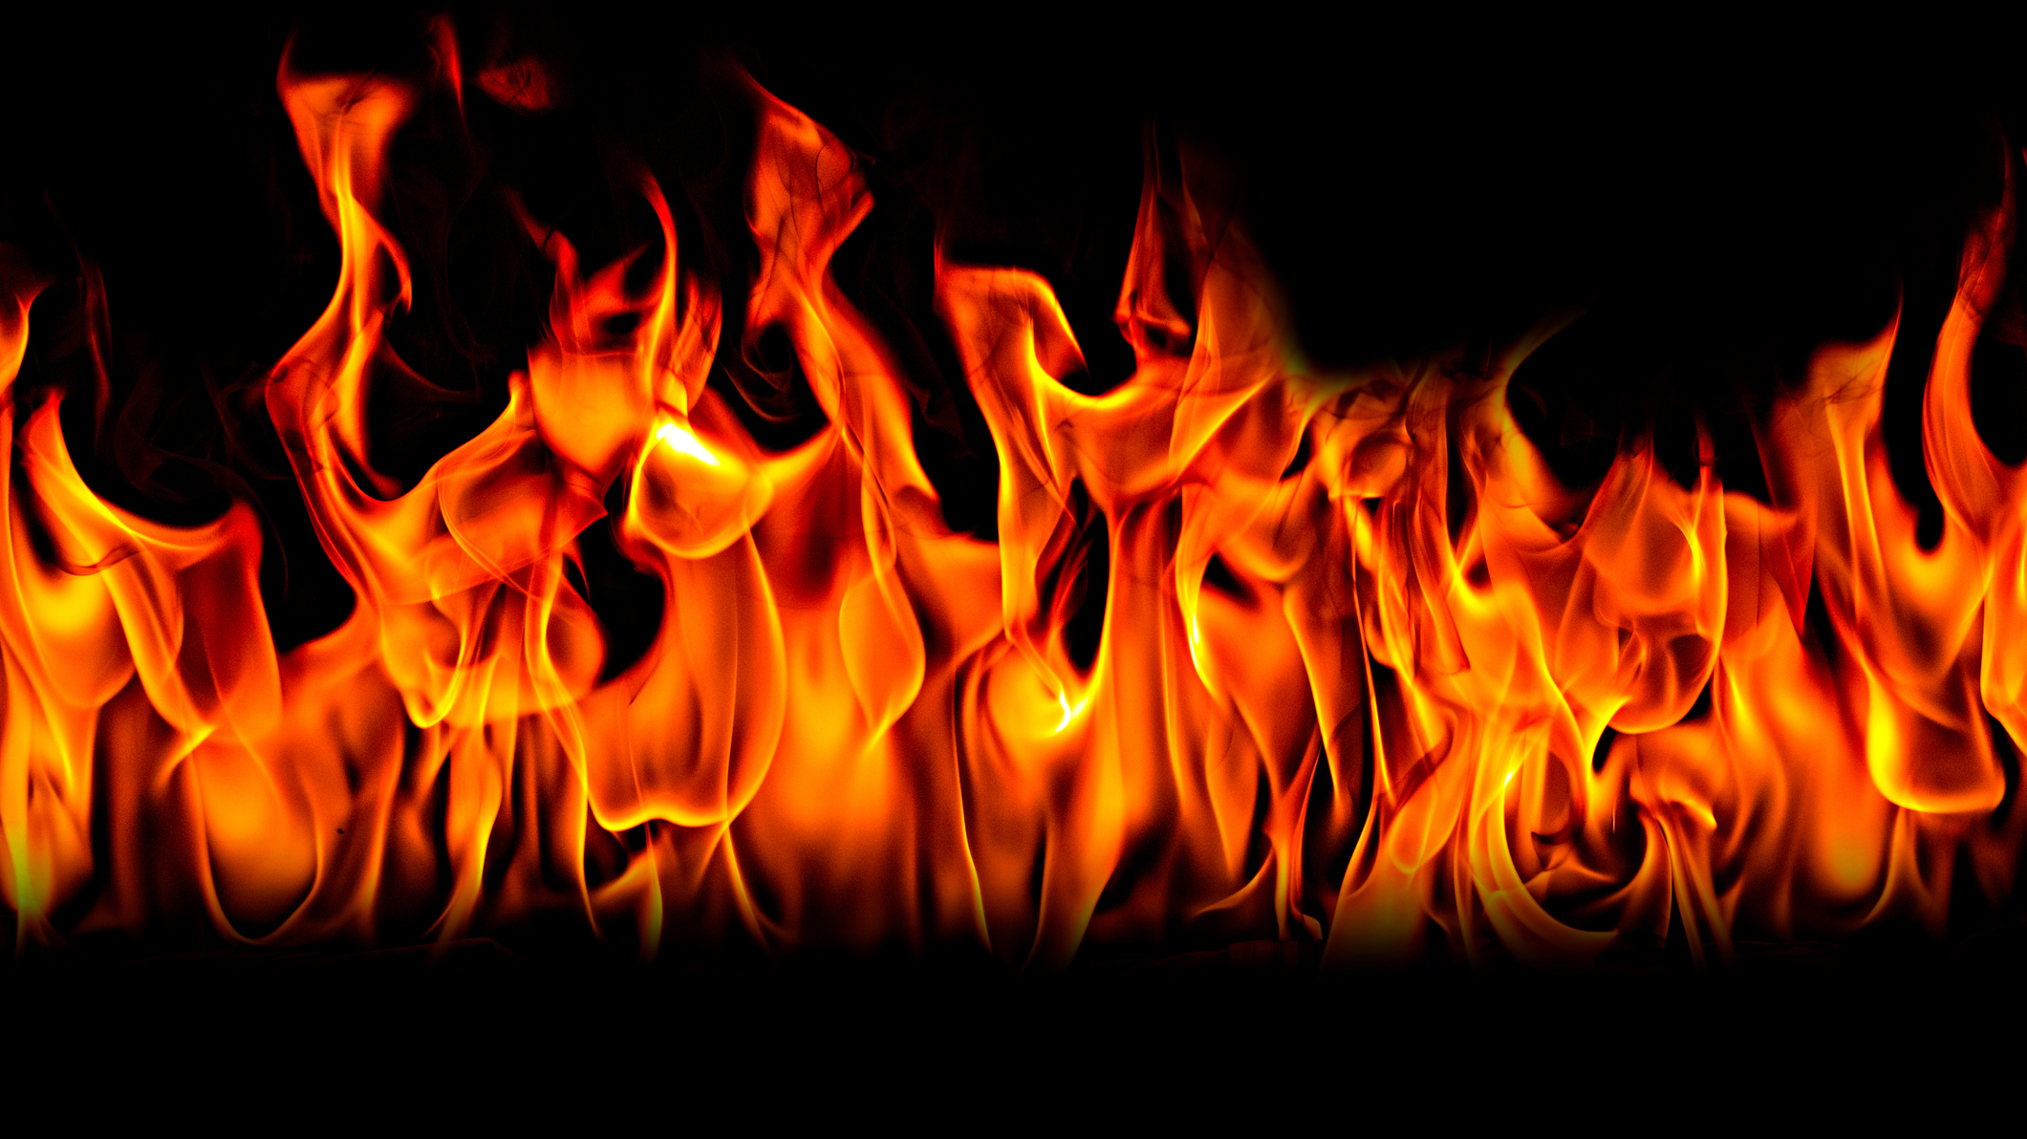
Conclusions:
Summer months are peak fire season due to high temperatures and extreme drought in the state.
The highest number of fires occur between 1pm-3pm, which is the hottest part of the day.
Most fire causes are unknown.
Fires across the state have been progressively increasing from 2012-2022, with a large increase over the past 3 years due to rising temperatures and longer droughts.

