Slide 1



Google GDG Hackathon 2024
Nutrition Monitoring App using Gemini AI
FOODBUDDY
By group 91M (Jennifer, Giann, Brian, Winona)

Slide 2


Outline
01
Our Motivation
02
Functionality
03
Implementation of Gemini AI
04
How does it work
05
Future Developments
06
Q & A

Slide 3


INTRODUCTION
Why we create this app

Slide 4

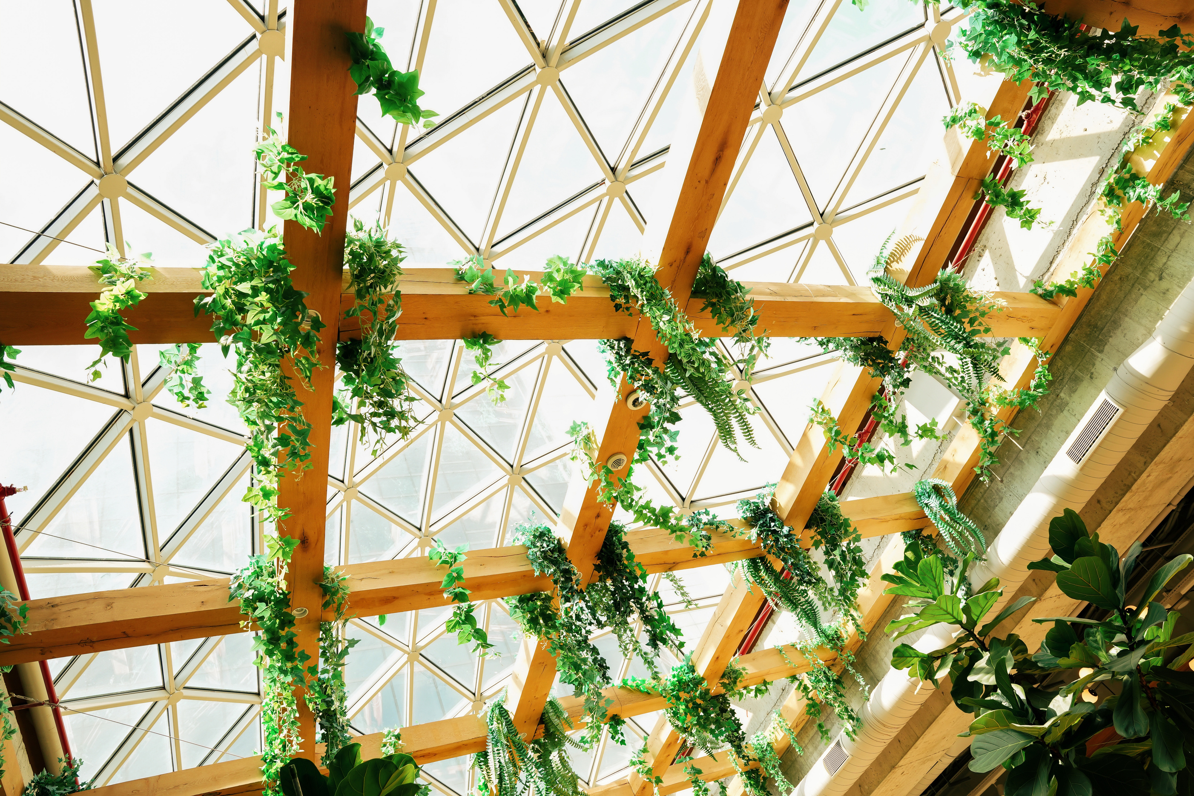
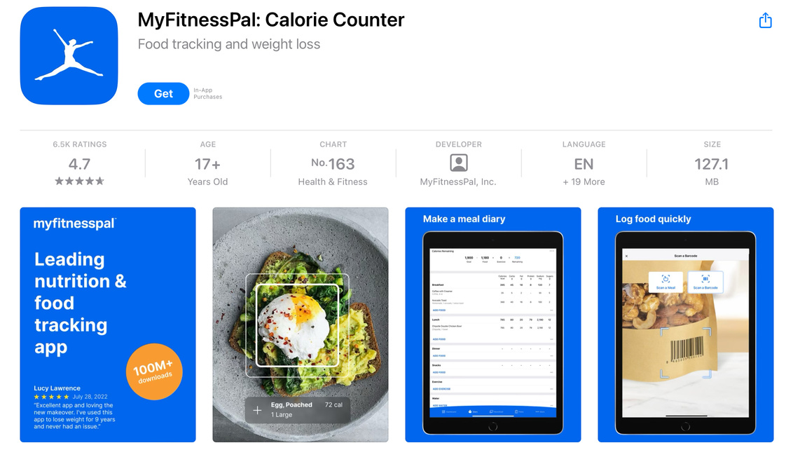
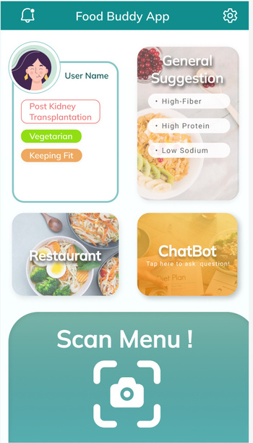
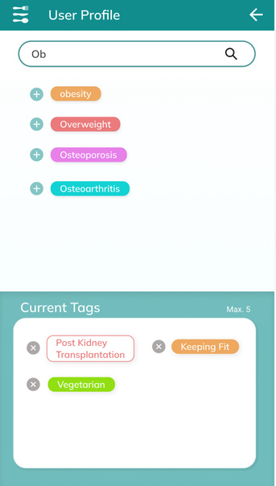


OTHER APP
OUR APP
Con uk sider user's
Medical history,
Dietary restrictions,
Goals
Create a meal recommendation list that suits the user.
No suggestions for people with medical histories.
No meal suggestions based on a specific menu.

Slide 5
FOOD BUDDY APP

Slide 6
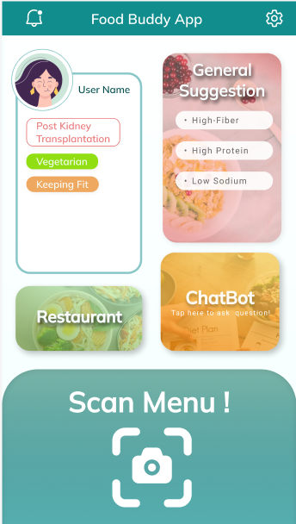

Dash-board
02
General
Suggestions
01
User profile
Gemini AI
ChatBot
04
03
Restaurant
Suggestion
05
Menu
Scanner

Slide 7
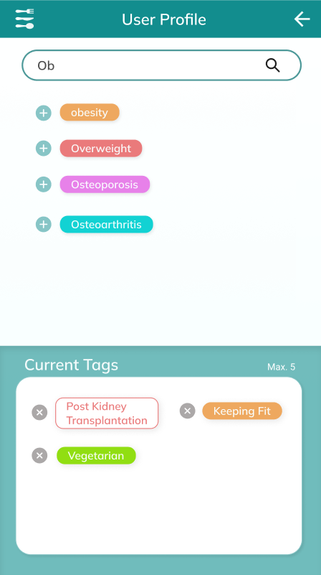

User Profile
01 Search Bar
• search your wanted tag here
• show related tags
02 Add Tags
• Add new tag by tapping in the tag / plus sign
03 Chosen Tags
• Press the cross to remove any tags
• You can have at most 5 tags

Slide 8
DEMONSTRATION
GEMINI CHATBOT

Slide 9
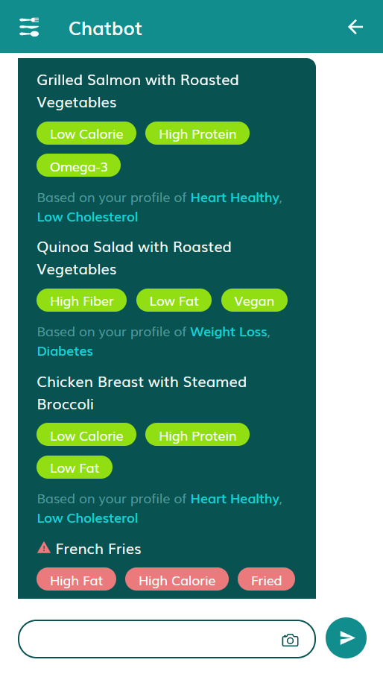
Chatbot
02
Receive recommendations
03
Follow-up questions
01
Take photo and send

Slide 10





App
Flow
SERVER
base64 -> image
Image -> base64
Photo of Menu
Recommend foods
Add tags
Convert to JSON

Slide 11
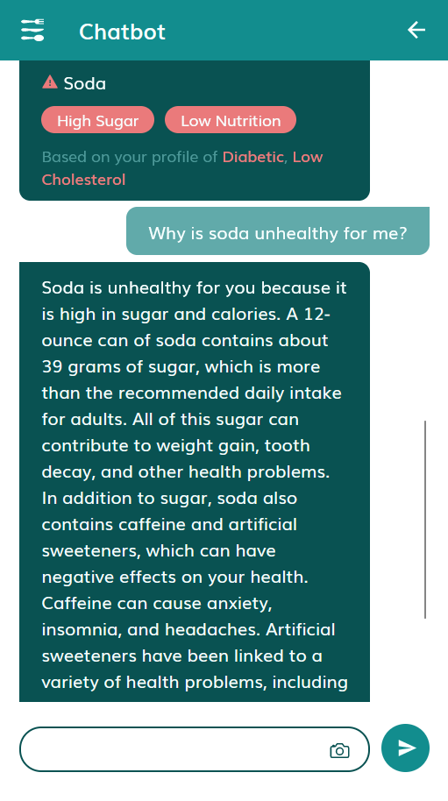
01
OCR
Menu parsing model
02
Text parsing for food items
03
Analyze user profile for suitable food types
04
Choose food items based on previous steps
05
Consider previous responses and explain reasoning (transparency)
Conversational model
06
Output as JSON (integration)/
plaintext within word limit

Slide 12
FUTURE
DEVELOPMENT

Slide 13

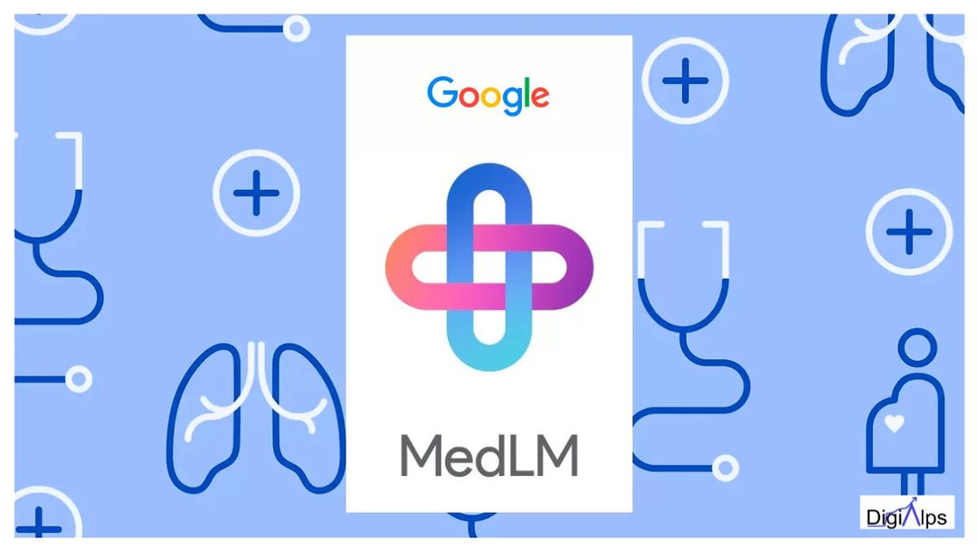

Future technology integration
RAG - MedLM
Flutter
01
02
use MedLM as the language model component in the RAG setup
Migrate from React to Flutter

Slide 14
Apply technology for new functions
RAG - MedLM
Greater accuracy and timeliness
Professional verification and academic basis
use MedLM as the language model component in the RAG setup
Specific information for uncommon ailments

Slide 15
Apply technology for new functions
Flutter
Better integration with Gemini AI
Faster Performance
Migrate from React to Flutter

Slide 16
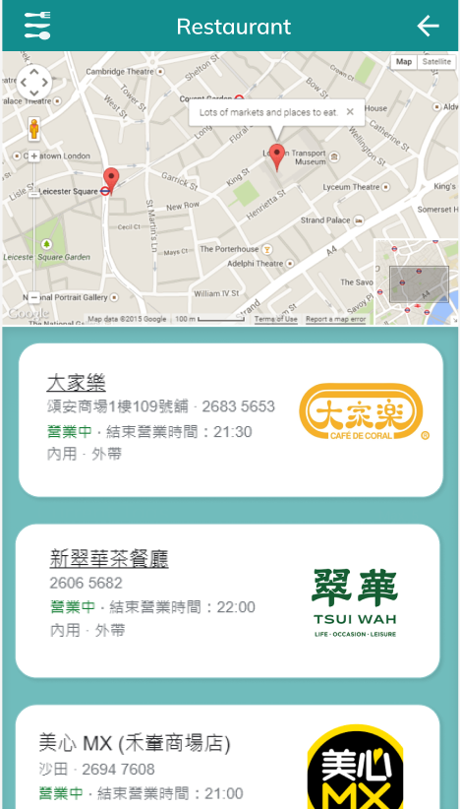
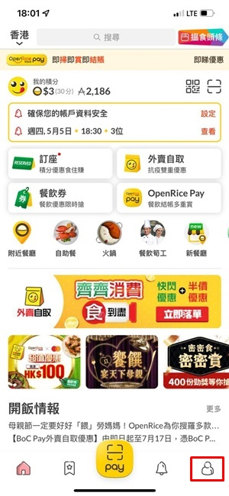
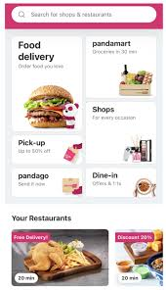
Apply technology for new functions
Restaurant recommendations

Slide 17


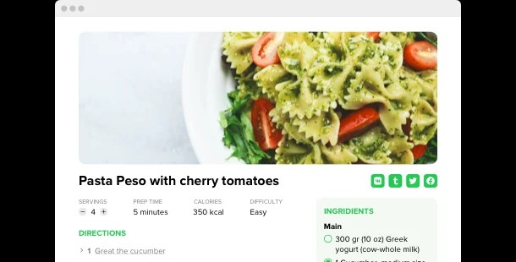
Apply technology for new functions
Recipe Recommendations

Slide 18
Q&A

Slide 19
THANKS

