Slide 1
Sample plugins

Slide 2
PART0 Set-up

Slide 3
http://bit.ly/xdpluginlabs
https://console.adobe.io

Slide 4
PART1 Getting started

Slide 5
Create a Rectangle Instance
const shape = new Rectangle();
shape.width = 100;
shape.height = 100;

Slide 6
Color the Rectangle
shape.fill = new Color("#f00");

Slide 7
Place the Rectangle in the Artboard
selection.insertionParent.addChild(shape);

Slide 8
Move the Rectangle
shape.moveInParentCoordinates(100, 100);

Slide 9
PART2 Creating a "button padding” plugin

Slide 10
Place a button around a text
???
OK!
OK!

Slide 11
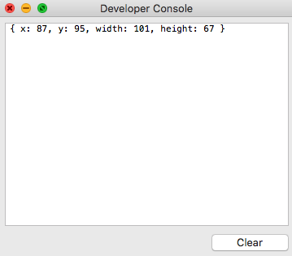
Style the text and get the textBounds
const textNode = selection.items[0];
textNode.textTransform = “uppercase”;
const textBounds = textNode.boundsInParent;
Y
X
ok!
height
width

Slide 12
Set padding and create a Rectangle
const padding = 30;
const shape = new Rectangle();
shape.width = textBounds.width + 2*padding;
shape.height = textBounds.height + 2*padding;
shape.stroke = new Color("blue");
Padding

Slide 13
Place the Rectangle in the Artboard
selection.insertionParent.addChild(shape);

Slide 14
Place the rectangle on top of the text
shape.placeInParentCoordinates({x: 0, y: 0},
{x: textBounds.x - padding, y: textBounds.y - padding});
Y - padding
X - padding
OK!
Padding

Slide 15
PART3 Creating a dialog UI

Slide 16
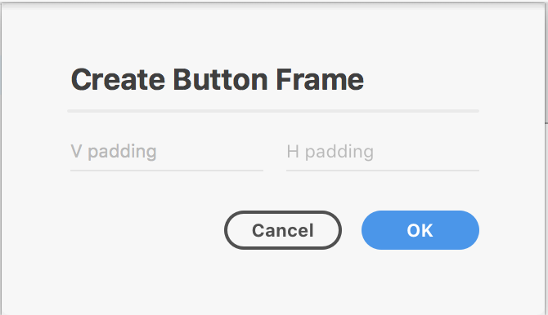
Place a button around a text (UI)
???
OK!
OK!

Slide 17
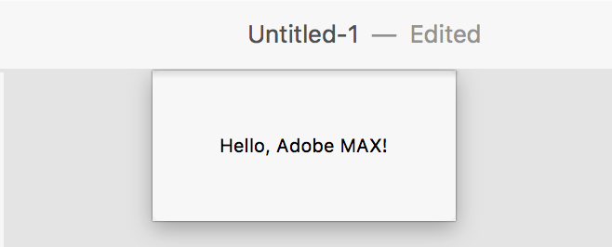
Create a simple dialog
let dialog = document.createElement("dialog");
dialog.innerHTML = "Hello, Adobe MAX!";
document.appendChild(dialog);
return dialog.showModal()

Slide 18
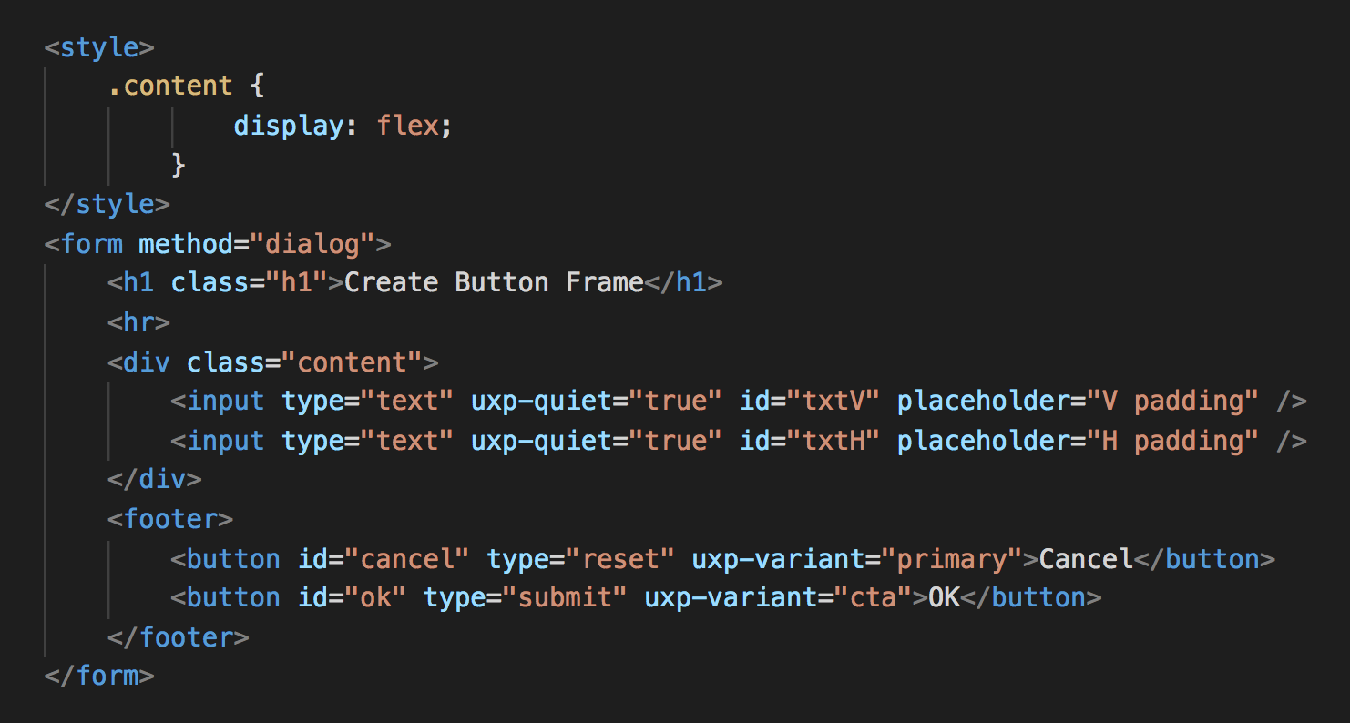
Insert your HTML
let dialog = document.createElement("dialog");
dialog.innerHTML = ”YOUR_HTML_CODE";
document.appendChild(dialog);
return dialog.showModal()

Slide 19
PART4 Putting it all together

Slide 20
PART5 Panel Plugin

