Slide 1
Book1
File created on: 4/14/19 6:59:26 AM EDT

Slide 2
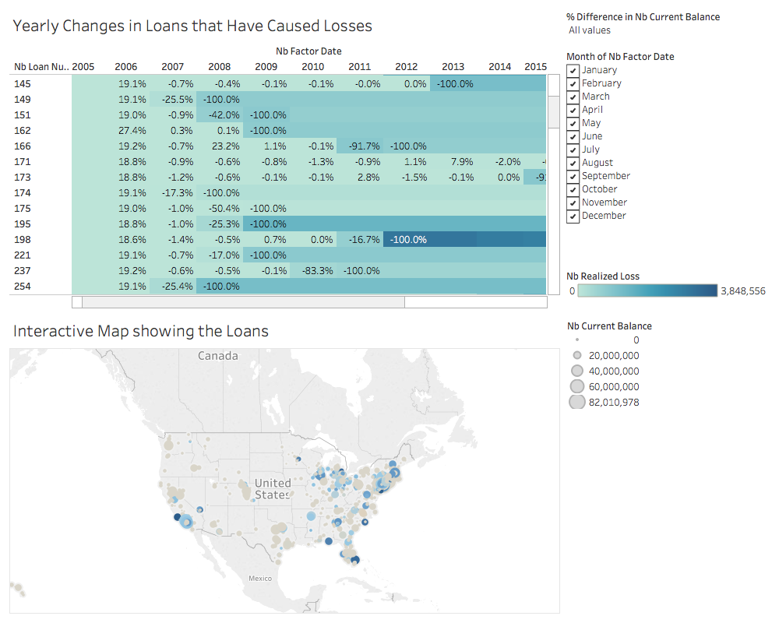

Slide 3
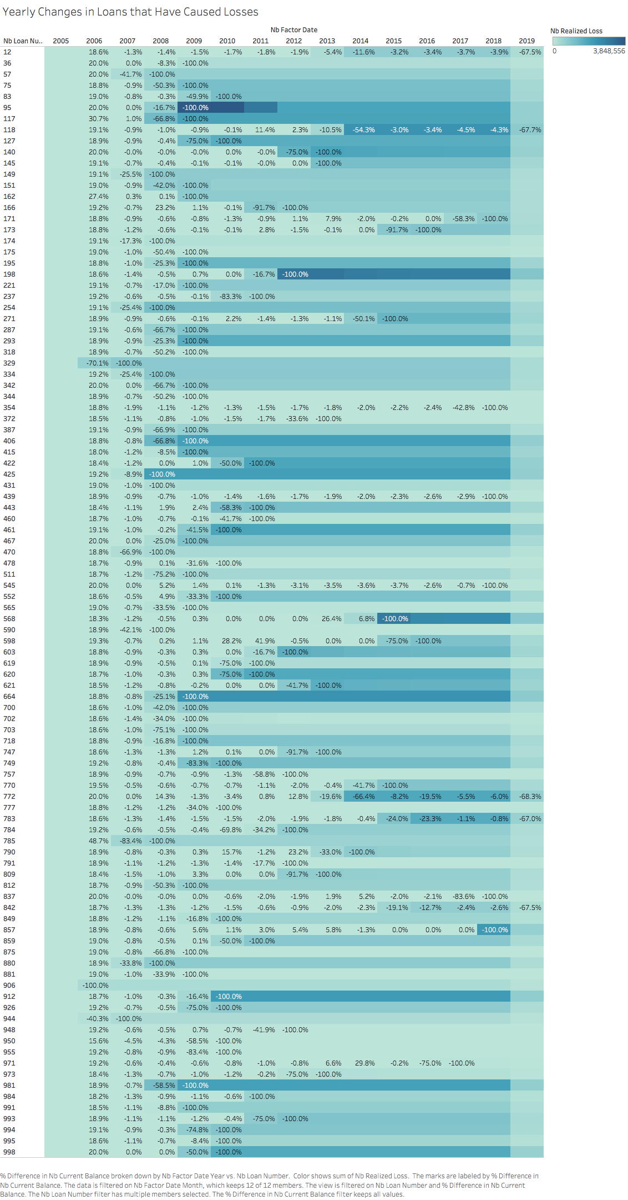

Slide 4
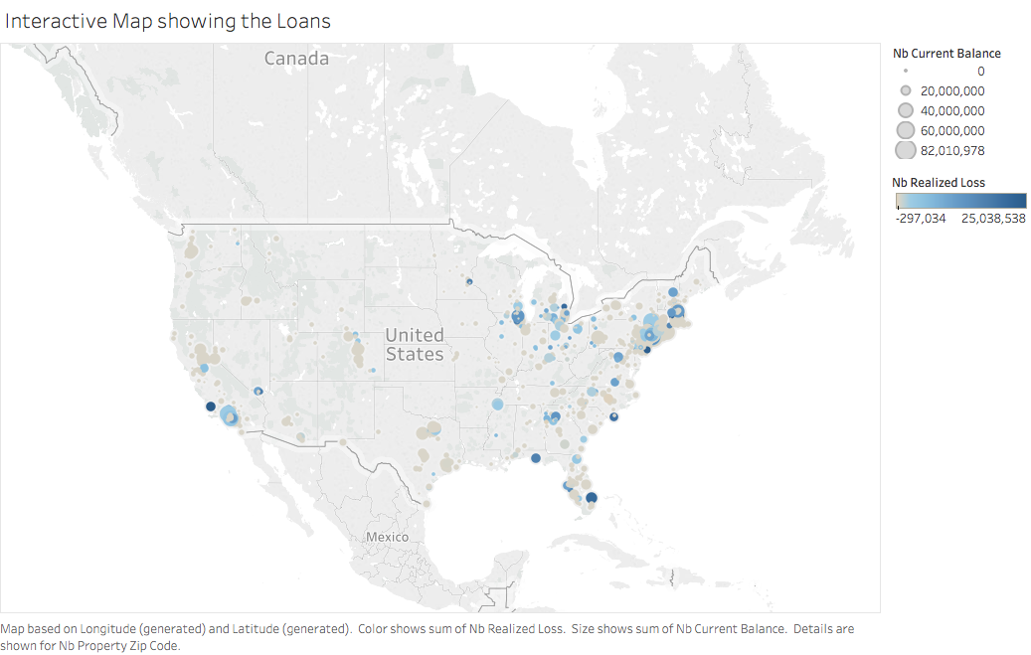

Slide 5
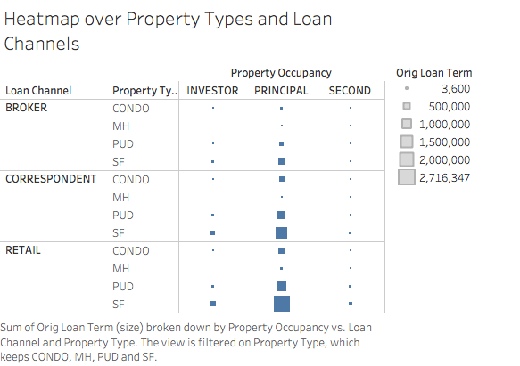

Slide 6
