Slide 1
PyOpal Graphical User Interface
Erin Wright
Rutherford Appleton Laboratory, Harwell
University of Manchester
13/08/2024

Slide 2
Overview
Interface functionality
Code structure
Flow diagrams
Data structures
Key methods / functions
Documentation
Limitations
Potential future additions

Slide 3
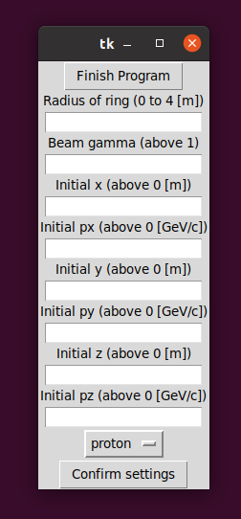
Interface Functionality
Present throughout. Closes windows and ends program
Initial setup for ring size and beam/distribution
Validates options

Slide 4
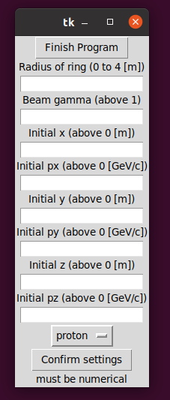
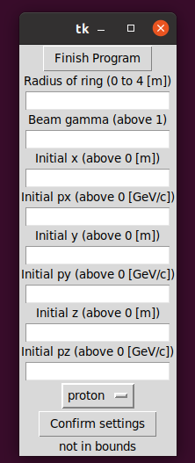
Validation
Input menu cleared for new inputs
Error message shown at bottom of screen

Slide 5
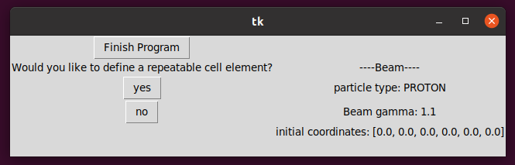
Option to define a repeatable cell
Selected beam settings shown here

Slide 6
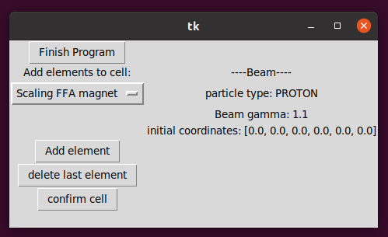
Making a cell element
Drop-down menu for adding elements. Also contains drift space, general multipole, and RF cavity
Adds element in drop-down menu. Takes to settings screen
Saves cell and moves onto ring building
Element list shown here
Removes last element added

Slide 7
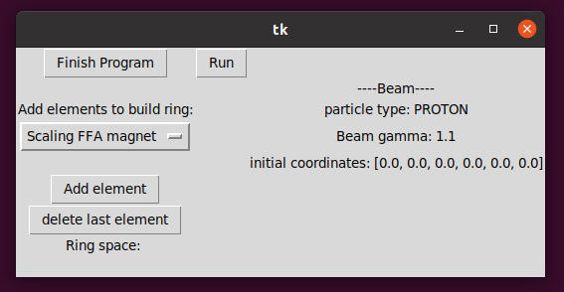
Building the ring
Runs OPAL simulation
Same as before, but contains cell if defined
As before
Element list shown here
Displays space left in the ring [m]

Slide 8
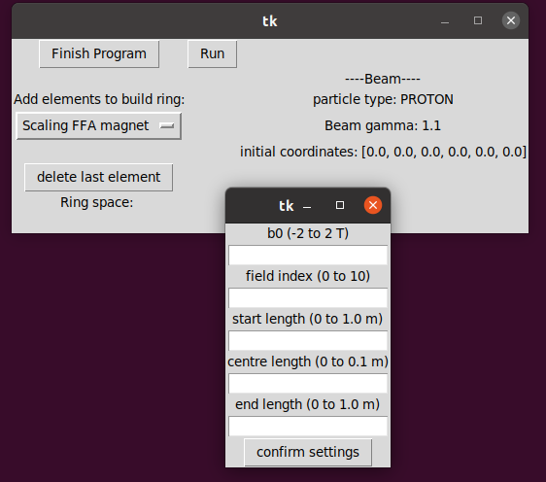
Adding elements
Options window opens and grabs focus
Lets user input the settings required for that element
Validates inputs

Slide 9
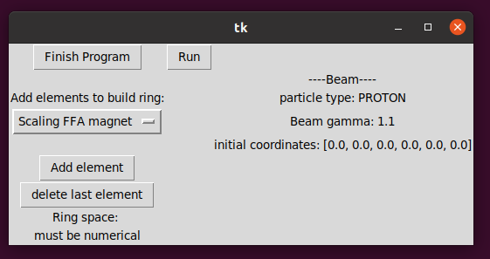
Validation
Error message shown here, and addition cancelled

Slide 10
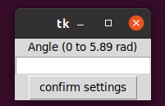
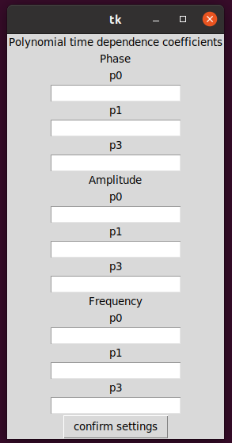
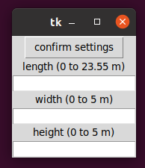
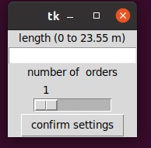
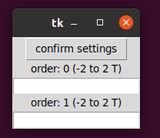
Options windows
RF cavity
Drift space
Multipole

Slide 11
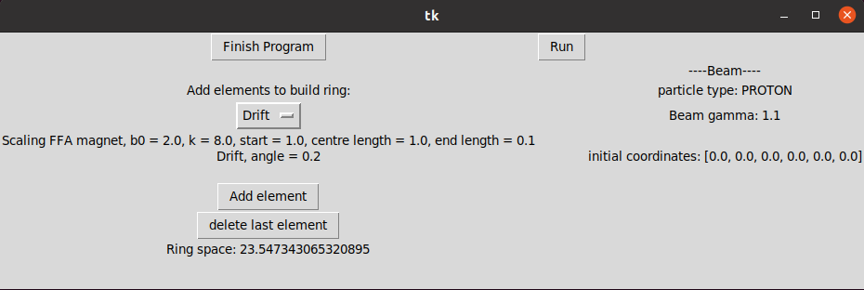
Adding elements
Runs OPAL
Deleting removes the last element in the list (disappears from view)
Elements and settings shown in a list here

Slide 12
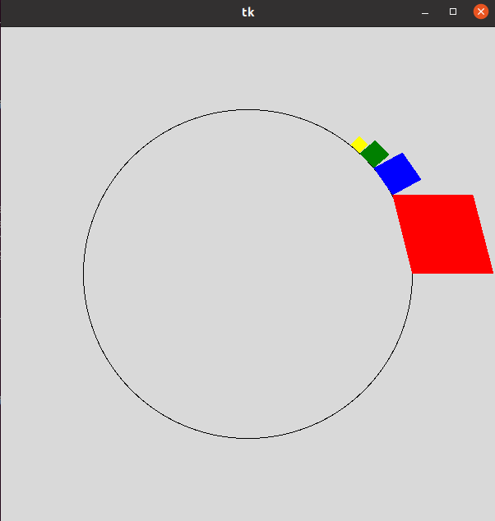
Running OPAL
Main window changes.
New window opens displaying representation of elements in the ring (uses OPAL start and end positions).
All elements shown as squares.
Colour coded:
-red = scaling FFA magnet
-blue = drift space
-green = multipole
-yellow = RF cavity

Slide 13
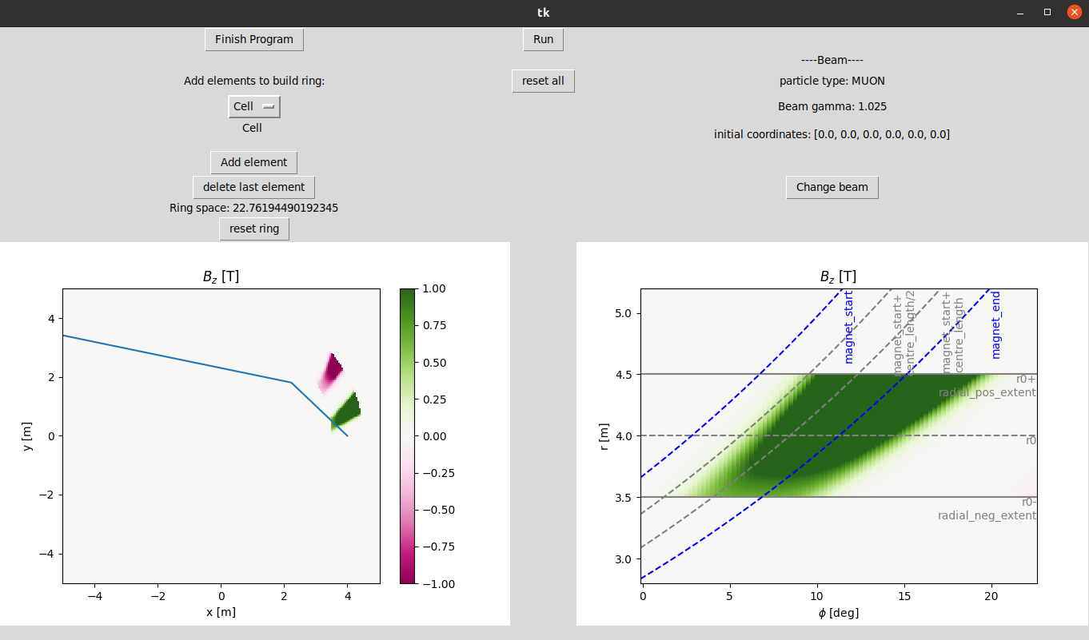
3
2
4
1

Slide 14
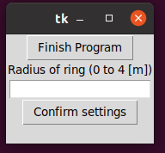
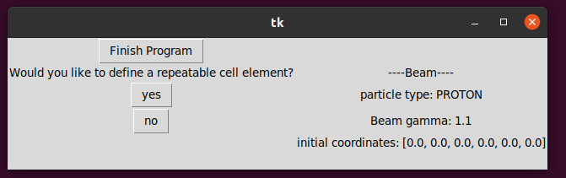
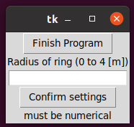
Reset ring
Choose radius of ring
Proceed with cell and/or ring building as before
Validated as before

Slide 15
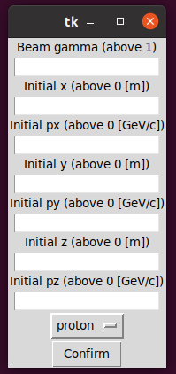
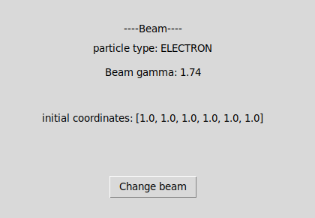
Reset beam
Choose beam settings as before
Ring left unchanged
Beam display updated

Slide 16
Code structure - files
4 main files:
GUI_prototype_10.py: Main bulk of code. Contains GUI class and main()
GUI_runner.py: OPAL runner class
Opt_window.py: options window class
GUI_dicts.py: makes variable dictionaries and defines constant ones

Slide 17
Code structure – classes and functions
GUI_runner
GUI_prototype_10
Runner
Inherits from Minimal Runner
Controls running of OPAL
Circle
GUI
Draws a circle in ring display window
Radius set by user
Creates main window and widgets
Creates ring display window
Contains the runner as attribute
Controls flow of interface
opt_window
Also contains functions for validation and finding angle around ring
Options window
Main() function
New window
Creates widgets for inputting settings via dictionaries
Circle

Slide 18
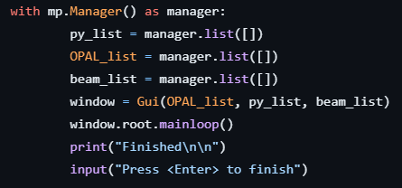
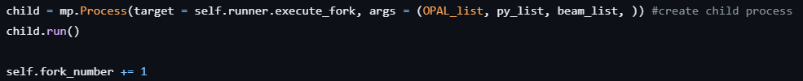
Multiprocessing
Inbuilt multiprocessing package is used.
OPAL is run as a separate process from the interface.
A manager is used so there is a shared memory space between all processes.
Data can then be passed between OPAL and the interface.

Slide 19
Shared memory space
3 lists in shared memory: py_list, OPAL_list, beam_list
py_list
OPAL_list
beam_list
Built up in python, used by OPAL
contains information on elements added and settings selected
Used by OPAL to fill line object with the correct element objects
[ [ { "element_type": class name}, settings], ....]
Built up in OPAL, used by python
contains the name, start and end position of each element OPAL adds to line object
Used by python to make ring display
[ [name, start, end], ....]
Built up in python, used by OPAL
contains beam and distribution settings
Used by OPAL to make the Beam and Distribution objects
[particle, gamma, [coords] ]

Slide 20
GUI class flow diagram
Instantiated by main()
Shared Memory
Py_list
OPAL_list
Beam_list
Initial settings
beam_list
Validation
Make runner
py_list
Make cell?
y
n
Build cell
Build ring
Run OPAL
draw OPAL
OPAL_list
Reset all
Reset beam
Reset cell
Update plots
Add to ring

Slide 21
Runner class flow diagram
Instantiated by GUI
fork
i > py_list length?
Shared Memory
Py_list
OPAL_list
Beam_list
beam_list
Make distribution
beam_list
Make element
Make beam
Set attributes
py_list
Make line
Add to py_list
Execute track_run
y
i += 1
i > element number?
y
Make plots
n
OPAL_list
Get name, start and end positions and add to OPAL_list
i += 1

Slide 22
Data structures
Dictionaries used in several parts of the code. The majority are defined in GUI_dicts.py
BEAM_SETUP
List of dictionaries
Each dictionary contains a widget type, and a dictionary of arguments
If it is an input widget, the bounds are also contained
Used when choosing beam settings
Iterated through to determine widget class and instantiate an object with the arguments given
Structure: [ {"widget" : class name, "options" : {args}, "bounds" : [lower, upper] }, ... ]
BEAM_DISPLAY
List of dictionaries
Each dictionary contains a widget type, and a dictionary of arguments
Used when displaying beam settings
Iterated through to determine widget class and instantiate an object with the arguments given
Structure: [ {"widget" : class name, "options" : {args}, ... ]

Slide 23
BOUNDS_DICT
Dictionary
Contains an OPAL element class name as key, and a list of bounds (one for each setting) as value
Used during validation
Structure: {"class name" : [ [lower, upper], …], … }
ALL_OPTIONS
Dictionary of lists (of dictionaries...)
Dictionary is an element class name as the key, and a list of widget dictionaries as the value
Each widget dictionary has the same structure as in BEAM_SETUP but without bounds for input widgets
Used when displaying options for an added element
Iterated through to determine widget class and instantiate an object with the arguments given
{ "OPAL class name" : [ {"widget" : widget class name, "options" : {args} },... ], ... }
COLOURS
Dictionary
Contains an OPAL element class name as key, and the name of its colour in the ring display as the value
Used by python when drawing the ring
Structure: {"class name" : colour, … }

Slide 24
Dictionaries defined in GUI
settings
Dictionary
Contains the settings the user selected for the added element (validated)
Structure: {“arg name” : chosen value, … }
add
List of dictionaries
Data to be appended to py_list

Slide 25
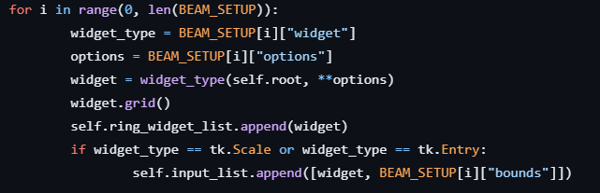
Key functions – displaying widgets with dictionaries
i > length of BEAM_DISPLAY?
y
Exit loop
n
Set widget variable to BEAM_SETUP[i]["widget"]
Set args to BEAM_SETUP[i][“options"]
i += 1
Instantiate object of widget with **args and display
y
Add to input_list
Input widget?
n
Add to widget_list

Slide 26
Key functions – choosing element settings
Options window called by GUI
Correct widget list chosen from ALL_OPTIONS
Display widgets in options window as in previous slide
GUI adds confirm button
Confirm pressed
y
n
Add element with settings as arguments
i > length of input_list?
Any invalid inputs?
n
y
Get input from widget i
Error message
i += 1
valid?
n
y
Cancel addition
flag
Add to settings_list

Slide 27
Flags
Flags used to make functions adaptable:
invalid_flag: indicates that one or more input is non-numerical, or outside the bounds
keep_window: tells initial setup function if the window is being restarted, or if the window is being kept
If kept, all previous widgets must be deleted
ring_flag: tells initial setup function if it is just the ring that is being reset (if True) or both the ring AND the beam (if False)
full: True if ring is full, False otherwise. Tells add_element method if element is allowed
cell_made: True if user defined a cell element. Determines if “cell” included in element menu
making_cell: True if cell currently being made. If so, elements are added to the cell attribute instead of py_list

Slide 28
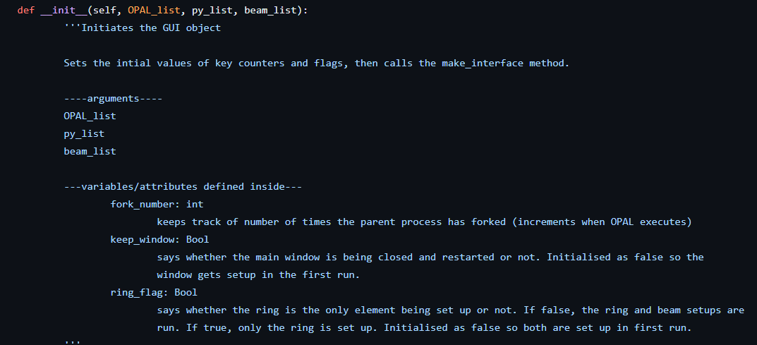
Documentation
Docstrings are written below the definition of each method / function:
Brief description
More detailed description
Arguments
Returns
Variables / attributes used and defined within the function
One-line comments in code to make more readable

Slide 29
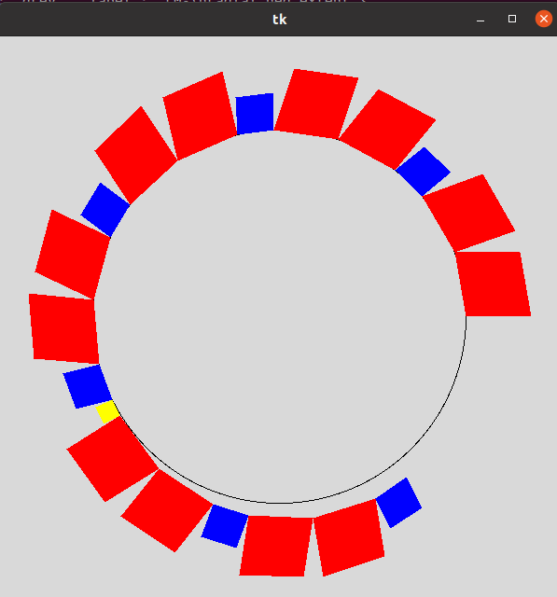
Limitations
RF cavities cause ring to deviate from perfect circle, so ring space doesn’t always work.
If elements are too big, problems occur when finding the angle around the ring.
Element settings can’t be changed one selected.
Elements can only be deleted in order.
Only one cell can be defined.
Problems if user closes an options window without selecting options
Definitely some code that isn’t as efficient as it could be – potential for refactoring

Slide 30
Future Additions
Make time dependence model an option (could be added to RF options functions).
Let user select the fringe field model (could be added to options window as general function).
Once implemented in pyOpal, more beam and distribution options should be added.
Allow multiple cells and super-periods to be defined. Button for making cell would always be present and not occur in main sequence.
Fix problem with large elements – maybe by limiting the upper bound, or changing function for finding angle.
Cylindrical field map might not be needed – show ring display here instead?
Code needs refactoring to see if existing functions could be reused to avoid repetition and make more readable (I could do this over next few days).
Make documentation into a page like the one used for OPAL.

Slide 31
Thank you!

