Slide 1
Script Character Emotion Recognition
CS 584 Team 39 Presentation
Biao Sun A20475197
Jianhua Tu A20480216
Ye Yu A20478640

Slide 2
Abstract
This task is to analyze and identify the emotions of each character involved in every dialogue and action description in the script scenes from multiple dimensions. Comparing with traditional sentimental classification task, there are more changes in this task. Emotions are multidimensional, and each emotion has a degree. For example, the degree of happiness ranges from 0 to 5, with 0 being none and 5 being the strongest. A sentence may have a variety of emotions, such as joy, surprise. Emotion classification is for a certain role in a sentence, rather than the whole sentence. A sentence may have multiple roles with different emotions. Considering the property of the task, we tried a few networks which different from what the multi-classifier does.

Slide 3
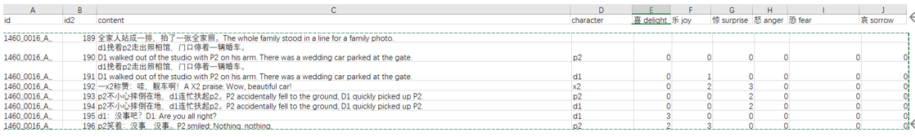
Data
The above table is an example: The table content contains the script of a movie. The character column contains the specified character, that is mentioned in the script. The last 6 columns are the labels, which is in the training data but missing in the test data. The task is to identify the given character’s six emotions: love, happiness, surprise, anger, fear, and sorrow, and numerically rank them according to the script. A sentence has multiple characters, such as p2, d1 and x2, and for each character, the type and degree of emotion needs to be identified. In the sample, there is one line: A X2 Praise: “Wow, beautiful car!", which contains two emotions: "joy" and "surprise", and they are in degree 2 and 3, respectively.

Slide 4
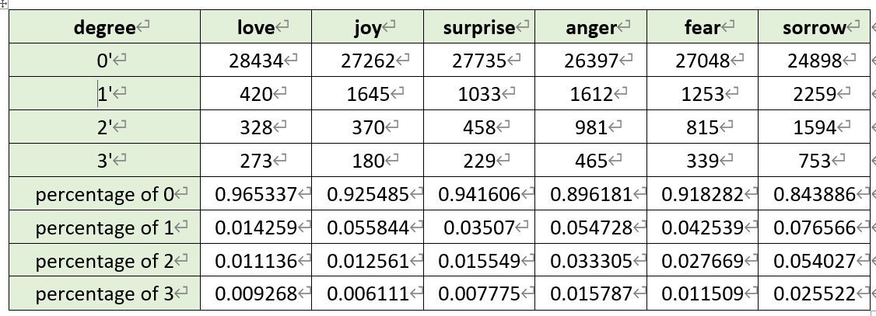
A total of 42896 labeled data were randomly shuffled and divided into training set and validation set in a ratio of 8:2. We have counted the label distribution on the training set, and it is obvious from the data distribution that emotion value 0 accounts for the vast majority. The higher the emotional value, the smaller the proportion.

Slide 6

evaluation indicators
The score of the algorithm in this competition is calculated by the common root mean square error (RMSE), and the emotion values corresponding to the six emotions identified by "text content + character name" are counted:
Where yi,j is the predicted emotion value, xi,j are the marked emotion value, and n is the total number of test samples. The final ranking is based on score.

Slide 7
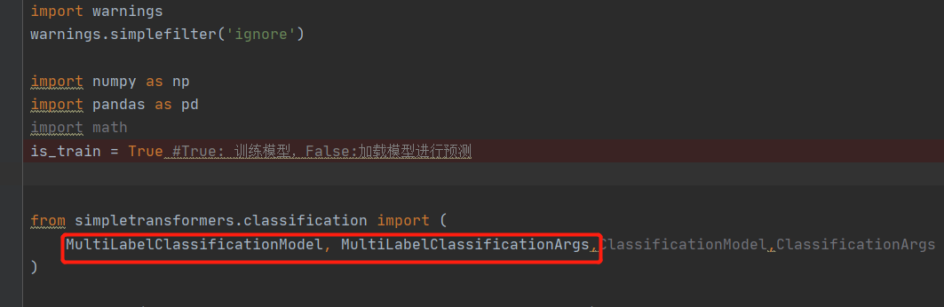
Baseline model’s shotcommings
Baseline model simplifys the multi-label multi-classification problem as a multi-label binary classification problem. It only gives 0 or 1 for an emotion, and ignores intensity degree of it

Slide 8
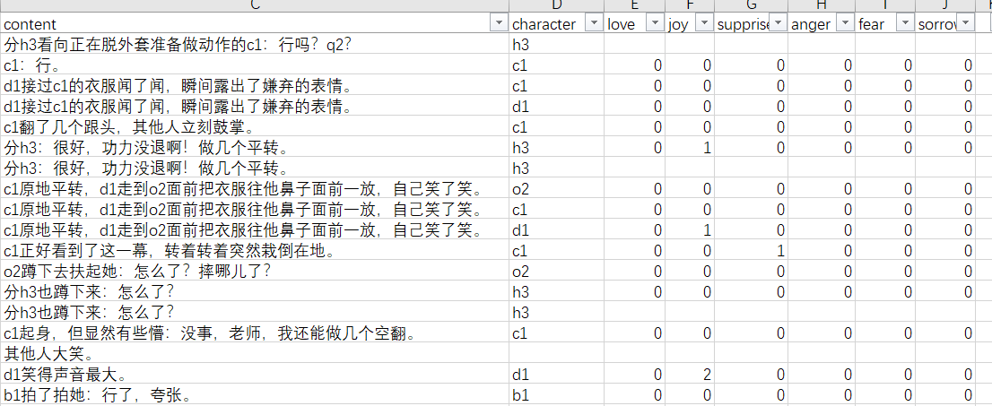
Baseline model’s shotcommings （1）

Slide 9
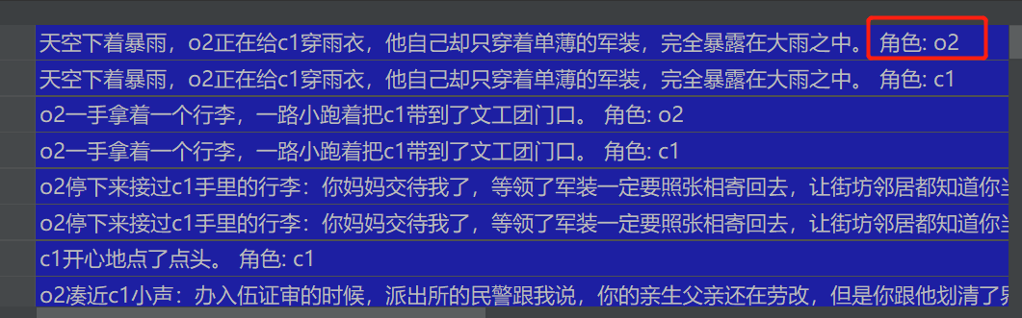
Baseline model’s shotcommings （2）
Baseline model simply merge the character into script text, while the character is the key role to the prediction.

Slide 10
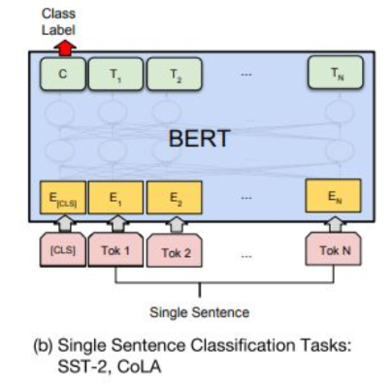
Baseline model’s shotcommings （2）
Baseline model simply merge the character into script text as a single sentence, and make classification for the sentence.
But actually character is key to the prediction.

Slide 11
Baseline model’s shotcommings （3）
Baseline model doesn’t use the context, it input only one sentence and predict the emotion
Sometimes the historic sentences helps to predict the emotion.

