Slide 1
Script Character Emotion Recognition
CS 584 Team 39 Presentation
Biao Sun A20475197
Jianhua Tu A20480216
Ye Yu A20478640

Slide 2
Background (Ye Yu A20478640)
This is a competition task, the preliminary contest is from Sep. to 22nd Nov.
To analyze and identify the emotions of each character involved in every dialogue and action description in the script scenes from multiple dimensions.
Comparing with traditional sentimental classification task, this task has its own characteristics and challenges.
Emotions are multidimensional, love, joy, anger, surprise, fear, sorrow; each type of emotion has a degree, the degree ranges from 0 to 3, with 0 being none, 3 being the strongest.
Emotion classification is for a certain role in a sentence, rather than the whole sentence.
A sentence may have multiple roles.
Considering the property of the task, we tried a few different methods.

Slide 3
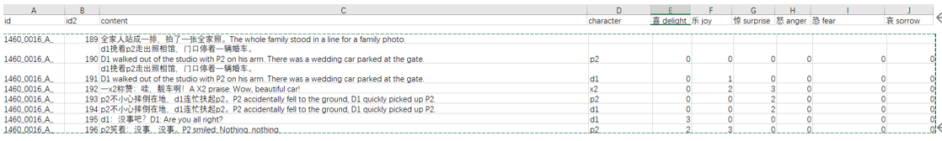
Data Analysis
The above table is an example: The table content contains the script of a movie.
The character column contains the specified character, that is mentioned in the script.
Last 6 columns: the labels, in the training data but missing in the test data.
The task is to identify the given character’s six emotions: love, happiness, surprise, anger, fear, and sorrow, and numerically rank them according to the script.
A sentence has multiple characters, such as p2, d1 and x2, and for each character, the type and degree of emotion needs to be identified.
In the sample, there is one line: An x2 Praise: “Wow, beautiful car!", which contains two emotions: "joy" and "surprise", and they are in degree 2 and 3, respectively.

Slide 4
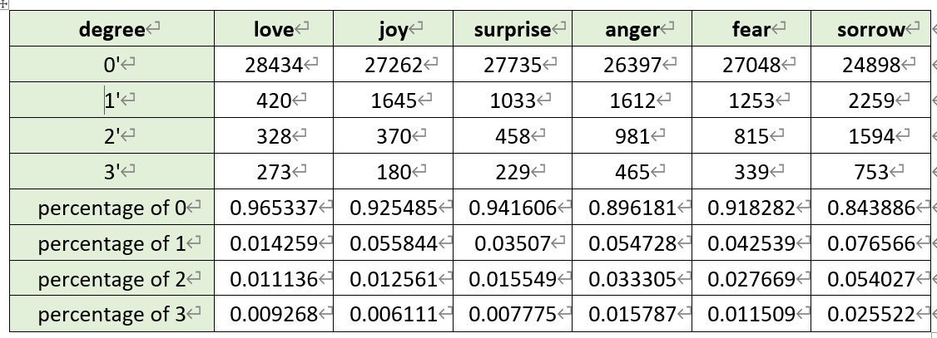
A total of 42896 labeled data were randomly shuffled and divided into training set and validation set in a ratio of 8:2.
We have counted the label distribution on the training set, and it is obvious from the data distribution that emotion value 0 accounts for the vast majority.
The higher the emotional value, the smaller the proportion.

Slide 6

evaluation indicators
The score of the algorithm in this competition is calculated by the common root mean square error (RMSE), and the emotion values corresponding to the six emotions identified by "text content + character name" are counted:
Where yi,j is the predicted emotion value, xi,j are the marked emotion value, and n is the total number of test samples.
The final ranking is based on the score.

Slide 7
Baseline model
Biao Sun A20475197

Slide 8
Baseline model-summary
Network framework: Simple Transformer
Because the number of two categories is small, we simplify the four categories into two categories, which is also one of the conditions for using simple transformer.
Classification Type: Multi-label Binary Clissification
We merge the character name and the dialogue into a sentence, so we turn the character's emotion recognition into a text classification problem.
Because there are many kinds of emotions to be recognized, it is a multi-label classification problem.

Slide 9
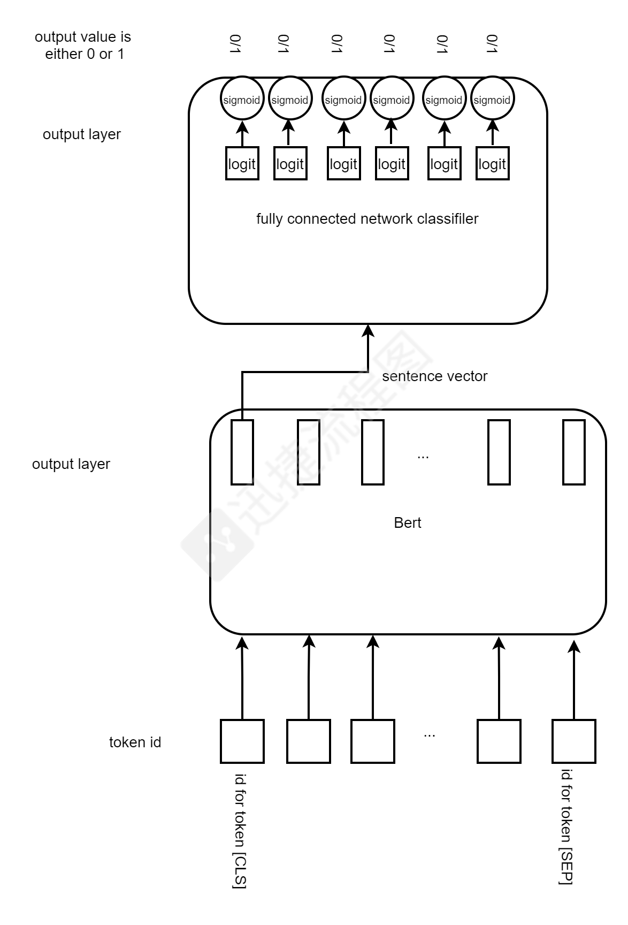
Baseline model STRUCTURE
Network structure
Input: batch sentences
Vectorization: Convert sentences to vectors
with BERT
Classification: Use Full Connect Network classifier
to classify sentence vectors
Output: Use the sigmoid activation function to
output the probability

Slide 10
Baseline model-preprocessing
Vectorization
To convert the text into a vector, we use the currently popular and effective bert-base vector
a) Length alignment: Take out the text in a batch of 8, and after calculating the maximum text length, padding the text to this length, so that the text is processed into a sequence of the same length.
b) Text to vector: The character sequence of the sample is sent to the bert model, and the vector is taken from the first unit of the last layer of the bert model as the vector of the entire sentence.

Slide 11
Baseline model-classification
Classification
a) Fully connected layer: The sentence vector is sent to the fully connected network for classification. Since it has 6 labels, it passes through 6 neurons and outputs 6 logit.
b) Activation layer: This multi-label classification task uses the sigmoid activation function to convert each logit into a probability. This is different from the multi-classification task. Multi-classification uses 6 logit as softmax
C) Output prediction tags: The probability of sigmoid output is converted to 1 if it is greater than 0.5, and it is converted to 0 if it is less than or equal to 0.5.

Slide 12
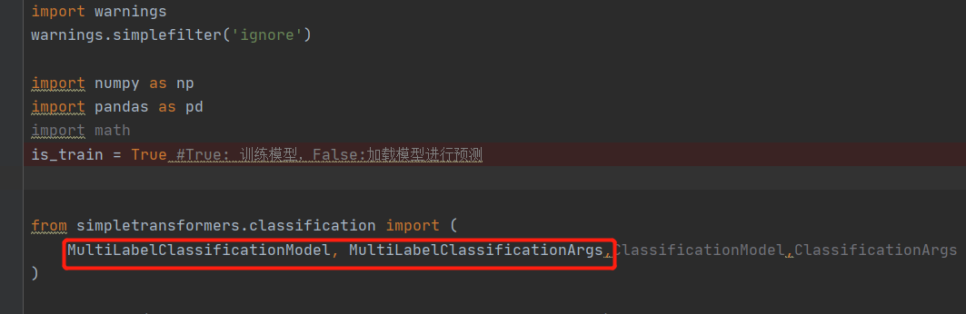
Baseline model’s shoRtcomings & improvment by Jianhua Tu
We use existing python package simpletransformers to build the baseline models quickly
But it has shortcomings or limitations

Slide 13
Improved models
We rebuilt the network with Pytorch which allows us freely define the structure and loss functions
We built 3 versions with suitable network structure and overcome the shortcomings step by step

Slide 14
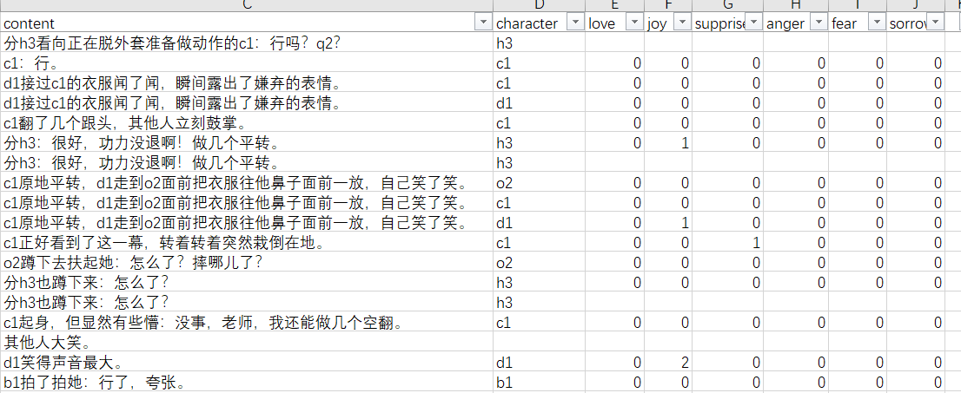
Baseline model’s shortcomings（1）
Baseline model simplifies the multi-label multi-classification problem as a multi-label binary classification problem. It only gives 0 or 1 for an emotion, but the emotion value could be 2 or 3

Slide 15
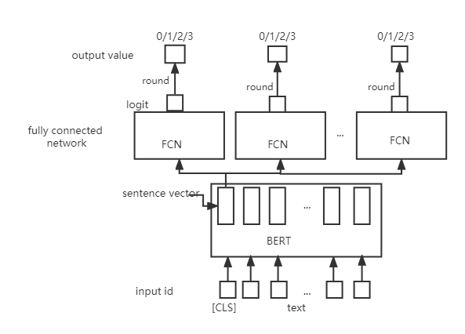
Improved model(1)
6 output blocks corresponding to 6 emotions
Regard it as regression problem instead of multi-classification problem, because the target is a numeric value 0,1,2,3,different from cat/dog classification whose value can not be comparable in size
Use MSE loss function instead of cross entropy loss
Total loss is the summation of all output blocks’ loss
Output one dimension logit of float type
Convert float number into integer by rounding

Slide 16
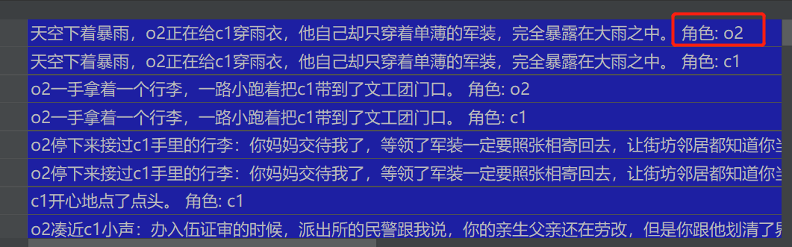
Baseline model’s shortcomings （2）
Baseline model simply merges the character into script text, forming a longer text.

Slide 17
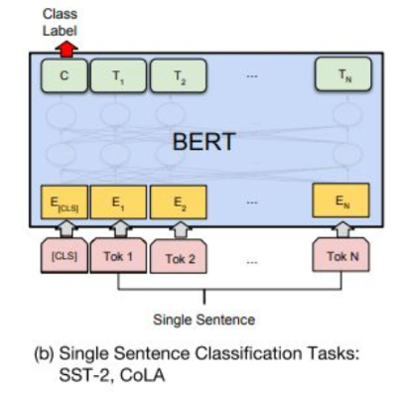
Baseline model’s shortcomings （2）
script text merged with the character is fed into the model as a single sentence.
But different characters might have different emotions, and it is the key information
By merging, the character is mixed up with other words in the text, the model might not be able to learn the importance of the character

Slide 18
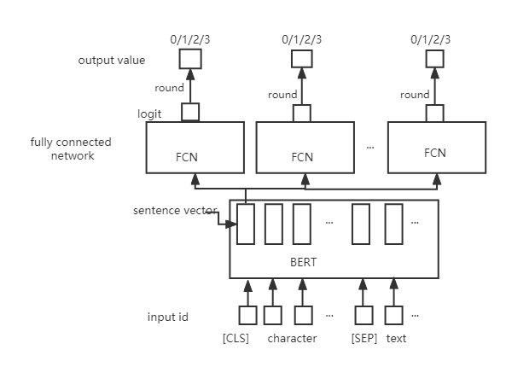
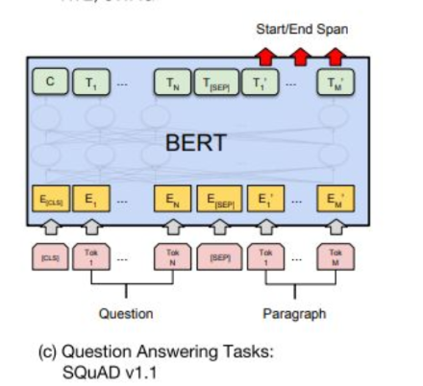
Improved model(2)
Separate character from script text
Referring to the QA task, Character is regarded as question, script text is regarded as paragraph
Attention mechanism in side the BERT

Slide 19
Baseline model’s shortcomings （3）
Baseline model doesn’t use the context, the input sentence is only the current one sentence
Sometimes the historic sentences help to predict the emotion.

Slide 20

Improved model(3)
Preprocess the data: make a script text list, remove duplicates and sort them by the sentence id
Find previous 2 texts by sentence id, and merge them into current text to generate a longer text
Use the same structure of the improved model 2

Slide 21
Results(RMSE score)
 | Validation dataset | Test dataset
Baseline model | 0.6787 | 0.6814
Improved model (1) | 0.6837 | 0.6816
Improved model (2) | 0.6860 | 0.6842
Improved model (3) | 0.6907 | 0.6864

Slide 22

Results(place in the competition)
Won the place 212
Defeat 350 teams

Slide 23
Thank you

