Slide 1
Baseline model
Biao Sun A20475197

Slide 2
Baseline model-summary
Network framework: Simple Transformer
Because the number of two categories is small, we simplify the four categories into two categories, which is also one of the conditions for using simple transformer.
Classification Type: Multi-label Binary Clissification
We merge the character name and the dialogue into a sentence, so we turn the character's emotion recognition into a text classification problem.
Because there are many kinds of emotions to be recognized, it is a multi-label classification problem.

Slide 3
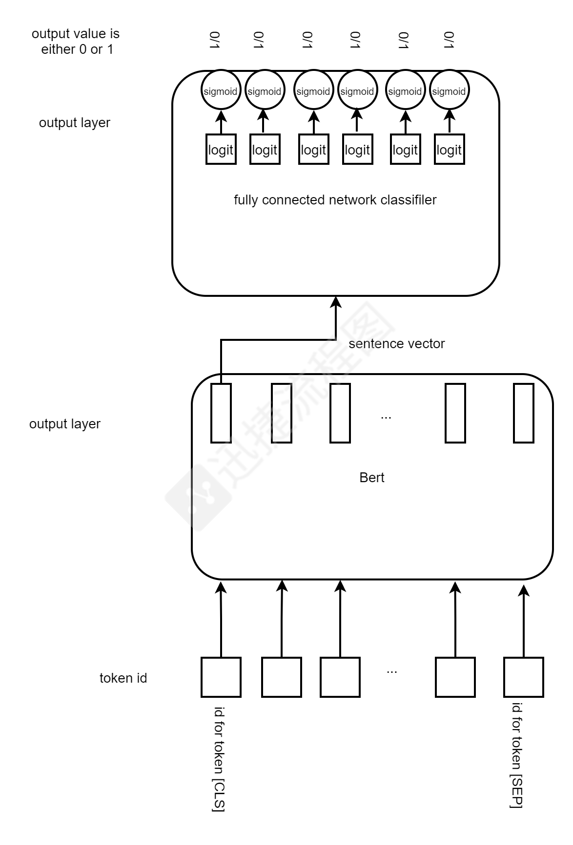
Baseline model STRUCTURE
Network structure
Input: batch sentences
Vectorization: Convert sentences to vectors
with BERT
Classification: Use Full Connect Network classifier
to classify sentence vectors
Output: Use the sigmoid activation function to
output the probability

Slide 4
Baseline model-preprocessing
Vectorization
To convert the text into a vector, we use the currently popular and effective bert-base vector
a) Length alignment: Take out the text in a batch of 8, and after calculating the maximum text length, padding the text to this length, so that the text is processed into a sequence of the same length.
b) Text to vector: The character sequence of the sample is sent to the bert model, and the vector is taken from the first unit of the last layer of the bert model as the vector of the entire sentence.

Slide 5
Baseline model-classification
Classification
a) Fully connected layer: The sentence vector is sent to the fully connected network for classification. Since it has 6 labels, it passes through 6 neurons and outputs 6 logit.
b) Activation layer: This multi-label classification task uses the sigmoid activation function to convert each logit into a probability. This is different from the multi-classification task. Multi-classification uses 6 logit as softmax
C) Output prediction tags: The probability of sigmoid output is converted to 1 if it is greater than 0.5, and it is converted to 0 if it is less than or equal to 0.5.

