Slide 1
Script Character Emotion Recognition
CS 584 Team 39 Presentation
Biao Sun A20475197
Jianhua Tu A20480216
Ye Yu A20478640

Slide 2
Abstract
This task is to analyze and identify the emotions of each character involved in every dialogue and action description in the script scenes from multiple dimensions. Comparing with traditional sentimental classification task, there are more changes in this task. Emotions are multidimensional, and each emotion has a degree. For example, the degree of happiness ranges from 0 to 5, with 0 being none and 5 being the strongest. A sentence may have a variety of emotions, such as joy, surprise. Emotion classification is for a certain role in a sentence, rather than the whole sentence. A sentence may have multiple roles with different emotions. Considering the property of the task, we tried a few networks which different from what the multi-classifier does.

Slide 3
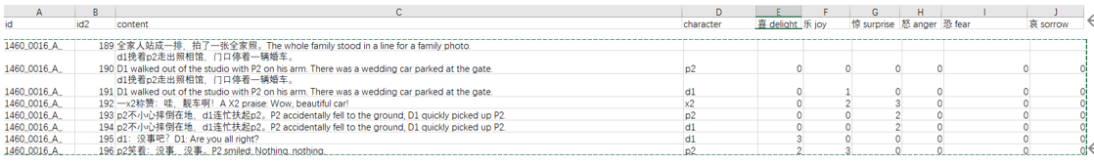
Data
The above table is an example: The table content contains the script of a movie. The character column contains the specified character, that is mentioned in the script. The last 6 columns are the labels, which is in the training data but missing in the test data. The task is to identify the given character’s six emotions: love, happiness, surprise, anger, fear, and sorrow, and numerically rank them according to the script. A sentence has multiple characters, such as p2, d1 and x2, and for each character, the type and degree of emotion needs to be identified. In the sample, there is one line: A X2 Praise: “Wow, beautiful car!", which contains two emotions: "joy" and "surprise", and they are in degree 2 and 3, respectively.

Slide 4
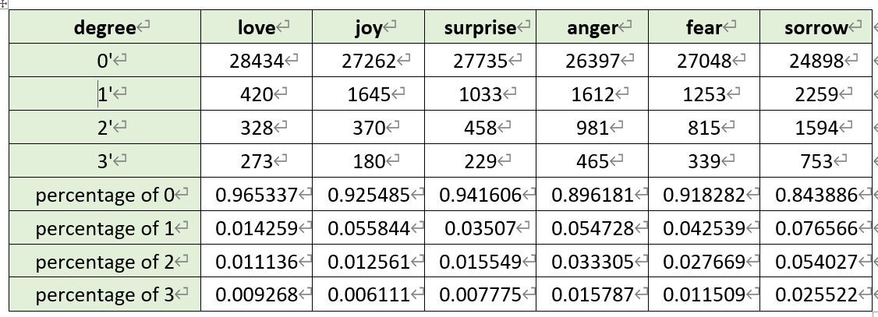
A total of 42896 labeled data were randomly shuffled and divided into training set and validation set in a ratio of 8:2. We have counted the label distribution on the training set, and it is obvious from the data distribution that emotion value 0 accounts for the vast majority. The higher the emotional value, the smaller the proportion.

Slide 6

evaluation indicators
The score of the algorithm in this competition is calculated by the common root mean square error (RMSE), and the emotion values corresponding to the six emotions identified by "text content + character name" are counted:
Where yi,j is the predicted emotion value, xi,j are the marked emotion value, and n is the total number of test samples. The final ranking is based on score.

Slide 7
Script Character Emotion Recognition
CS 584 Team 39 Presentation
Biao Sun A20475197
Jianhua Tu A20480216
Ye Yu A20478640

Slide 8
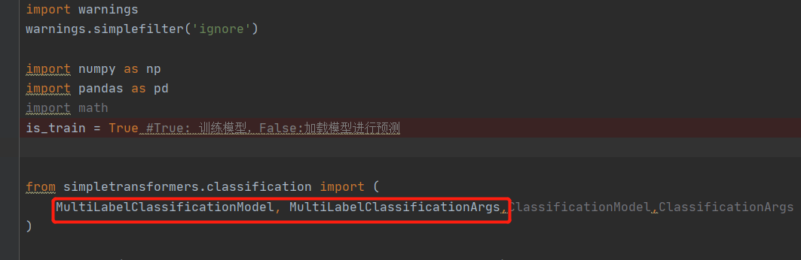
Baseline model’s shoRtcomings & improvment by Jianhua Tu
We use existing python package simpletransformers to build the baseline models quickly
But it has shortcomings or limitations

Slide 9
Improved models
We rebuilt the network with Pytorch which allows us freely define the structure and loss functions
We built 3 versions with suitable network structure and overcome the shortcomings step by step

Slide 10
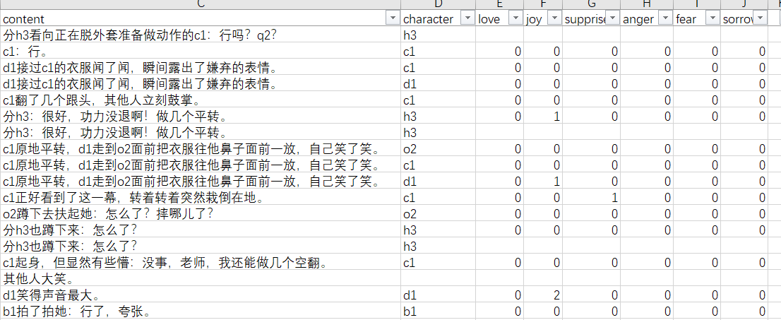
Baseline model’s shoRtcoming（1）
Baseline model simplifys the multi-label multi-classification problem as a multi-label binary classification problem. It only gives 0 or 1 for an emotion, but the emotion value could be 2 or 3

Slide 11
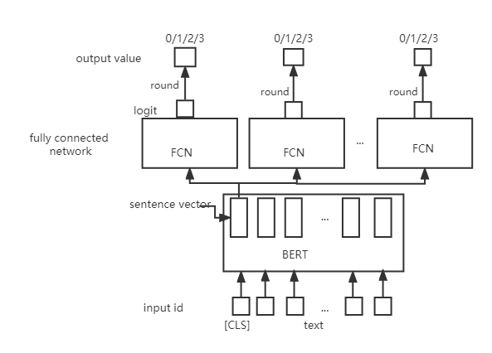
Improved model(1)
6 output blocks corresponding to 6 emotions
Regard it as regression problem instead of multi-classification problem, because the target is a numeric value 0,1,2,3,different from cat/dog classification whose value can not be comparable in size
Use MSE loss function instead of cross entropy loss
Total loss is the summation of all output blocks’ loss
Output one dimension logit of float type
Convert float number into integer by rounding

Slide 12
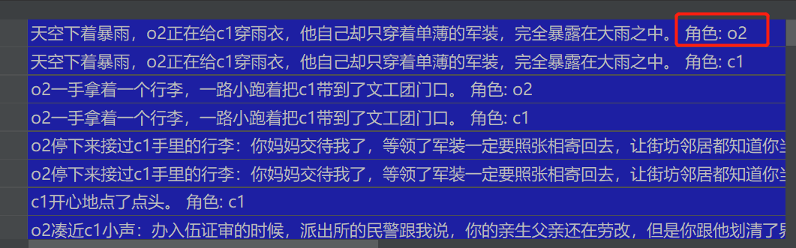
Baseline model’s shotcommings （2）
Baseline model simply merges the character into script text, forming a longer text.

Slide 13
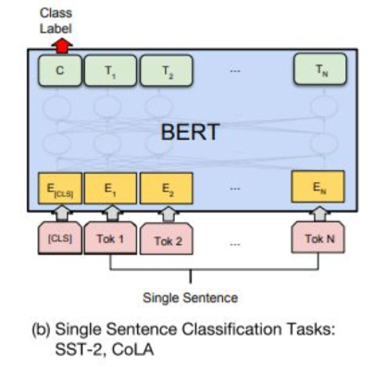
Baseline model’s shoRtcomings （2）
script text merged with the character is fed into the model as a single sentence.
But different characters might have different emotions, and it is the key information
By merging, the character is mixed up with other words in the text, the model might not be able to learn the importance of the character

Slide 14
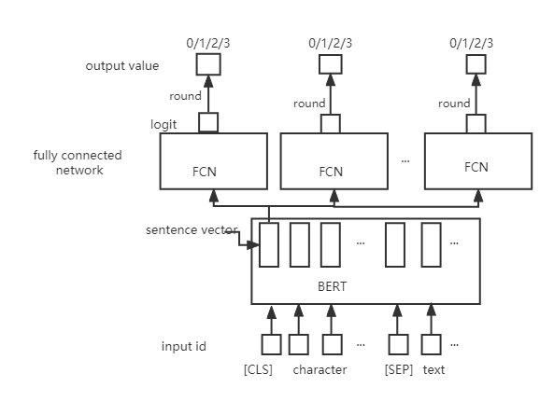
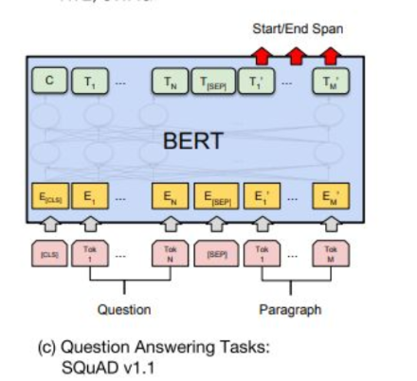
Improved model(2)
Separate character from script text
Referring to the QA task, Character is regarded as question, script text is regarded as paragraph
Attention mechanism in side the BERT

Slide 15
Baseline model’s shoRtcomings （3）
Baseline model doesn’t use the context, the input sentence is only the current one sentence
Sometimes the historic sentences help to predict the emotion.

Slide 16
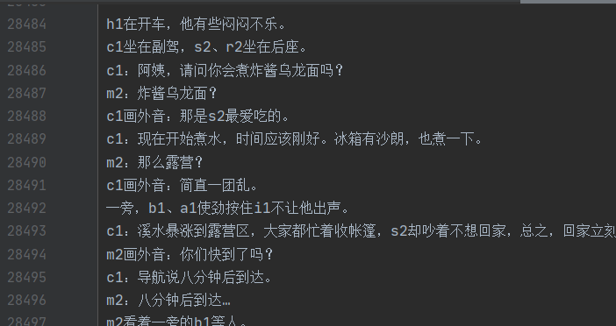
Improved model(3)
Preprocess the data:make a script text list, remove duplicates and sort them by the sentence id
Find previous 2 texts by sentence id, and merge them into current text to generate a longer text
Use the same structure of the improved model 2

Slide 17
Results(RMSE score)
 | Validation dataset | Test dataset
Baseline mode | 0.6787 | 0.6814
Improved mode (1) | 0.6837 | 0.6816
Improved mode (2) | 0.6860 | 0.6842
Improved mode (3) | 0.6907 | 0.6864

Slide 18

Results(place in the competition)
Won the place 212
Beated 350 teams

