Slide 1
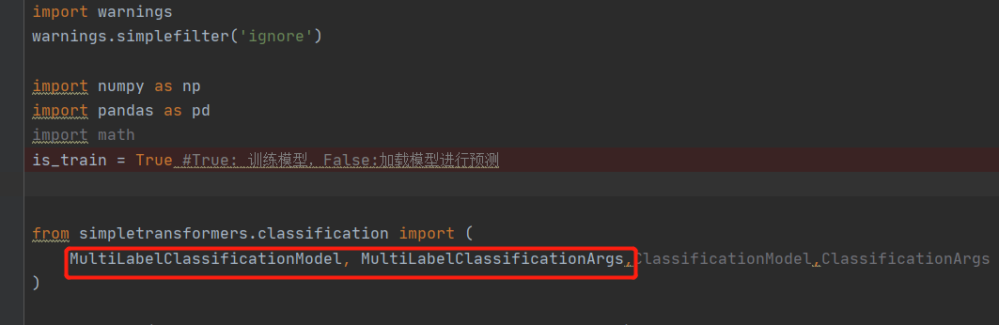
Baseline model’s shoRtcomings & improvment by Jianhua Tu
We use existing python package simpletransformers to build the baseline models quickly
But it has shortcomings or limitations

Slide 2
Improved models
We rebuilt the network with Pytorch which allows us freely define the structure and loss functions
We built 3 versions with suitable network structure and overcome the shortcomings step by step

Slide 3
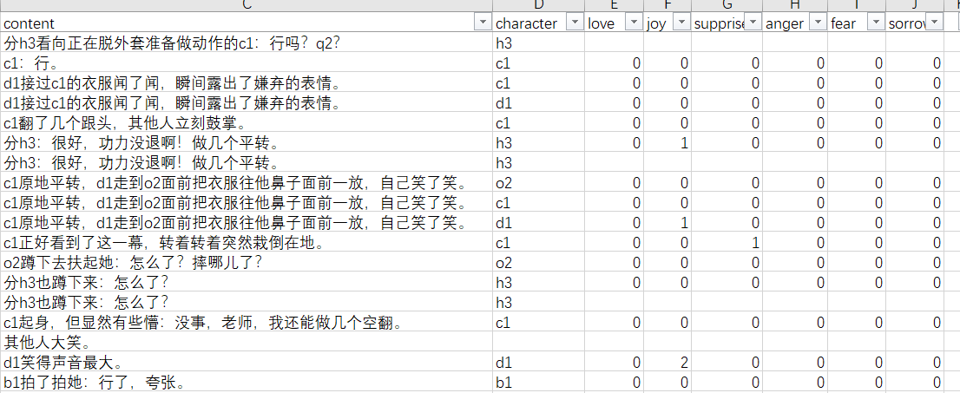
Baseline model’s shoRtcoming（1）
Baseline model simplifys the multi-label multi-classification problem as a multi-label binary classification problem. It only gives 0 or 1 for an emotion, but the emotion value could be 2 or 3

Slide 4
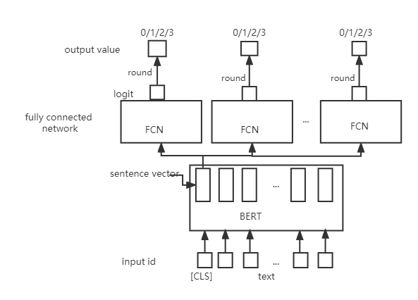
Improved model(1)
6 output blocks corresponding to 6 emotions
Regard it as regression problem instead of multi-classification problem, because the target is a numeric value 0,1,2,3,different from cat/dog classification whose value can not be comparable in size
Use MSE loss function instead of cross entropy loss
Total loss is the summation of all output blocks’ loss
Output one dimension logit of float type
Convert float number into integer by rounding

Slide 5
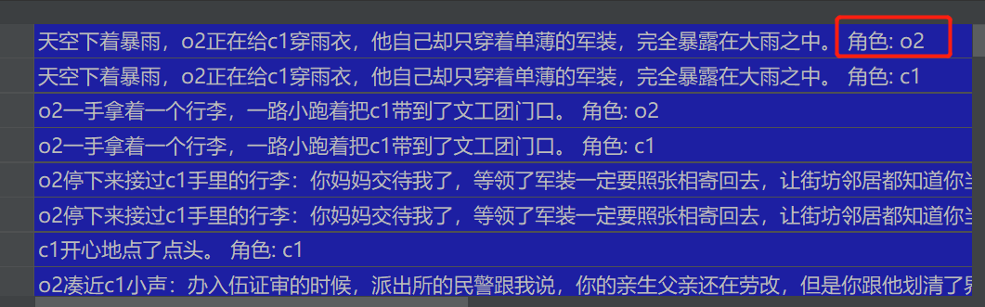
Baseline model’s shotcommings （2）
Baseline model simply merges the character into script text, forming a longer text.

Slide 6
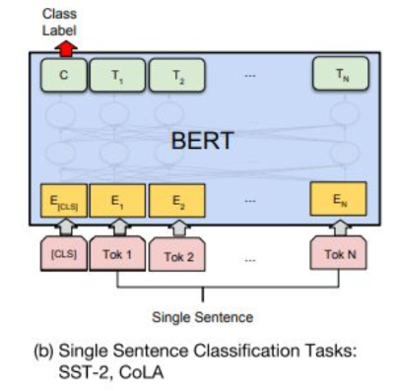
Baseline model’s shoRtcomings （2）
script text merged with the character is fed into the model as a single sentence.
But different characters might have different emotions, and it is the key information
By merging, the character is mixed up with other words in the text, the model might not be able to learn the importance of the character

Slide 7
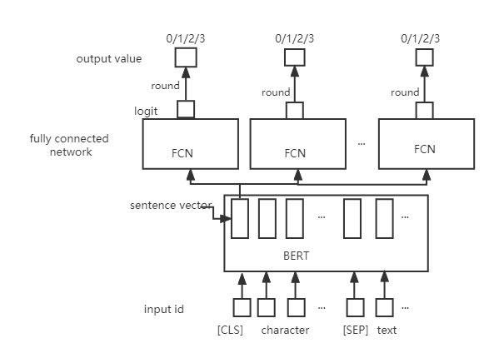
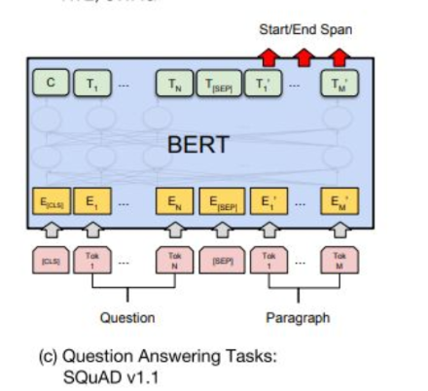
Improved model(2)
Separate character from script text
Referring to the QA task, Character is regarded as question, script text is regarded as paragraph
Attention mechanism in side the BERT

Slide 8
Baseline model’s shoRtcomings （3）
Baseline model doesn’t use the context, the input sentence is only the current one sentence
Sometimes the historic sentences help to predict the emotion.

Slide 9
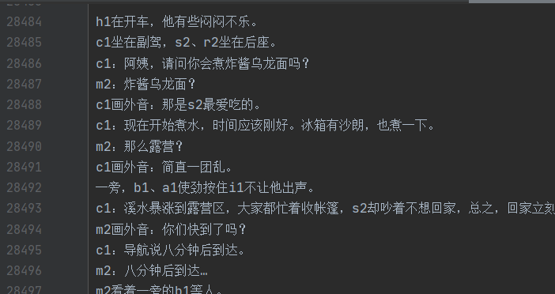
Improved model(3)
Preprocess the data:make a script text list, remove duplicates and sort them by the sentence id
Find previous 2 texts by sentence id, and merge them into current text to generate a longer text
Use the same structure of the improved model 2

Slide 10
Results(RMSE score)
 | Validation dataset | Test dataset
Baseline model | 0.6787 | 0.6814
Improved model (1) | 0.6837 | 0.6816
Improved model (2) | 0.6860 | 0.6842
Improved model (3) | 0.6907 | 0.6864

Slide 11

Results(place in the competition)
Won the place 212
Beated 350 teams

Slide 12
Thank you

