Slide 1


SHORT - TERM PROJECT
GETTING STARTED WITH AMAZON S3 MULTI - REGION ACCESS POINT
Presented By:
Group-3:
22551A0570 – Surya
22551A05F1 – Erina
22551A05K1 –Shupta
22551A4618 - Vignesh
Under the guidance of: Mr.SIVA SANKAR RAMADEV

Slide 2
EXECUTIVE SUMMARY
INTRODUCTION :
We completed our project during course from 03-12-2024 to 13-12-2024. During this period, We gained valuable experience and knowledge about our project ( Getting started with amazon s3 multi region access point ), learning how to utilize Amazon s3 & multi region access point of AWS effectively and efficiently. This experience included developing real-time projects and models.
Project Organization: Techwing is a leading organization promoting AWS & REDHAT in medical for technical research. It fosters innovation and excellence by creating a collaborative environment among researchers, practitioners, and students.

Slide 3
Summary of Activities: Techwing promotes interdisciplinary research and collaboration at the intersection of AWS & REDHAT course. Key activities include organizing conferences, symposia, and workshops, offering training programs, and providing funding and mentorship for research projects. The society also develops ethical guidelines and best practices for AWS &REDHAT applications.
Conclusion: The project provided a great experience in using multi region access point using s3 efficiently. This experience significantly enhanced my understanding and application of Amazon s3 technologies.

Slide 4
PROCESS
1.Create amazon s3 buckets
2.CREATE s3 multi-region access point
3.Configure s3 replication & failover configuration
4.Iam permissions
5.Use your multi-region access point
6.Vpc endpoints
7.MoNitor s3 replication & requests
8.Clean up resources server

Slide 5
1. CREATE S3 BUCKET
In this project, we can use existing Amazon S3 buckets behind a new S3 Multi-Region Access Point. New S3 buckets are not required. However, we recommend that you create new S3 buckets to simplify replication of data and clean up.
PROCESS:
Sign in to the AWS Management console and open the Amazon S3 console.
In the Amazon S3 left-hand navigation, select Buckets. Then, select Create bucket.
Enter a descriptive DNS compliant name, taking note of the supported AWS Regions for Multi-Region Access Points. select the Region we want our bucket to be created in.
Select ACLs disabled, so that access to the bucket and its objects is specified using only bucket policies.

Slide 6
PROCESS:
For Block Public Access settings for this bucket, keep the default selection Block all public
access and select disable.
For Default encryption, select SSE-S3 as this will allow you to set up replication rules from within the Multi-Region Access point. For more information about how Amazon S3 uses AWS KMS, see the AWS Key Management Service Developer Guide.
Leave the default settings and select Create bucket.
To create at least one more S3 bucket to add to your S3 Multi-Region Access point. Each bucket must be in a different AWS Region. You can add one bucket per AWS Region in up to 17 separate AWS Regions to a single S3 Multi-Region Access Point.
After sometime s3 bucket showing created.

Slide 7
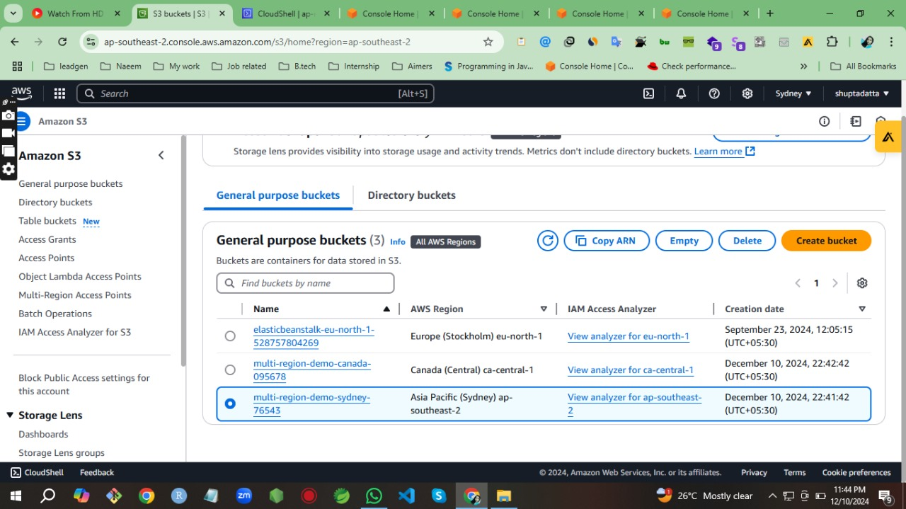
OUTPUT :

Slide 8
2. CREATE S3 MULTI-REGION ACCESS POINT
In this module, we will learn how to create an Amazon S3 Multi-Region Access Point. we will name our access point and add our previously created buckets.
Step-by-Step “S3 MULTI-REGION ACCESS POINT”
We will Create an S3 Multi-Region Access Point.
Name our access point and add buckets. Each access point needs a name, unique within each account. This name is only for administration, not data access.
Then Add our previously created buckets.
The recommended setting of Block all Public Access is enabled by default.
Select Create Multi-Region Access Point. Wait for its status to show as Ready before proceeding. Refresh the list to see the updated status.

Slide 9
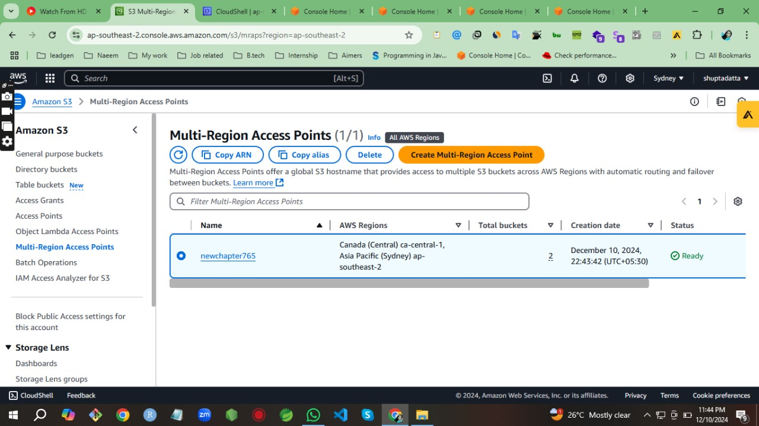
OUTPUT :

Slide 10
Configure S3 Replication AND Failover Configuration :
Select the name of your Multi-Region Access Point to configure additional settings and copy the ARN.
Select the Replication and failover tab. The Replication and failover overview (Replication) map shows the AWS Regions of the buckets that you added to the Multi-Region Access Point. The lack of arrows shows that S3 Cross-Region Replication has not yet been configured.
Choose Replication rules and select Create replication rules.
Choose the Replicate objects among all specified buckets template.
Select all the included buckets and choose Enable Bucket Versioning.
For Scope, choose Apply to all objects in the bucket.
Then, select Create replication rules.

Slide 11
Configure S3 Replication AND Failover Configuration :
Then, Review the Replication and failover overview (Replication) map, it should now show two way replication between your S3 buckets.
Open Buckets in a new browser tab. Then, select the name of one of the buckets that we previously created. Under the Objects tab, select Upload. Add a file from our computer. Select Upload.
Set one of the Regions to passive, and select Save routing status.
Review the Replication and failover overview (Failover) map, showing the new status.
In the Failover configuration page, select an active Region and a passive Region.
Then, select Failover.

Slide 12
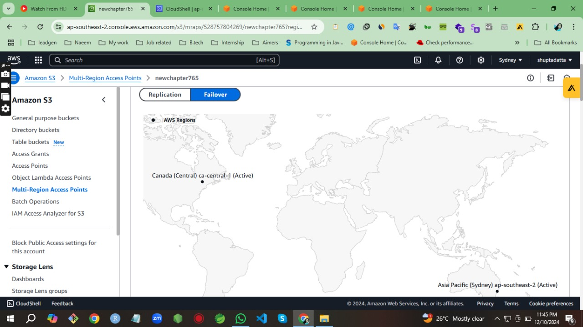
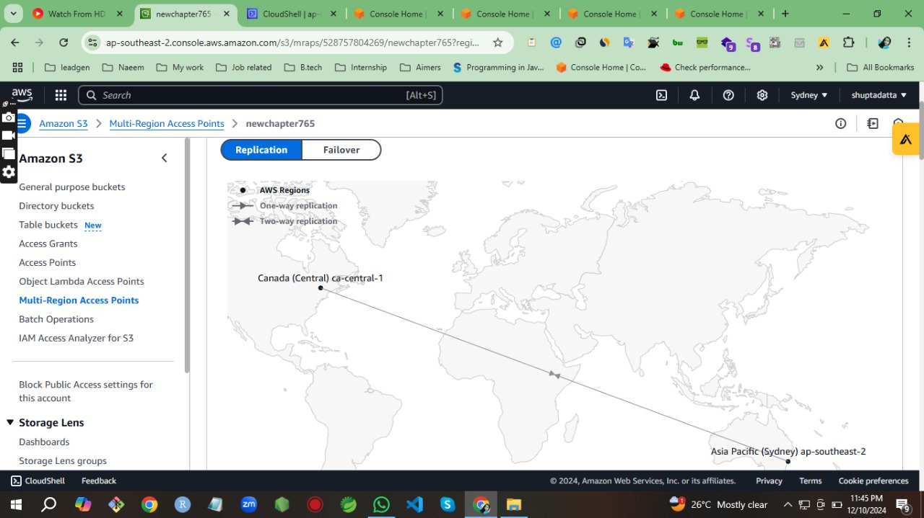
OUTPUT:

Slide 13
USING TWO OR MORE MULTI-REGION ACCESS POINT
We take the new tab and open AWS console. Then we changed the region, click the cloud shell.
After command prompt will be visible. Now we need to write the commands. First command is “ dd if=/dev/urandom of=test1.file bas=1M count=10 “. Output is “10+0 records in and records out.
2nd is “aws s3 cp test1.files3://arn:aws:s3::528757804269:accesspoint/m3utyxph4qtjd.mrap”
Similarly we created 4 test files for the purpose of multi-region. Like test1, test2, test3, test4.

Slide 14
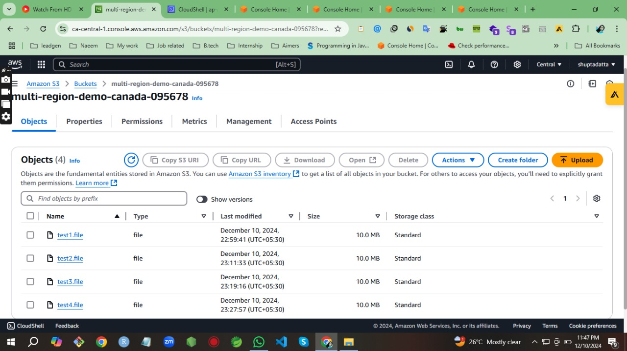
OUTPUT

Slide 15
HOW TO CONNECT MULTI-REGION POINT:
We learned how to monitor Amazon S3 Replication in the Multi-Region Access Point console, and S3 request metrics in Amazon CloudWatch.
Then we take a new tab and select the regions Sydney and Canada one by one. And apply same commands again.
As a output we got -
“ download:s3://arn:aws:s3::528757804269:accesspoint/m3utyxph4qtze.mrfe/test4.file to
./test4.file “
Finally, we got our desired output.

Slide 16
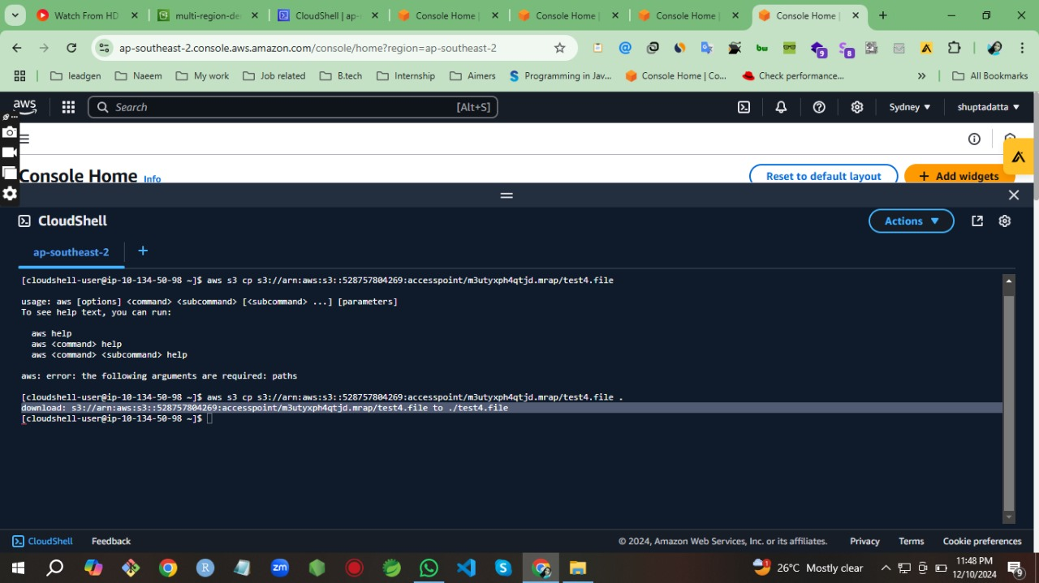
OUTPUT

Slide 17
CLEAN UP RESOURCES :
We will go through the steps to delete all the resources we created throughout this tutorial.
It is a best practice to delete resources we are no longer using to avoid unwanted charges.
In the Amazon S3 console menu, chose Multi-Region Access Points.
Select the radio button to the left of the name of your access point, then select Delete.
Empty and then delete the new S3 buckets created for this guide.
Deleting a bucket will automatically delete its replication rules.
CONCLUSION:
In this way, we successfully done our project.
And we improved our knowledge about this project.

Slide 18
THANK YOU

