Slide 1
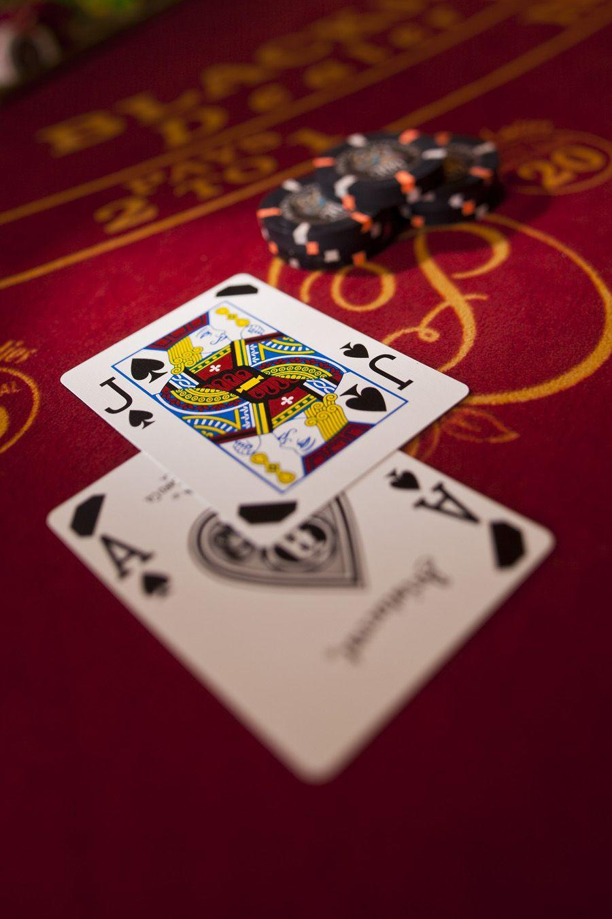


Smart Contracts Group Project.
Blackjack on Ethereum Blockchain
University of Basel, 3. December 2021
Group 7:
Ciriaco De Minico
Eric Fäh
Anton Kurinnyy
Artur Ostertag

Slide 2
Motivation for Blackjack Smart Contract
Intuition behind decentralized casino / Blackjack
Players in a regular casino or online casino must trust the casino
In a smart contract, you can verify the probability distribution and the payout mechanisms
Most casinos are private firms, and investors need a lot of capital to receive equity
Further implementation possibilities for instance token with additional rights that allows you to become a shareholder of the contract and receive earnings
Blackjack is straight forward game
Clear Structure with rules
Makes it easier to program
Trendy Topic (Decentraland)

Slide 3
Challenges and our solutions to them
What are the attack points of our smart contracts?
Randomization
Off-Chain Oracles
Commit and Reveal
Blockhash of future Block
Only Start if Round Over
Round End = True
Deposit Process
msg.sender
msg.value
Withdrawal Process
msg.sender
msg.value
Bet = 0

Slide 4

Remix Smart Contract Demonstration

Slide 5
End of Presentation
Thank you for your attention, happy gambling!
Comments and/or Questions?

