Slide 1


MANAGEMENT COMMITTEE REVIEW
MONTHLY DEPARTMENTAL PERFORMANCE REVIEW
COVERED PERIOD: JUNE-JULY
PRESENTED BY: ERIS ALYANA O. BUENAVENTURA
AUGUST 17, 2026

Slide 2

OBJECTIVES
Present IT project status, progress, and priorities.
Review completed, ongoing, on-hold, and upcoming initiatives.
Identify issues, risks, and project bottlenecks.
Highlight IT contributions to operational efficiency.
Present project costs, timelines, and resource requirements.
Seek management guidance and approvals on key IT matters.

Slide 3
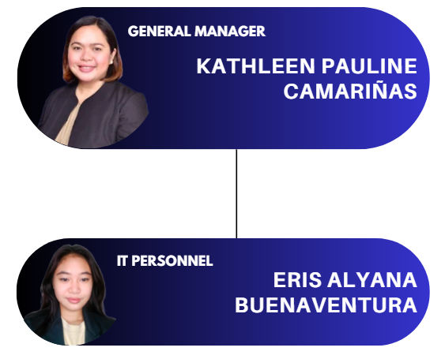
ORGANIZATIONAL
CHART

Slide 4
IT DEPARTMENT
OVERVIEW
Department Function
Responsible for the company’s IT systems, infrastructure, and digital project implementation to support business operations.
Manpower Status
IT Personnel: 1 (Solo IT Support / Administrator)
End-to-end IT operations (development, maintenance, support, deployment)
Key Responsibilities
Technical support for all departments
Current Workload Summary
Completed Projects: 6
Ongoing Projects: 2
On Hold Projects: 2
Not Started Projects: 2

Slide 5
MONTHLY
HIGHLIGHTS
Item | Status | Impact
EAMS App & Management | Completed (100%) | Attendance monitoring implemented
Canva, GDrive & Zoom | Completed (100%) | Productivity and collaboration tools implemented
PBSI PVC ID | Completed (100%) | 32 employee IDs completed
Shared Calendar / Calling Card / Printer | Completed (100%) | Scheduling, branding, and office equipment support completed
Backup/Archive Files | Ongoing (3%) | ZIP/email backup process and upload monitoring ongoing
Saveplus ID Card Design | Ongoing (80%) | 3 ID design renders for checking with Sir Oriel
Polystar ID Card Design | Ongoing (30%) | 2 ID design renders for checking with Ma’am Kath

Slide 6
IT PROJECT PERFORMANCE
DASHBOARD
Status | Count | Remarks
Completed | 6 | Successfully delivered
Ongoing | 2 | Currently in progress
On Hold | 2 | Awaiting resolution or management direction
Not Started | 2 | Pending implementation

Slide 7
DEPARTMENT
CONTRIBUTION
SYSTEMS
EAMS / HRIS and application support
CONNECTIVITY
PLDT, network, and biometric connectivity
DATA
Backup, archive, and data banking
PRODUCTIVITY
Google Drive, Canva, Zoom, and Shared Calendar
EQUIPMENT
Printer, PC, and end-user setup
SUPPORT
Technical assistance and troubleshooting across departments

Slide 8
ISSUES/CONCERNS/ BOTTLENECKS
Issue | Root Cause | Affected Department | Required Action | Escalation Needed
LinisPlus project on hold | Source code / development issues | IT / Management | Evaluate project viability and determine next steps | Management Decision
Network Setup on hold | Network consolidation and backup/wired plan pending | All Departments | Review proposed setup and implementation direction | Management Guidance
Backup/Archive process ongoing | Permanent data banking solution not yet started | All Departments | Continue ZIP/email collection, upload, and monitoring | Monitoring
Canary Biometric connection pending | Wired connectivity implementation not yet started | HR / Operations | Coordinate IT assistance and cabling implementation | Management Coordination

Slide 9
RISK & EXPOSURE REVIEW
Project | Risk | Impact | Mitigations
Backup/Archive Files | Medium | Manual backup process and incomplete archiving | Continue upload monitoring and move toward permanent storage
LinisPlus Project | Medium | Extended project delay / unresolved development issues | Management review and decision on continuation
Network Setup | Medium | Connectivity reliability and infrastructure limitations | Proper design, testing, and backup connectivity planning
Canary Biometric Project | Low | Setup delay may affect stable biometric connectivity | Coordinate materials, cabling, and implementation schedule
Data Banking Project | Medium | No permanent centralized storage yet | Proceed with centralized storage and backup planning
ID Card Design | Low | Approval/revision delays | Obtain feedback and finalize approved design

Slide 10
ACTION PLANS
Action Item | Responsible Person | Timeline | Success Measure
Continue Backup/Archive file collection and monitoring | IT | Ongoing | Files uploaded and archive progress tracked
Finalize ID card design after checking | IT / Management | Ongoing | Approved ID design ready for implementation
Review Network Setup proposal and requirements | IT / Management | Pending | Scope and implementation direction approved
Implement Canary Biometric wired connectivity | IT / Management | Pending | Stable wired biometric connection established
Establish permanent centralized data storage | IT | Q3 2026 | Data banking and backup process operational
Resolve or obtain direction on LinisPlus | Management / IT | Pending | Project status formally decided

Slide 11
SUPPORT NEEDED
Decisions Needed • Direction on LinisPlus continuation • Direction on Network Setup and permanent data banking • Approval / coordination for Canary Biometric wired connectivity Operational Support • Timely submission of files and requirements from departments • Coordination during testing and implementation • Management feedback and approval for pending IT initiatives Current Priority • Continue Backup/Archive monitoring • Finalize ID card design • Progress permanent data banking and network planning

Slide 12
THANK YOU

