Slide 1
CusToM Workshop - Kinematic tutorial
Charles Pontonnier, Pierre Puchaud

Slide 2

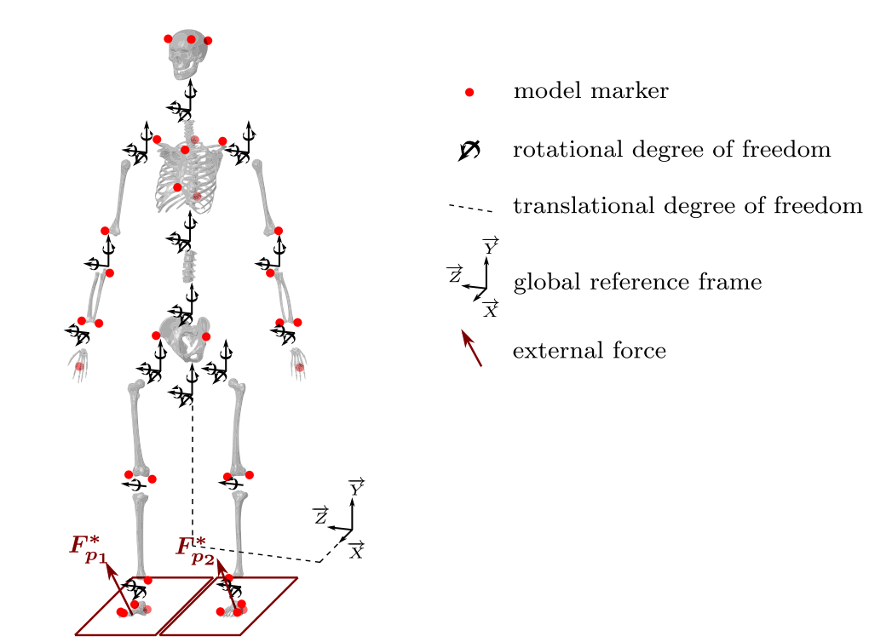
Generate Parameters of the Model
Size : 1.755 m
Mass : 70 Kg
Osteo-articular model – full body
Pelvis
Pelvis LowerTrunk
Leg
Arms
Marker Set
MarkerSet_2 (M2S makerset)
2 markers on hand
No Muscles

Slide 3
AnalysisParameters
Only Inverse Kinematic Active Step
Levenberg-marquardt
5Hz filter butterworh 2nd order zero lag

Slide 4

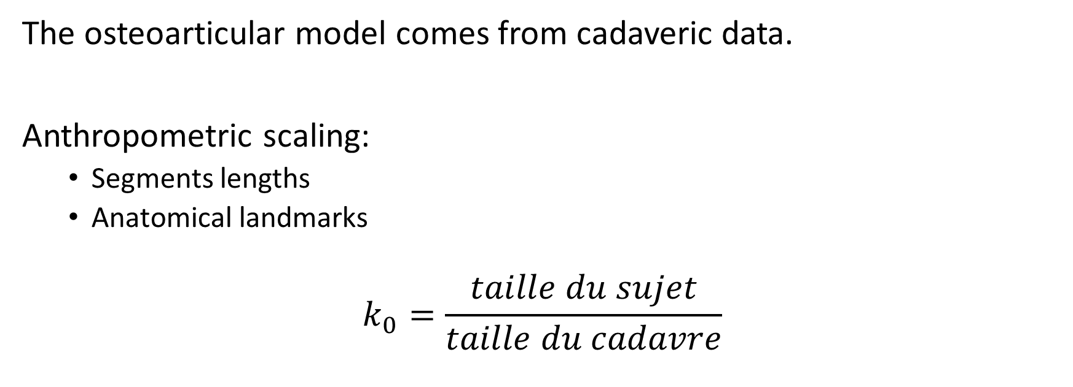
What CusToM is Doing ?
The osteoarticular model comes from cadaveric data.
Anthropometric scaling:
Segments lengths
Anatomical landmarks
$$k_{0}=\frac{taille du sujet}{taille du cadavre}$$

Slide 5
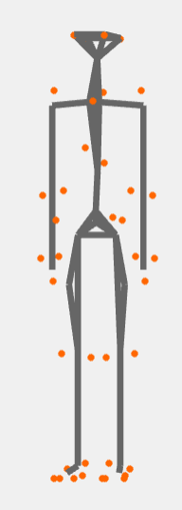

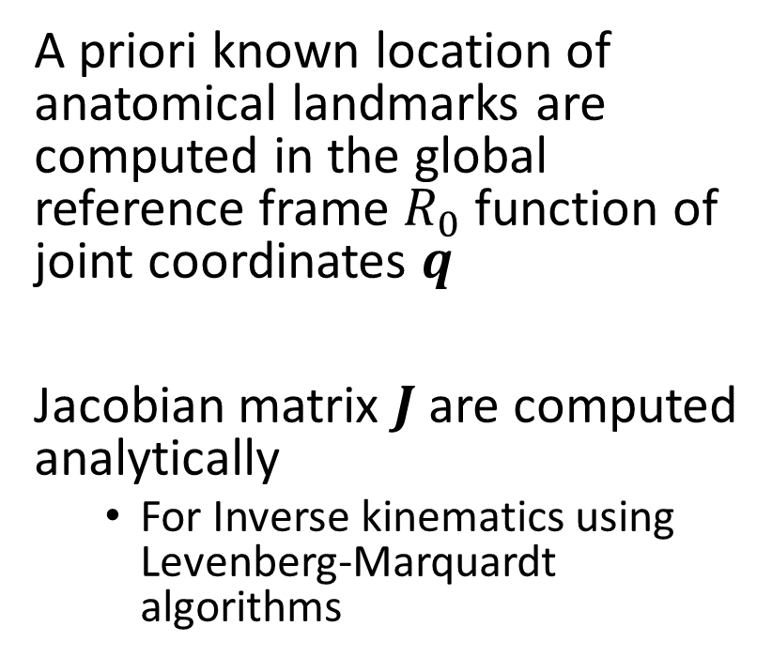
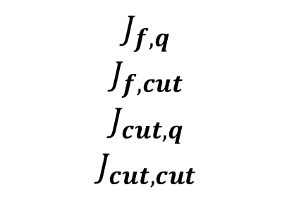

What CusToM is Doing ?
A priori known location of anatomical landmarks are computed in the global reference frame $R_{0}$ function of joint coordinates $q$
Jacobian matrix $J$ are computed analytically
For Inverse kinematics using Levenberg-Marquardt algorithms
$${}_{}^{R_{0}}{X_{marker}}=f(q)$$
$$J_{f,q}$$
$$J_{f,cut}$$
$$J_{cut,q}$$
$$J_{cut,cut}$$

Slide 6

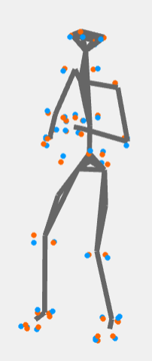
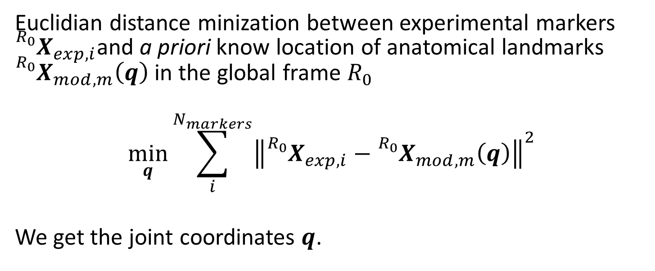
What CusToM is Doing ?
Euclidian distance minization between experimental markers ${}_{}^{R_{0}}{X_{exp,i}}$and a priori know location of anatomical landmarks ${}_{}^{R_{0}}{X_{mod,m}\left(q\right)}$ in the global frame $R_{0}$
$$\min_{q}{\sum_{i}^{N_{markers}}{{\left\|{}_{}^{R_{0}}{X_{exp,i}}−{}_{}^{R_{0}}{X_{mod,m}\left(q\right)}\right\|}^{2}}}$$
We get the joint coordinates $q$.

Slide 7
First results – Kinematic residuals

Slide 8
First results – Joint coordinates

Slide 9
What about the quality of the model ? – Right Shank length

Slide 10
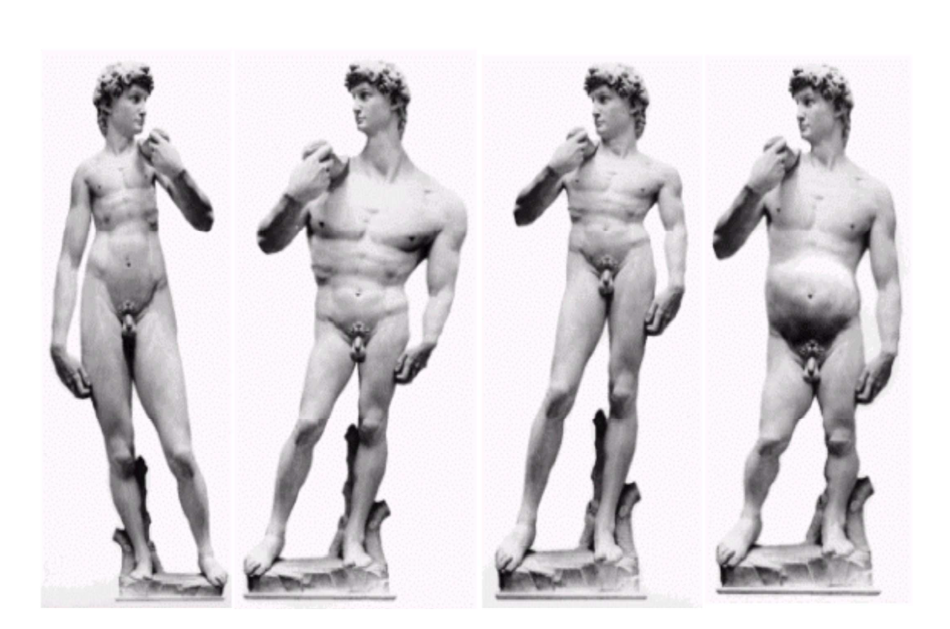
What about the quality of the model ?
For a same size, segment lengths can vary between subjects.

Slide 11
Enhancing the Osteoarticular model
We will add a geometric calibration step
Folder : SideStep_Geometric_Calibration
Same previous steps, except for AnalysisParameters.

Slide 12
Geometrical Calibration step
Frames used
Selection method of frames : UniformlyDistributed
Number of frames : 20
Body length
Homethetic factors of Clavicles are linked to homothetic factor of the Thorax
Marker Position
Direction of markers to optimize in local frames ( Z is medio-lateral )
Axis of rotation
Orientation of Joint axis can be optimized to fit subject-specific joint axis.
For example knee axis. Two rotation angles have to be introduced.

Slide 13
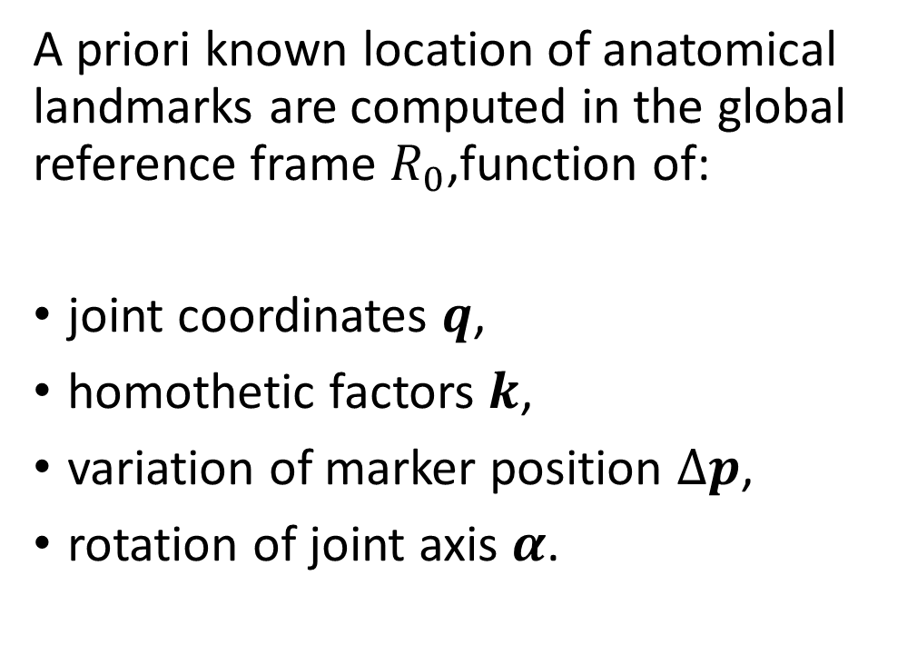
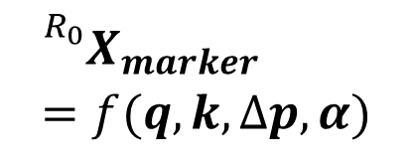
What is CusToM Doing ?
A priori known location of anatomical landmarks are computed in the global reference frame $R_{0}$,function of:
joint coordinates $q$,
homothetic factors $k$,
variation of marker position $Δp$,
rotation of joint axis $α$.
$${}_{}^{R_{0}}{X_{marker}}=f(q,k,Δp,α)$$

Slide 14
What is CusToM Doing ?
Uniformely distributed frames
Frames are chosen equally spaced in ROM.c3d

Slide 15
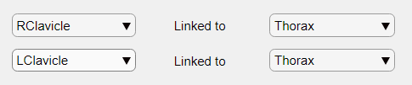
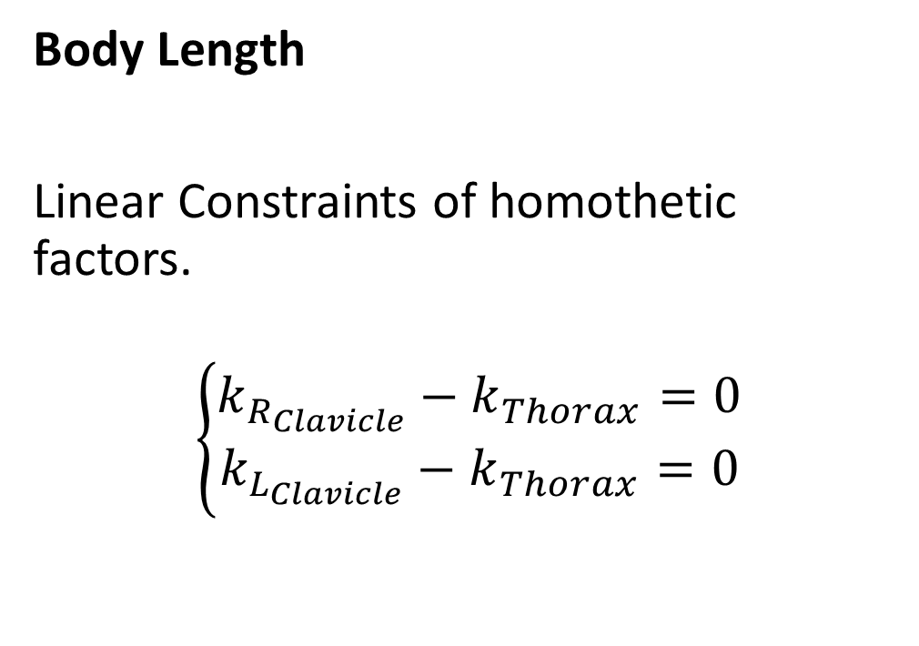
What is CusToM Doing ?
Body Length
Linear Constraints of homothetic factors.
$$\left\{\begin{aligned}k_{R_{Clavicle}}−k_{Thorax}=0 \\ k_{L_{Clavicle}}−k_{Thorax}=0\end{aligned}\right.$$

Slide 16

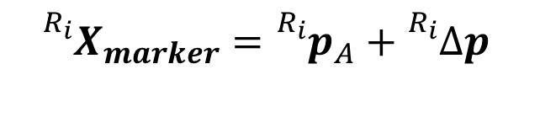
What is CusToM Doing ?
$${}_{}^{R_{i}}{X_{marker}}={}_{}^{R_{i}}{p_{A}}+{}_{}^{R_{i}}{Δp }$$
Axis of rotation
Some location of markers are optimized
In this case :
RKNE is trusted for x,y,z direction
RKNI is trusted for x direction and optimized for y and z direction
RKNE
RKNI

Slide 17
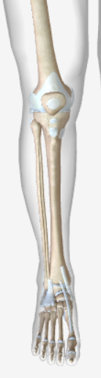





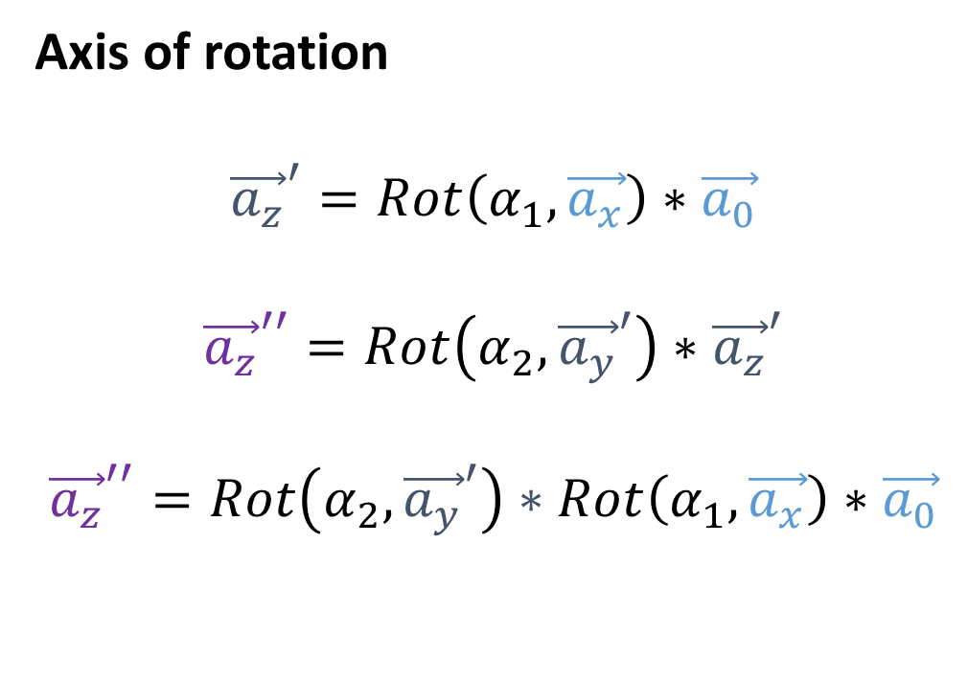








What is CusToM Doing ?
$${\vec{a_{y}}}^{′}$$
$$\vec{a_{y}}$$
Axis of rotation
$${\vec{a_{z}}}^{′}=Rot\left(α_{1},\vec{a_{x}}\right)∗\vec{a_{0}}$$
$${\vec{a_{z}}}^{′′}=Rot\left(α_{2},{\vec{a_{y}}}^{′}\right)∗{\vec{a_{z}}}^{′}$$
$${\vec{a_{z}}}^{′′}=Rot\left(α_{2},{\vec{a_{y}}}^{′}\right)∗Rot\left(α_{1},\vec{a_{x}}\right)∗\vec{a_{0}}$$
$$α_{1}$$
$$\vec{a_{0}}=\vec{a_{z}}$$
$${\vec{a_{z}}}^{′′}$$
$$α_{1}$$
$${\vec{a_{z}}}^{′′}$$
$$α_{2}$$
$${\vec{a_{z}}}^{′}$$
$$α_{2}$$
$$\vec{a_{x}}$$
$${\vec{a_{x}}}^{′′}$$

Slide 18
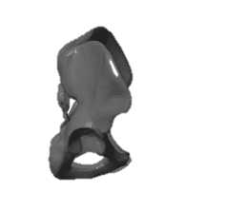
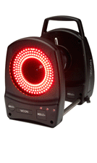
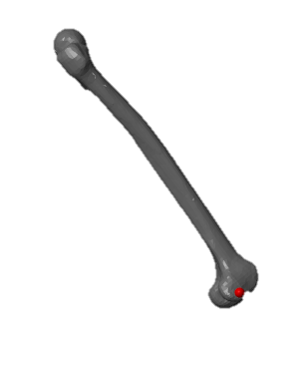
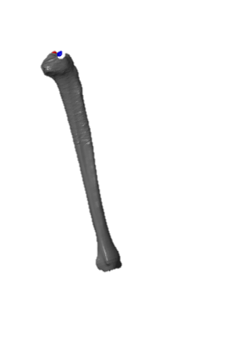
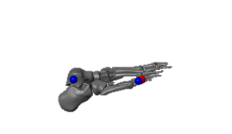

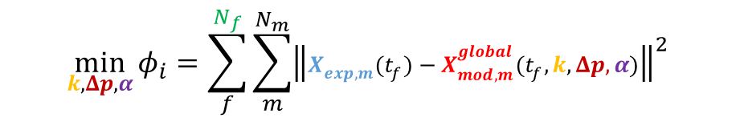









What is CusToM Doing ? – Geometrical Calibration Process
Equally spaced sets of frames:
$$N_{f}$$
Muller et al. 2015
Parameters identification
At each iteration i
$$X_{mod,1}^{global}$$
$$q_{1}$$
$$\min_{k,Δp,α}{φ_{i}=\sum_{f}^{N_{f}}{\sum_{m}^{N_{m}}{{\left\|X_{exp,m}(t_{f})−X_{mod,m}^{global}(t_{f},k,Δp,α)\right\|}^{2}}}}$$
$$X_{exp,1}$$
Regression method
Based on height
RM
$$q_{2}$$
Inverse kinematics
Lu and O’Connor et al. 1999
$$q_{3}$$
Criterion satisfied ?
$$\frac{φ_{i}−φ_{i−1}}{φ_{i−1}}<5\%$$
$$No$$
$$Yes$$
$$Stop$$

Slide 19
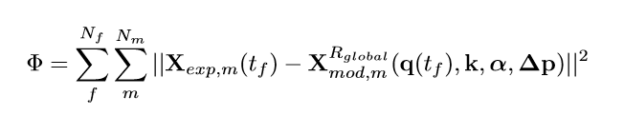
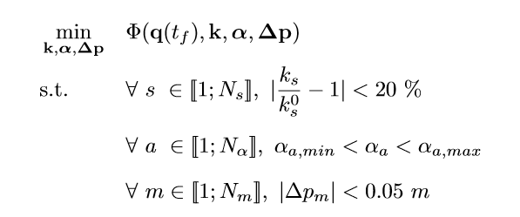
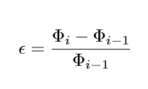
What is CusToM Doing ?

Slide 20
Calibration Results

