Slide 1
CusToM Workshop
Kinematic tutorial

Slide 2

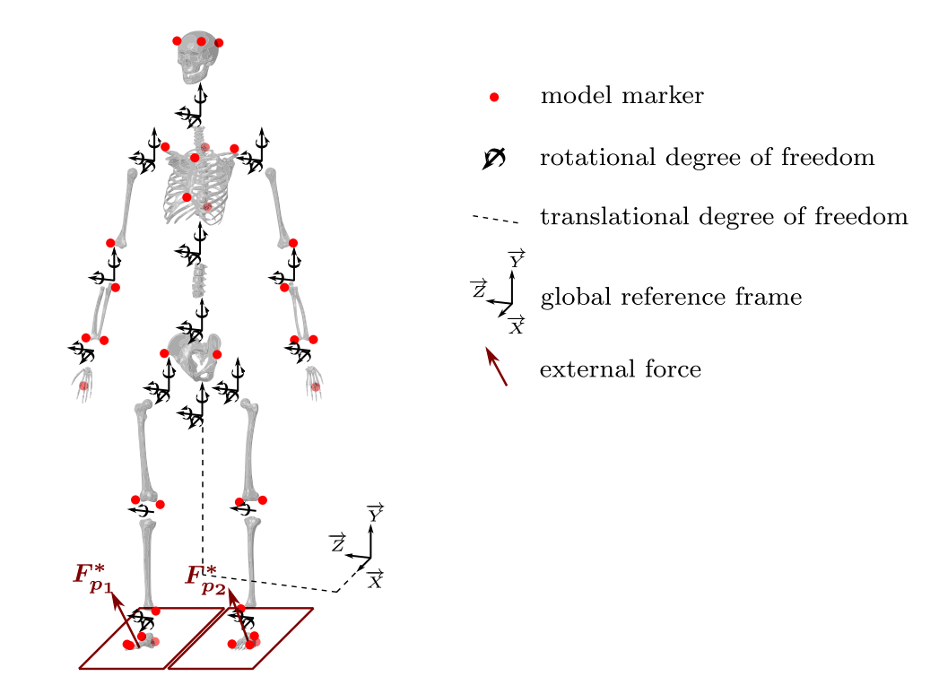
Generate Parameters of the Model
Size : 1.755 m
Mass : 70 Kg
Osteo-articular model – full body
Pelvis
Pelvis LowerTrunk
Leg
Arms
Marker Set
MarkerSet_2 (M2S makerset)
2 markers on hand
No Muscles

Slide 3
AnalysisParameters
Only Inverse Kinematic Active Step
Levenberg-marquardt
5Hz filter butterworh 2nd order zero lag

Slide 4

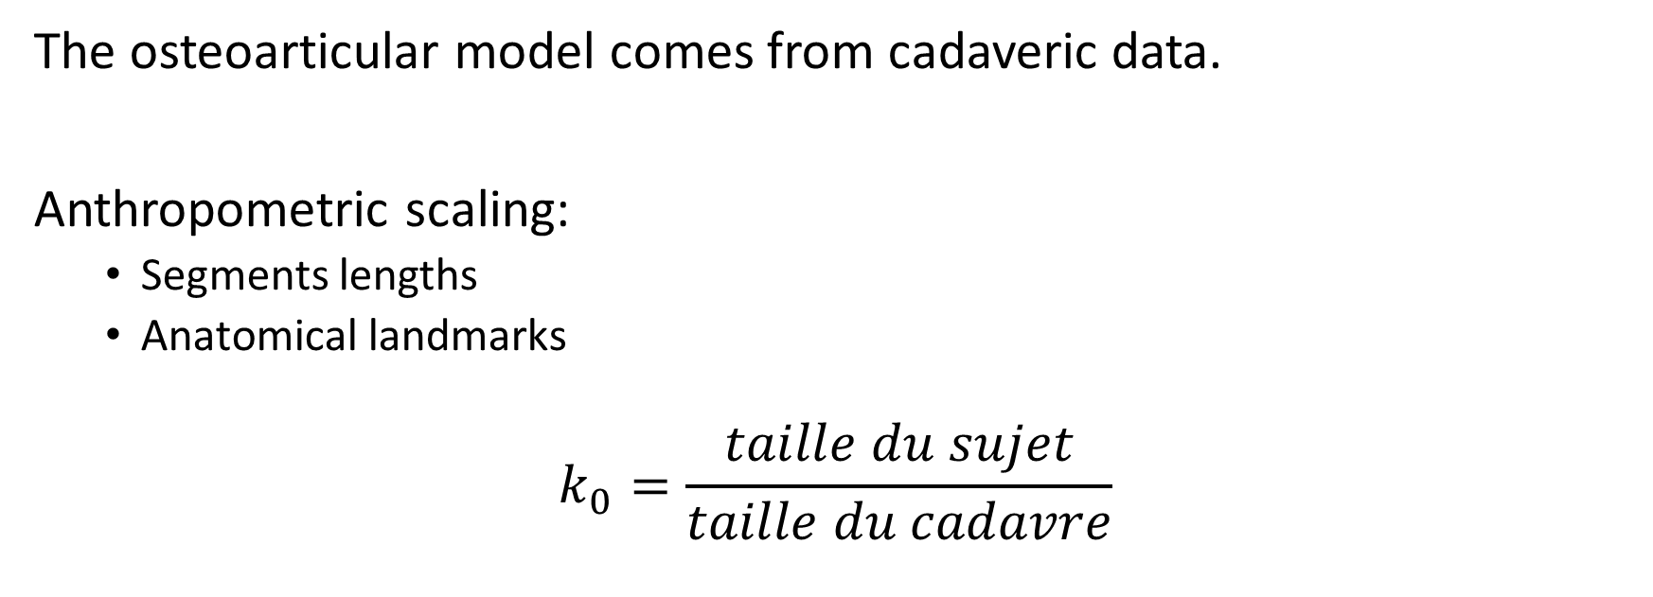
What CusToM is Doing ?
The osteoarticular model comes from cadaveric data.
Anthropometric scaling:
Segments lengths
Anatomical landmarks
$$k_{0}=\frac{taille du sujet}{taille du cadavre}$$

Slide 5
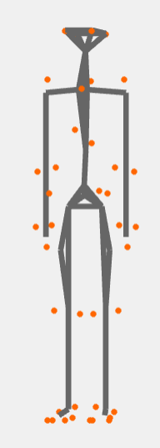

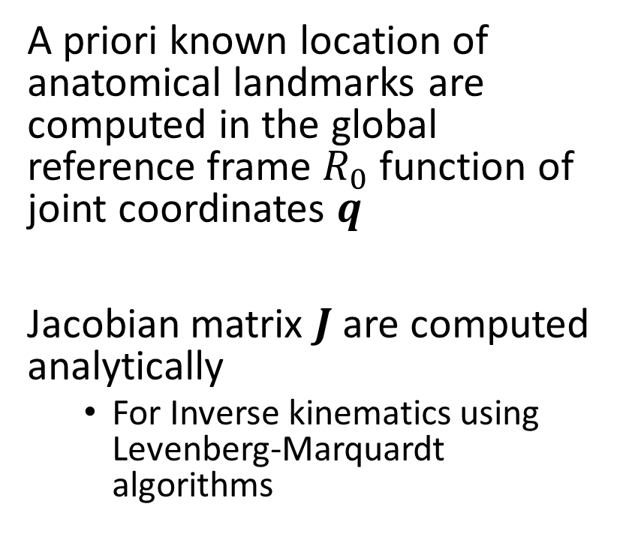
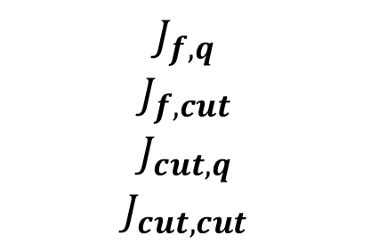

What CusToM is Doing ?
A priori known location of anatomical landmarks are computed in the global reference frame $R_{0}$ function of joint coordinates $q$
Jacobian matrix $J$ are computed analytically
For Inverse kinematics using Levenberg-Marquardt algorithms
$${}_{}^{R_{0}}{X_{marker}}=f(q)$$
$$J_{f,q}$$
$$J_{f,cut}$$
$$J_{cut,q}$$
$$J_{cut,cut}$$

Slide 6

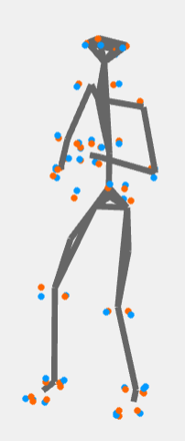
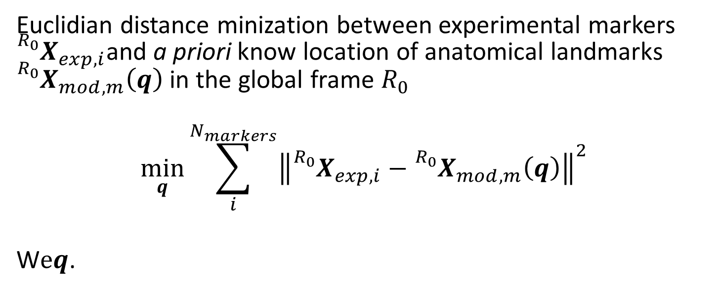
What CusToM is Doing ?
Euclidian distance minization between experimental markers ${}_{}^{R_{0}}{X_{exp,i}}$and a priori know location of anatomical landmarks ${}_{}^{R_{0}}{X_{mod,m}\left(q\right)}$ in the global frame $R_{0}$
$$\min_{q}{\sum_{i}^{N_{markers}}{{\left\|{}_{}^{R_{0}}{X_{exp,i}}−{}_{}^{R_{0}}{X_{mod,m}\left(q\right)}\right\|}^{2}}}$$
W$eq$.

