Slide 1
CusToM Workshop
Muscle forces tutorial
Charles Pontonnier, Pierre Puchaud

Slide 2
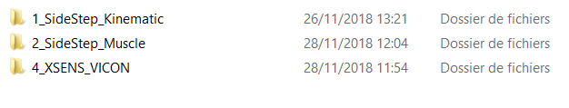
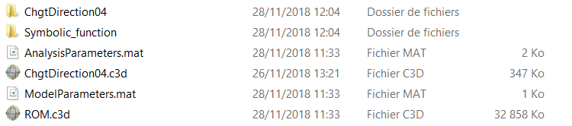
Pre-work
1. Create a new folder in Examples and name it 2_SideStep_Muscle
2. Copy/paste SideStep_Geometric_Calibration folder in 2_SideStep_Muscle and rename it SideStep_Muscle_Opti
. Supress the BiomechanicalModel.mat file inside the folder SideStep_Muscle_Opti
Should look like this:
Examples folder

Slide 3

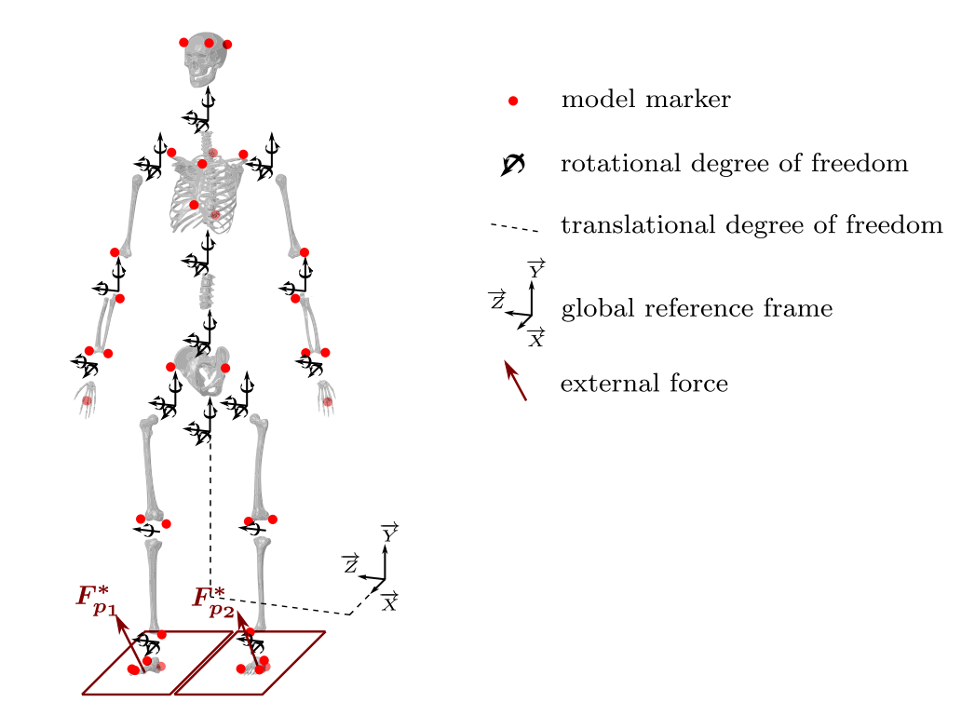
Generate Parameters of the Model
First load parameters: size, mass, osteoarticular and marker sets are ok !
Add muscles to right and left legs
Classical Leg model [Daamsgard2006]
Generate Parameters

Slide 4
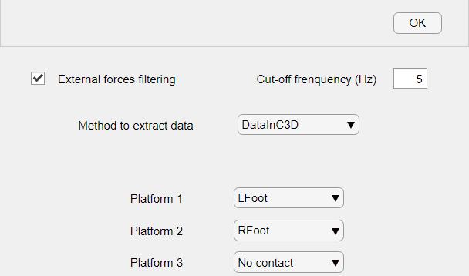
Generate analysisParameters
First load parameters: kinematics are ok!
Open Inverse Dynamics options: enable
Select « From Experiments » for External forces
Open Options, select « DataInC3D »
Select « Lfoot » for Platform 1 and « Rfoot » for Platform 2
This is the source where external forces applied to the model will be read
This is a priori knowledge that you should know from your own experiments !!!!!

Slide 5
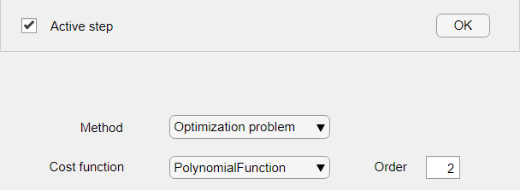
Generate analysisParameters
First load parameters: kinematics are ok!
Open « Inverse Dynamics » options: enable
Select « From Experiments above » for External forces
Open Options, select « DataInC3D »
Select « Lfoot » for Platform 1 and « Rfoot » for Platform 2
Open « Muscle forces estimation » Options
Select Optimization problem, and Polynomial function (order 2)

Slide 6
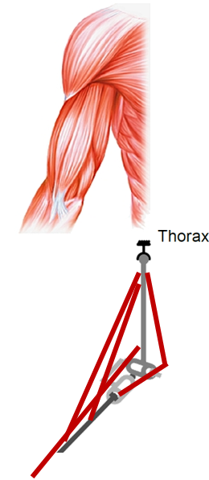
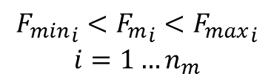
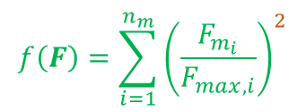

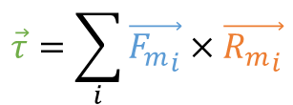
What does this mean ?
The resulting problem to solve for MS forces estimation will be:
$$\min{f(F)}$$
$$\vec{τ}=\sum_{i}{\vec{{F_{m}}_{i}}×\vec{{R_{m}}_{i}}}$$
s.t.
$${F_{min}}_{i}<{F_{m}}_{i}<{F_{max}}_{i}$$
$$i=1…n_{m}$$
$$f\left(F\right)=\sum_{i=1}^{n_{m}}{{\left(\frac{F_{m_{i}}}{F_{max,i}}\right)}^{2}}$$

Slide 7


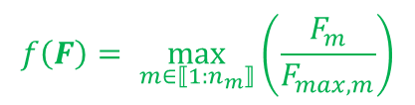

Alternatives
$$f\left(F\right)=\sum_{i=1}^{n_{m}}{{\left(\frac{F_{m_{i}}}{F_{max,i}}\right)}^{p}}$$
$p$
Muscle synergy
Change order to $p$
$$f\left(F\right)= \max_{m∈⟦1:n_{m}⟧}\left(\frac{F_{m}}{F_{max,m}}\right)$$
$$p →∞$$
Maximal Synergy
Change Polynomial Function to MinMax
See
Rasmussen, J., Damsgaard, M., & Voigt, M. (2001). Muscle recruitment by the min/max criterion—a comparative numerical study. Journal of biomechanics, 34(3), 409-415.

Slide 8
RUN

Slide 9
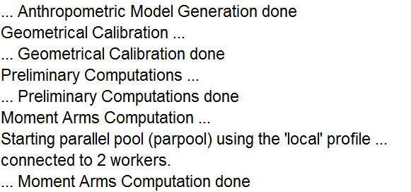
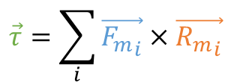
What CusToM is doing ?
Not new
New
$$\vec{τ}=\sum_{i}{\vec{{F_{m}}_{i}}×\vec{{R_{m}}_{i}}}$$
Analytical solution computed and gathered as a matlab function

Slide 10
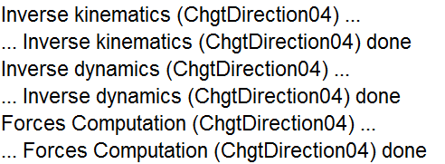
What CusToM is doing ?
Not new
Newton-Euler Algorithm

Slide 11
Newton Euler-Algorithm
For more details, see 5_INVERSE-DYNAMICS.pdf
Charles Pontonnier, Pierre Puchaud

Slide 12
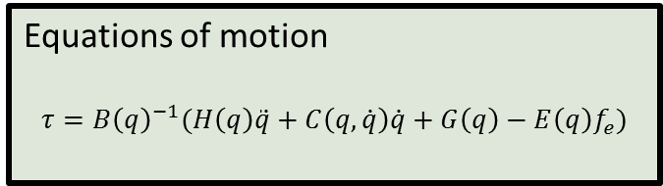



Main issue
At time $t_{k}$
External forces
$f_{e}$($t_{k}$)
Equations of motion
$$τ=B{\left(q\right)}^{−1}(H\left(q\right)\ddot{q}+C\left(q,\dot{q}\right)\dot{q}+G\left(q\right)−E\left(q\right)f_{e})$$
Joint torques
$τ$($t_{k})$
$$\left(q_{d}\left(t_{k}\right), {\dot{q}}_{d}\left(t_{k}\right),{\ddot{q}}_{d}(t_{k}) \right)$$
Angles, angular velocities and accelerations

Slide 13
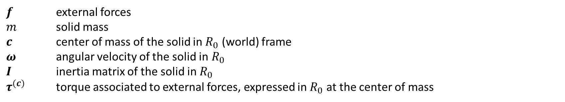
Newton Euler equations for a solid $S$
$$P$$
At center of mass
$$O$$
$$\left\{\begin{aligned}f=m\ddot{c} \\ τ^{(c)}=I\dot{ω}+ω ×Iω\end{aligned}\right.$$
$$R_{0}$$
$$C$$
(1)
(2)
Acceleration momentum
$f$ external forces
$m$ solid mass
$c$ center of mass of the solid in $R_{0}$ (world) frame
$ω$ angular velocity of the solid in$R_{0}$
$I$ inertia matrix of the solid in $R_{0}$
$τ^{(c)}$ torque associated to external forces, expressed in $R_{0}$ at the center of mass

Slide 14
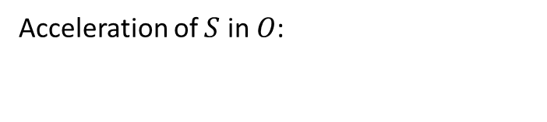

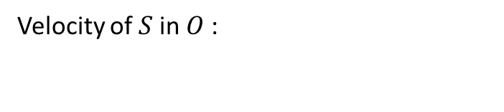
Spatial equations of motion [Featherstone2007]
$$P$$
Velocity of $S$in $O$:
$$v_{O}=\dot{c}+c ×ω$$
Acceleration of $S$ in $O$:
$${\dot{v}}_{O}=\ddot{c}+\dot{c} ×ω+c ×\dot{ω}$$
$$O$$
$$R_{0}$$
$$C$$
The center of mass acceleration becomes:
$$\ddot{c}={\dot{v}}_{O}−c ×\dot{ω}+ω×(v_{O}+ω ×c)$$
Replacing in (1), it comes
$$f=m({\dot{v}}_{O}−c ×\dot{ω}+ω×\left(v_{O}+ω ×c\right))$$

Slide 15
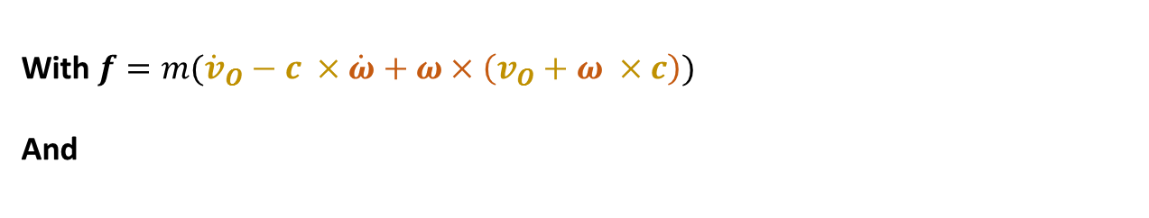
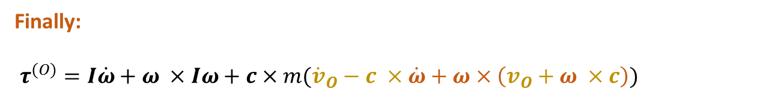
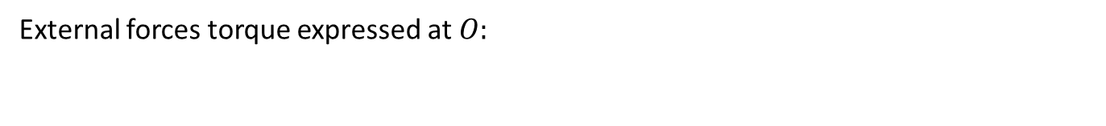
Spatial equations of motion [Featherstone2007]
$$P$$
External forces torque expressed at $O:$
$$τ^{(O)}=τ^{(c)}+c×f$$
$$O$$
With $f=m({\dot{v}}_{O}−c ×\dot{ω}+ω×\left(v_{O}+ω ×c\right))$
And
$$R_{0}$$
$$C$$
$$τ^{(c)}=I\dot{ω}+ω ×Iω$$
Finally:
$τ^{(O)}=I\dot{ω}+ω ×Iω+c×m({\dot{v}}_{O}−c ×\dot{ω}+ω×\left(v_{O}+ω ×c\right))$

Slide 16
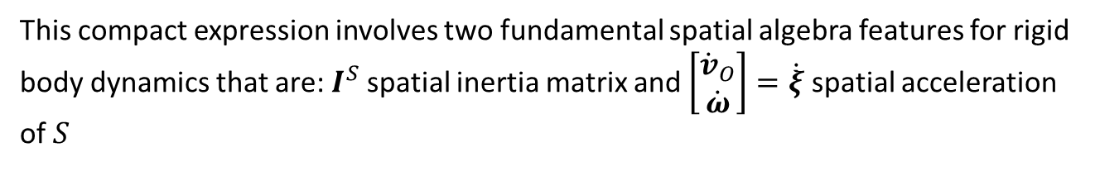
Spatial equations of motion [Featherstone2007]
$$P$$
$$f=m({\dot{v}}_{O}−c ×\dot{ω}+ω×\left(v_{O}+ω ×c\right))$$
$$O$$
$$R_{0}$$
$$C$$
$τ^{(O)}=I\dot{ω}+ω ×Iω+c×m({\dot{v}}_{O}−c ×\dot{ω}+ω×\left(v_{O}+ω ×c\right))$
That can be expressed with a matrix expression
$$\left[\begin{aligned}f \\ τ\end{aligned}\right]=I^{S}\left[\begin{aligned}{\dot{v}}_{O} \\ \dot{ω}\end{aligned}\right]+\left[\begin{matrix}\hat{ω} & 0 \\ \hat{v_{O}} & \hat{ω}\end{matrix}\right]I^{S}\left[\begin{aligned}v_{O} \\ ω\end{aligned}\right]=I^{S}\left[\begin{aligned}{\dot{v}}_{O} \\ \dot{ω}\end{aligned}\right]+\left[\begin{aligned}\begin{aligned}v_{O} \\ ω\end{aligned}\end{aligned}\right]×I^{S}\left[\begin{aligned}v_{O} \\ ω\end{aligned}\right]$$
!
(application produit vectoriel)
This compact expression involves two fundamental spatial algebra features for rigid body dynamics that are: $I^{S}$ spatial inertia matrix and $\left[\begin{aligned}{\dot{v}}_{O} \\ \dot{ω}\end{aligned}\right]=\dot{ξ}$ spatial acceleration of $S$
$$\hat{ω}=\left[\begin{matrix}0 & −ω_{z} & ω_{y} \\ ω_{z} & 0 & −ω_{x} \\ −ω_{y} & ω_{x} & 0\end{matrix}\right]$$

Slide 17

Spatial inertia and spatial acceleration
$$P$$
Spatial inertia matrix: 6 x 6 Symmetrical matrix:
$$O$$
$$I_{}^{s}=\left[\begin{matrix}m𝕀 & m{\hat{c}}^{t} \\ m\hat{c} & m\hat{c}{\hat{c}}^{t}+I\end{matrix}\right]$$
$$R_{0}$$
$$C$$
Spatial acceleration: not a physical acceleration
$$\left[\begin{aligned}{\dot{v}}_{O} \\ \dot{ω}\end{aligned}\right]=\dot{ξ}$$
$𝕀$ identity matrix

Slide 18
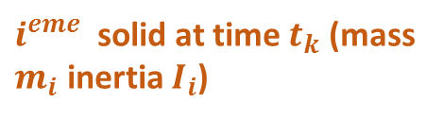

Equations of motion of one solid in a polyarticulated chain of solids
$$\left[\begin{aligned}f_{i} \\ τ_{i}\end{aligned}\right]−\left[\begin{aligned}f_{i+1} \\ τ_{i+1}\end{aligned}\right]+f_{e_{i}}=I_{i}^{S}\left[\begin{aligned}{\dot{v}}_{O_{i}} \\ {\dot{ω}}_{i}\end{aligned}\right]+\left[\begin{aligned}\begin{aligned}v_{O_{i}} \\ ω_{i}\end{aligned}\end{aligned}\right]×I_{i}^{S}\left[\begin{aligned}v_{O_{i}} \\ ω_{i}\end{aligned}\right]$$
$${f_{a}}_{i}$$
$${f_{a}}_{μ(i)}$$
${f_{a}}_{μ(i)}$($t_{k})$
…
$i^{eme}$ solid at time $t_{k}$ (mass $m_{i}$ inertia $I_{i}$)
${f_{e}}_{i}$($t_{k})$
$c_{i}$($t_{k})$
$q_{i}$($t_{k})$
${f_{a}}_{i}$($t_{k})$
$p_{i}$($t_{k})$
$n_{b}$ polyarticulated solids with $n_{q}$ joints

Slide 19

Newton-Euler algorithm
Recursive Newton-Euler algorithm
Knowing joint angles, joint velocities and joint accelerations at time $t_{k}$
Computing cartesian and angular velocities of all bodies from the base to extremities
Computing joint reaction forces of all solids from extremities to the base
For $i=1$ to $n_{B}$ do
$$\dot{ξ_{i}}=f(q,\dot{q},\ddot{q},{f_{e}}_{i},{\dot{ξ}}_{λ(i)})$$
End
For $i=n_{B}$ to $1$ do
${f_{a}}_{i}=f(\dot{ξ_{i}}$,${f_{e}}_{i},$ ${f_{a}}_{μ(i)})$
End
À un instant $t_{k}$

Slide 20

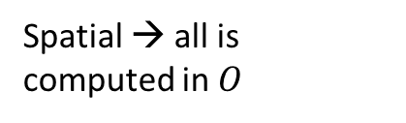
Newton-Euler algorithm
For $i=1$ to $n_{B}$ do
$$\dot{ξ_{i}}=f(q,\dot{q},\ddot{q},{f_{e}}_{i},{\dot{ξ}}_{λ(i)})$$
End
For $i=n_{B}$ to $1$ do
${f_{a}}_{i}=f(\dot{ξ_{i}}$,${f_{e}}_{i},$ ${f_{a}}_{μ(i)})$
End
$${{}_{}^{0}R}_{i}={{}_{}^{0}R}_{λ(i)}{{}_{}^{λ(i)}R}_{i}(q_{i})$$
Solid position and orientation update
$$p_{i}=p_{λ(i)}+{{}_{}^{0}R}_{λ(i)}b_{i}$$
$${{}_{}^{(0)}u}_{i}={{}_{}^{0}R}_{λ(i)}{{}_{}^{λ(i)}u}_{i}$$
Joint axis between $i−1$and $i$ orientation update
$$ξ_{i}=ξ_{λ(i)}+\left[\begin{matrix}p_{i}×u_{i} \\ u_{i}\end{matrix}\right]{\dot{q}}_{i}$$
Spatial velocity update
!
Spatial → all is computed in $O$
$$\dot{ξ_{i}}{=\dot{ξ}}_{λ(i)}+\left[\begin{matrix}{\hat{ω}}_{i} & {\hat{v}}_{0_{i}} \\ 0 & {\hat{ω}}_{i}\end{matrix}\right]\left[\begin{matrix}p_{i}×u_{i} \\ u_{i}\end{matrix}\right]{\dot{q}}_{i}+\left[\begin{matrix}p_{i}×u_{i} \\ u_{i}\end{matrix}\right]{\ddot{q}}_{i}$$
Spatial acceleration update

Slide 21
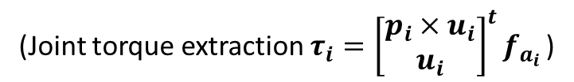
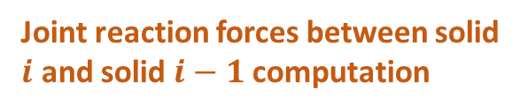




Newton-Euler algorithm
Center of mass position update for solid $i$
For $i=1$ to $n_{B}$ do
$$\dot{ξ_{i}}=f(q,\dot{q},\ddot{q},{f_{e}}_{i},{\dot{ξ}}_{λ(i)})$$
End
For $i=n_{B}$ to $1$ do
${f_{a}}_{i}=f(\dot{ξ_{i}}$,${f_{e}}_{i},$ ${f_{a}}_{μ(i)})$
End
$${{}_{}^{(0)}c}_{i}=p_{i}+{{}_{}^{0}R}_{i}{}_{}^{i−1}{c_{i}}$$
$$I_{i}^{s}=\left[\begin{matrix}m_{i}𝕀 & m_{i}{{\hat{c}}_{i}}^{t} \\ m_{i}{\hat{c}}_{i} & m_{i}{\hat{c}}_{i}{\hat{c}}_{i}^{t}+I_{i}\end{matrix}\right]$$
Spatial inertia matrix computation for solid $i$
$$f_{i}^{acc}=I_{i}^{s}\dot{ξ_{i}}+ξ_{i}×I_{i}^{s}ξ_{i}$$
Spatial acceleration quantities computation for solid $i$
${f_{a}}_{μ(i)}$($t_{k})$
$$f_{a_{i }}=\left[\begin{matrix}f_{i} \\ τ_{i}\end{matrix}\right]=f_{i}^{acc}−{f_{e}}_{i}−\sum_{μ(i)}{{f_{a}}_{j}}$$
Joint reaction forces between solid $i$ and solid $i−1$computation
${f_{e}}_{i}$($t_{k})$
$c_{i}$($t_{k})$
(Joint torque extraction $τ_{i}={\left[\begin{matrix}p_{i}×u_{i} \\ u_{i}\end{matrix}\right]}^{t}f_{a_{i }}$)
$q_{i}$($t_{k})$
${f_{a}}_{i}$($t_{k})$
$$τ_{i}^{\left(p_{i}\right)}.u_{i}=\left(τ_{i}^{\left(0\right)}+f_{i}×p_{i}\right).u_{i}$$
$p_{i}$($t_{k})$
$i^{eme}$ solid at time $t_{k}$ (mass $m_{i}$ inertia $I_{i}$)

Slide 22



Summary
$$s_{i}=\left[\begin{matrix}p_{i}×u_{i} \\ u_{i}\end{matrix}\right]$$
$${\dot{s}}_{i}=\left[\begin{matrix}{\hat{ω}}_{i} & {\hat{v}}_{0_{i}} \\ 0 & {\hat{ω}}_{i}\end{matrix}\right]\left[\begin{matrix}p_{i} × u_{i} \\ u_{i}\end{matrix}\right]$$
With synthetic notations:
4 steps Newton-Euler algorithm
$ξ_{i}=ξ_{i−1}+s_{i}{\dot{q}}_{i}$ (spatial velocity update)
${ \dot{ξ}}_{i}={ \dot{ξ}}_{i−1}+s_{i}{\ddot{q}}_{i}+{\dot{s}}_{i}{\dot{q}}_{i}$ (spatial acceleration update)
$f_{a_{i }}=I_{i}^{s}{ \dot{ξ}}_{i}+ξ_{i}×I_{i}^{s}ξ_{i}−{f_{e}}_{i}+\sum_{μ(i)}{{f_{a}}_{j}}$ (computing actions of $λ\left(i\right)$ on $i$)
$τ_{i}=s_{i}^{T}f_{a_{i}}$ (extracting joint torques)
Pour $i$ from$1$ to $n_{B}$
Pour $i$ from $n_{B}$ to $1$
!
This implementation ask for a knowledge of all quantities at point $O$

Slide 23
