Slide 1
Inteligência Computacional Aplicada ao Controle
Reinaldo Bianchi
Ricardo Destro
2015

Slide 2
Algoritmos Genéticos
Aula de hoje:
Algoritmos Genéticos
Programação genética
AG aplicados ao controle PID
Baseada no capítulo 9 e 10 do livro:
Artificial Intelligence: A Guide to Intelligent Systems (2nd Edition), de Michael Negnevitsk
Slides disponíveis em:
http://ai-lab.appspot.com/

Slide 3


Slide 4
Lecture 9
Evolutionary Computation: Genetic algorithms
Introduction, or can evolution be intelligent?
Simulation of natural evolution
Genetic algorithms
Case study: maintenance scheduling with genetic algorithms
Summary

Slide 5
Can evolution be intelligent?
Intelligence can be defined as the capability of a system to adapt its behaviour to ever-changing environment. According to Alan Turing, the form or appearance of a system is irrelevant to its intelligence.
Evolutionary computation simulates evolution on a computer. The result of such a simulation is a series of optimisation algorithms, usually based on a simple set of rules. Optimisation iteratively improves the quality of solutions until an optimal, or at least feasible, solution is found.

Slide 6
The behaviour of an individual organism is an inductive inference about some yet unknown aspects of its environment. If, over successive generations, the organism survives, we can say that this organism is capable of learning to predict changes in its environment.
The evolutionary approach is based on computational models of natural selection and genetics. We call them evolutionary computation, an umbrella term that combines genetic algorithms, evolution strategies and genetic programming.

Slide 7
Simulation of natural evolution
On 1 July 1858, Charles Darwin presented his theory of evolution before the Linnean Society of London. This day marks the beginning of a revolution in biology.
Darwin’s classical theory of evolution, together with Weismann’s theory of natural selection and Mendel’s concept of genetics, now represent the neo-Darwinian paradigm.

Slide 8
Neo-Darwinism is based on processes of reproduction, mutation, competition and selection. The power to reproduce appears to be an essential property of life.
The power to mutate is also guaranteed in any living organism that reproduces itself in a continuously changing environment.
Processes of competition and selection normally take place in the natural world, where expanding populations of different species are limited by a finite space.

Slide 9
Evolution can be seen as a process leading to the maintenance of a population’s ability to survive and reproduce in a specific environment. This ability is called evolutionary fitness.
Evolutionary fitness can also be viewed as a measure of the organism’s ability to anticipate changes in its environment.
The fitness, or the quantitative measure of the ability to predict environmental changes and respond adequately, can be considered as the quality that is optimised in natural life.

Slide 10
How is a population with increasing fitness generated?
Let us consider a population of rabbits. Some rabbits are faster than others, and we may say that these rabbits possess superior fitness, because they have a greater chance of avoiding foxes, surviving and then breeding.
If two parents have superior fitness, there is a good chance that a combination of their genes will produce an offspring with even higher fitness. Over time the entire population of rabbits becomes faster to meet their environmental challenges in the face of foxes.

Slide 11
Simulation of natural evolution
All methods of evolutionary computation simulate natural evolution by creating a population of individuals, evaluating their fitness, generating a new population through genetic operations, and repeating this process a number of times.
We will start with Genetic Algorithms (GAs) as most of the other evolutionary algorithms can be viewed as variations of genetic algorithms.

Slide 12
Genetic Algorithms
In the early 1970s, John Holland introduced the concept of genetic algorithms.
His aim was to make computers do what nature does. Holland was concerned with algorithms that manipulate strings of binary digits.
Each artificial “chromosomes” consists of a number of “genes”, and each gene is represented by 0 or 1:

Slide 13
Nature has an ability to adapt and learn without being told what to do. In other words, nature finds good chromosomes blindly. GAs do the same. Two mechanisms link a GA to the problem it is solving: encoding and evaluation.
The GA uses a measure of fitness of individual chromosomes to carry out reproduction. As reproduction takes place, the crossover operator exchanges parts of two single chromosomes, and the mutation operator changes the gene value in some randomly chosen location of the chromosome.

Slide 14
Basic genetic algorithms
Step 1: Represent the problem variable domain as a chromosome of a fixed length, choose the size of a chromosome population N, the crossover probability p_{c} and the mutation probability p_{m}.
Step 2: Define a fitness function to measure the performance, or fitness, of an individual chromosome in the problem domain. The fitness function establishes the basis for selecting chromosomes that will be mated during reproduction.

Slide 15
Step 3: Randomly generate an initial population of chromosomes of size N: x₁, x₂ , . . . , x_{N}
Step 4: Calculate the fitness of each individual chromosome: f (x₁), f (x₂), . . . , f (x_{N})
Step 5: Select a pair of chromosomes for mating from the current population. Parent chromosomes are selected with a probability related to their fitness.

Slide 16
Step 6: Create a pair of offspring chromosomes by applying the genetic operators - crossover and mutation.
Step 7: Place the created offspring chromosomes in the new population.
Step 8: Repeat Step 5 until the size of the new chromosome population becomes equal to the size of the initial population, N.
Step 9: Replace the initial (parent) chromosome population with the new (offspring) population.
Step 10: Go to Step 4, and repeat the process until the termination criterion is satisfied.

Slide 17
Genetic algorithms
GA represents an iterative process. Each iteration is called a generation. A typical number of generations for a simple GA can range from 50 to over 500. The entire set of generations is called a run.
Because GAs use a stochastic search method, the fitness of a population may remain stable for a number of generations before a superior chromosome appears.
A common practice is to terminate a GA after a specified number of generations and then examine the best chromosomes in the population. If no satisfactory solution is found, the GA is restarted.

Slide 18
Genetic algorithms: case study
A simple example will help us to understand how a GA works. Let us find the maximum value of the function (15x - x²) where parameter x varies between 0 and 15. For simplicity, we may assume that x takes only integer values. Thus, chromosomes can be built with only four genes:

Slide 19
Suppose that the size of the chromosome population N is 6, the crossover probability p_{c} equals 0.7, and the mutation probability p_{m} equals 0.001. The fitness function in our example is defined by
f(x) = 15 x – x²

Slide 20
The fitness function and chromosome locations

Slide 21
In natural selection, only the fittest species can survive, breed, and thereby pass their genes on to the next generation. GAs use a similar approach, but unlike nature, the size of the chromosome population remains unchanged from one generation to the next.
The last column in Table shows the ratio of the individual chromosome’s fitness to the population’s total fitness. This ratio determines the chromosome’s chance of being selected for mating. The chromosome’s average fitness improves from one generation to the next.

Slide 22
Roulette wheel selection
The most commonly used chromosome selection techniques is the roulette wheel selection.

Slide 23
Crossover operator
In our example, we have an initial population of 6 chromosomes. Thus, to establish the same population in the next generation, the roulette wheel would be spun six times.
Once a pair of parent chromosomes is selected, the crossover operator is applied.

Slide 24
First, the crossover operator randomly chooses a crossover point where two parent chromosomes “break”, and then exchanges the chromosome parts after that point. As a result, two new offspring are created.
If a pair of chromosomes does not cross over, then the chromosome cloning takes place, and the offspring are created as exact copies of each parent.

Slide 25
Crossover

Slide 26
Mutation operator
Mutation represents a change in the gene.
Mutation is a background operator. Its role is to provide a guarantee that the search algorithm is not trapped on a local optimum.
The mutation operator flips a randomly selected gene in a chromosome.
The mutation probability is quite small in nature, and is kept low for GAs, typically in the range between 0.001 and 0.01.

Slide 27
Mutation

Slide 28
The genetic algorithm cycle

Slide 29
Nota do Bianchi
Reprodução = Exploitação
Mutação = Exploração
Deve se balancear a exploração e a utilização dos melhores resultados, de maneira similar a outras técnicas.
ELITISMO

Slide 30
ELITISMO
Mantém os n melhores indivíduos da população anteior na nova população

Slide 31
Genetic algorithms: case study
Suppose it is desired to find the maximum of the “peak” function of two variables:
where parameters x and y vary between -3 and 3.
The first step is to represent the problem variables as a chromosome - parameters x and y as a concatenated binary string:

Slide 32
We also choose the size of the chromosome population, for instance 6, and randomly generate an initial population.
The next step is to calculate the fitness of each chromosome. This is done in two stages.
First, a chromosome, that is a string of 16 bits, is partitioned into two 8-bit strings:
Then these strings are converted from binary (base 2) to decimal (base 10):

Slide 33
Now the range of integers that can be handled by 8-bits, that is the range from 0 to (2⁸ - 1), is mapped to the actual range of parameters x and y, that is the range from -3 to 3:
To obtain the actual values of x and y, we multiply their decimal values by 0.0235294 and subtract 3 from the results:

Slide 34
Using decoded values of x and y as inputs in the mathematical function, the GA calculates the fitness of each chromosome.
To find the maximum of the “peak” function, we will use crossover with the probability equal to 0.7 and mutation with the probability equal to 0.001. As we mentioned earlier, a common practice in GAs is to specify the number of generations. Suppose the desired number of generations is 100. That is, the GA will create 100 generations of 6 chromosomes before stopping.

Slide 35
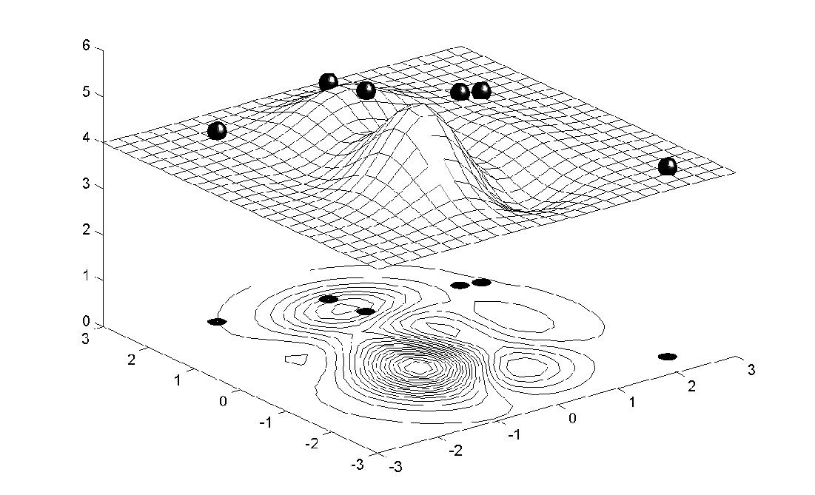
Chromosome locations on the surface of the “peak” function: initial population

Slide 36
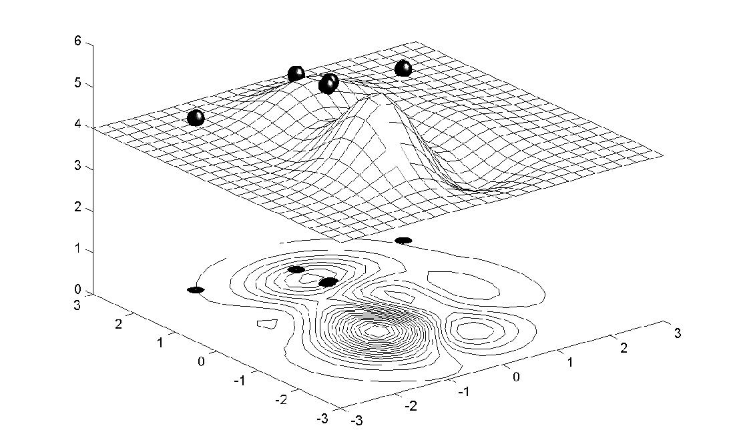
Chromosome locations on the surface of the “peak” function: first generation

Slide 37
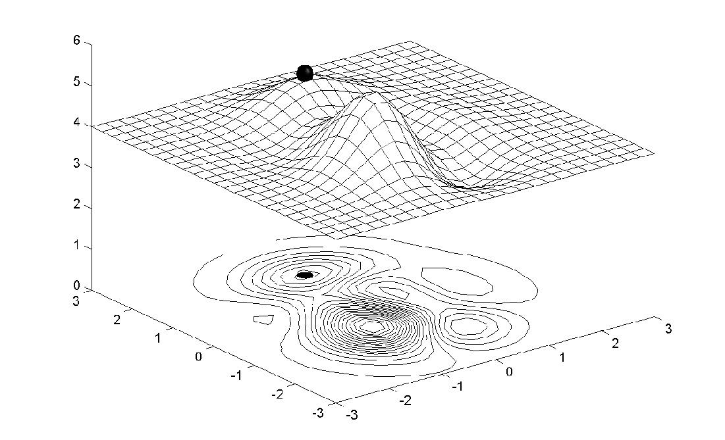
Chromosome locations on the surface of the “peak” function: local maximum

Slide 38
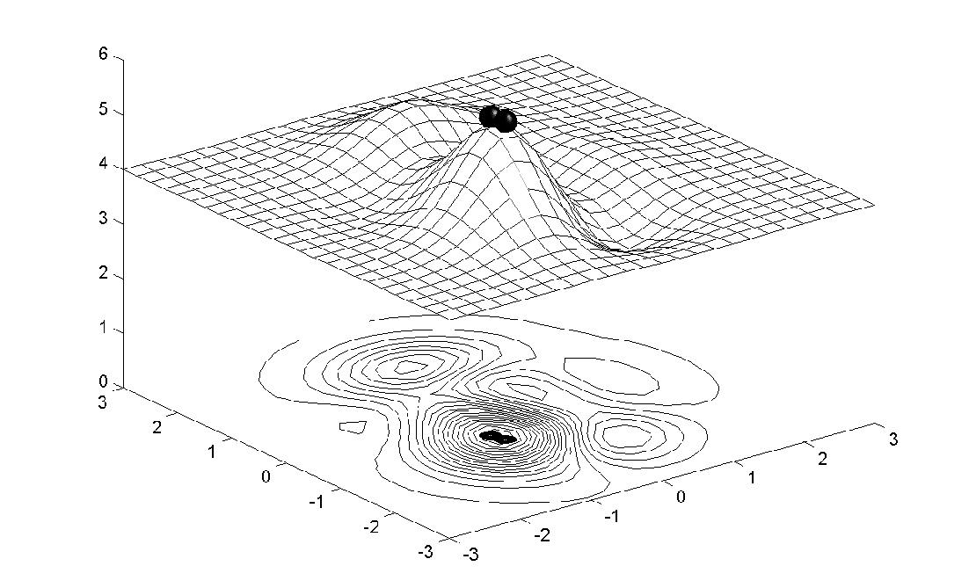
Chromosome locations on the surface of the “peak” function: global maximum

Slide 39
Performance graphs for 100 generations of 6 chromosomes: local maximum
F i t n e s s

Slide 40
Performance graphs for 100 generations of 6 chromosomes: global maximum
F i t n e s s

Slide 41
Performance graphs for 20 generations of
60 chromosomes
F i t n e s s

Slide 42
Lecture 10
Evolutionary Computation: Evolution strategies and genetic programming
Evolution strategies
Genetic programming
Summary

Slide 43
Genetic programming
One of the central problems in computer science is how to make computers solve problems without being explicitly programmed to do so.
Genetic programming offers a solution through the evolution of computer programs by methods of natural selection.
In fact, genetic programming is an extension of the conventional genetic algorithm, but the goal of genetic programming is not just to evolve a bit- string representation of some problem but the computer code that solves the problem.

Slide 44
Genetic programming is a recent development in the area of evolutionary computation. It was greatly stimulated in the 1990s by John Koza.
According to Koza, genetic programming searches the space of possible computer programs for a program that is highly fit for solving the problem at hand.
Any computer program is a sequence of operations (functions) applied to values (arguments), but different programming languages may include different types of statements and operations, and have different syntactic restrictions.

Slide 45
Since genetic programming manipulates programs by applying genetic operators, a programming language should permit a computer program to be manipulated as data and the newly created data to be executed as a program.
For these reasons, LISP was chosen as the main language for genetic programming.
NOTA do BIANCHI: Hoje se usa com qualquer linguagem.

Slide 46
LISP S-expression (− (*A B) C)

Slide 47
How do we apply genetic programming to a problem?
Before applying genetic programming to a problem, we must accomplish five preparatory steps:
1. Determine the set of terminals. 2. Select the set of primitive functions. 3. Define the fitness function. 4. Decide on the parameters for controlling the run. 5. Choose the method for designating a result of the run.

Slide 48
The Pythagorean Theorem helps us to illustrate these preparatory steps and demonstrate the potential of genetic programming. The theorem says that the hypotenuse, c, of a right triangle with short sides a and b is given by
The aim of genetic programming is to discover a program that matches this function.

Slide 49
To measure the performance of the as-yet- undiscovered computer program, we will use a number of different fitness cases. The fitness cases for the Pythagorean Theorem are represented by the samples of right triangles in Table. These fitness cases are chosen at random over a range of values of variables a and b.

Slide 50
Step 1: Determine the set of terminals. The terminals correspond to the inputs of the computer program to be discovered. Our program takes two inputs, a and b.
Step 2: Select the set of primitive functions. The functions can be presented by standard arithmetic operations, standard programming operations, standard mathematical functions, logical functions or domain-specific functions. Our program will use four standard arithmetic operations +, −, * and /, and one mathematical function sqrt.

Slide 51
Step 3: Define the fitness function. A fitness function evaluates how well a particular computer program can solve the problem. For our problem, the fitness of the computer program can be measured by the error between the actual result produced by the program and the correct result given by the fitness case.
Typically, the error is not measured over just one fitness case, but instead calculated as a sum of the absolute errors over a number of fitness cases. The closer this sum is to zero, the better the computer program.

Slide 52
Step 4: Decide on the parameters for controlling the run. For controlling a run, genetic programming uses the same primary parameters as those used for GAs. They include the population size and the maximum number of generations to be run.
Step 5: Choose the method for designating a result of the run. It is common practice in genetic programming to designate the best-so-far generated program as the result of a run.

Slide 53
Once these five steps are complete, a run can be made. The run of genetic programming starts with a random generation of an initial population of computer programs. Each program is composed of functions +, −, *, / and sqrt, and terminals a and b.
In the initial population, all computer programs usually have poor fitness, but some individuals are more fit than others. Just as a fitter chromosome is more likely to be selected for reproduction, so a fitter computer program is more likely to survive by copying itself into the next generation.

Slide 54
Crossover in genetic programming:
Two parental S-expressions

Slide 55
Crossover in genetic programming:
Two offspring S-expressions

Slide 56
Mutation in genetic programming
A mutation operator can randomly change any function or any terminal in the LISP S-expression. Under mutation, a function can only be replaced by a function and a terminal can only be replaced by a terminal.

Slide 57
Mutation in genetic programming:
Original S-expressions

Slide 58
Mutation in genetic programming:
Mutated S-expressions

Slide 59
In summary, genetic programming creates computer programs by executing the following steps:
Step 1: Assign the maximum number of generations to be run and probabilities for cloning, crossover and mutation. Note that the sum of the probability of cloning, the probability of crossover and the probability of mutation must be equal to one.
Step 2: Generate an initial population of computer programs of size N by combining randomly selected functions and terminals.

Slide 60
Step 3: Execute each computer program in the population and calculate its fitness with an appropriate fitness function. Designate the best- so-far individual as the result of the run.
Step 4: With the assigned probabilities, select a genetic operator to perform cloning, crossover or mutation.

Slide 61
Step 5: If the cloning operator is chosen, select one computer program from the current population of programs and copy it into a new population.
• If the crossover operator is chosen, select a pair of computer programs from the current population, create a pair of offspring programs and place them into the new population.
• If the mutation operator is chosen, select one computer program from the current population, perform mutation and place the mutant into the new population.

Slide 62
Step 6: Repeat Step 4 until the size of the new population of computer programs becomes equal to the size of the initial population, N.
Step 7: Replace the current (parent) population with the new (offspring) population.
Step 8: Go to Step 3 and repeat the process until the termination criterion is satisfied.

Slide 63
Fitness history of the best S-expression

Slide 64
What are the main advantages of genetic programming compared to genetic algorithms?
Genetic programming applies the same evolutionary approach. However, genetic programming is no longer breeding bit strings that represent coded solutions but complete computer programs that solve a particular problem.
The fundamental difficulty of GAs lies in the problem representation, that is, in the fixed-length coding. A poor representation limits the power of a GA, and even worse, may lead to a false solution.

Slide 65
A fixed-length coding is rather artificial. As it cannot provide a dynamic variability in length, such a coding often causes considerable redundancy and reduces the efficiency of genetic search. In contrast, genetic programming uses high-level building blocks of variable length. Their size and complexity can change during breeding.
Genetic programming works well in a large number of different cases and has many potential applications.

Slide 66
Programação Genética Aplicada ao Controle

Slide 67
Evoluindo Agentes Jogadores de Futebol
Luiz Carlos Maia Junior
Reinaldo Bianchi
Faculdade de Engenharia Industrial
FEI - São Bernardo do Campo

Slide 68
Objetivo
Objetivo:
Estudo da implementação de agentes inteligentes usando Programação Genética.
Domínio:
Futebol de Robôs.
Partidas de Futebol entre Robôs:
Motivantes;
Possibilitam a realização de experimentos reais;
Permite o desenvolvimento e testes de robôs com comportamento inteligente e cooperatividade.

Slide 69
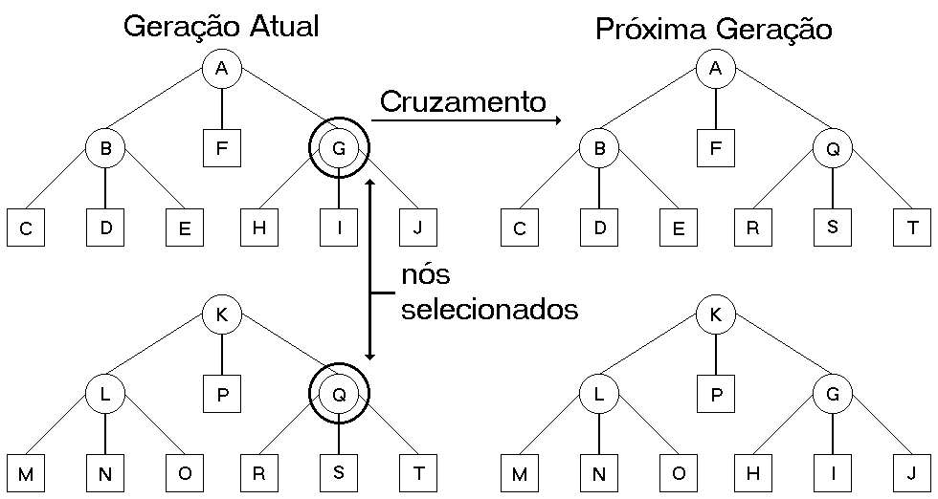
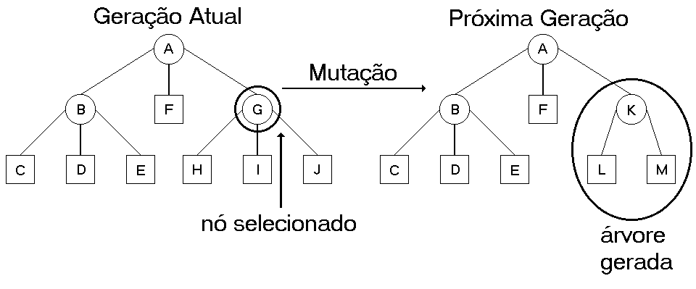
Programação Genética (II)
Cruzamento
São escolhidos dois indivíduos, selecionados pontos de cruzamento, e são criados dois descendentes.
Mutação
Um indivíduo é selecionado, um ponto de mutação, e a partir dele é criado um novo ramo. A mutação é pouco utilizada.

Slide 70
Agente Seguidor de Paredes (Koza, 1992)
Funções
PROGN3 (3), PROGN2 (2), IFWALL (I).
Terminais
WALKFRONT (F), WALKBACK (B), RIGHT (R), LEFT (L).
Parâmetros usados na Simulação
População (M) = 500;
Probabilidade de Cruzamento = 70%;
Probabilidade de Reprodução = 30%;
Limite de complexidade (no sorteio) = 1000.
Medida de Fitness:
fitness = fit – ( unfit / 500 );
fit: quantas vezes se movimentou dentro do caminho ideal;
unfit: quantas vezes se desviou ou revisitou uma posição.

Slide 71
Agente Seguidor de Paredes (II)
Exemplo de Gráfico Evolutivo

Slide 72
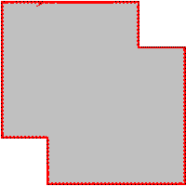
Agente Seguidor de Paredes (III)
Exemplo de Caminho Percorrido
Geração 7
Geração 48

Slide 73
Agente Seguidor de Bola
Funções
PROGN3 (3), PROGN2 (2), IFWALL (I);
Terminais
WALKFRONT (F), WALKBACK (B), RIGHT (R), LEFT (L), ALIGN (A).
Parâmetros
Iguais ao anterior.
Medida de Fitness:
fitness = hits * k – Σ(n / Dini);
hits quantas vezes atingiu a bola;
n é o número de passos (terminais que executou);
Dini é a distância inicial (ou com a bola parada);
n / Dini é recalculado a cada vez que o robô atinge a bola.

Slide 74
Agente Seguidor de Bola (II)
Exemplo de Gráfico Evolutivo

Slide 75
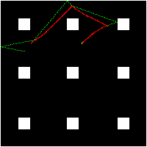
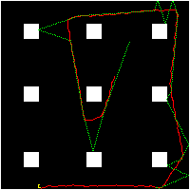
Agente Seguidor de Bola (III)
Exemplo de Caminho Percorrido
Geração 1
Geração 41

Slide 76
Implementação
A implementação foi feita no Sistema Operacional Linux em Linguagem C (compilador gcc);
Para organização das árvores e busca foi utilizada a busca “node left-right” que simplifica o processo;
Uma execução de 51 gerações leva em média 50 minutos para ser executada em um Celeron 400 MHz;
Os 100 melhores indivíduos da última geração e os dados necessários sobre a execução foram salvos em arquivo para serem analisados depois.

Slide 77
Conclusão
Os resultados obtidos permitem concluir que:
a Programação Genética possibilita a criação de indivíduos que apresentam os comportamentos básicos para atuar com eficiência no domínio do Futebol de Robôs.
Pode-se criar qualquer tipo de indivíduo desde que sejam conhecidas as habilidades necessárias e sua relação com o ambiente:
A simulação do ambiente é um aspecto muito importante na Programação Genética.

Slide 78
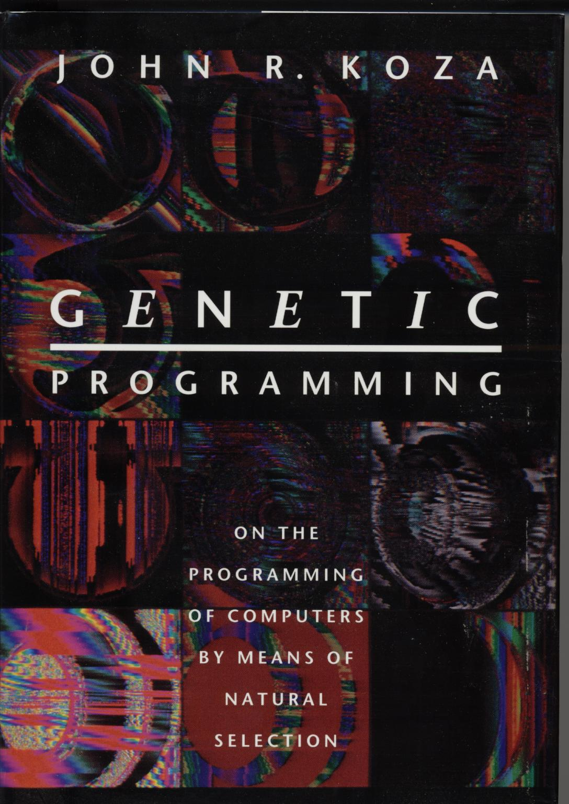
Exemplo Wall Follower, Box Mover
Do Livro Genetic Programming, Koza, 1992.

Slide 79
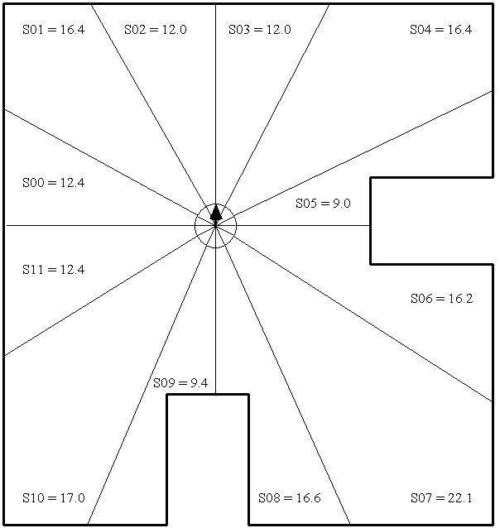
WALL-FOLLOWER
Notes:
BBB??? No number, only existed as embedded word file

Slide 80
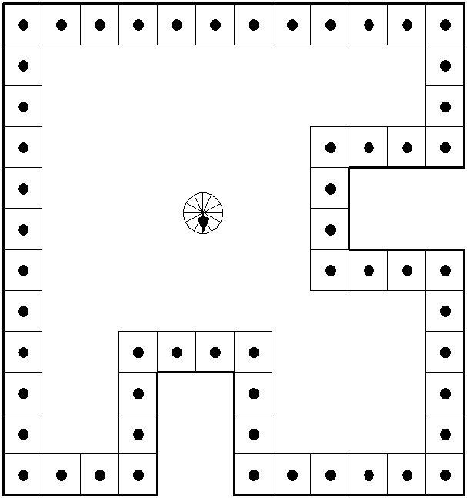
FITNESS
Notes:
BBB??? No number, only existed as embedded word file

Slide 81
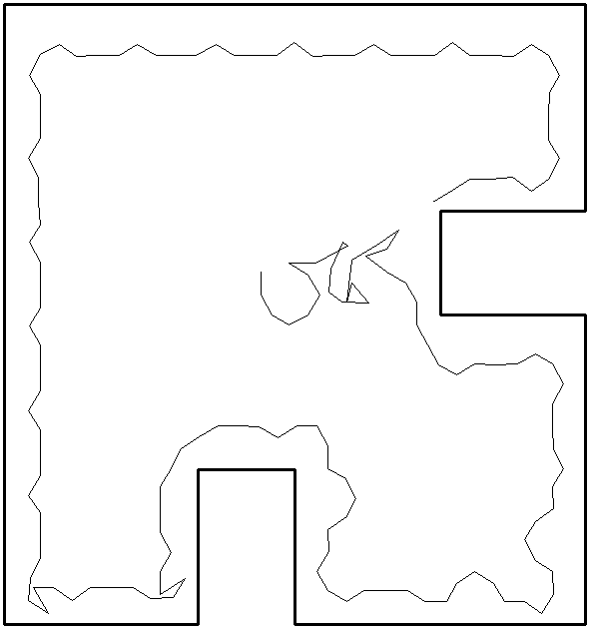
BEST OF GENERATION 57
Notes:
BBB??? No number, only existed as embedded word file

Slide 82
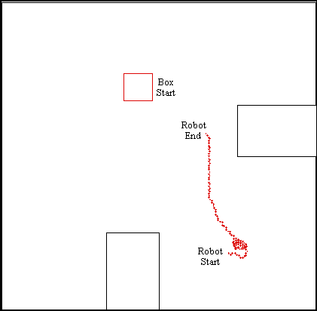
BOX MOVER - BEST OF 1st G

Slide 83
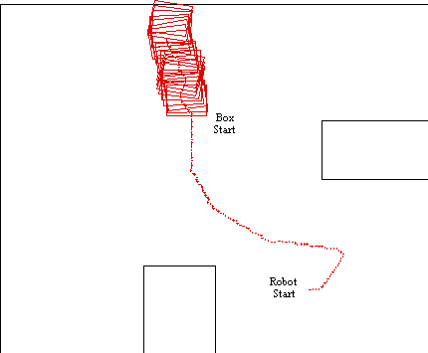
BOX MOVER GEN 45 – FITNESS CASE 1

Slide 84
GA Aplicado ao Controle
Sintonia de Controladores PID utilizando Algoritmos Genéticos
J. Franco M. Amaral, M. A. C. Pacheco, R. Tanscheit
Revista RICA, no. 8

Slide 85
Sintonia de Controladores PID utilizando Algoritmos Genéticos
O objetivo básico é a obtenção de ganhos do PID que satisfaçam a especificação de desempenho indicada pela forma da resposta ao degrau, em malha fechada, do sistema global.
A tarefa do AG é determinar o conjunto de ganhos que produz uma resposta de saída mais próxima da forma de resposta desejada em relação às mudanças de set-point.

Slide 86
Gene
No método proposto, os AG são aplicados como técnica de busca/otimização dos três ganhos associados ao tradicional controlador PID clássico:
Kp = ganho proporcional, Ki = ganho integral e Kd = ganho diferencial.
Estes três parâmetros caracterizam o indivíduo a ser avaliado.

Slide 87
Aptidão
Tendo em vista o objetivo principal, que é realizar a sintonia tendo como ponto de partida a resposta desejada ao degrau para o sistema global em malha fechada, o cálculo da aptidão para os indivíduos foi feito usando a diferênca quadrática:
Apt = Σn [Valor desejado – Valor obtido]^2

Slide 88
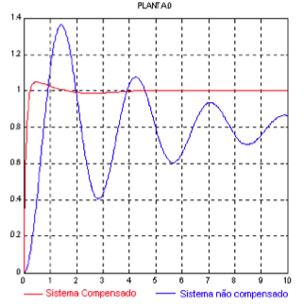

Resultados
Planta:
Ganho encontrados : Kp = 4,0; Ki = 5,0 e Kp = 3,11.
Obtidos após 10 gerações de uma população de 50 indivíduos.

Slide 89
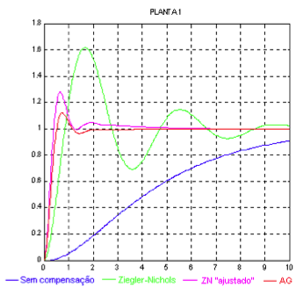


Resultados 2
Planta:
Ganhos:

Slide 90
Complicando ainda mais…
Sempre é possível combinar os diversos métodos de Inteligência Computacional…
Que tal Fuzzy-Genético?

Slide 91
Complicando ainda mais…
ALGORITMOS GENÉTICOS PARA OTIMIZAÇÃO DE UM CONTROLADOR NEBULOSO PARA SUPRESSÃO DE VIBRAÇÕES
Fábio M. U. Araújo, Carlos A. G. Fonseca, André L. Maitelli, Anderson V. de Medeiros

Slide 92
Objetivo
Neste trabalho um controlador nebuloso, tipo Takagi- Sugeno-Kang (TSK), utilizado para suprimir vibrações mecânicas, tem suas funções de pertinência otimizadas.
Um AG é usado para otimizar o conjunto das funções de pertinência, de entrada e saída, de tal controlador

Slide 93
Genes
Ccada indivíduo é formado por 22 genes.
Os dois primeiros genes do indivíduo correspondem aos coeficientes t1 e t2 da função linear de saída do controlador nebuloso.
Os demais genes são uma representação das funções de pertinência por seus pontos notáveis - funções triangulares.

Slide 94
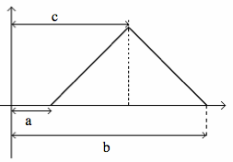
Gene

Slide 95
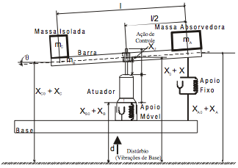
O Sistema Controlado

Slide 96
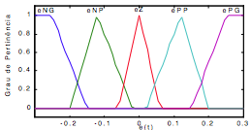
Resultados – Sistema Original

Slide 97
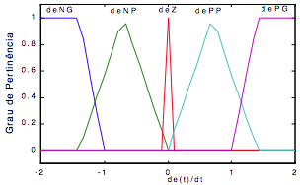
Resultados – Sistema Otimizado

Slide 98
Conclusão
Algoritmos Genéticos são ótimos para Otimização:
Centenas de Aplicações.
Em controle, utilizado para otimizar parâmetros de controladores, ou para criar programas controladores.

Slide 99
Laboratório
Problema do “Caixeiro Viajante” (TSP)
Mapas fornecidos
5, 10, 20,50 e 100 Cidades
Cada um possui uma variável mapa.
mapa(:,1) : sequencial da cidade.
mapa(:,2): Coordenada x.
mapa(:,3): Coordenada y .
Visualizar mapa
scatter(mapa(:,2,:),mapa(:,3,:))

Slide 100
AG no Matlab
[x,fval] = ga(FitnessFcn,numberOfVariables,options)
FitnessFcn → função objetivo
Ex.: FitnessFcn = @(x) (x(1)^2-x(2))
No TSP, distância percorrida em cada solução
numberOfVariables → qtdd de variáveis
No exemplo anterior, numberOfVariables =2
No TSP, quantidade de cidades!
Options.....

Slide 101
AG no Matlab
options = gaoptimset('PopulationType', 'custom',...
'PopInitRange',[1;cities],...
'CreationFcn',@create_permutations, ...
'CrossoverFcn',@crossover_permutation, ...
'MutationFcn',@mutate_permutation, ...
'PlotFcn', my_plot, ...
'Generations',50000,...
'PopulationSize',50, ...
'StallGenLimit',300,...
'Vectorized','on',...
'UseParallel','always',...
'TolFun',0,...
'Display','iter',...
'EliteCount',30);

Slide 102
AG no Matlab
[x,fval] = ga(FitnessFcn,numberOfVariables,options)
x → resposta mínima para FitnessFcn
No TSP, x{1} é a sequencia de cidades a percorrer
fval→ valor de FitnessFcn em x

Slide 103
AG no Matlab
Relatório
Menor distância percorrida para cada um dos mapas fornecidos.
Quantas gerações necessárias?
Variar tamanho da população
O que acontece? Converge mais rápido para a solução ótima?
Varia elitismo
O que acontece? Converge mais rápido para a solução ótima?

Slide 104
Fim

