Slide 1
Understanding FunScript
Ryan Riley and Daniel Mohl
@panesofglass and @dmohl
wizardsofsmart.net
Blog.danielmohl.com

Slide 2


FunScript
Build full web stack in F#
Generate JavaScript from F# for browser or Node.js
F# Quotations to string (AST)
400+ bootstrapped tests
Use F# records, discriminated unions, classes, modules, pattern matching, async workflows, etc.
Array, List, Seq, Option, Map, Set
TypeScript Provider

Slide 3

Building a Solution with FunScript
A simple TODO app
Reviewing the JavaScript

Slide 4
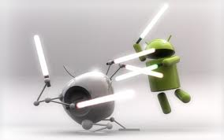
Lab Time
Lab walk through
Your Turn

