Slide 1
Student Details
Name : Priyadarshi Jindal
Student ID : STU6437f516a40961681388822
SkillsBuild Email-ID : priyadarshijindal@gmail.com
Internship domain : Artificial Intelligence
Start Date : : 12-06-2023
End date : : 24-07-2023

Slide 2
PROJECT TITLE
MENTAL FITNESS TRACKER

Slide 3
Problem statement
To develop a Machine Learning model having capability of analyzing health records and medical data of a patient to predict Disability-Adjusted Life Year (DALY), helping doctors and other mental health professionals in proactive diagnosis and treatment planning for it.

Slide 4
AGENDA/Process
Understanding project topic and do research work on it
Deciding working steps to develop project
Searching of relative Datasets for the project
Dataset Analysis and Data-Preprocessing
Use of suitable ML Models to predict the output
Evalutaing the accuracy of model
Use of model for the cause (to analyze mental health)

Slide 5
PROJECT OVERVIEW
The goal of this project is to develop a ML model that is capable of analyzing and predicting mental fitness of a human, based on the different input related to mental health provided to it. The inputs contains different data like past medical history of bipolar disorder etc. Different datasets and an advance ML model algorithm – Random Forest Regressor is used to achieve the project goals. Mental health workers and doctors can use this model as a tool for predicting mental health status of an individual and take suitable steps to help him to overcome from it and helping society to get rid of this mental health problem when suffered.

Slide 6
WHO ARE THE END USERS of this project?
Mental Health Professionals : Psychiatrist and his associated workers can use this tool to analyze the mental health of patients
Mental Health Organizations and Hospitals/Clinics : Hospitals can adapt this tool so that doctors working in it can increase their efficiency to tackle mental health problems of patients
Companies : Companies can tie up with doctors and can use this tool to look after the mental health of employees
Social Workers and NGOs : They can also use this tool for the well being of society. One such area is schools and colleges where they can use this tool for students to analyze their mental health status

Slide 7
YOUR SOLUTION AND ITS VALUE PROPOSITION
Random Forest Regressor based ML Model to predict Mental Health Fitness of an individual by calculating DALY of a patient
Helps health professionals to efficiently predict the mental health of a patient
On successful detection helps both doctors and patients to tackle the problem early and more efficiently
Diverse area sectors like schools, colleges etc. can use this tool for analyzing mental health of individuals and help to prevent or cure the problem and hence improving the life expectancy of an individual

Slide 8
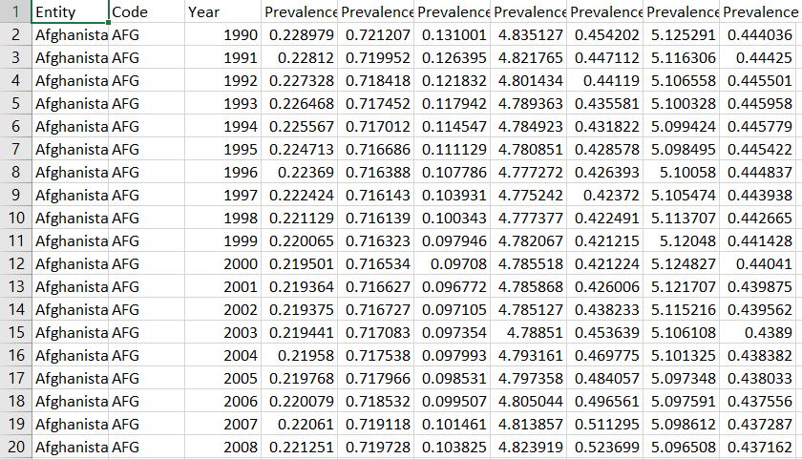
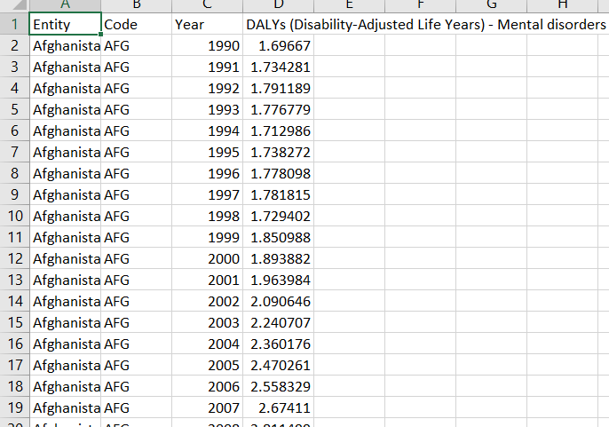
How did you customize the project and make it your own
By using various inbuilt libraries of python and socially available datasets for mental health, and by implementing /using them in my project I had made it my own

Slide 9
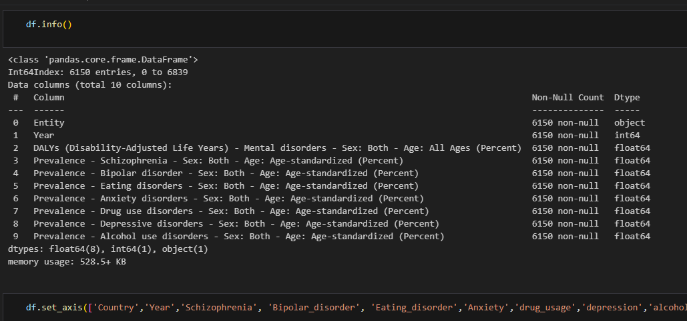

Slide 10
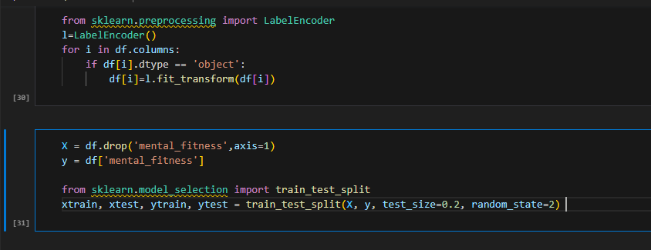
MODELLING

Slide 11
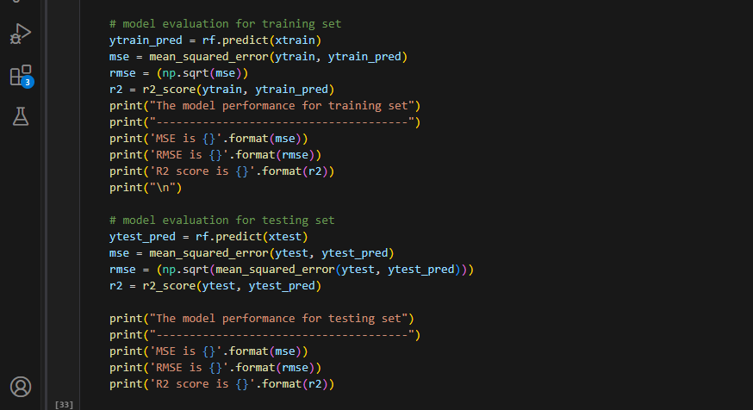
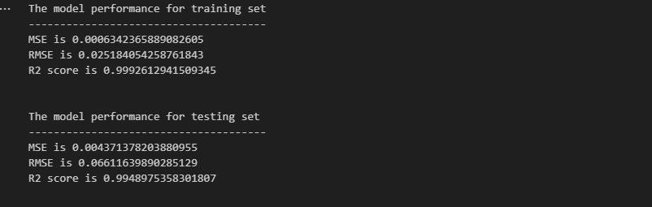
Results

Slide 12
links
Code Link :
https://drive.google.com/drive/folders/1bQbDH5b6BIIR8B3G5SDCWi8fGnxV6QU?usp=drive_link
Drive Link : https://drive.google.com/drive/folders/1bQbDH5b6BIIR8B3G5SDCWi8fGnxV-6QU?usp=drive_link

