Slide 1


ROCKBUSTER Movie Market Around The World
Erjola Alihoxha

Slide 2
Understanding the problem
Product Sales
Product Locations
Sales for all Locations
Which movies contributed the most,/least in the revenue?
What was the average rental duration for all videos?
Which countries are Rockbuster customer based in?
Where are the customers with high lifetime based in?
Do sales figures vary between geographic regions?

Slide 3
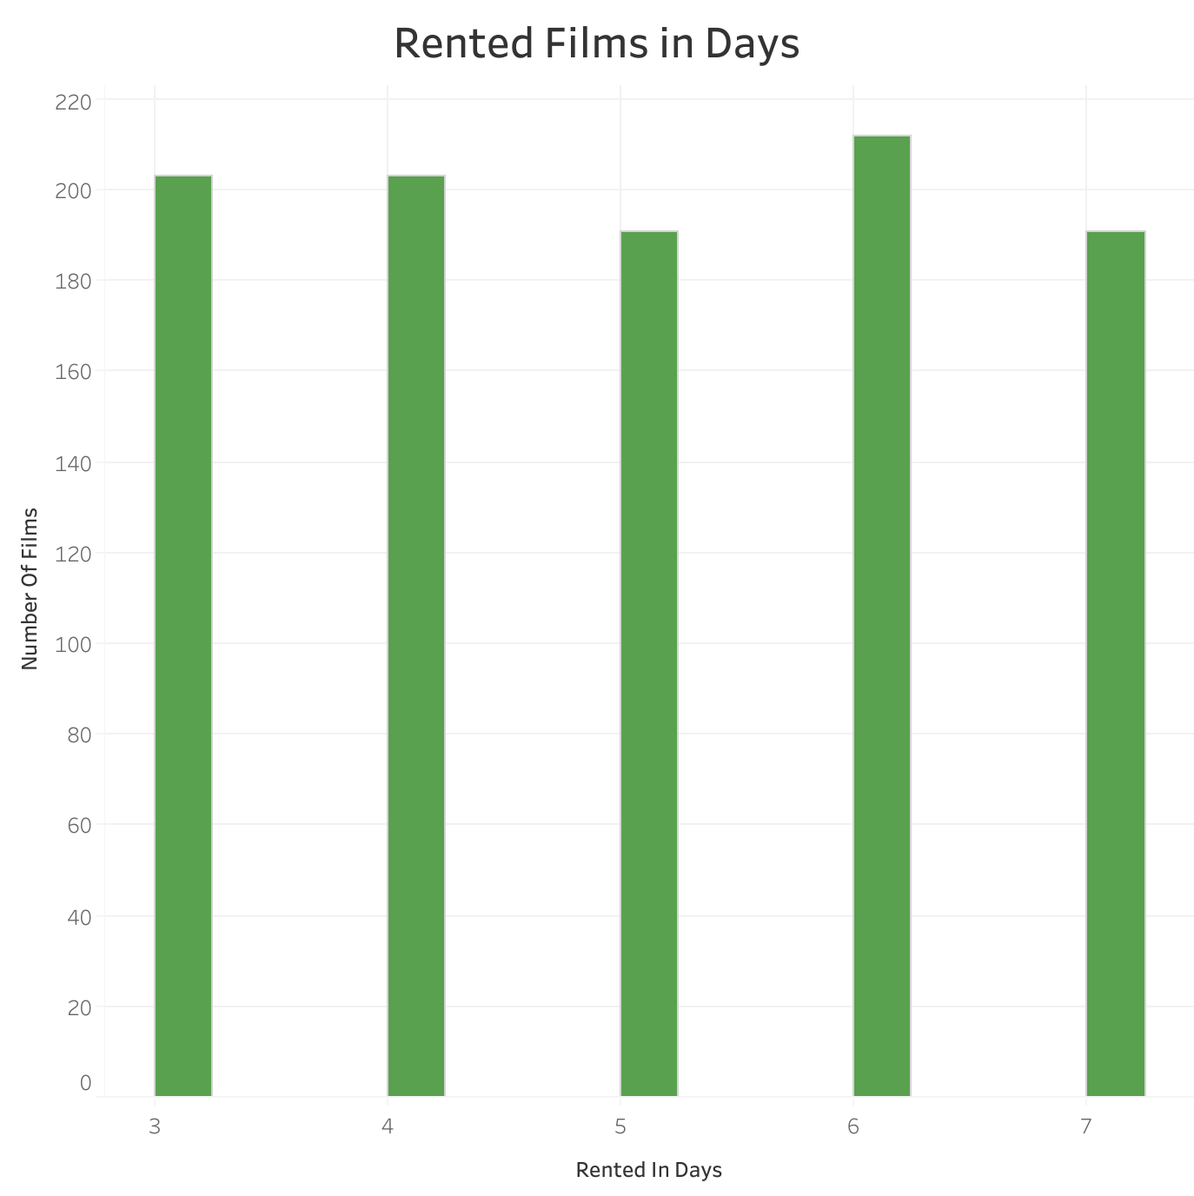
A trend of how long the movies are rented.
Rockbuster average rental duration is 4.986 days with the maximum number of renting in 6 days.
Notes:
https://public.tableau.com/app/profile/erjola.alihoxha/viz/RentedFilmsinDays/Sheet1

Slide 4
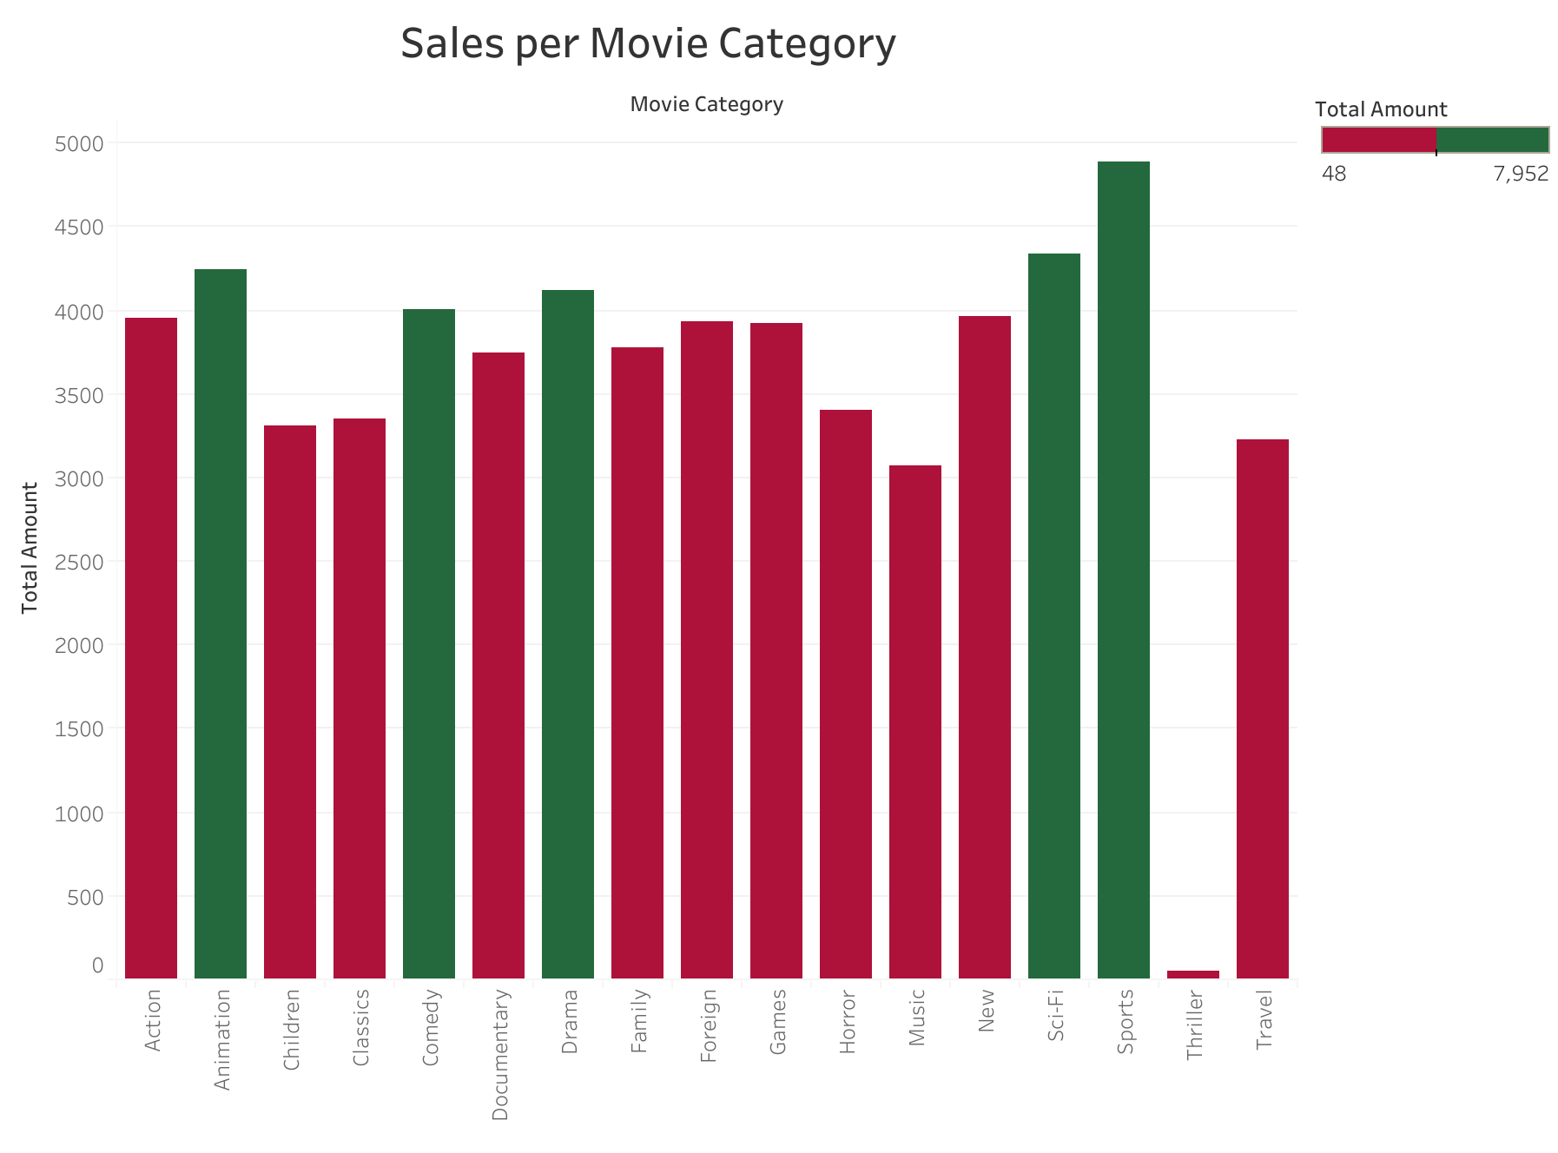
The graph represents sales by movie category. The top five categories that contributed the most in Rockbuster sales are Sports, Sci-Fi, Animation, Drama and Comedy.
Notes:
https://public.tableau.com/app/profile/erjola.alihoxha/viz/RockbusterMovieCategory/SalesbyMovieCategory?publish=yes

Slide 5
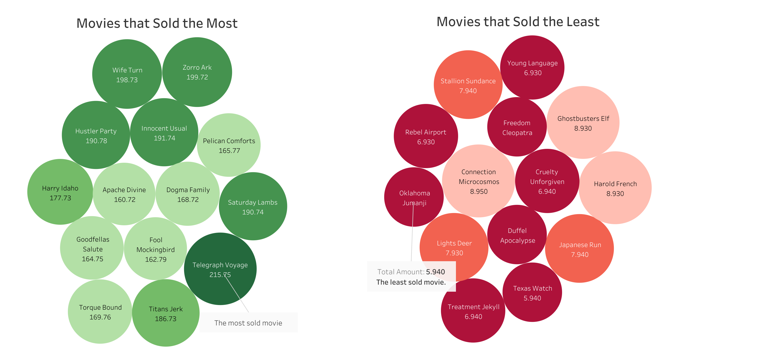
On the left side are the movies that contributed the most on Rockbuster revenue, above $160 per movie, and on the right side are the movies that contributed the least, below $10 per movie.
Notes:
https://public.tableau.com/app/profile/erjola.alihoxha/viz/Rockbustermostleastmoviesales/Dashboard1

Slide 6
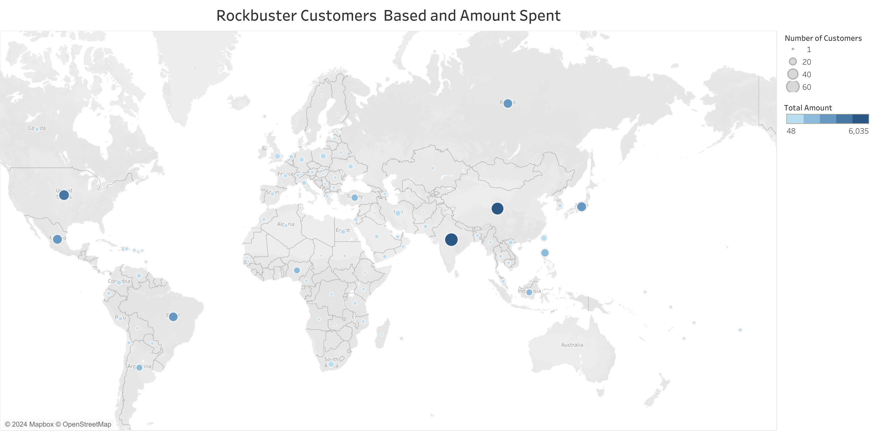
As seen from the visualization, sales vary from region to region with India, China, and the United States leading the highest number of customers and sales.
Notes:
https://public.tableau.com/app/profile/erjola.alihoxha/viz/RockbusterProjectC/Sheet1

Slide 7
Conclusions
The average rental duration is 4.986 days.
The average rental rate is $2.98
The most sold movie categories in Rockbuster are Sports, Sci-Fi, Animation, Drama and Comedy.
The sales vary from region to region, and the top three countries with highest number of customers and sales are India, China, and the United States

Slide 8

Thank you!
For further questions contact me at alihoxhaerjola@gmail.com

