Slide 1
Data Science Project: VeriSpor
Erkam Çetkin Meltem Karabastık Helin Kuş Fatih Mehmet Alagöz Uğur Kılıçdoğan

Slide 2
Introduction
This project aims to build good machine learning using data science techniques. The main purpose of this project is to make the data suitable for machine learning by using data Preprocessing techniques and to achieve high accuracy results. Commonly used preprocessing steps are data cleaning, data integration, data transformation, feature selection, data encoding, handling outliers, data splitting

Slide 3
Data Preprocessing
Data preprocessing is one of the most important steps in data science. It includes the preparation and cleaning of raw data before it is used for analysis and modelling. In other words, it is the improvement studies on the data set. We used data preprocessing techniques to improve the quality of the data and ensure the accuracy of our model.

Slide 4
Data Preprocessing
A. Data Cleaning
Nowadays, raw data may contain errors or missing values. Our data set has too many missing values and they reduce data quality and may adversely affect its analysis. Thanks to data cleaning, we ensure the accuracy of the data set and improvment of the model performance. So, we struggled with editing the missing data in data set. We use pipeline method and thanks to the pipeline, all codes appear sequentially on a single line, reducing the risk of errors. In addition, we can get more results with less code. We filled these missing data according to the type of each column​

Slide 5
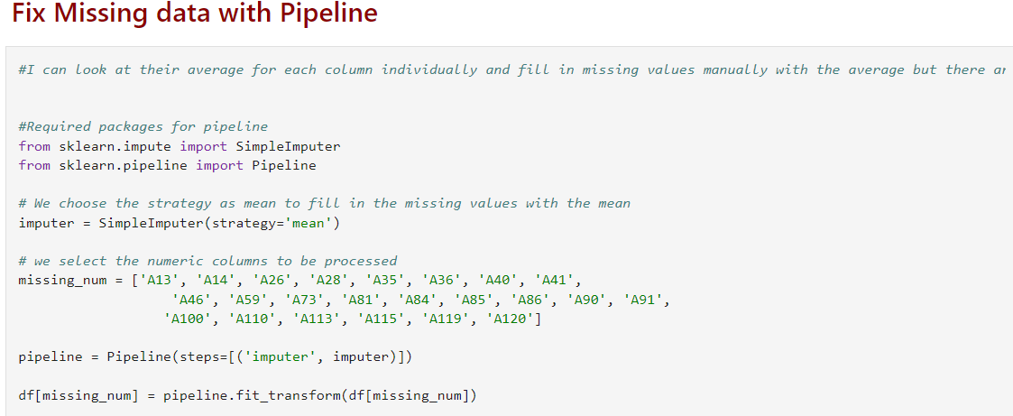
Data Preprocessing
A. Data Cleaning(Cont)
For this example, we filled in the missing values by averaging because values are numeric. So that machine learning model is not affected by missing data.

Slide 6
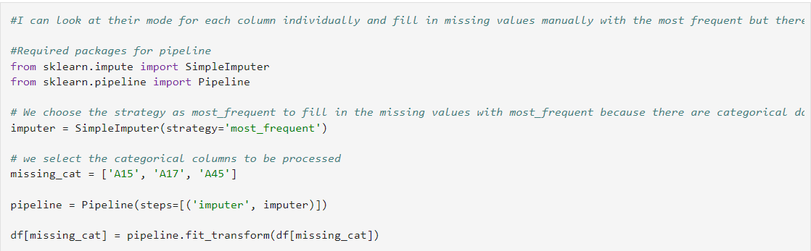
Data Preprocessing
A. Data Cleaning (Cont)
On the other hand, for categorical values, missing data is filled with the mode. Mode represents the most common or most frequently used value of a categorical variable. Therefore, we used mode for categorical variables so that our machine learning model is not affected by missing values

Slide 7
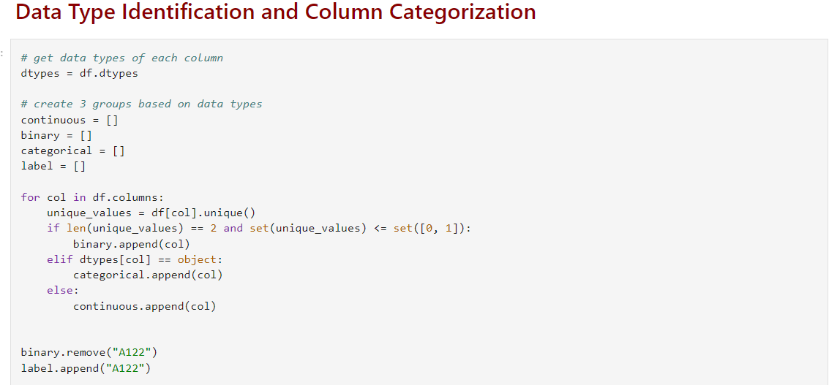
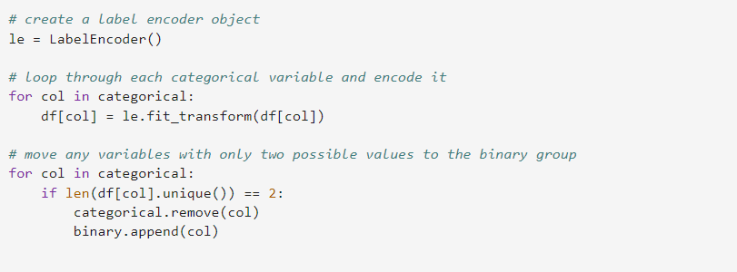
Data Preprocessing
B. Data encoding and Feature selection
Another important data preprocessing step that we applied is data encoding and feature selection.
Notes:
In this step, we divided the data into 3 different categories according to their types as continuous, binary, and categorical. By categorizing the data, we can apply to appropriate data preprocessing techniques for each data type. For example, for binary variables that include yes-no, male-female we can encode them as 0s and 1s and it is a important preprocessing technique for machine learning. After that, we apply to data encoding that is a data preprocessing method. We encoded categorical values as numeric labels to make the dataset ready before machine learning. Most machine learning algorithms work with numerical values because direct use of categorical values is not in a format that machine learning algorithms can understand. The reason of this machine learning algorithms require numerical data in order to perform mathematical operations and calculations.

Slide 8
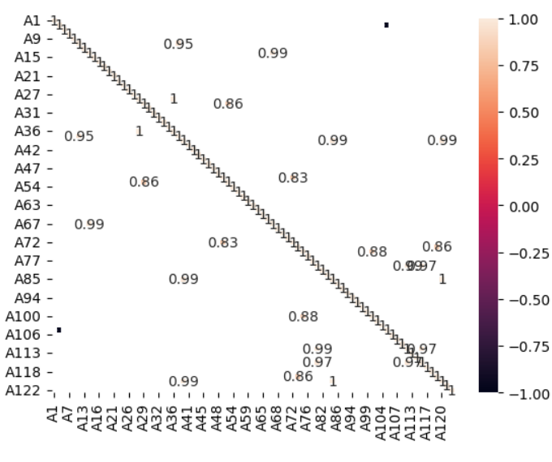
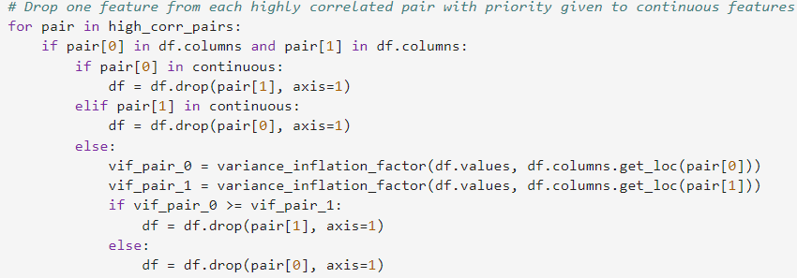
Data Preprocessing
C. Correlation Matrix
We examined the correlation matrix as another important data preprocessing step
Notes:
Firstly, We filtered the columns greater than 0.8 and less than -0.8 and visualized them to see the relationship between them. In machine learning, highly correlated pairs can cause multicollinearity problems. So, We Identify Highly Correlated Feature Pairs and extracted one feature from each highly correlated pair to eliminate redundancy. So, by preventing overfitting we made our dataset more suitable for machine learning.

Slide 9
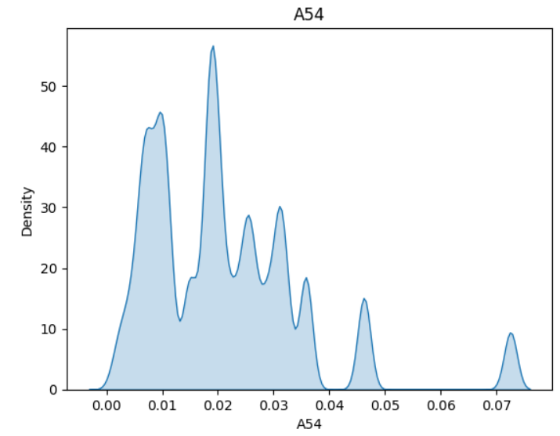
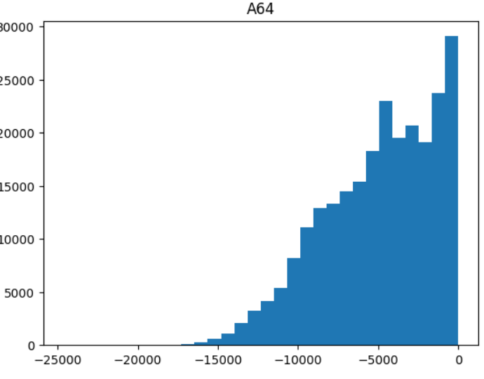
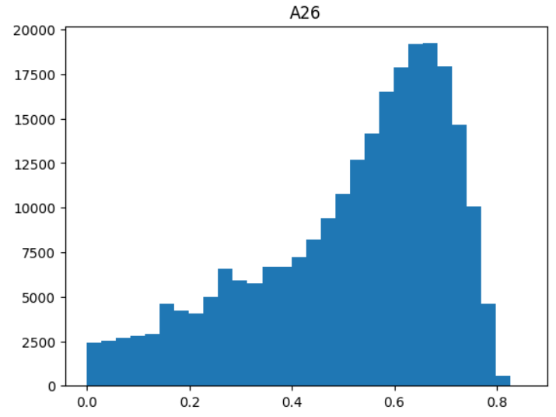
Data Preprocessing
D. Visualization Methods
Another of the most important data preprocessing steps is data visualization.
Visualization for Continuous Feature
Notes:
we appleid to data visualization because before machine learning we wanted to make sure the data is clean, fit and see visually if there are any errors. We use Histograms for Continuous Features because histogram provide insights into the range, central tendency, and spread of the data. They show the distribution of values for each continuous feature. So histograms help us understand the characteristics of the data and enable us to make the right decisions in data analysis and modelling. Furthermore, we use count plots for categorical features. They show the distribution of each category. Using these visualizations before machine learning, we can better understand data and review errors for the last time

Slide 10
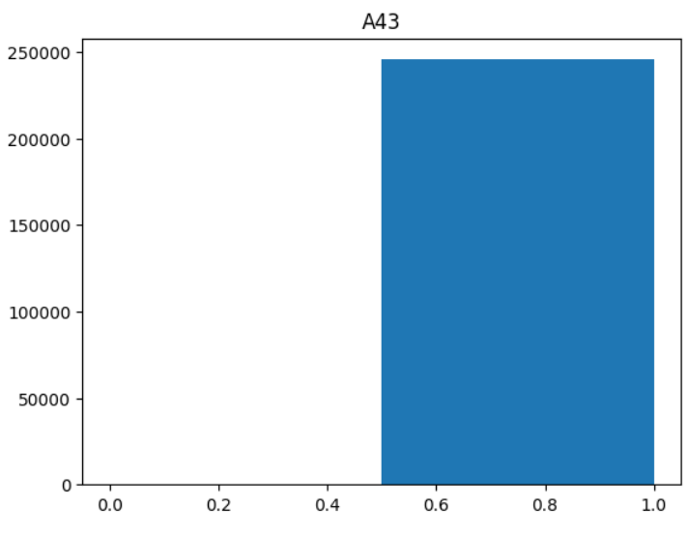
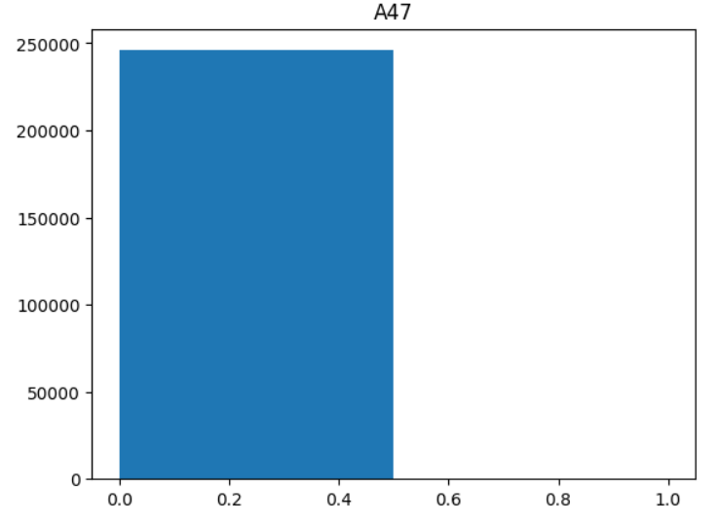
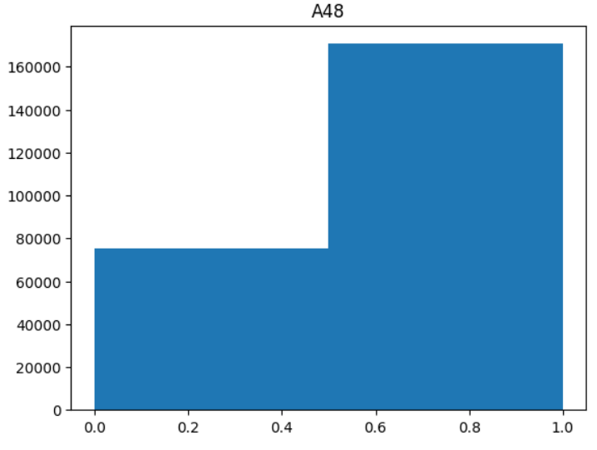
Data Preprocessing
D. Visualization Methods(Cont)
Visualization for Binary Feature

Slide 11
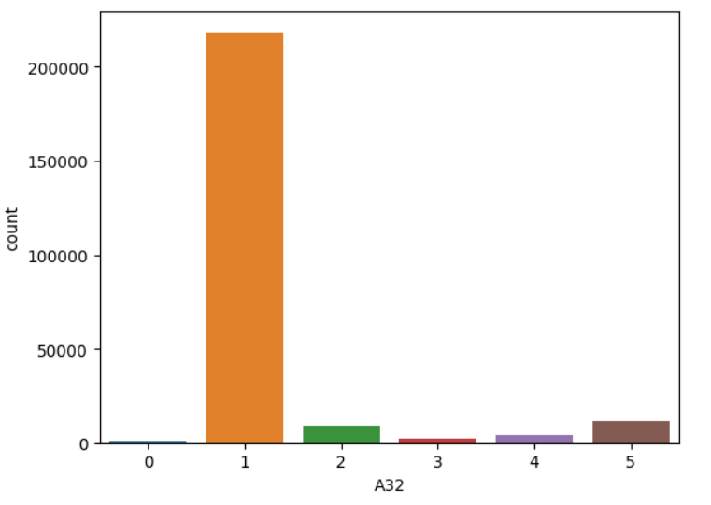
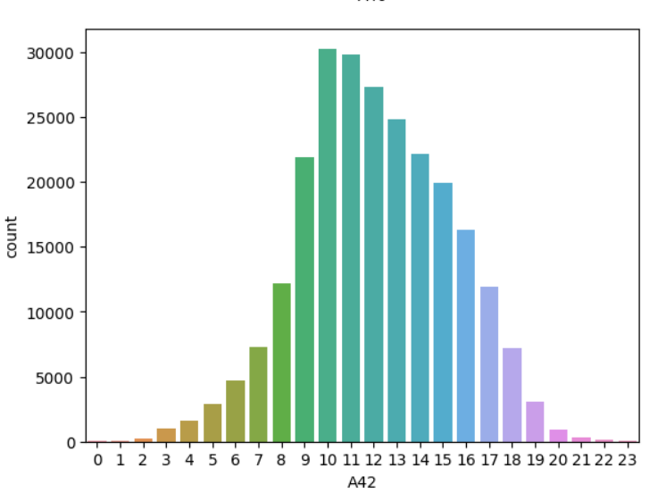
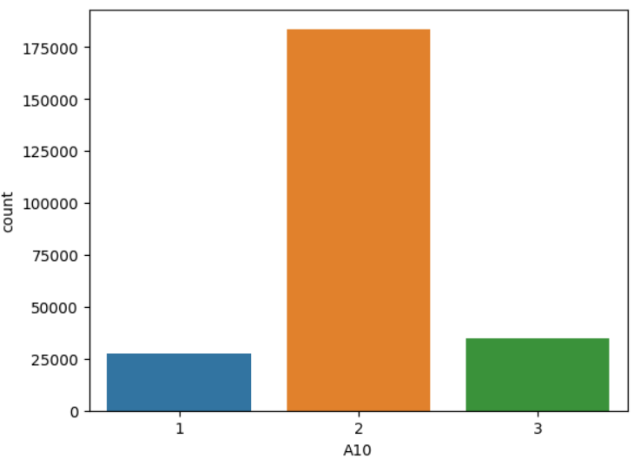
Data Preprocessing
D. Visualization Methods(Cont)
Visualization for Categorical Feature

Slide 12
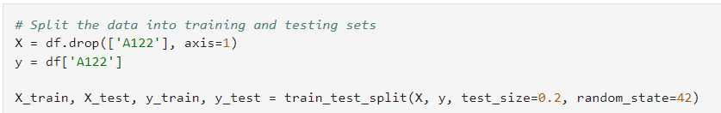
Data Preprocessing
F. Data Splitting
Before starting machine learning, another important data preprocessing step is data splitting.
Notes:
The purpose of data splitting is to evaluate the performance of a machine learning model on unseen data. We divided the data as training and test set and created our model on the training set and evaluated its performance on the test set. By doing this, we get an estimate of how the model we created performs on the new data. In addition, the model we created may perform well on the training set, but may perform poorly on new data. This indicates that overfitting can exist.

Slide 13
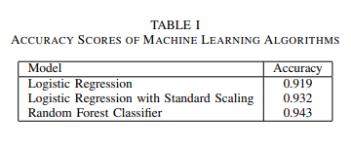
MACHINE LEARNING MODELS
We used some machine learning algorithms to predict the target variable based on our features.
A. Logistic Regression
B. Logistic Regression with Standard Scaling
C. Random Forest Classifier
Notes:
A. Logistic Regression we used logistic regression as machine learning in our project. Because we are trying to find out how well our machine learning fits the real data, and since our target column is binary data. So, we used the logistic regression model, which is a classification algorithm. Finally, we trained the Logistic Regression model on the training data and evaluated performance. By using logistic regression model, Our accuracy score is ”0.9192”. Accuracy score indicates how well the model performs in predicting the target variable B. Logistic Regression with Standard Scaling We applied standard scaling to improve the performance of the our Logistic Regression model. We used standard scaling because we ensure that all features were at the same scale. Thus, we ensured that the performance of our model could be better. The model was trained on the scaled training data and The performance of the model was evaluated using the accuracy score. By using Standard Scaling our accuracy score is 0.9193 and it shows an improvement over the previous model. C. Random Forest Classifier Finally, We applied random forest classifier machine learning algorithm in our project. Using this algorithm we wanted our accuracy value to be slightly better. Random Forests can reduce overfitting and improve generalization performance. By using Random Forest Classifier our accuracy score is 0.9193 we can say Using the Random Forest Classifier algorithm is an effective method when predicting the target variable.

Slide 14
Challenges and Solutions
Dealing missing data
One of the most important difficulties we faced in our project was dealing with missing data. there was too much missing data in the dataset. But, we overcame this challenge by using the pipeline method, spending less time and code.
feature selection and deletion of not useful features
there are so many features, it took us a while to figure out and find what features were needed. Thanks to the correlation analysis, we figured out which columns we should delete and thus we deleted the features that were not useful in the dataset
Notes:
Firstly, the fact that the columns in the dataset are not named and not knowing the logic of the dataset caused us to not fully understand the project. One of the most important difficulties we faced in our project was dealing with missing data. there was too much missing data in the dataset. But, we overcame this challenge by using the pipeline method, spending less time and code. Another challenge we faced in our project was feature selection and deletion of not useful features. Because there are so many features, it took us a while to figure out and find what features were needed. Thanks to the correlation analysis, we figured out which columns we should delete and thus we deleted the features that were not useful in the dataset. Additionally, we preserved the useful features in the dataset. By doing this, we also prevented overfitting.

Slide 15
THANK YOU

