Slide 1

06.05.2025
AWS-DevOps
NT
Devops
Prometheus-Grafana
B 303

Slide 2
Monitoring: What it is & why to

Slide 3
Monitoring: What it is & why to
Monitoring is watching: It's like keeping an eye on your computer systems to see how they're doing.
Collect data: Monitoring gathers data about how fast a system is running, if there are errors, and other important info.
Get alerts: It can tell you when something goes wrong, often before it becomes a bigger problem.
Make decisions: The information helps you decide when to upgrade, fix, or change things to keep systems healthy.
Improve performance: By understanding data from monitoring, you can make systems faster and more reliable.
Secure and comply: Helps make sure your systems are secure and meet rules set by companies.

Slide 4
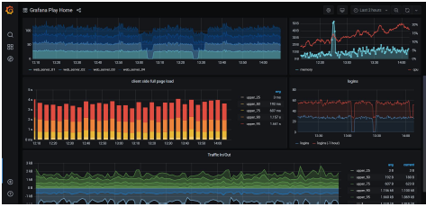
Monitoring: What it is & why to
Ensure that a system or service is:
Available
Fast
Correct
Efficient
etc.

Slide 5
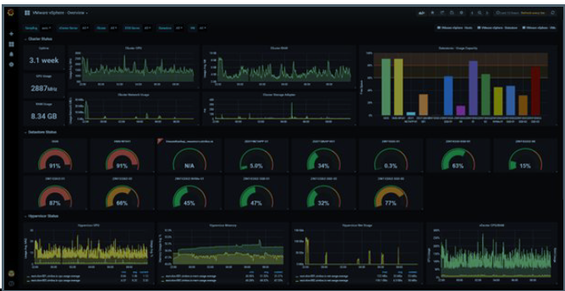
Monitoring: What it is & why to
Potential Problems:
Disk full no new data stored
Software bug, request errors
High temperature hardware failure
Network outage services cannot communicate
Low memory utilization money wasted

Slide 6
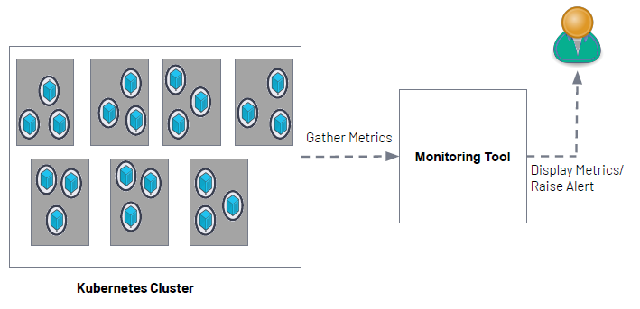
Monitoring: What it is & why to

Slide 7
What is Prometheus?

Slide 8

What is Prometheus?
Metrics-based monitoring & alerting stack
Metrics collection and storage
Querying, alerting, dashboarding
For all levels of the stack!
Made for dynamic cloud/container environments

Slide 9
What is Prometheus?
A quick overview of what Prometheus is about:
Gather metrics into database
Scheduled pull/harvest/scrape actions – HTTP/TCP requests
Provide exporters (adapters) that expose metrics
Make metrics available to consuming systems and humans
Such as Grafana (for dashboarding), REST APIs, through Prometheus UI – Graphs, Console, PromQL
Analyze metrics according to alert rules and determine if alerts are “ﬁring”
Act on ﬁring alerts and send notiﬁcations

Slide 10
Terminology
Prometheus Server: The main server that scrapes and stores the scraped metrics in a time series database
Time-series Database: Designed to store data that changes with time
Scrape: Prometheus server uses a pulling method to retrieve metrics
Target: The Prometheus server’s clients that it retrieves info from (Linux/Windows Server, single app, db, Apache server, etc.)
Alert Manager: Component responsible for handling alerts
Exporter: Target libraries that convert and export existing metrics into Prometheus format

Slide 11
Terminology
Instance: The endpoint that is scraped, usually corresponding to a single process
Job: A collection of instances with the same purpose
For example, an API server job with four replicated instances:
job: api-server
instance 1: 1.2.3.4:5670
instance 2: 1.2.3.4:5671
instance 3: 5.6.7.8:5670
instance 4: 5.6.7.8:5671

Slide 12
Terminology
Prometheus pulls (scrape) metrics from a client (target) over http and places the data into its time series database that you can query using its own query language: promQL
Prometheus uses “exporters” that are installed/configured on the clients in order to convert and expose their metrics in a Prometheus format
The AlertManager receives metrics from the Prometheus server, makes sense of the metrics and then forwards an alert to the chosen notification system

Slide 13
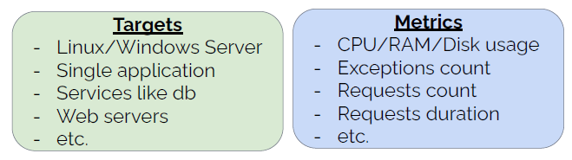
How Prometheus works
Prometheus server monitors targets and each target has metrics that are monitored.

Slide 14
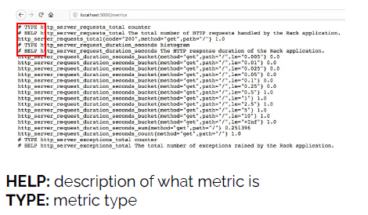
How Prometheus works
Prometheus stores metrics as human-readable text-based format

Slide 15
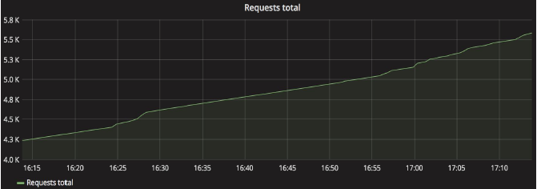
Metric Types
Counter: used for any value that increases, such as a request count or error count

Slide 16
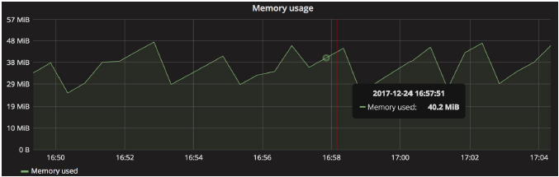
Metric Types
Gauge: used for values that go down as well as up, such as current memory usage or the number of items in a queue or the number of requests in progress

Slide 17
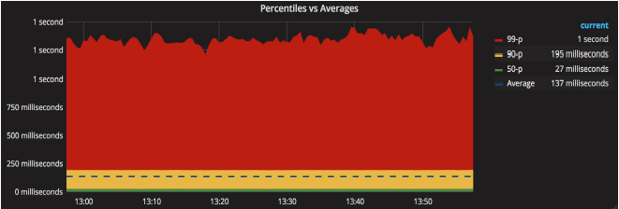
Metric Types
Histogram/Summary: measure the frequency of value observations. It tracks how long something takes or how big such as the size of a request.

Slide 18
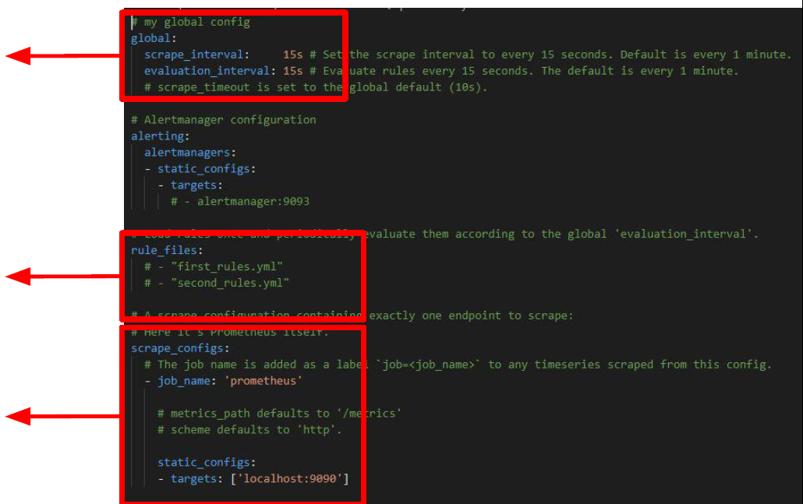
Configuring Prometheus
Prometheus comes with a sample configuration file
at which interval targets will be scraped
rules for gathering metric values or creating alerts
Resources that Prometheus monitors

Slide 19
What is Grafana?

Slide 20

What is Grafana?
Grafana is an open-source analytics and interactive visualization web application.
It provides charts, graphs, and alerts for the web when connected to supported data sources.

Slide 21


