Slide 1


IZMIR BAKIRCAY UNIVERSITY GRADUATE EDUCATION INSTITUTE BUSINESS INTELLIGENCE AND DATA ANALYTICS NON-THESIS MASTER'S PROGRAM GRADUATION PROJECT PRESENTATION
Estimation of Football Player Valuations Using Machine Learning Techniques: The Case of Turkish Football Super League
Student: Erkan Çetinyamaç
Advisor: Dr. Serhat Peker

Slide 2
Content
Business Understanding
Project Aim
Proposed Models
Data Collection – Web Scrapping
Data Description
Data Preparation
Model Building
Results – Cluster Based Models
Results – Position Based Models
Conclusion
Future Works

Slide 3
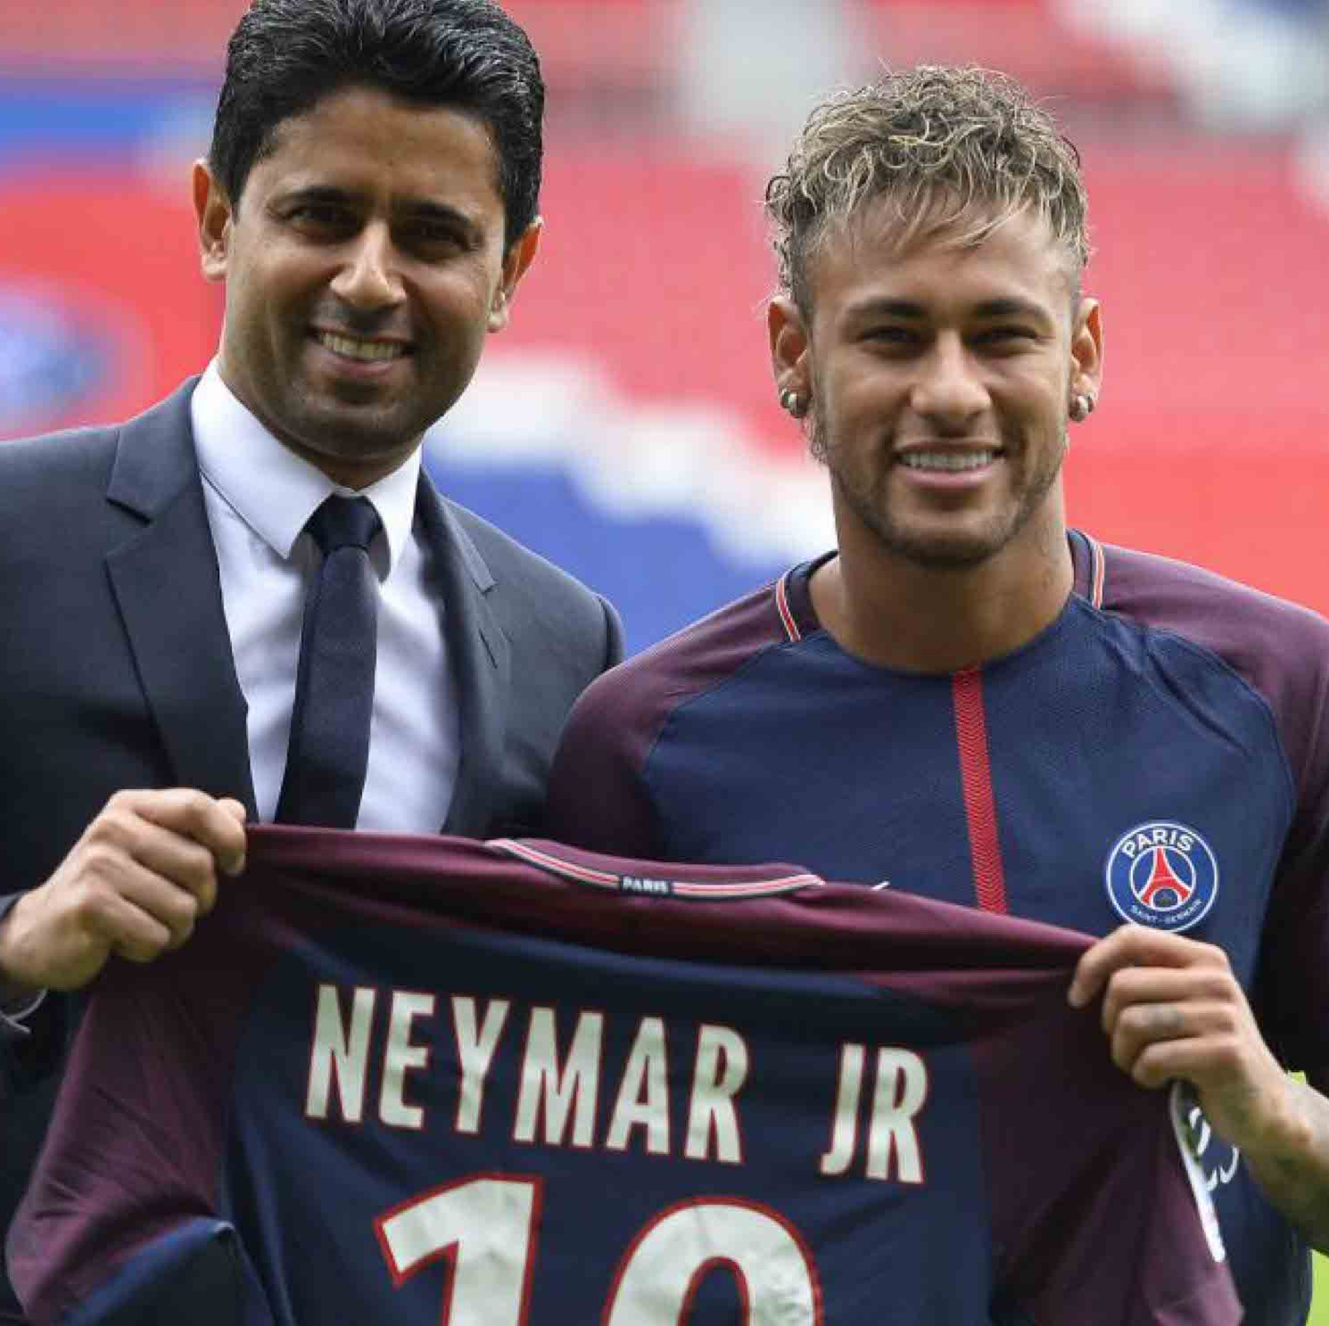
Business Understanding
Every year astronomical amount of money is invested by the football clubs in the transfer window period to hire or release players. Predicting players’ transfer market value is a crucial task for the football clubs to sustain their financial balance.

Slide 4
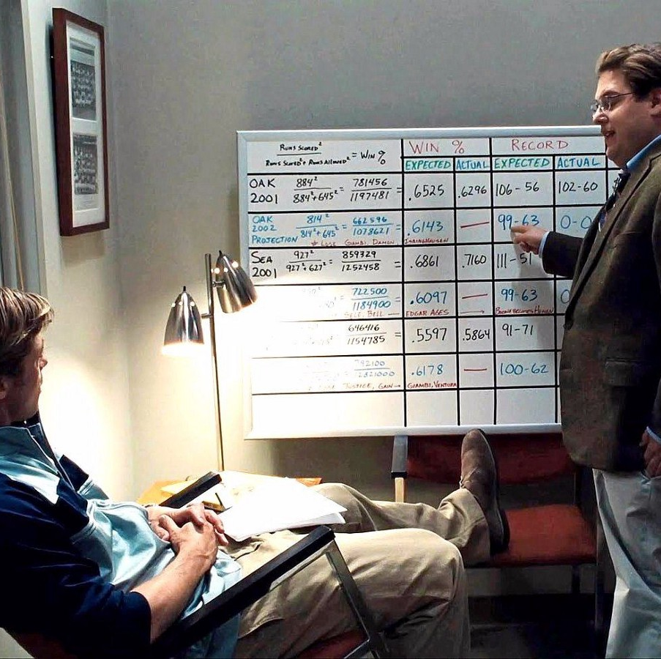
Project Aim
The main aim of the project is to evaluate performance metrics of an end season statistics of players to discover player valuation changes by means of their performance and contribute football teams regarding to creating a team according to their budgets.
This concept is very similar to Moneyball strategy used by Billy Beane at Oakland Athletics Baseball team in the 2002 season. The statistical analyzes is used to get new players with a reasonable budget.

Slide 5
Proposed Models
Classifier | Positions |  |  |  | Clusters |  |  | Class Labels
 | Goalkeeper | Defender | Midfielder | Forward | 1 | 2 | 3 | 2 | 3
1 | ✓ |  |  |  |  |  |  | ✓
2 | ✓ |  |  |  |  |  |  |  | ✓
3 |  | ✓ |  |  |  |  |  | ✓
4 |  | ✓ |  |  |  |  |  |  | ✓
5 |  |  | ✓ |  |  |  |  | ✓
6 |  |  | ✓ |  |  |  |  |  | ✓
7 |  |  |  | ✓ |  |  |  | ✓
8 |  |  |  | ✓ |  |  |  |  | ✓
9 |  |  |  |  | ✓ |  |  | ✓
10 |  |  |  |  | ✓ |  |  |  | ✓
11 |  |  |  |  |  | ✓ |  | ✓
12 |  |  |  |  |  | ✓ |  |  | ✓
13 |  |  |  |  |  |  | ✓ | ✓
14 |  |  |  |  |  |  | ✓ |  | ✓
Table 1. Proposed Model Scenarios

Slide 6


Data Collection – Web Scrapping
Tranfermarkt.com is a reference website that determines the transfer fee of the players based on its members’ opinions.
WhoScored provides match results, player ratings from the top football leagues and competitions
Beautiful Soup is a Python package for parsing HTML and XML documents. It creates parse trees that is helpful to extract the data easily.
Collected data contains football players’ features who plays in Turkish Super Football League and their whole season performance stats and transfer market values of the 2020-2021 season.

Slide 7
Data Description
Indicator | Type | Description
accurateThroughBallPerGame | Numerical | Refers to a player's accurate long pass per game.
redCard | Numerical | Refers to the # of red cards received by a player.
dribbleWonPerGame | Numerical | Refers to a player’s successful ball maneuvers per game.
foulGivenPerGame | Numerical | Refers to # of fouls committed on a player per match
offsideGivenPerGame | Numerical | Refers to a player's # of being offside status per game.
aerialWonPerGame | Numerical | Refers to a player's # of aerial ball duels won per game.
tacklePerGame | Numerical | Refers to success rate of a player’s tackles per game.
interceptionPerGame | Numerical | Refers to success rate of a player’s interception per game.
foulsPerGame | Numerical | Refers to a player's # of fouls committed.
offsideWonPerGame | Numerical | Refers to a player's # of offside won per game.
wasDribbledPerGame | Numerical | Refers to a player’s # of get passed by the opponent with ball maneuvers per game.
outfielderBlockPerGame | Numerical | Refers to # of blocks made by players per game.
clearancePerGame | Numerical | Refers to # of clearances made by players per game.
Table 2. Feature Description

Slide 8
Data Description
Indicator | Type | Description
apps | Numerical | Refers to a player's total # of appearances in the matches.
firstStart | Numerical | Refers to a player's total # of being in starting XI in the matches.
minsPlayed | Numerical | Refers to minutes played at league matches.
isForeign | Binary-Nominal | Refers whether the player is foreign or local.
newToTeam | Binary-Nominal | Refers whether the player joined the team recently or not.
newToLeague | Binary-Nominal | Refers whether the player joined the league recently or not.
goal | Numerical | Refers to the # of goals a player has scored in the season.
goalShotRatio | Numerical | Refers to how many of a player's total shots were scored.
passSuccess | Numerical | Refers to a player's successful pass percentage in the season.
keyPassPerGame | Numerical | Refers to a player's # of key passes per game.
assistTotal | Numerical | Refers to the # of assists a player has made in the season.
totalPassesPerGame | Numerical | Refers to the total # of passes a player has made per game.
accurateCrossesPerGame | Numerical | Refers to a player's accurate cross per game.
accurateLongPassPerGame | Numerical | Refers to a player's accurate long pass per game.
Table 3. Feature Description

Slide 9
Data Description
Variable | Mean | Median | Std. | Min | Max
newToTeam | - | - | - | 0 | 1
newToLeague | - | - | - | 0 | 1
isForeign | - | - | - | 0 | 1
firstStart | 14.05 | 12 | 11.42 | 0 | 39
apps | 19.17 | 19 | 11.61 | 1 | 40
minsPlayed | 1259.64 | 1102 | 984.78 | 1 | 3424
goal | 1.68 | 0 | 2.91 | 0 | 22
foulGivenPerGame | 0.67 | 0.58 | 0.52 | 0 | 3.35
tacklePerGame | 0.84 | 0.78 | 0.68 | 0 | 4
interceptionPerGame | 0.68 | 0.54 | 0.63 | 0 | 4
foulsPerGame | 0.77 | 0.75 | 0.54 | 0 | 3
offsideWonPerGame | 0.10 | 0 | 0.20 | 0 | 1.50
wasDribbledPerGame | 0.51 | 0.45 | 0.41 | 0 | 2.03
outfielderBlockPerGame | 0.15 | 0.06 | 0.22 | 0 | 1.30
aerialWonPerGame | 0.87 | 0.59 | 0.88 | 0 | 5.67
keyPassPerGame | 0.46 | 0.36 | 0.45 | 0 | 2.87
dribbleWonPerGame | 0.49 | 0.37 | 0.50 | 0 | 3.93
assistTotal | 1.11 | 0 | 1.84 | 0 | 17
totalPassesPerGame | 24.86 | 23.50 | 15.05 | 0 | 76.97
accurateCrossesPerGame | 0.27 | 0.08 | 0.36 | 0 | 2.53
accurateLongPassPerGame | 1.77 | 1.14 | 1.88 | 0 | 12
accurateThroughBallPerGame | 0.01 | 0 | 0.03 | 0 | 0.25
clearancePerGame | 0.98 | 0.56 | 1.14 | 0 | 6.04
offsideGivenPerGame | 0.10 | 0 | 0.18 | 0 | 2
passSuccess | 77.52 | 80.27 | 13.58 | 0 | 100
Table 4. Statistical Feature Description

Slide 10
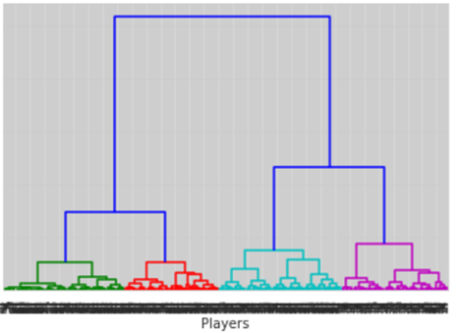
Data Preparation
TwoStep Cluster Analysis
After the k value is determined, k-means clustering was used with respect to k=4 value.
Cluster | Sample Size | Average apps | Average firstStart | Average minsPlayed
0 | 178 | 4.71 | 1.70 | 176.36
1 | 131 | 34.04 | 31.48 | 2773.50
2 | 166 | 26.13 | 19.03 | 1682..39
3 | 164 | 15.94 | 8.47 | 798.25
Average | 160 | 19.17 | 14.05 | 1259.64
Table 5. Cluster Descriptive Statistics
Figure 1. Dendrogram Using Ward Linkage

Slide 11
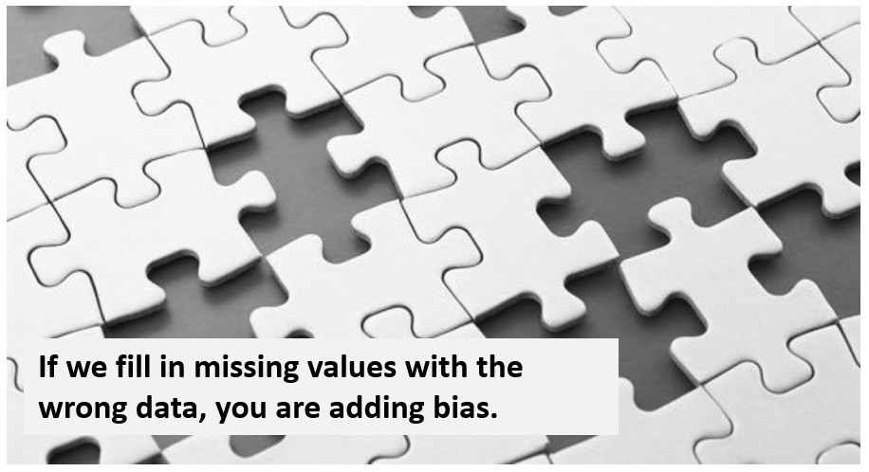
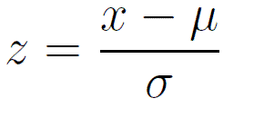

Data Preparation
Feature Engineering
$goalShotRatio =\frac{Goal}{totalShots}$ $PlayerValuation=\frac{CurrentValue−PreSeasonValue}{PreSeasonValue}∗100$
Feature Encoding & NA Value Imputation
Standartization
Z-scores are a popular standardized score used in the area of statistics. This method can be used when the mean and standard deviation of a population is known.

Slide 12
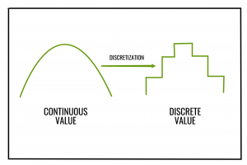
Data Preparation
Converting a regression problem to a classification.
Equal-Frequency Discretization
Separating all possible values into ‘N’ number of bins,
each having the same amount of observations.
Cluster | Label # | Discretization Intervals
1 | 2-Label | [-∞, 25, ∞]
1 | 3-Label | [-∞, 0, 70, ∞]
2 | 2-Label | [-∞, 0, ∞]
2 | 3-Label | [-∞, -22.22, 25.00, ∞]
3 | 2-Label | [-∞, -11.11, ∞]
3 | 3-Label | [-∞, -25.00, 10.74, ∞]
Position | Label # | Discretization Intervals
Goalkeeper | 2-Label | [-∞ 0,∞]
Goalkeeper | 3-Label | [-∞ -16.99, 25.00, ∞]
Defender | 2-Label | [-∞, 0, ∞]
Defender | 3-Label | [-∞, -17.32, 25.00, ∞]
Midfielder | 2-Label | [-∞, 0, ∞]
Midfielder | 3-Label | [-∞, -16.99, 25.00, ∞]
Forward | 2-Label | [-∞, 0, ∞]
Forward | 3-Label | [-∞, -17.32, 25.00, ∞]
Table 6. Discretization Intervals for Cluster Based Models
Table 7. Discretization Intervals for Position Based Models

Slide 13
Model Building
Indicator/Classifiers | 1-2 | 3-4 | 5-6 | 7-8 | 9-14
apps | ✓ | ✓ | ✓ | ✓ | ✓
firstStart | ✓ | ✓ | ✓ | ✓ | ✓
minsPlayed | ✓ | ✓ | ✓ | ✓ | ✓
isForeign | ✓ | ✓ | ✓ | ✓ | ✓
newToTeam | ✓ | ✓ | ✓ | ✓ | ✓
newToLeague | ✓ | ✓ | ✓ | ✓ | ✓
goal |  | ✓ | ✓ | ✓ | ✓
goalShotRatio |  |  |  | ✓ | ✓
passSuccess |  | ✓ | ✓ | ✓ | ✓
keyPassPerGame |  |  | ✓ |  | ✓
assistTotal |  |  | ✓ | ✓ | ✓
totalPassesPerGame |  |  | ✓ |  | ✓
accurateCrossesPerGame |  |  | ✓ |  | ✓
accurateLongPassPerGame | ✓ |  | ✓ |  | ✓
accurateThroughBallPerGame |  |  | ✓ |  | ✓
redCard |  |  |  | ✓ | ✓
dribbleWonPerGame |  |  | ✓ | ✓ | ✓
foulGivenPerGame |  | ✓ |  | ✓ | ✓
offsideGivenPerGame |  |  |  | ✓ | ✓
aerialWonPerGame |  | ✓ |  | ✓ | ✓
tacklePerGame | ✓ | ✓ |  |  | ✓
interceptionPerGame | ✓ | ✓ |  |  | ✓
foulsPerGame |  | ✓ |  |  | ✓
offsideWonPerGame |  | ✓ |  |  | ✓
wasDribbledPerGame |  | ✓ |  |  | ✓
outfielderBlockPerGame |  | ✓ |  |  | ✓
clearancePerGame | ✓ |  |  |  | ✓
Algorithms
Support Vector Machines
Logistic Regression
Gradient Boosting Machine
K-Nearest Neighbors
Decision Tree (CART)
Random Forrest
XGBoost
Table 8. Feature Selection for Models

Slide 14
Results – Cluster Based Models
Algorithm | Recall |  | Precision |  | F-measure
 | 2-label | 3-label | 2-label | 3-label | 2-label | 3-label
SVM | 0.60 | 0.35 | 0.60 | 0.28 | 0.60 | 0.29
LR | 0.55 | 0.33 | 0.55 | 0.32 | 0.55 | 0.31
GBM | 0.45 | 0.38 | 0.45 | 0.38 | 0.44 | 0.37
DT | 0.50 | 0.33 | 0.50 | 0.32 | 0.50 | 0.32
KNN | 0.45 | 0.31 | 0.45 | 0.26 | 0.44 | 0.27
RF | 0.57 | 0.33 | 0.61 | 0.28 | 0.54 | 0.27
XGB | 0.52 | 0.37 | 0.53 | 0.35 | 0.51 | 0.35
MC | 0.25 | 0.12 | 0.50 | 0.33 | 0.33 | 0.17
Algorithm | Recall |  | Precision |  | F-measure
 | 2-label | 3-label | 2-label | 3-label | 2-label | 3-label
SVM | 0.52 | 0.24 | 0.52 | 0.22 | 0.52 | 0.22
LR | 0.49 | 0.25 | 0.48 | 0.24 | 0.48 | 0.25
GBM | 0.51 | 0.36 | 0.51 | 0.36 | 0.51 | 0.36
DT | 0.45 | 0.26 | 0.45 | 0.26 | 0.45 | 0.26
KNN | 0.47 | 0.25 | 0.47 | 0.20 | 0.47 | 0.20
RF | 0.47 | 0.36 | 0.46 | 0.36 | 0.45 | 0.35
XGB | 0.59 | 0.38 | 0.59 | 0.37 | 0.59 | 0.37
MC | 0.28 | 0.11 | 0.50 | 0.33 | 0.36 | 0.16
Table 9. Evaluation Metrics for Cluster - 1
Table 10. Evaluation Metrics for Cluster - 2
Algorithm | Recall |  | Precision |  | F-measure
 | 2-label | 3-label | 2-label | 3-label | 2-label | 3-label
SVM | 0.62 | 0.43 | 0.63 | 0.44 | 0.61 | 0.41
LR | 0.62 | 0.48 | 0.62 | 0.50 | 0.62 | 0.48
GBM | 0.60 | 0.55 | 0.60 | 0.56 | 0.60 | 0.52
DT | 0.64 | 0.45 | 0.65 | 0.48 | 0.63 | 0.45
KNN | 0.52 | 0.34 | 0.52 | 0.29 | 0.51 | 0.30
RF | 0.58 | 0.36 | 0.58 | 0.35 | 0.58 | 0.34
XGB | 0.52 | 0.53 | 0.52 | 0.52 | 0.52 | 0.52
MC | 0.25 | 0.08 | 0.50 | 0.33 | 0.33 | 0.13
Table 11. Evaluation Metrics for Cluster - 3

Slide 15
Results – Position Based Models
Algorithm | Recall |  | Precision |  | F-measure
 | 2-label | 3-label | 2-label | 3-label | 2-label | 3-label
SVM | 0.67 | 0.50 | 0.75 | 0.41 | 0.58 | 0.34
LR | 0.67 | 0.61 | 0.75 | 0.76 | 0.58 | 0.54
GBM | 0.54 | 0.50 | 0.55 | 0.19 | 0.49 | 0.28
DT | 0.52 | 0.50 | 0.55 | 0.25 | 0.49 | 0.30
KNN | 0.67 | 0.61 | 0.75 | 0.52 | 0.58 | 0.51
RF | 0.71 | 0.56 | 0.70 | 0.60 | 0.70 | 0.41
XGB | 0.62 | 0.67 | 0.62 | 0.28 | 0.60 | 0.39
MC | 0.20 | 0.07 | 0.50 | 0.33 | 0.29 | 0.11
Algorithm | Recall |  | Precision |  | F-measure
 | 2-label | 3-label | 2-label | 3-label | 2-label | 3-label
SVM | 0.59 | 0.46 | 0.59 | 0.45 | 0.59 | 0.44
LR | 0.59 | 0.46 | 0.61 | 0.45 | 0.59 | 0.45
GBM | 0.58 | 0.45 | 0.59 | 0.43 | 0.58 | 0.43
DT | 0.47 | 0.38 | 0.46 | 0.38 | 0.46 | 0.37
KNN | 0.55 | 0.42 | 0.56 | 0.41 | 0.55 | 0.42
RF | 0.57 | 0.46 | 0.57 | 0.45 | 0.57 | 0.45
XGB | 0.54 | 0.47 | 0.54 | 0.45 | 0.54 | 0.45
MC | 0.28 | 0.14 | 0.50 | 0.33 | 0.36 | 0.19
Table 12. Evaluation Metrics for Goalkeeper Postion
Table 14. Evaluation Metrics for Middlefield Postion
Algorithm | Recall |  | Precision |  | F-measure
 | 2-label | 3-label | 2-label | 3-label | 2-label | 3-label
SVM | 0.56 | 0.36 | 0.56 | 0.36 | 0.56 | 0.34
LR | 0.51 | 0.41 | 0.51 | 0.46 | 0.48 | 0.42
GBM | 0.51 | 0.28 | 0.51 | 0.29 | 0.51 | 0.29
DT | 0.48 | 0.23 | 0.48 | 0.21 | 0.48 | 0.22
KNN | 0.43 | 0.38 | 0.43 | 0.34 | 0.43 | 0.35
RF | 0.50 | 0.42 | 0.50 | 0.42 | 0.50 | 0.42
XGB | 0.48 | 0.31 | 0.48 | 0.31 | 0.48 | 0.31
MC | 0.29 | 0.13 | 0.50 | 0.33 | 0.37 | 0.18
Algorithm | Recall |  | Precision |  | F-measure
 | 2-label | 3-label | 2-label | 3-label | 2-label | 3-label
SVM | 0.63 | 0.45 | 0.64 | 0.29 | 0.61 | 0.33
LR | 0.59 | 0.53 | 0.60 | 0.65 | 0.58 | 0.47
GBM | 0.49 | 0.50 | 0.49 | 0.54 | 0.48 | 0.46
DT | 0.59 | 0.51 | 0.60 | 0.52 | 0.58 | 0.50
KNN | 0.59 | 0.41 | 0.61 | 0.55 | 0.57 | 0.41
RF | 0.52 | 0.48 | 0.53 | 0.46 | 0.50 | 0.39
XGB | 0.48 | 0.50 | 0.48 | 0.50 | 0.48 | 0.46
MC | 0.24 | 0.08 | 0.50 | 0.33 | 0.33 | 0.13
Table 13. Evaluation Metrics for Defence Postion
Table 15. Evaluation Metrics for Forward Postion

Slide 16

Conclusion
Fourteen models are deployed according to football players’ positions and our clusters which is based on playing minutes and appearances features in order to predict player valuation change that based on total of 639 rows of our unique data set.
The best F1 – measure is 0.70 and achived at position-based model for goalkeepers with 2 labelled target.
We demonstrated the value of machine learning and data mining techniques to estimate players’ transfer market values. The methodology we propose can be adapted not only to the Turkish league, but also to other football leagues and sports branches.
We expect that the football industry will increasingly adopt data analytics to support player recruitment and transfer negotiations decisions.

Slide 17
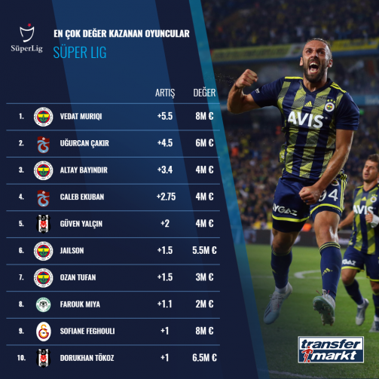
Future Works
Predicting transfer market values of football players who play in Turkish Super League with our trained machine learning models for the 2021-2022 season.

Slide 18
THANK YOU FOR YOUR ATTENTION!

