Slide 1
Version Control
Tool for managing set of files
Keep track of changes
Create snapshots
Users can revert back to earlier version
Backing up systems

Slide 2
Git
is another version control system
is created by Linus Torvalds
There is also svn, cvs
GitHub, GitLab, Bitbucket

Slide 3
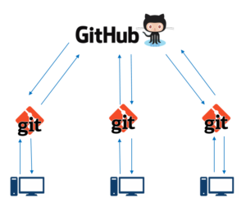
Git vs GitHub
Git
It is an open source tool
It is a version control system
GitHub
github.com is a website which uses Git to store files
GitHub is a company name which owns github.com
GitHub is their product
GitHub is a file or code sharing service to collaborate with different people.

Slide 4
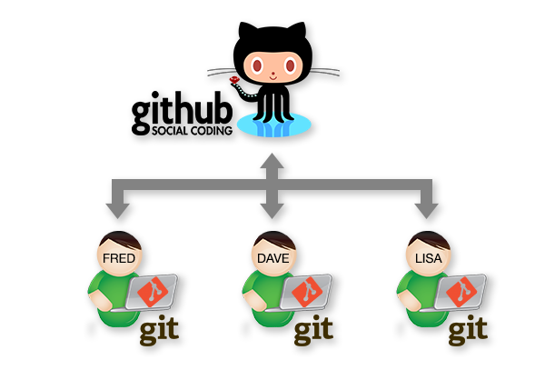

Collaboration
Before
After
Tester1
task1
Combined Tasks
Tester1
Tester2
task2
Task1
Task2
Task3
Task4
Tester3
Tester3
task3
Tester2
Tester4
Tester4
task4

Slide 5
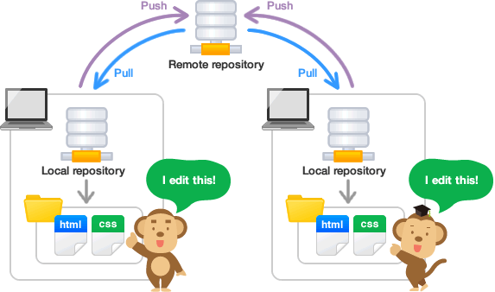

Slide 6
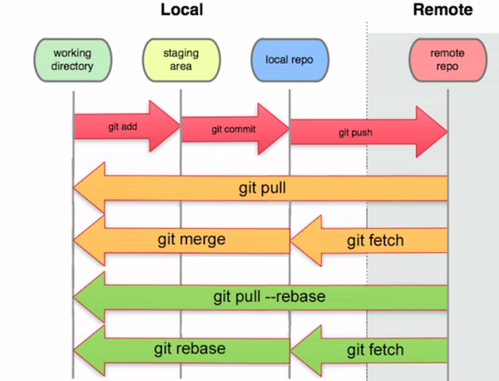

Slide 7
Local repo
Local repo
Remote
Repository
Pulls & Clones
Adds & Commits
Pushes
Local
Local

Slide 8
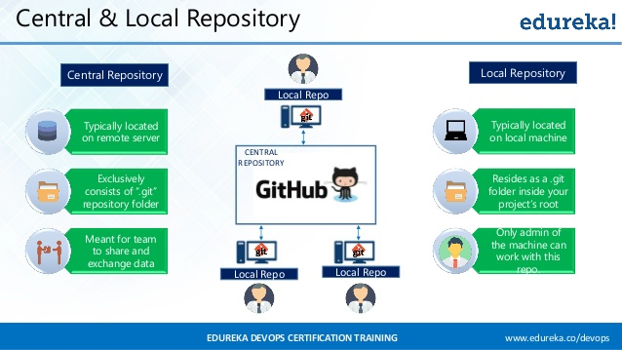

Slide 9
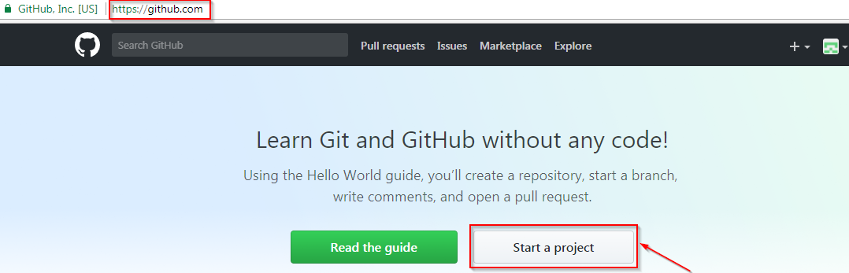
Go to the link: https://github.com/ Click on “Start a new project”

Slide 10
A repository is a storage space where your project lives. It can be local to a folder on your computer, or it can be a storage space on GitHub or another online host. You can keep code files, text files, images or any kind of a file in a repository. You need a GitHub repository when you have done some changes and are ready to be uploaded.

Slide 11
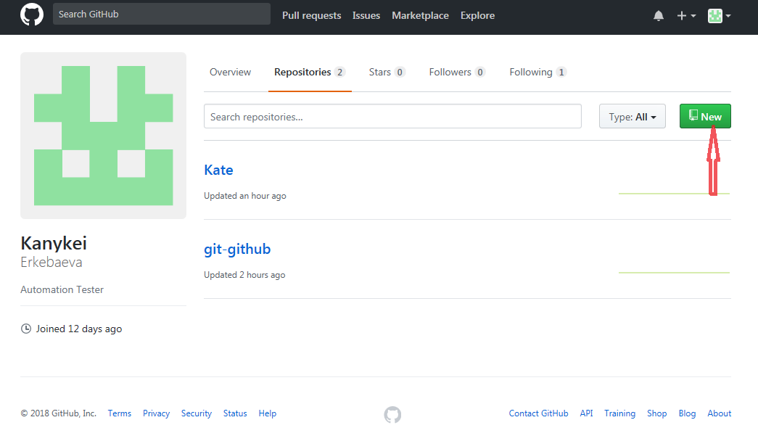
If you can not find “Create New Project” go to your profile click “Repositories” and click on green button “New”

Slide 12
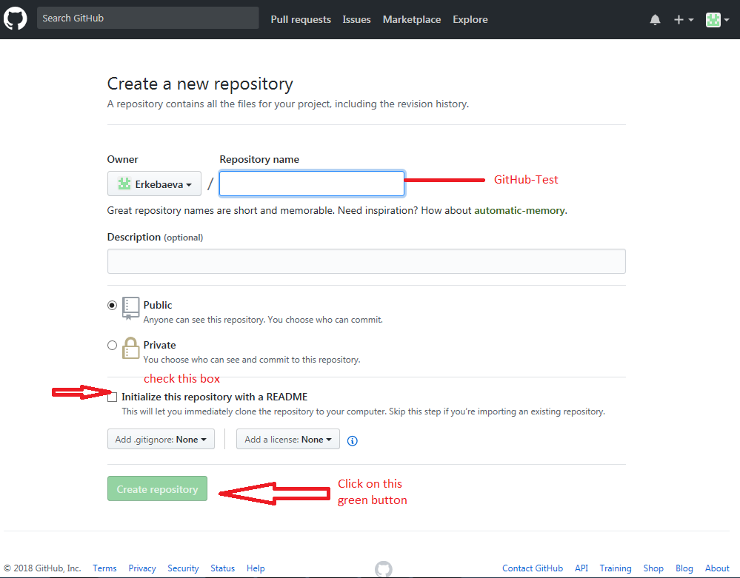
Enter any repository name and click on “Create Repository”. You can also give a description to your repository (optional)

Slide 13
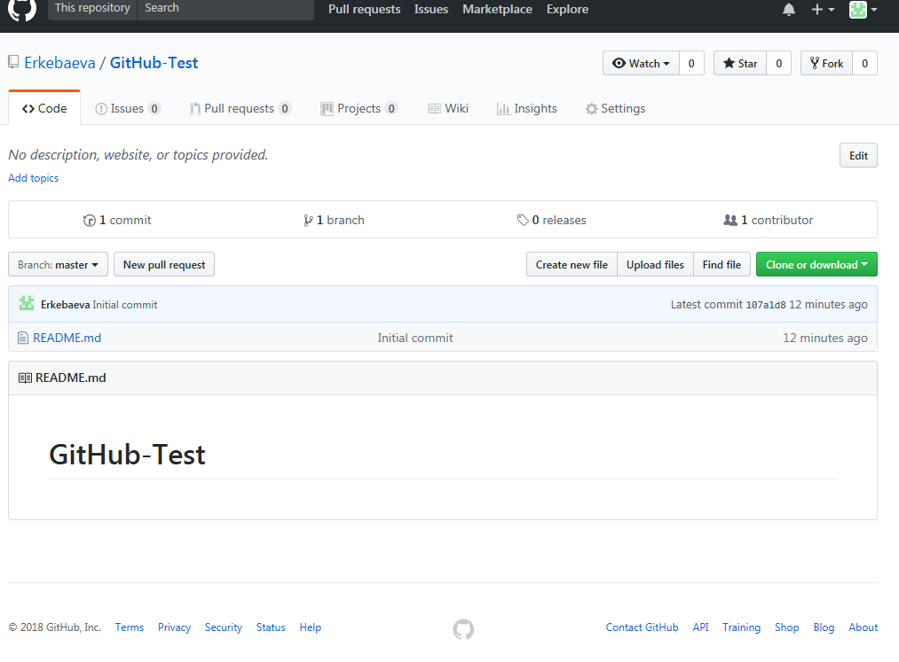
Congratulations, your repository is successfully created!

Slide 14
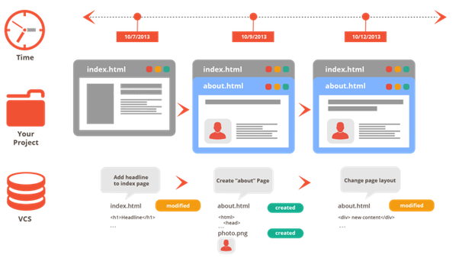
Storing Versions -Snapshots of all versions are properly documented and stored. -Versions are also named accurately.

Slide 15
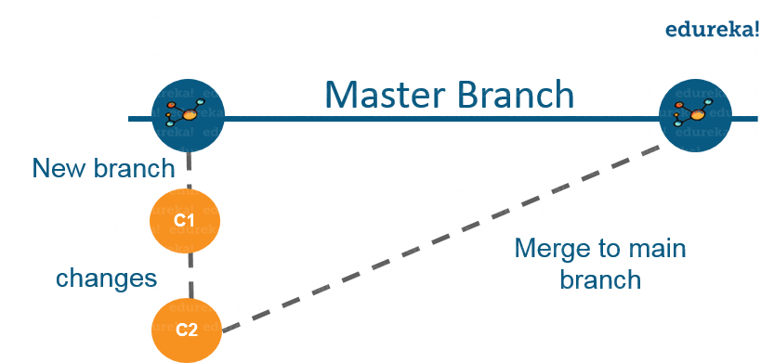
Parallel development

Slide 16
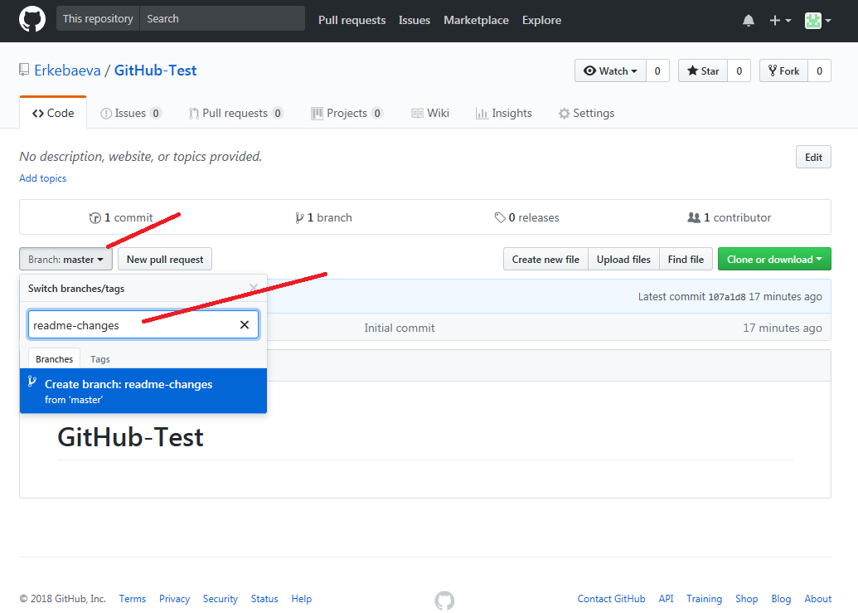
Click on the dropdown “Branch: master” As soon as you click on the branch, you can find an existing branch or you can create a new one. In my case, I am creating a new branch with a name “readme- changes” The new branch is just the copy of master branch. So let’s perform some changes in our new branch and make it look different from the master branch.

Slide 17
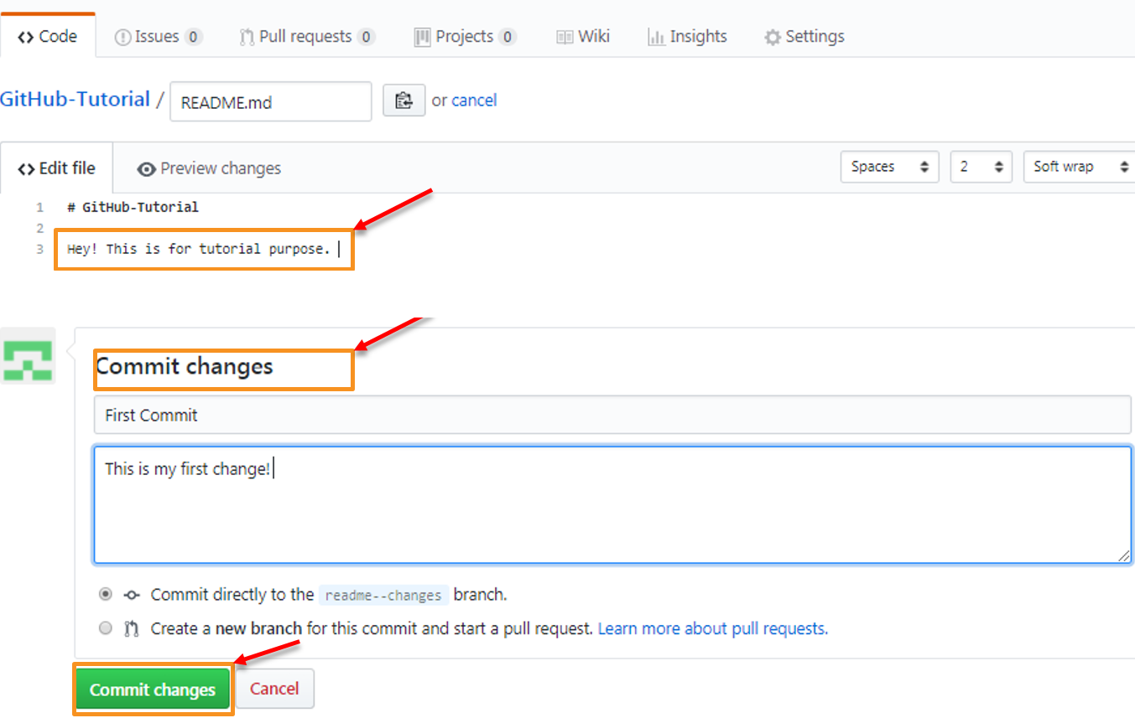
Click on “readme- changes” file which we have just created. Click on the “edit” or a pencil icon in the rightmost corner of the file. Once you click on that, an editor will open where you can type in the changes or anything. Write a commit message which identifies your changes. Click commit changes in the end.

Slide 18
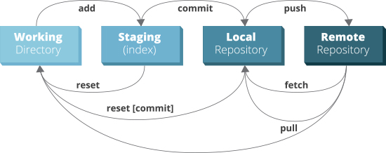
Git Operations & Commands

Slide 19
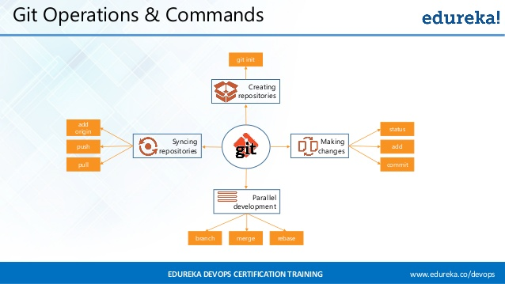

Slide 20
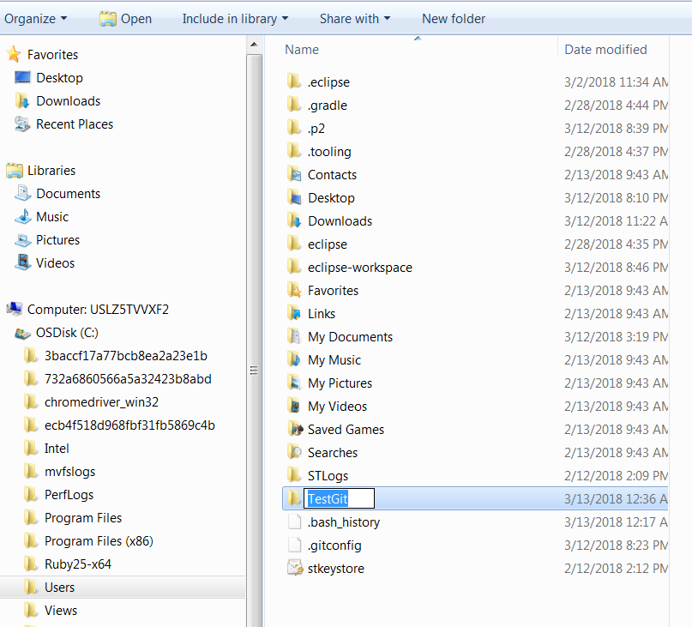
Open your folder/directory where you want to store all your project files; right click and select ‘Git Bash here’.

Slide 21
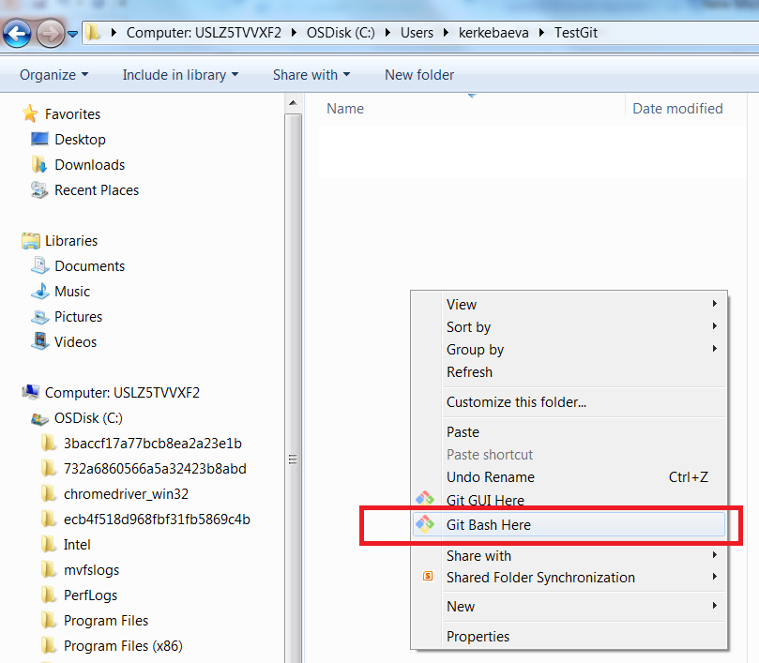

Slide 22
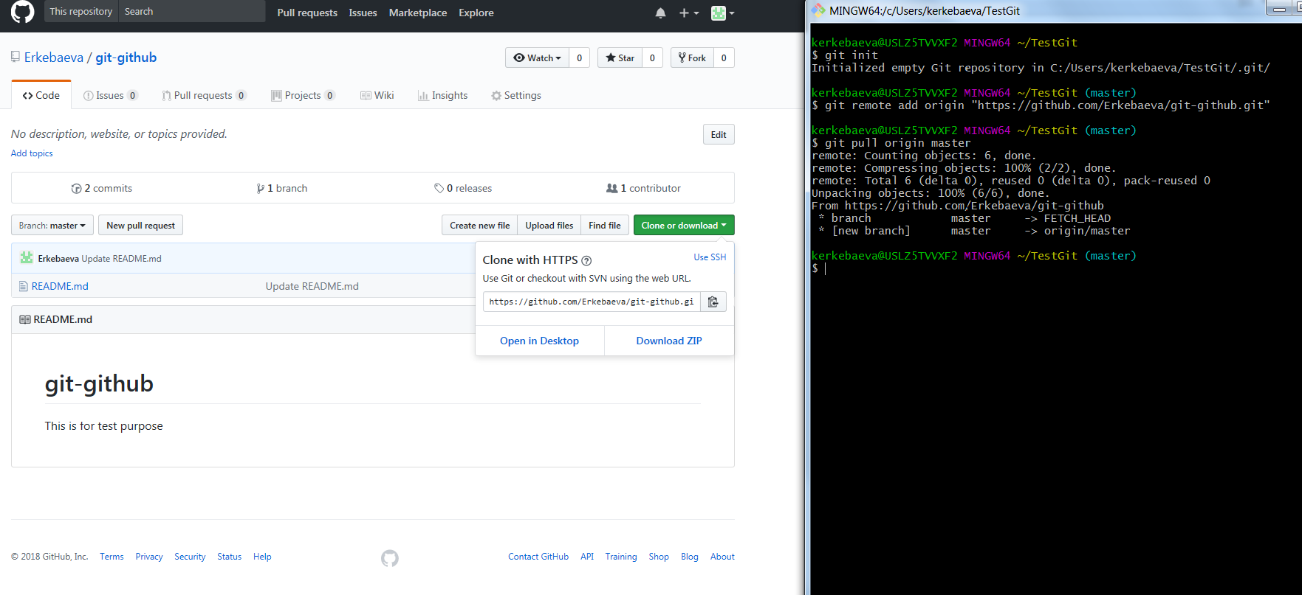

Slide 23
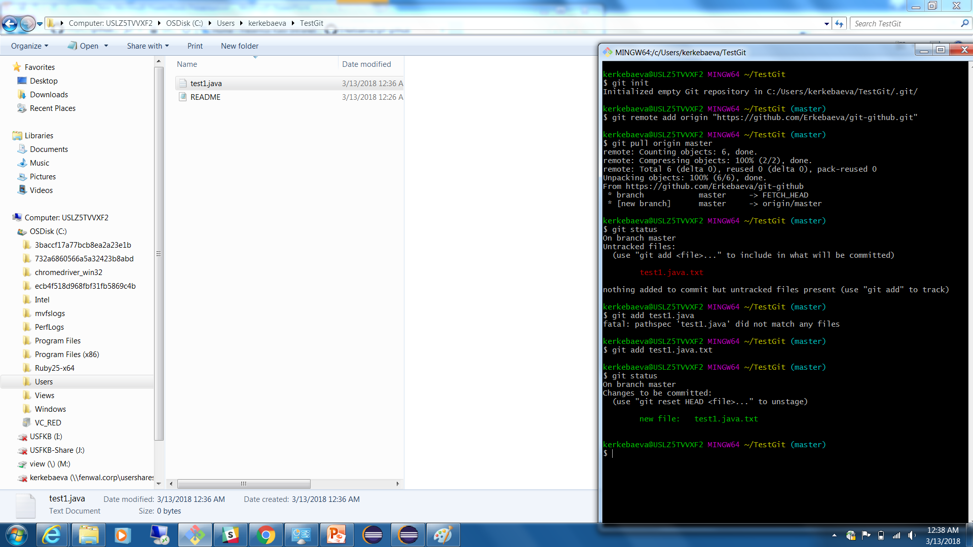
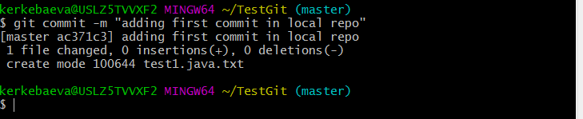
Untracked file
You can not commit without providing a massage
After we add file
Adding commit

Slide 24
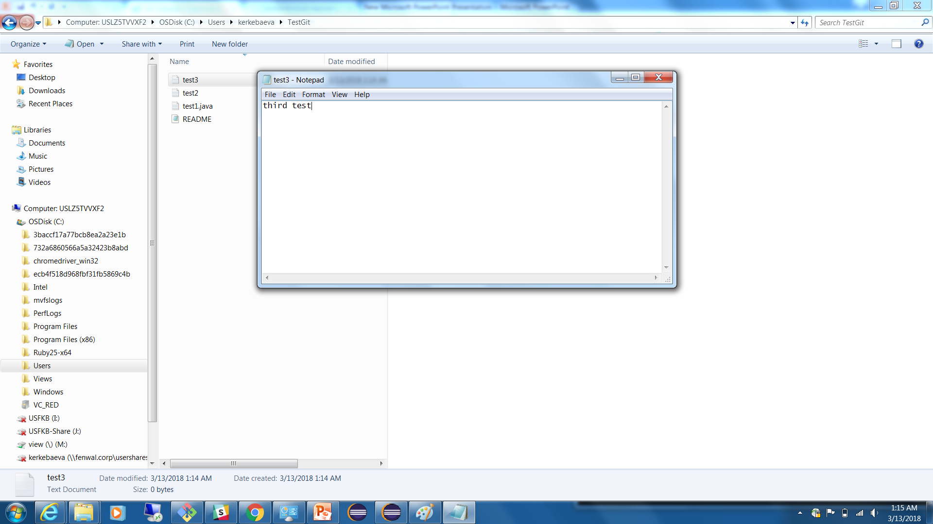
Creating 2 new text files on my local repo and also modify previous file which was added already

Slide 25
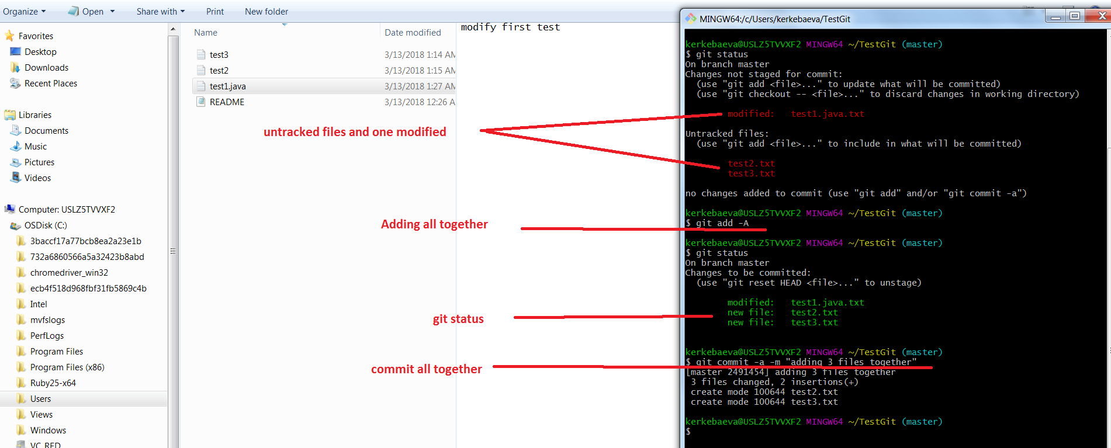

Slide 26
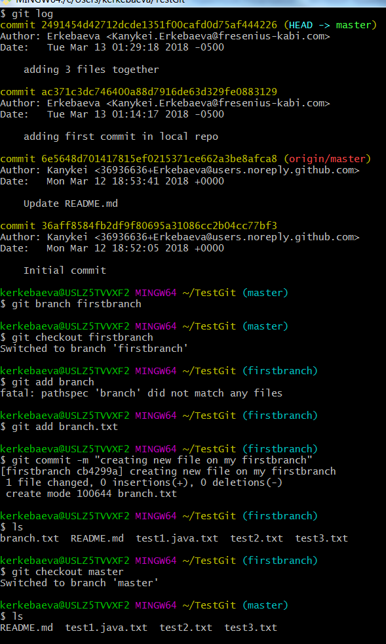
log all info
Create branch
Switch branch
Originated from master branch

Slide 27
