Slide 1

Convex-Hull Algorithms
Computational Geometry
Project Presentation
Erkin Aydın
ID: 22002956
CS478
Sec. 01

Slide 2
Presentation Layout
Implementation Details ~ 1 min.
Ideas and Pseudo-codes of Algorithms ~ 3 min.
Benchmarks ~ 1 min.
Graham’s Scan ~ 5 min.
Jarvis March ~ 5 min.
Quickhull ~ 5 min.
Merge Hull ~ 5 min.
Any Questions? ~ 5 min.

Slide 3
Implementation Details
Python 3.12.2 64-bit
Conda Environment
Following modules are used:
math (for polar angle calculation)
numpy (for generation of gaussian-uniform points)
tkinter (for visualization using canvas)
gc (for triggering garbage collector in benchmarking)
time (for measuring runtimes in benchmarking)
Y-axis is flipped in tkinter.canvas
tkinter.canvas coordinates do not match real coordinates of the points, hence point addition, zooming in and out was implemented using a scale factor.

Slide 4
Graham’s Scan

Slide 5
Graham’s Scan
Idea:
Select a pivot point for sure in the convex hull
Transform points where pivot is the origin
Sort points wrt the origin by polar angles
if two points has the same polar angle, sort wrt. the distance to origin
Construct a DLCL (Doubly-Linked Circular List) using points
Traverse DLCL
if v, v.next, v.next.next is NOT left turn, delete v.next, continue deleting till v, v.next, v.next.next is left turn
Remaining DLCL after traversal contains the convex hull.
Runtime: O(nlogn) where n is the number of points

Slide 6
Graham’s Scan
PREPARATION_GRAHAMS_SCAN(S)
1: p_min_y := NULL
2: min_y := INTEGER_MAX
3: for each point p in S do
4: | if p.y < min_y then
5: | | p_min_y := p
6: | | min_y := p.y
7: | else if p.y = min_y and p.x < p_min_y.x then
8: | | p_min_y := p
9: negative_min_x := p_min_y.x
10: negative_min_y := p_min_y.y
11: for each point p in S do
12: | p.x := p.x + negative_min_x
13: | p.y := p.y + negative_min_y
14: sorted_points_list := Sort points lexicographically first with respect to the polar angles they make, then by the distance to the origin, that is, p_min_y
15: sorted_dlcl := By a traversal of sorted_points_list, add the sorted points to the sorted_dlcl
16: return p_min_y, sorted_dlcl
SCAN_GRAHAMS_SCAN(p_min_y, sorted_dlcl)
1: v := p_min_y := START
2: w :=sorted_dlcl.PRED[v]
3: f = FALSE
4: while sorted_dlcl .NEXT[V] ≠ START or f = FALSE do
5: | if sorted_dlcl .NEXT[V] = w then
6: | | f = TRUE
7: | if Left(v, sorted_dlcl .NEXT[V], sorted_dlcl .NEXT[sorted_dlcl .NEXT[V]]) then
8: | | v = sorted_dlcl .NEXT[V]
9: | else then
10: | | delete sorted_dlcl .NEXT[V]
11: | | v := sorted_dlcl .PRED[V]
12: end of scan, sorted_dlcl contains convex hull

Slide 7
Jarvis March

Slide 8
Jarvis March
2D specialization of Gift Wrapping Algorithm
Idea:
Select a start point for sure in convex hull (same logic in Graham’s Scan)
March Up
Calculate the next point making the smallest polar angle with current point and x-axis, add to hull
In case there are multiple, choose the furthest point
current point := next point
March Down
Calculate the next point making the smallest polar angle with current point and negative x-axis, add to hull
In case there are multiple, choose the furthest point
current point := next point
Runtime: O(hn) where h is the number of points in the hull

Slide 9
Jarvis March
16: convex_hull := {}
17: repeat
18: | smallest_angle := 360
19: | next_point := NULL
20: | for each point p of S do
21: | | if angle made by p, current_point and axis_to_check < smallest_angle then
22: | | | next_point := p
23: | | | smallest_angle := angle made by p, current_point and axis_to_check
24: | if smallest_angle = prev_angle then
25: | | convex_hull := convex_hull / prev_point
26: | convex_hull := convex_hull ∪next_point
27: | prev_point := next_point
28: | prev_angle := next_angle
29: | if next_point.y = max_y then
30: | | axis_to_check := negative x-axis
31: until current_point = p_min_y
32: return convex_hull
JARVIS_MARCH(S)
1: p_min_y := NULL
2: min_y := INTEGER_MAX
3: max_y := INTEGER_MIN
4: for each point p in S do
5: | if p.y < min_y then
6: | | p_min_y := p
7: | | min_y := p.y
8: | else if p.y = min_y and p.x > p_min_y.x then
9: | | p_min_y := p
10: | if p.y > max_y then
11: | | max_y := p.y
12: current_point := p_min_y
13: axis_to_check := x-axis
14: prev_angle := 0
15: prev_point := NULL

Slide 10
Quickhull

Slide 11
Quickhull
Idea:
In each recursive call, eliminate points for sure NOT in the convex hull.
These points are points internal to triangle(left_most_point, right_most_point, apex_point)
Apply recursive calls to remaining points.
Runtime: O(n^2) in the worst case, where n is the number of points

Slide 12
Quickhull
QUICKHULL_INITIAL_CALL(S)
1: l₀ := (x₀, y₀) // The point with smallest abscissa
2: r₀ := (x₀, y₀ – ε) // ε = 1e-9 for instance
3: convex_hull := QUICKHULL(S, l₀, r₀) / r₀
QUICKHULL(S, l, r)
1: if S = {l, r} then
2: | return {l, r}
3: else
4: | h := FURTHEST(S, l, r)
5: | S⁽¹⁾ := Set of points in S that are on or left of line lh
6: | S⁽²⁾ := Set of points in S that are on or left of line hr
7: | return ( QUICKHULL(S⁽¹⁾, l, h) || QUICKHULL(S⁽²⁾, h, r) ) / h

Slide 13
Merge Hull

Slide 14
Merge Hull
Idea:
Divide input to two parts arbitrarily the same size
Apply recursive calls to these two parts, construct their hulls
Merge hulls (discard monotone chains if helpful)
Call Graham’s Scan on merged hull
Runtime: O(nlogn) where n is the number of points, but disrupts cache locality!!!

Slide 15
Merge Hull
MERGE_HULL(S)
1: if |S| < 4(any small integer would suffice as well) then
2: | return S
3: Construct S₁ and S₂ where S₁∪S₂ = S and |S₁| ≈ |S₂|
4: H(S₁) := MERGE_HULL(S₁)
5: H(S₂) := MERGE_HULL(S₂)
6: H(S) := MERGE(H(S₁), H(S₂))
7: return H(S)
MERGE(H(S₁), H(S₂))
1: p1 := any point internal to H(S₁)
2: sorted_list := {}
3: if p1 is internal to H(S₂) then
4: | sorted_list := Merge H(S₁) and H(S₂) in linear time (as they are in sorted angular order)
5: else
6: | s1 := supporting line 1 between p and H(S₂)
7: | s2 := supporting line 2 between p and H(S₂)
8: | H(S₂) := H(S₂) / {monotone chain between s1 and s2}
9: | sorted_list := Merge H(S₁) and H(S₂) in linear time (as they are in sorted angular order now)
10: return GRAHAMS_SCAN(sorted_list)

Slide 16
Benchmarks

Slide 17
Benchmarks - Some Details
Benchmarking with 2D Gaussian and Uniform Distributions
Always using the copy of same set of points for algorithms
Force garbage collector to deallocate the copy (16GB RAM not being enough)
Always calling “performance” versions of the algorithms (no visualization overheads).
If one operation is done in a specific way, then do the same in other algorithms (for instance, point line classification)
Initial call of Quickhull is included in the benchmarks

Slide 18
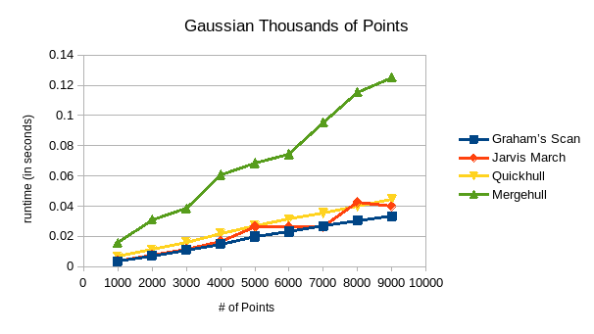
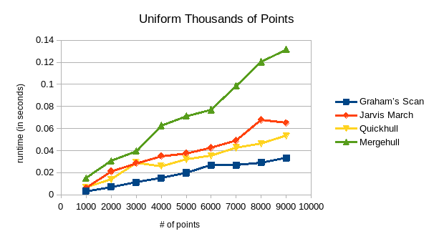
Benchmarks - Thousands of Points

Slide 19
Benchmarks - Thousands of Points (Gaussian)
Gaussian # of Points | Graham’s Scan | Jarvis March | Quickhull | Mergehull
1000 | 0.0034 | 0.0039 | 0.0067 | 0.0157
2000 | 0.0071 | 0.0077 | 0.0113 | 0.0311
3000 | 0.0111 | 0.0118 | 0.0163 | 0.0385
4000 | 0.0149 | 0.0170 | 0.0221 | 0.0606
5000 | 0.0200 | 0.0265 | 0.0272 | 0.0686
6000 | 0.0232 | 0.0265 | 0.0314 | 0.0742
7000 | 0.0269 | 0.0261 | 0.0355 | 0.0954
8000 | 0.0305 | 0.0426 | 0.0399 | 0.1154
9000 | 0.0333 | 0.0398 | 0.0446 | 0.1251

Slide 20
Benchmarks - Thousands of Points (Uniform)
Uniform # of Points | Graham’s Scan | Jarvis March | Quickhull | Mergehull
1000 | 0.0034 | 0.0061 | 0.0067 | 0.0152
2000 | 0.0072 | 0.0213 | 0.0139 | 0.0307
3000 | 0.0114 | 0.0286 | 0.0292 | 0.0396
4000 | 0.0152 | 0.0351 | 0.0259 | 0.0628
5000 | 0.0200 | 0.0377 | 0.0323 | 0.0714
6000 | 0.0268 | 0.0427 | 0.0352 | 0.0770
7000 | 0.0268 | 0.0492 | 0.0427 | 0.0985
8000 | 0.0292 | 0.0679 | 0.0462 | 0.1203
9000 | 0.0333 | 0.0650 | 0.0534 | 0.1316

Slide 21
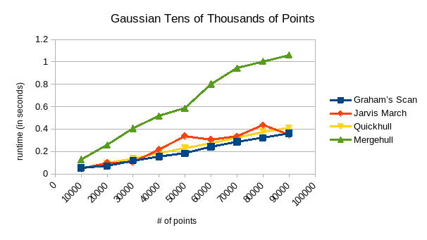
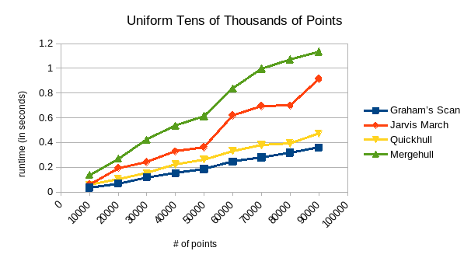
Benchmarks - Tens of Thousands of Points

Slide 22
Benchmarks - Tens of Thousands of Points (Gaussian)
Gaussian # of Points | Graham’s Scan | Jarvis March | Quickhull | Mergehull
10000 | 0.0546 | 0.0450 | 0.0492 | 0.1297
20000 | 0.0703 | 0.0976 | 0.0953 | 0.2588
30000 | 0.1180 | 0.1021 | 0.1383 | 0.4046
40000 | 0.1535 | 0.2167 | 0.1853 | 0.5170
50000 | 0.1838 | 0.3366 | 0.2297 | 0.5856
60000 | 0.2426 | 0.3060 | 0.2766 | 0.8011
70000 | 0.2851 | 0.3348 | 0.3214 | 0.9435
80000 | 0.3223 | 0.4346 | 0.3734 | 1.0054
90000 | 0.3611 | 0.3481 | 0.4100 | 1.0624

Slide 23
Benchmarks - Tens of Thousands of Points (Uniform)
Uniform # of Points | Graham’s Scan | Jarvis March | Quickhull | Mergehull
10000 | 0.0351 | 0.0626 | 0.0579 | 0.1365
20000 | 0.0690 | 0.1947 | 0.1048 | 0.2692
30000 | 0.1178 | 0.2413 | 0.1512 | 0.4226
40000 | 0.1513 | 0.3283 | 0.2233 | 0.5349
50000 | 0.1860 | 0.3615 | 0.2625 | 0.6126
60000 | 0.2453 | 0.6182 | 0.3328 | 0.8380
70000 | 0.2812 | 0.6946 | 0.3809 | 0.9967
80000 | 0.3170 | 0.6992 | 0.3942 | 1.0710
90000 | 0.3586 | 0.9147 | 0.4727 | 1.1361

Slide 24
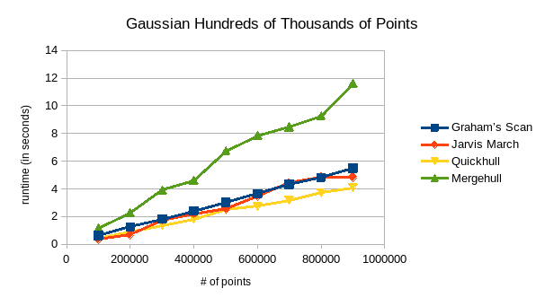
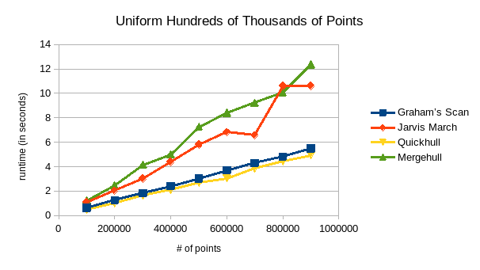
Benchmarks - Hundreds of Thousands of Points

Slide 25
Benchmarks - Hundreds of Thousands of Points (Gaussian)
Gaussian # of Points | Graham’s Scan | Jarvis March | Quickhull | Mergehull
100000 | 0.6350 | 0.3787 | 0.4582 | 1.1453
200000 | 1.2614 | 0.6669 | 0.9132 | 2.2799
300000 | 1.8296 | 1.7499 | 1.3648 | 3.9079
400000 | 2.4047 | 2.2082 | 1.8200 | 4.6113
500000 | 3.0305 | 2.5656 | 2.5141 | 6.7550
600000 | 3.6480 | 3.4682 | 2.7400 | 7.8475
700000 | 4.3250 | 4.4360 | 3.1913 | 8.4824
800000 | 4.8194 | 4.8356 | 3.7248 | 9.2754
900000 | 5.4997 | 4.8386 | 4.0979 | 11.6035

Slide 26
Benchmarks - Hundreds of Thousands of Points (Uniform)
Uniform # of Points | Graham’s Scan | Jarvis March | Quickhull | Mergehull
100000 | 0.6336 | 1.0945 | 0.5078 | 1.2337
200000 | 1.2614 | 2.0359 | 0.9951 | 2.4708
300000 | 1.8320 | 3.0390 | 1.6802 | 4.1608
400000 | 2.4087 | 4.3898 | 2.0913 | 4.9900
500000 | 3.0253 | 5.8173 | 2.7034 | 7.2679
600000 | 3.7033 | 6.8304 | 3.0461 | 8.4086
700000 | 4.2939 | 6.5753 | 3.8485 | 9.2208
800000 | 4.8119 | 10.6119 | 4.4460 | 10.0980
900000 | 5.4933 | 10.6145 | 4.9286 | 12.3625

Slide 27
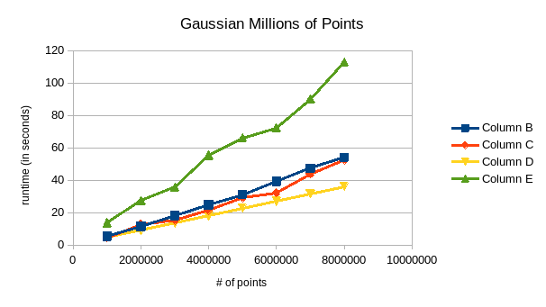
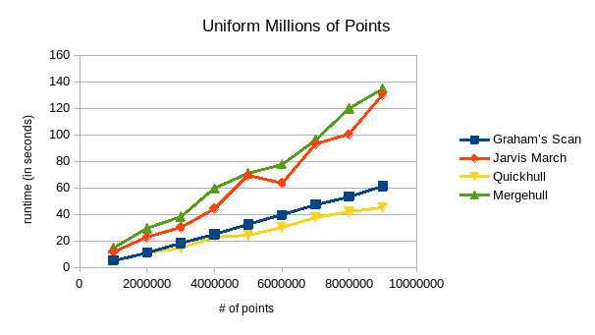
Benchmarks - Millions of Points

Slide 28
Benchmarks - Millions of Points (Gaussian)
Gaussian # of Points | Graham’s Scan | Jarvis March | Quickhull | Mergehull
1000000 | 5.3303 | 4.4366 | 4.6022 | 13.7636
2000000 | 11.4630 | 12.6671 | 9.0942 | 27.5042
3000000 | 18.2356 | 15.1313 | 13.5974 | 35.7251
4000000 | 24.8451 | 21.2768 | 18.3058 | 55.3236
5000000 | 31.1413 | 29.3554 | 22.9048 | 66.2315
6000000 | 39.2451 | 32.3453 | 27.1136 | 72.2360
7000000 | 47.3976 | 43.9561 | 31.7827 | 90.0517
8000000 | 54.0594 | 52.4300 | 36.2385 | 112.9743
9000000 | 62.1922 | 50.6276 | 40.7769 | 126.0339

Slide 29
Benchmarks - Millions of Points (Uniform)
Uniform # of Points | Graham’s Scan | Jarvis March | Quickhull | Mergehull
1000000 | 5.2599 | 11.9393 | 4.9705 | 14.5706
2000000 | 11.2483 | 22.9326 | 11.0469 | 29.4271
3000000 | 18.2670 | 30.0377 | 14.3552 | 38.2512
4000000 | 24.9986 | 44.3057 | 22.4549 | 59.5555
5000000 | 32.4901 | 69.3380 | 24.3222 | 70.9150
6000000 | 39.6263 | 63.5350 | 30.3493 | 77.8194
7000000 | 47.3875 | 92.7945 | 37.8516 | 96.3750
8000000 | 53.3399 | 100.2511 | 42.1172 | 119.6141
9000000 | 61.4059 | 130.1873 | 45.2904 | 134.7874

Slide 30
Any Questions?

