Slide 1

Soul Reclaimer
2D GAME BY 李麗恩

Slide 2
PLAYER
ENEMY
Content
CONCEPT
MAP
SCOPE
REFRENCE

Slide 3
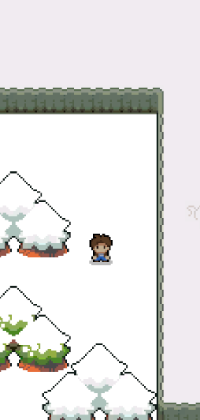
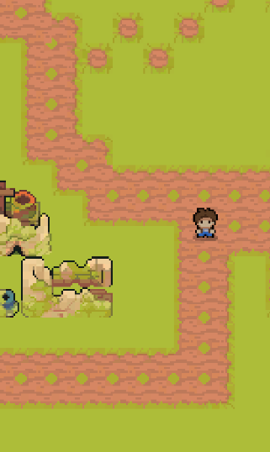
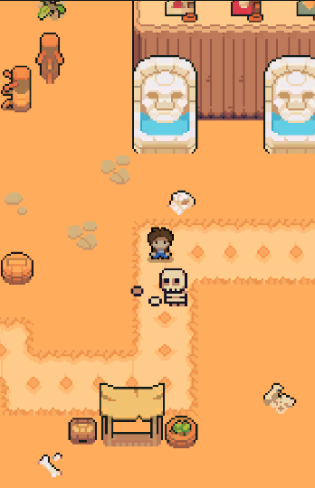
Game concept
The concept of this game is about speed and treasure hunting.
Players must move quickly to collect treasures scattered across the map before time runs out.
The game features three different maps, each with its own level of difficulty and unique challenges.
This game tests the player’s reaction speed, movement accuracy, and ability to plan routes efficiently while avoiding obstacles.

Slide 4
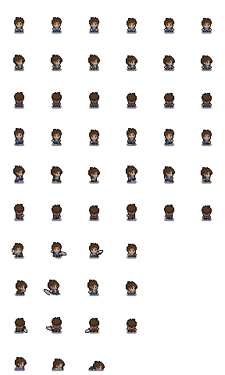
Player
I created the character so it can move in four directions: left, right, front, and back, making it look like a 3D character in a 2D game. This makes the gameplay feel more dynamic and realistic.

Slide 5

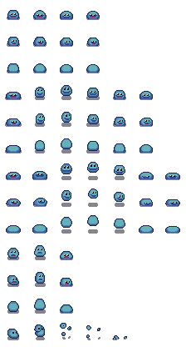



Enemy
Enemy 1 — Contact Damage
  Behavior : Does not actively attack.
  Effect : When the player touches it, the player
loses 1 HP.
Enemy 2 — Aggressive Fighter
  Behavior : Moves toward the player once detected
within a certain range.
  Effect : When the player touches it,
the player loses 1 HP
Enemy 3 — Boss: The Bubble Master
  Main Attack: Releases bubbles that players must destroy.
  Mechanics:
  When the player attacks a bubble, the Boss loses HP.
  The Boss also releases a tracking entity that cannot be avoided or destroyed, and if it touches the player, they lose HP.

Slide 6
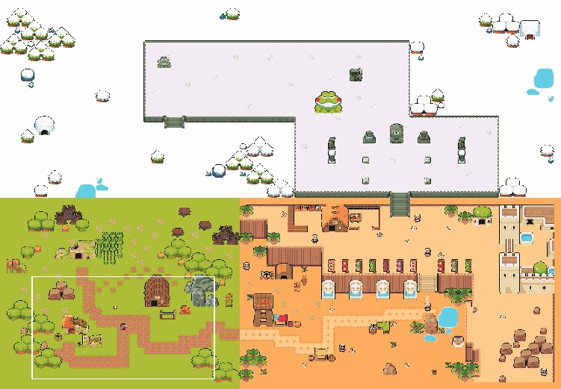
Snow Zone
Scope
Desert Zone
Each zone has its own theme and enemies encouraging full exploration of the world to complete the main quest.
Forest Zone

Slide 7
Map 1 — Forest Zone: The First Challenge
Welcome to the Forest Zone, the first area of your journey.
This peaceful-looking land hides danger among its trees.
  🧟‍♂️ Around 20 enemies roam throughout the map.
  ⏱️ You have 2 minutes to defeat all 20 enemies.
  💎 While fighting, you must also collect hidden treasures scattered around the map.
  💊 Medipacks may appear with a 30% chance, allowing you to recover some HP during battle.
  🚪 Once all enemies are defeated and treasures collected, a portal will open, allowing you to proceed to the next map.
This stage tests your speed, awareness, and strategy — defeat all enemies before time runs out!

Slide 8
Map 2 — Desert Zone: The Heat of Battle
After surviving the forest, you enter the Desert Zone, a land of scorching heat and endless sand.
This area is tougher, with enemies that move and attack more aggressively.
  🪓 There are 7 enemies scattered around the desert village and ruins.
  ⚔️ Each enemy has its own attack range and pattern, requiring precise timing and strategy.
  💎 You must defeat all 7 enemies to clear the area.
  💊 Medipacks may appear with a 50% chance, helping you recover HP under the harsh desert sun.
  🚪 Once all enemies are defeated, the path to the final map will be unlocked.
The desert tests your patience and skill — one wrong move under the blazing sun can cost your victory.

Slide 9
Map 3 — Snow Zone: The Final Showdown
You have reached the Snow Zone, the final and most dangerous area of the game.
The freezing wind and endless snow hide deadly enemies and two powerful bosses.
  🧟 Enemy 1 and Enemy 2 return, now stronger and appearing in groups.
  👑 Two powerful Bosses await at the heart of the snowy land.
  💥 The first boss attacks with deadly bubbles that must be destroyed to reduce its HP.
  ⚔️ The second boss releases unavoidable tracking orbs that constantly follow the player — each hit causes HP loss.
  ⏱️ To win, players must defeat both bosses and all remaining enemies to clear the map.
The final battle combines every skill you’ve learned — speed, timing, and courage. Only true heroes will survive the storm.

Slide 10
Thank You

