Slide 1
ChainMind
• Autonomous Disruption Resolver
• Human-approved supply-chain response for manufacturing.
CHAINMIND · 01
Notes:
Opening: ChainMind turns disruption signals into recommendations that a human can review. This demo uses local fixtures and sandboxes.

Slide 2
Problem: the buffer runs out before the response arrives
• Microchip X cargo is delayed five days.
• Available stock covers only three days of production.
• Supplier search, inventory analysis, and decisions are fragmented across systems.
CHAINMIND · 02
Notes:
Explain the two stockout days as a demo-fixture result, not a production forecast.

Slide 3
Why AWS and SAP
• SAP S/4HANA and Ariba are the operational data systems of record.
• AWS maps event ingestion, compute, orchestration, audit, identity, and agentic AI options.
• Production integration through BTP and Integration Suite is a target, not active connectivity in this demo.
CHAINMIND · 03
Notes:
Describe SAP as system of record and ChainMind as a system of action.

Slide 4
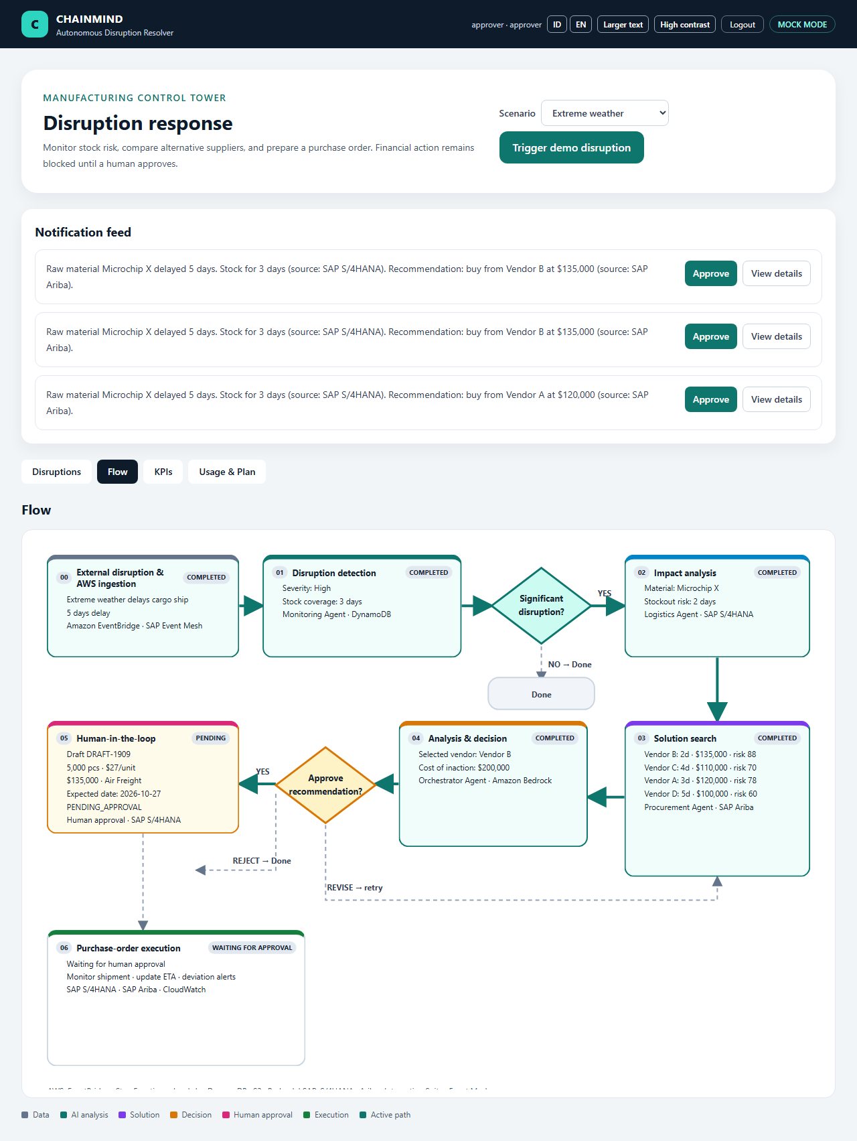
Architecture and flow
• Event → Monitoring → Logistics → Procurement → Orchestrator.
• Step Functions waits for a human decision before execution.
• Python computes coverage, cost, and ranking; the LLM only summarizes rationale.
CHAINMIND · 04
Notes:
Walk through the diagram; all adapters exercised in this demo are mock or sandbox implementations.

Slide 5
Four agents, clear responsibilities
• Monitoring: classify severity and persist events.
• Logistics: calculate coverage, stockout, BOM impact, and estimated loss.
• Procurement: compare at least two alternative vendors.
• Orchestrator: evaluate economics, recommend, and draft a PO.
CHAINMIND · 05
Notes:
All financial calculations are deterministic; the language model does not compute money.

Slide 6
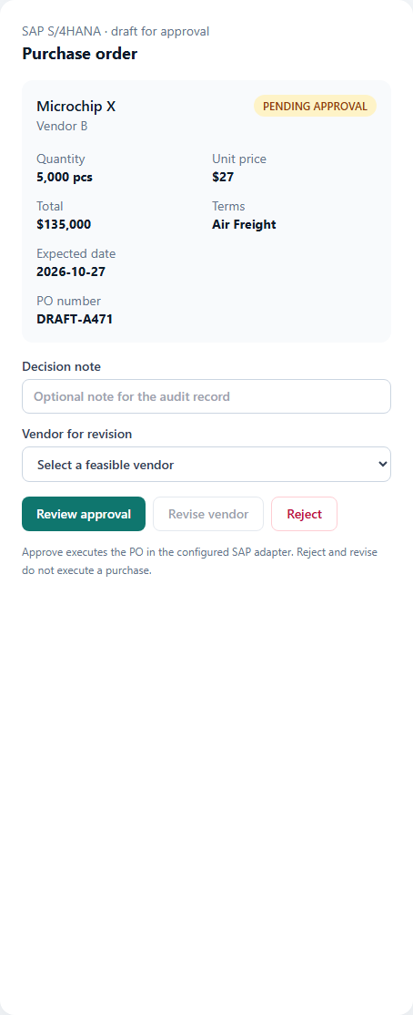
Live demo: from weather alert to draft PO
• Microchip X: five-day delay; three-day buffer.
• Vendor B is selected: two-day lead time.
• 5,000 pcs × $27 = $135,000; Air Freight.
• Status remains PENDING_APPROVAL.
CHAINMIND · 06
Notes:
Trigger the weather scenario and show Flow, vendor comparison, and draft PO. Do not claim a real SAP transaction.

Slide 7
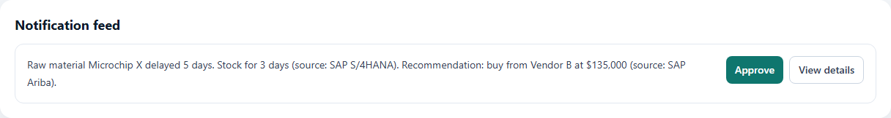
Human-in-the-loop and audit
• An approver reviews the recommendation and explicitly confirms a decision.
• No PO executes before approval.
• An eight-step audit trail and tracking outputs preserve traceability.
CHAINMIND · 07
Notes:
Clarify that approval and execution in this demo occur only in a local simulator.

Slide 8
Business model — illustrative hypothesis
• Starter / Professional / Enterprise tiers by disruption volume and active agents.
• One-time onboarding may cover SAP integration.
• Pricing, willingness to pay, and Marketplace listings are not validated.
CHAINMIND · 08
Notes:
UI prices are illustrative estimates, not a quote or invoice.

Slide 9
KPIs — illustrative targets
• Response time: a minutes-level target versus an assumed manual baseline.
• Line-stoppage risk, procurement workload, and decision consistency require pilot validation.
• Dashboard results are fixtures/simulation, not measured customer outcomes.
CHAINMIND · 09
Notes:
Never present KPI values as production results or forecasts.

Slide 10
Roadmap and risks
• Local demo → authorized sandbox pilot → tenant integration → production deployment.
• Key risks: data freshness, supplier quality, AWS/SAP access, security, and API changes.
• Mitigations: contract validation, guardrails, audit, required approval, and rollback.
CHAINMIND · 10
Notes:
Production requires security, cost, governance, and customer sign-off.

Slide 11
Verification and honest scope
• SAP sandbox simulating S/4HANA OData and Ariba; AWS verified with LocalStack and cdk synth.
• Backend 155 passed / 9 skipped; Vitest 15 passed; Playwright 10 passed.
• No AWS deployment or live SAP tenant connection was performed.
CHAINMIND · 11
Notes:
Use the exact claim shown. LocalStack and CDK synthesis do not mean production AWS verification.

