Slide 1
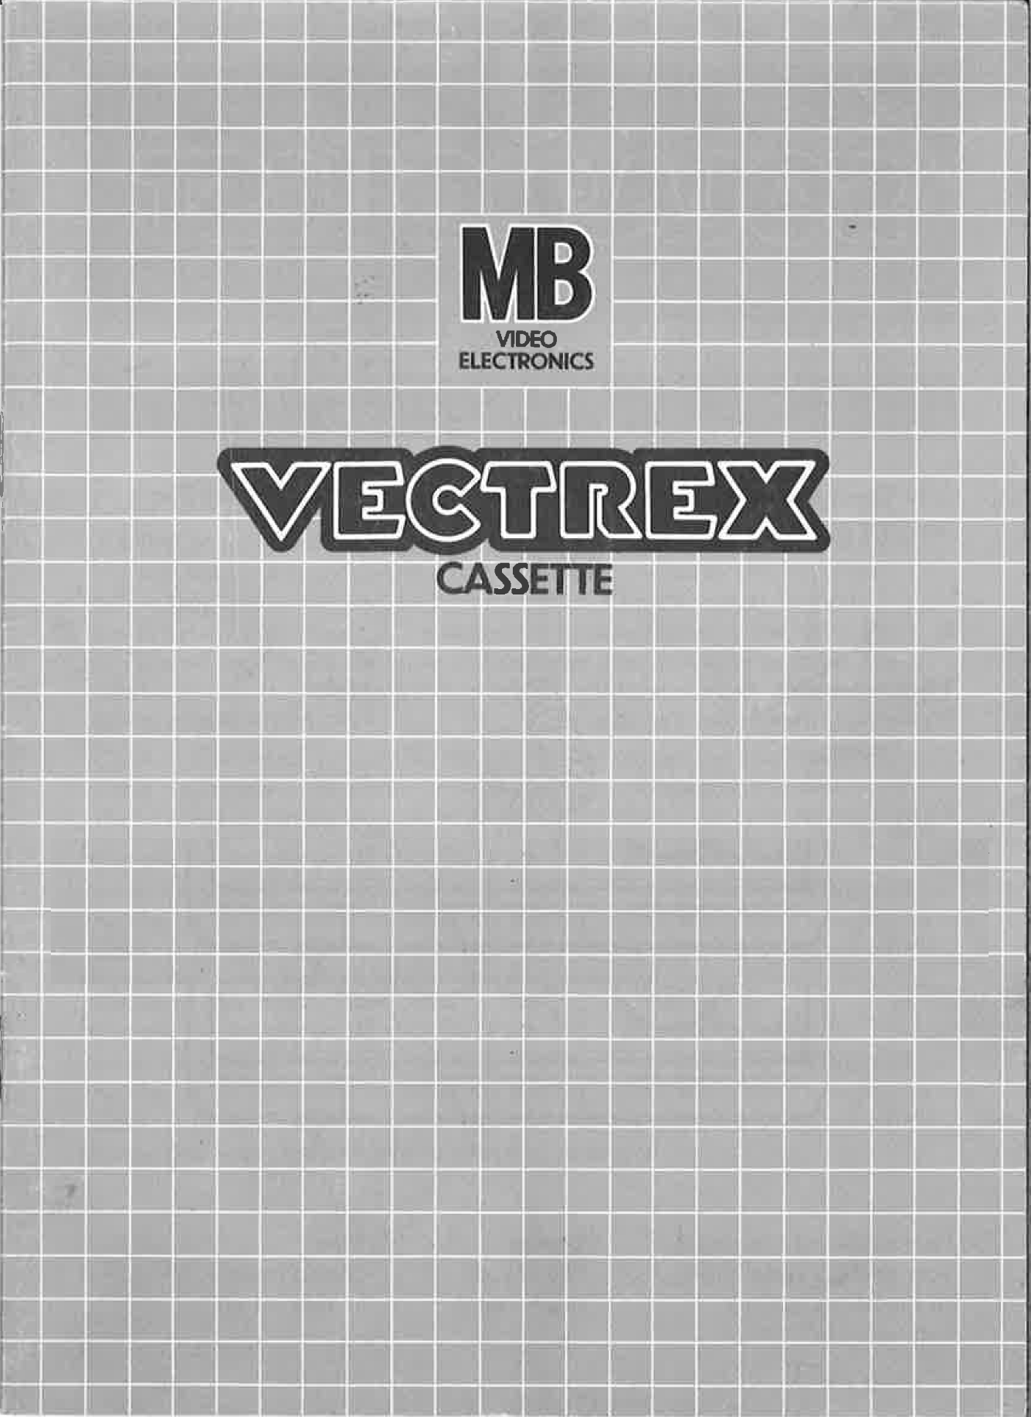
NEURO VECTOR

Slide 2
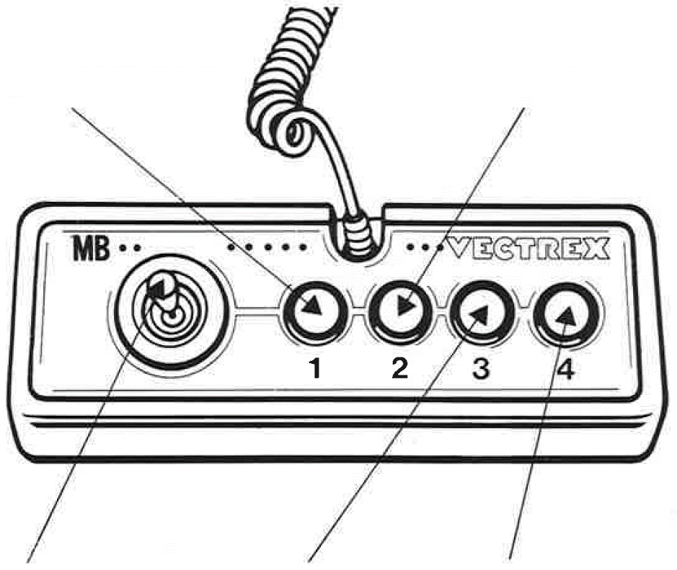
NEURO VECTOR
GAME CONTROLS
NEURO VECTOR is designed to be played with the built-in control panel only. The functions of the controls are:
Button 2
With the help of the second button the player can go back to the menu and select a different mode
Button 1
If stressed, press
Joystick
The joystick can be used to select the fitting option
Button 3
With the help of the third button the player can restart the current mode
Button 4
Button 4 confirms the selected input during your menu and during the game

Slide 3
HOW TO PLAY
PLAYER SELECTION
Conceptually, this game is a single player game, therefore only one player can play this game at a time and you do not need set anything. But if you have a friend right now, that is no problem. Just play the game in turns and look who can reach a higher score.
OPTION SELECTION
At the start of each game, after a short introduction, you arrive at the main menu. Here you can select between different game modes/options. There are in total 5 game modes:
- STILL
- PULSE
- PORTAL
- ORBIT
- ECHO
A small arrow on the left of the screen indicates the currently selected mode. When the game is booted for the first time, the mode “STILL” is selected. You can navigate through the modes using the joystick. To move the arrow down, push the joystick downward. To continue going down, you need to release the pressure of the joystick and then reapply the pressure in which way(down or up) you like to move.
On the right side of the screen, your current high score for the selected mode is displayed. A mode is considered completed when you reach a score of 16.
To select a mode, press button 4 and you will be immediately thrown into the level. Do not worry, if you dislike a mode, there is still the option to go back to menu and select a different mode.

Slide 4
HOW TO PLAY
GAME PLAY
After long years of studying and a lot of tears, you finally reached your dream job being a doctor. Now, on a daily basis, you try to help people by fixing their brains.
After selecting your game mode, you are greeted by a brain looking interface. Within this brain, there are 9 squares. The 9 squares are displayed in a 3 x 3 field. There are two phases. A “REMEMBER” and a “REPEAT” phase.
REMEMBER:
In the remember state, your task is to remember a specific sequence that will be displayed. In the 3 × 3 field, an “X” will appear. Try to remember where the “X” was.
REPEAT:
Your mission is to move your joystick to where the “X” was and press Button 4. You can move around with the joystick. Without applying pressure to the joystick, the “X” will appear in the middle square. This “X” indicates your current position. If you apply pressure to the right, the “X” will appear to the right. This means the “X” will appear in the direction in which you apply pressure.
TIMING
Your mission is to save lives, and you cannot take forever. At the top of the screen, you can see the lifeline and the beats per minute of your patient. The beats per minute will drop over time. If it drops to 0, you lose your patient and the level.

Slide 5
SCORING
Your score will be determined by how many “X” you could successfully repeat. Each mode saves a unique score. This score can go up to 16. If you reached 16 you finished the level.
HIGH SCORE MEMORY
As long as your machine is on, with the game cartridge in place, the highest score is retained. To see this score, press the Reset button. When the machine is turned off and the cartridge removed, the score is lost.
RESTARTING THE GAME
To restart a completed game with the same number of players and the same game option, press any of the four buttons once the game is over. If you wish to restart the game before it is completed, or change the number of players or the game option, press the Reset button.

Slide 6
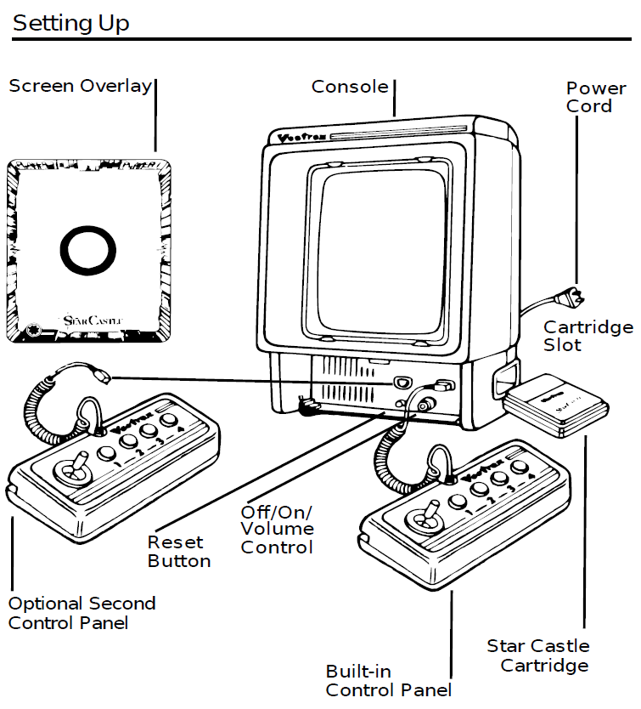
SETTING UP
CREDITS
This game was developed by Erlind Sejdiu and programmed in C and MC6809 assembly language. It is the outcome of a student project which was part of the elective course “Advanced hardware-oriented C and Assembly Language Programming” at Pforzheim University, Germany, in spring term 2025, supervised and tutored by Prof. Dr. rer. nat. Peer Johannsen.

Slide 7


