Slide 1
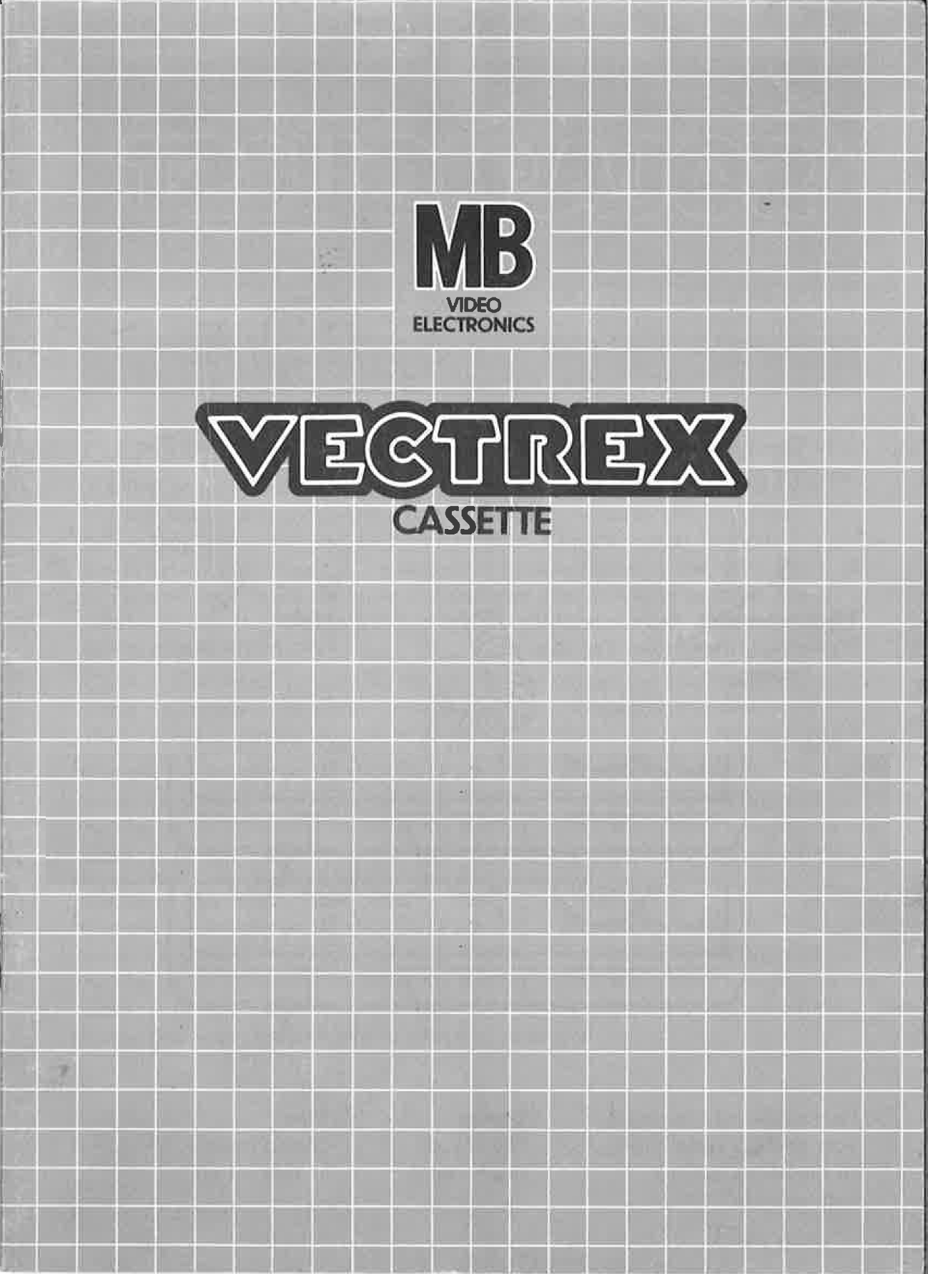
NEURO VECTOR

Slide 2
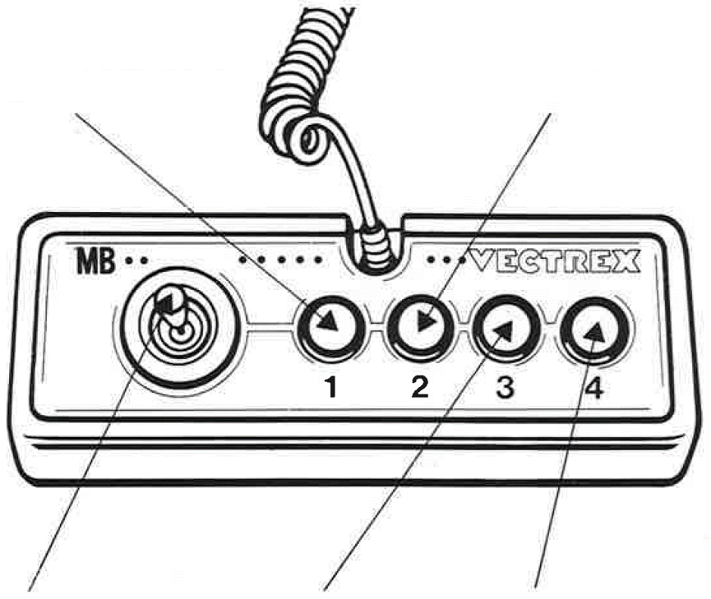
NEURO VECTOR
GAME CONTROLS
NEURO VECTOR is designed to be played with the built-in control panel only. The functions of the controls are:
Button 2
With the help of the second button the player can go back to the menu and select a different mode.
Button 1
Button one does nothing, but if you are stressed, you are free to press it.
Joystick
The joystick can be used to select the fitting option.
Button 3
With the help of the third button the player can restart the current mode.
Button 4
Button 4 confirms the selected input during your menu and during the game.

Slide 3
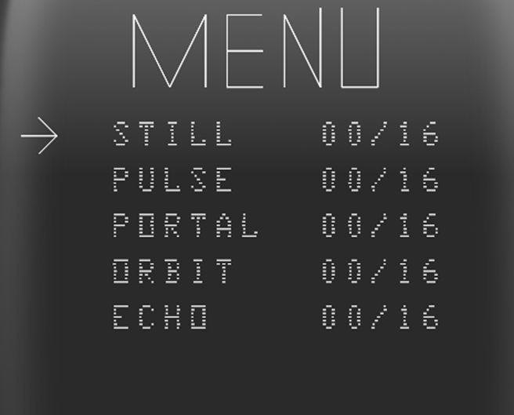
HOW TO PLAY
PLAYER SELECTION
This game is designed as a single-player experience, so only one player can play at a time. There are no additional player settings. If you have a friend with you, you can simply take turns and see who achieves the higher score.
OPTION SELECTION
At the start of each game, after a brief introduction, you will arrive at the main menu. Here, you can choose from five different game modes:
- STILL
- PULSE
- PORTAL
- ORBIT
- ECHO
A small arrow on the left side of the screen indicates the currently selected mode. The first time the game is launched, the default mode is STILL. You can navigate between the modes using the joystick. Push the joystick downward to move the arrow down. To continue moving in the same direction, release the joystick and then push it again in the desired direction (up or down).
On the right side of the screen, you can see your current high score for the selected mode. A mode is considered completed when you reach a score of 16.
To select a mode, press Button 4. You will immediately enter the level. If you decide you don’t like the mode, you can return to the menu and select a different one. Button 3 restarts the level and Button 2 lets you go to the menu.

Slide 4
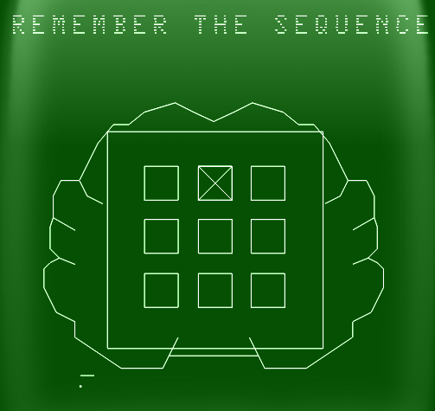
HOW TO PLAY
GAME PLAY
After years of dedication and countless tears, you’ve achieved your dream: becoming a neurosurgeon. Now, a patient’s life rests in your hands as you prepare to operate directly on their brain.
After selecting your game mode, you are greeted by a brain interface. Within this brain, there are 9 squares arranged in a 3 × 3 grid. Fixing a patient’s brain involves two phases, REMEMBER and REPEAT.
REMEMBER:
In the remember phase, your task is to remember a specific sequence that will be displayed. In the 3 × 3 field, a “X” will appear. Try to remember where the “X” was. You don’t need to press anything during this phase. After the sequence is shown, you will automatically move on to the REPEAT phase.
REPEAT:
Your job is to move the joystick to the square where the “X” showed up and hit Button 4. The “X” marks where you are on the grid and starts in the middle if you don’t touch the joystick. Push the stick in any direction, and the “X” will slide that way, landing in the square you’re pointing to. The REPEAT phase can differ in different modes, be careful, because some brains are just confusing.

Slide 5
HOW TO PLAY
TIMING:
As a doctor you want to save lives, and you cannot take forever. At the top of the screen, you can see the lifeline and the beats per minute of your patient. The beats per minute will drop over time. If it drops to 0, you lose your patient and the level.
MODES:
You can choose between 5 different modes. Some modes ought to confuse you with moving squares, but do not worry about the difficulty. In every Remember phase the squares will be displayed in a grid, which is much easier to remember.
SCORING
Your score is determined by how many “X” you can successfully repeat. Each mode saves a unique score, which can go up to 16. If you reach 16, you have completed the level.
At the bottom of the screen, you can see two progress lines.
The first progress line shows how many button presses are required.
The second progress line shows how close you actually are to completing the sequence.
HIGH SCORE MEMORY
As long as your machine is on, with the game cartridge in place, the highest score is retained. To see this score, press the Reset button. When the machine is turned off and the cartridge removed, the score is lost.
RESTARTING THE GAME
To restart a completed game with the same number of players and the same game option, press any of the four buttons once the game is over. If you wish to restart the game before it is completed, or change the number of players or the game option, press the Reset button.

Slide 6
HINTS FOR BEATING THE GAME
In the following, you can see a sequence of four “X” characters.
Remembering a sequence of four “X” characters is quite easy, but remembering a sequence of sixteen is much harder. It can help to divide and conquer the problem. Instead of trying to memorize sixteen individual positions, you can try to remember four shapes. In the example above, you would simply remember a T shaped structure.

Slide 7
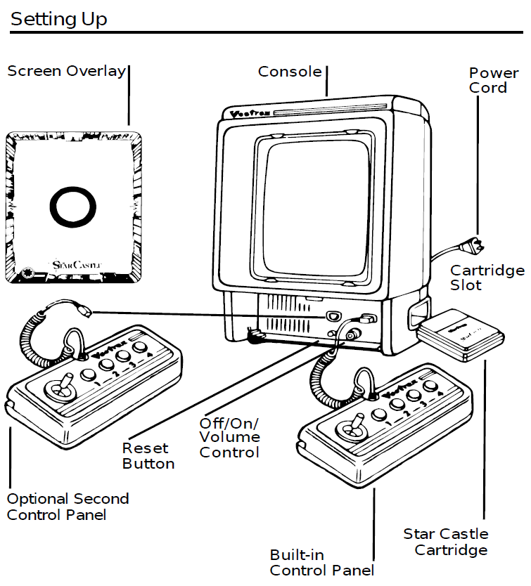
SETTING UP
CREDITS
This game was developed by Erlind Sejdiu and programmed in C and MC6809 assembly language. It is the outcome of a student project which was part of the elective course “Advanced hardware-oriented C and Assembly Language Programming” at Pforzheim University, Germany, in spring term 2025, supervised and tutored by Prof. Dr. rer. nat. Peer Johannsen.

Slide 8
