Slide 1
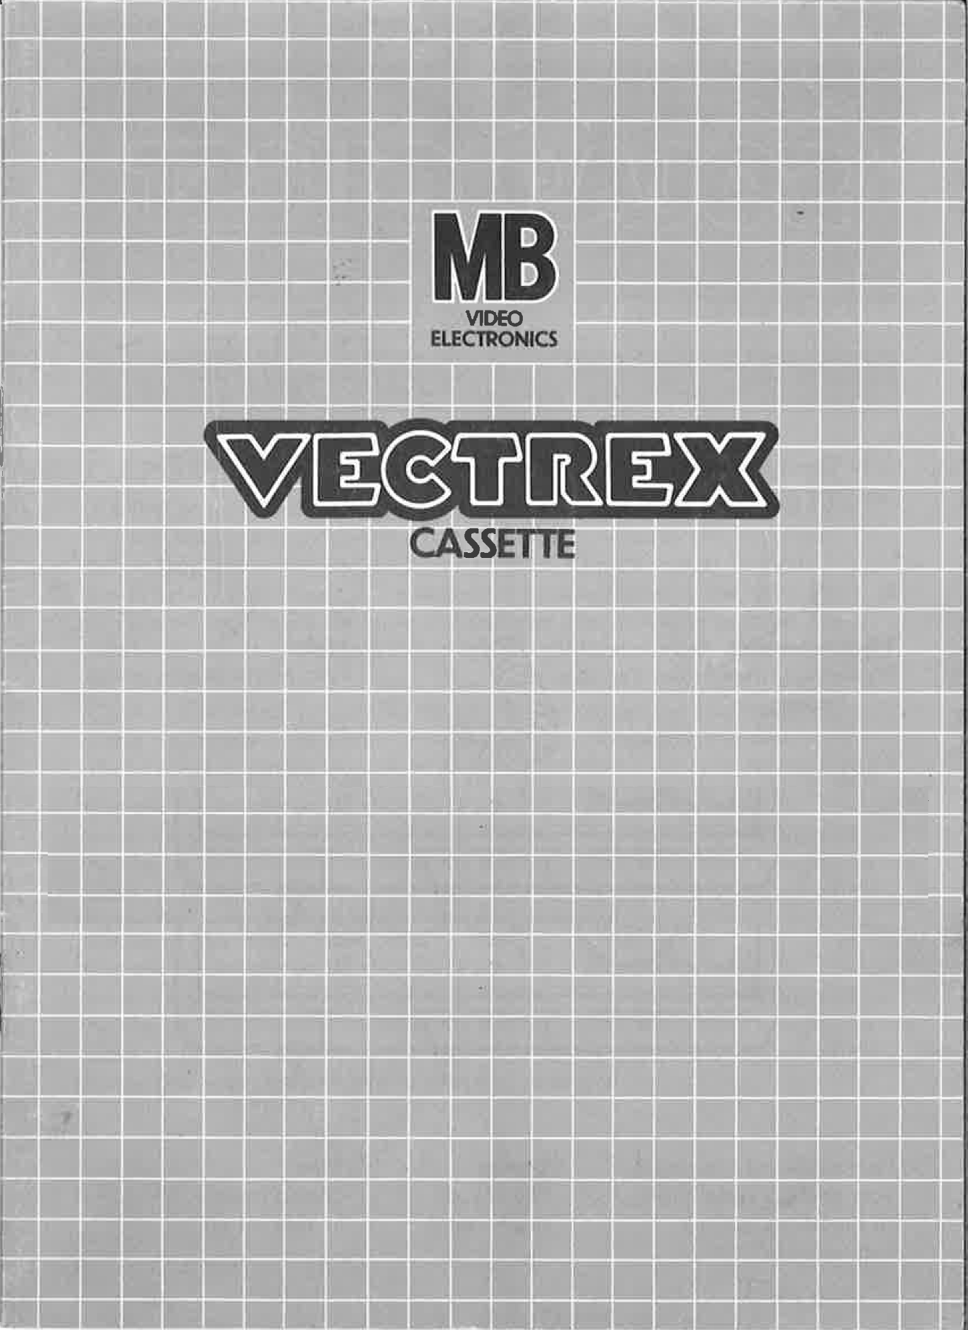
NEURO VECTOR

Slide 2
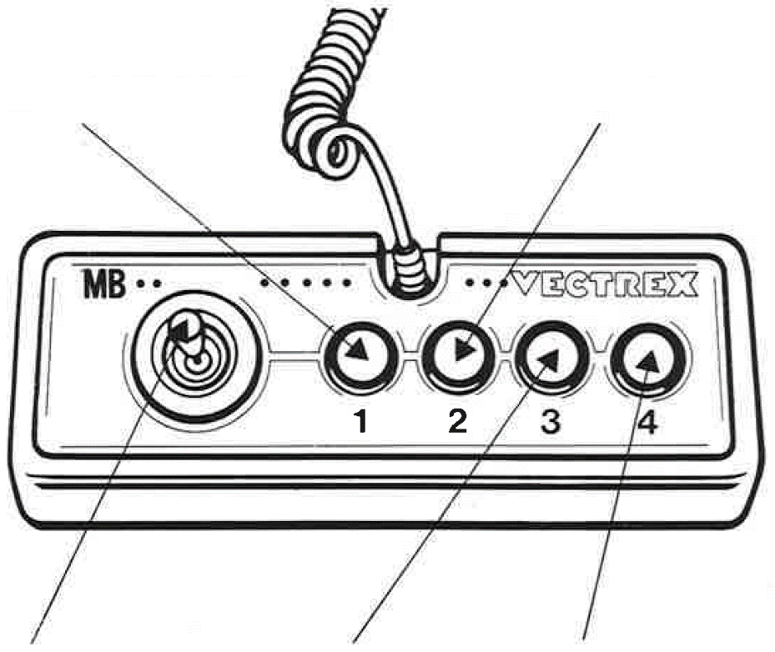
NEURO VECTOR
GAME CONTROLS
NEURO VECTOR is designed to be played with the built-in control panel only. The functions of the controls are:
Button 2
With the help of the second button the player can go back to the menu and select a different mode
Button 1
If stressed, press
Joystick
The joystick can be used to select the fitting option
Button 3
With the help of the third button the player can restart the current level
Button 4
Button 4 confirms the selected input during your menu and during the game

Slide 3
HOW TO PLAY
PLAYER SELECTION
Description of how many players can play this game and of how the number of players is selected in the game menu.
This is a single player game, therefore only one player can play this game.
OPTION SELECTION
Description of the available game options and of how these options are selected in the game menu.
You may choose between different modes. There are 5 different modes in total. These are called:
- NORMAL
- SCALER
- MOVER
- CIRCLE
- REVERSE
At the start of every game after a short introduction, you arrive in the menu. Within the menu you can selected different modes or options. A small arrow on the left side of the screen indicates the currently selected mode. At the start the normal mode is selected. You can move this arrow with the joystick. If you move the Joystick down the arrow will point now to the scaler Mode, to go further down you need to release the pressure of the joystick and reapply the pressure in the direction you like to go.
GAME PLAY
Detailed description of what the game is about and of how the game is played.
WHATEVER ELSE IS IMPORTANT
Description of whatever else is important in the game. Scores, lives, bonus points, etc.

Slide 4
HOW TO PLAY
GAME PLAY
After long years of studying and a lot of tears, you finally reached your dream job being a doctor. Now at a daily basis, you try to help people by fixing their brain.
After selecting your game mode, you are greeted by brain looking interface.
WHATEVER ELSE IS IMPORTANT
Description of whatever else is important in the game. Scores, lives, bonus points, etc.

Slide 5
SCORING
Points are awarded for achieving the following:
You will earn extra points for…
HIGH SCORE MEMORY
As long as your machine is on, with the game cartridge in place, the highest score is retained. To see this score, press the Reset button. When the machine is turned off and the cartridge removed, the score is lost.
RESTARTING THE GAME
To restart a completed game with the same number of players and the same game option, press any of the four buttons once the game is over. If you wish to restart the game before it is completed, or change the number of players or the game option, press the Reset button.

Slide 6
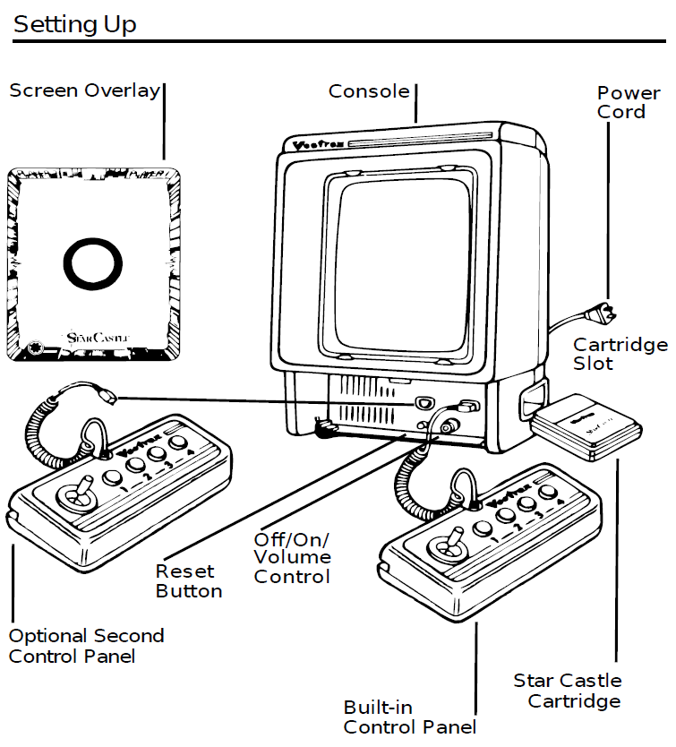
SETTING UP
CREDITS
This game was developed by Erlind Sejdiu and programmed in C and MC6809 assembly language. It is the outcome of a student project which was part of the elective course “Advanced hardware-oriented C and Assembly Language Programming” at Pforzheim University, Germany, in spring term 2025, supervised and tutored by Prof. Dr. rer. nat. Peer Johannsen.

Slide 7
