Slide 1

Evolution of Mobile Phones

Slide 2
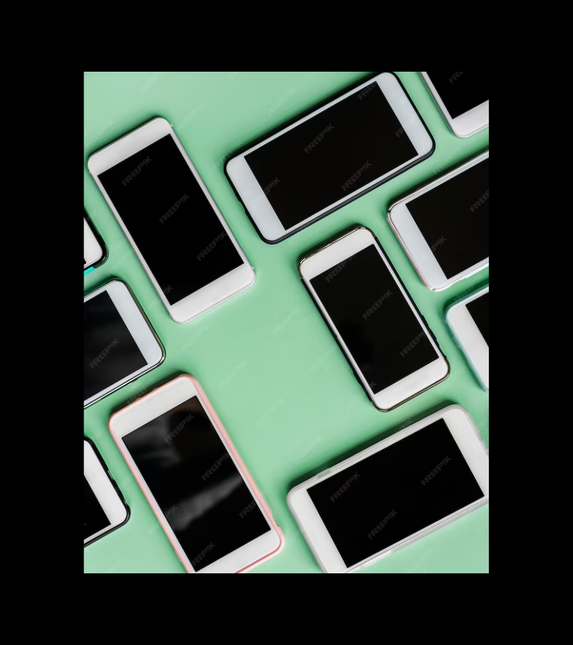
Introduction
Mobile phones have come a long way since the first commercially available device in 1983. From brick-sized devices to pocket-sized computers, mobile phones have evolved to become an indispensable part of our lives.

Slide 3

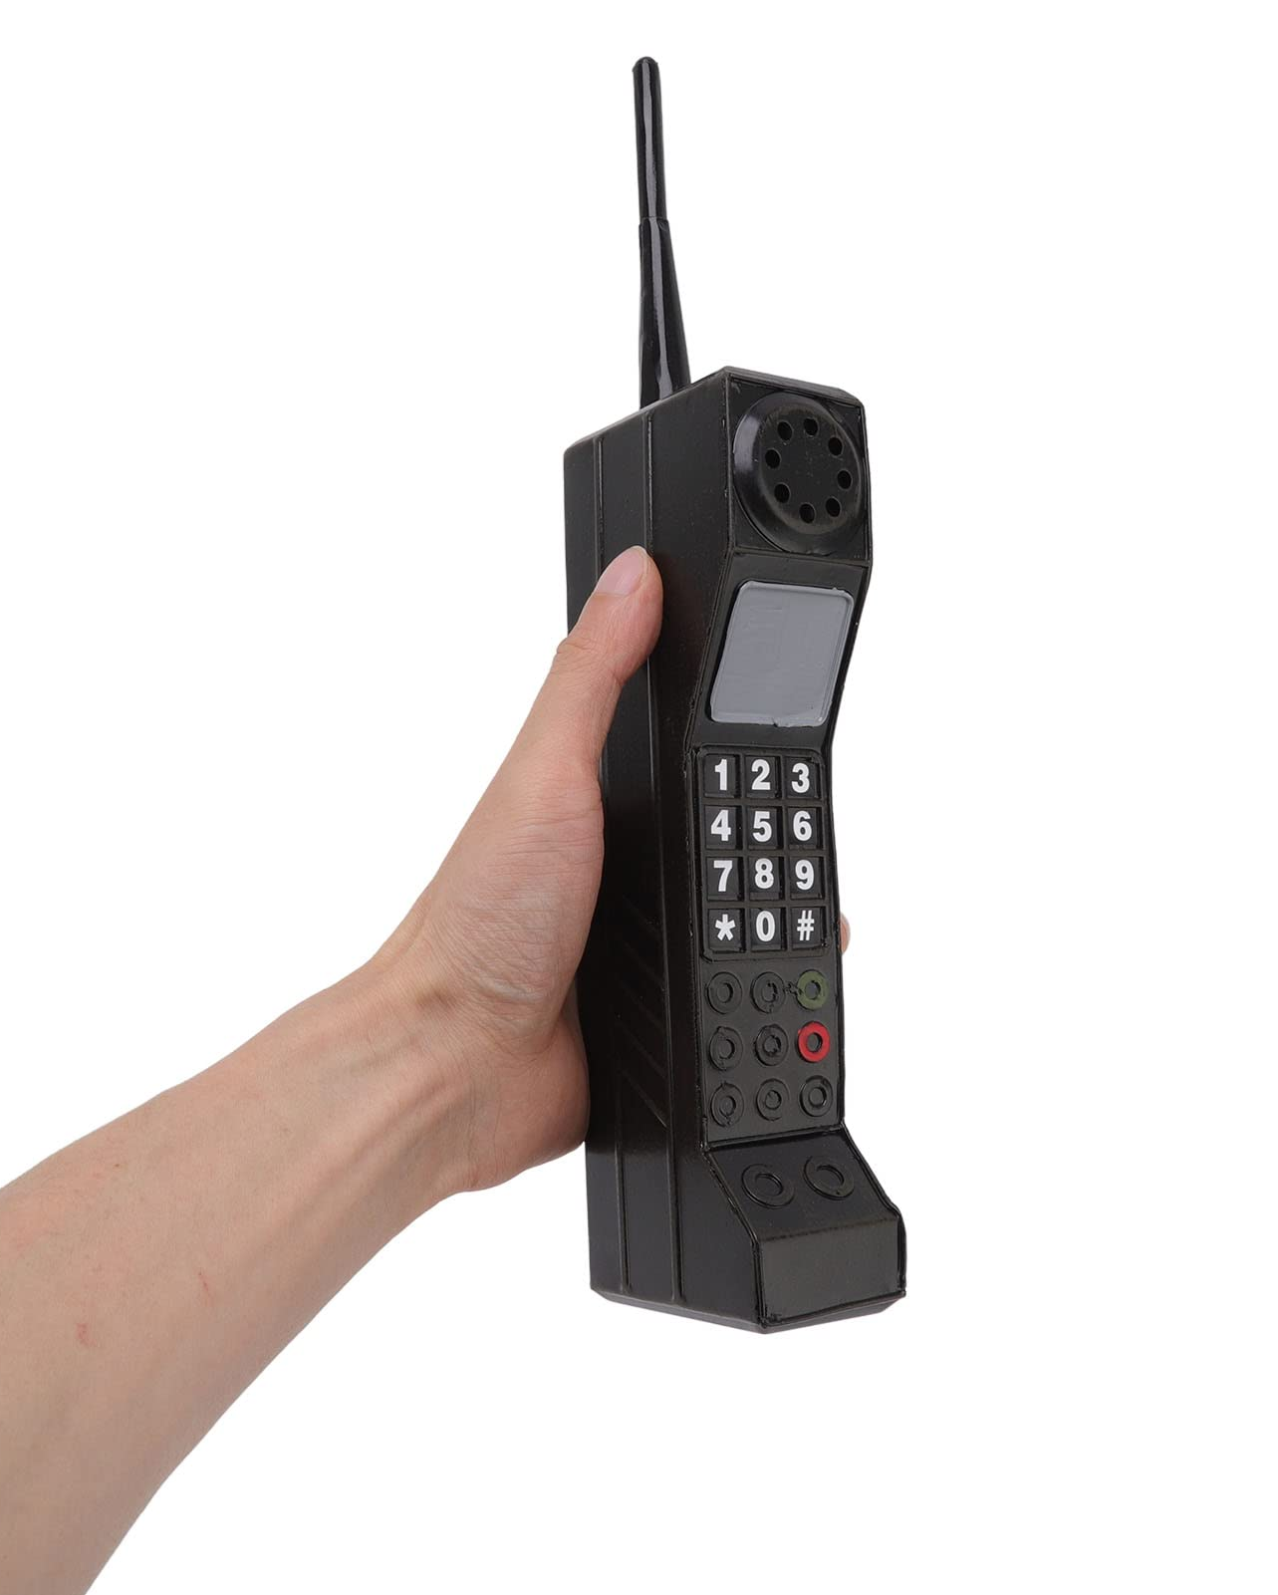
The Age of the Brick
The first mobile phones were heavy and bulky. They had limited range and battery life. The Motorola DynaTAC was the first commercially available mobile phone, weighing in at 2.5 pounds and costing $3,995.

Slide 4
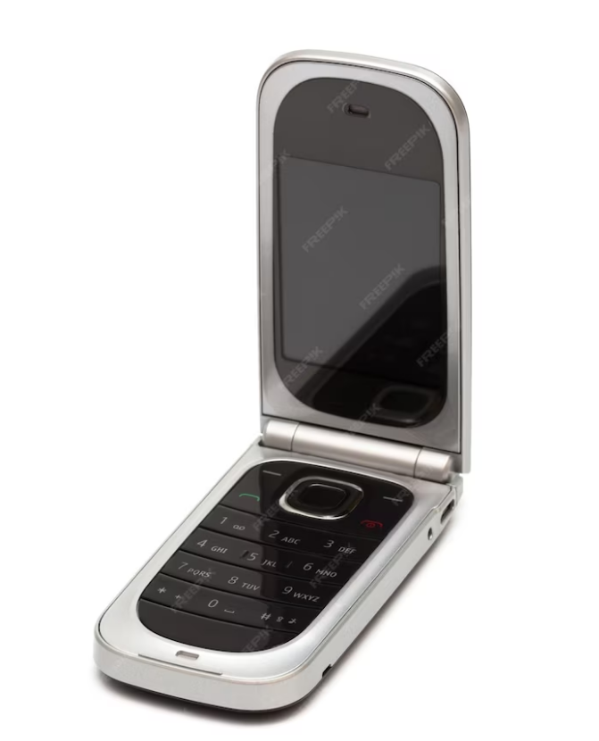
The Rise of Flip Phones
In the 199s, flip phones became popular. They were smaller and more compact than brick phones. The Motorola StarTAC was the first popular flip phone, and it sold over 60 million units.

Slide 5
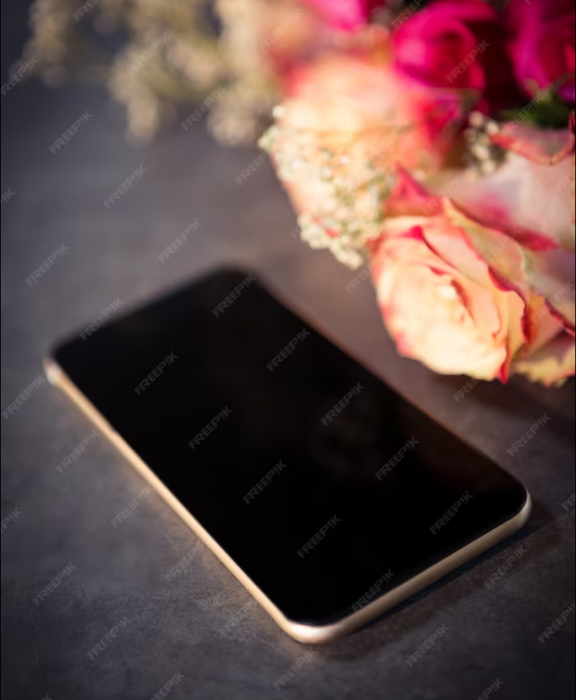
The Era of Smartphones
In the 200s, smartphones emerged. They had touchscreens, keyboards, and internet connectivity. The iPhone was a game-changer, introducing a new era of mobile computing.

Slide 6
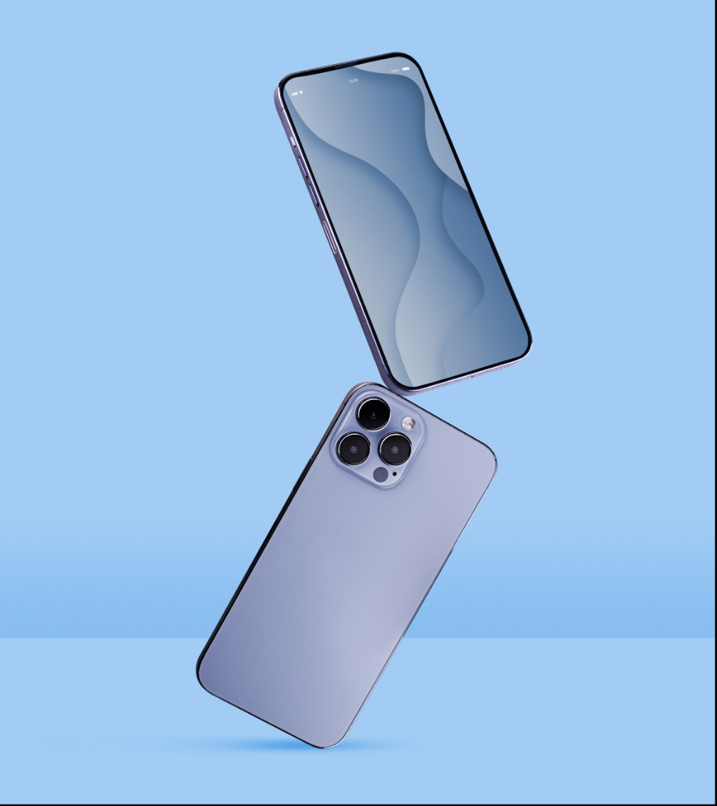
The Future of Mobile Phones
The future of mobile phones is exciting. With 5G technology, we can expect faster speeds and more reliable connections. Foldable phones are also on the horizon, promising new form factors and innovative designs.

Slide 7
Conclusion
Mobile phones have come a long way since the first brick-sized devices. From flip phones to smartphones, mobile phones have evolved to become an integral part of our daily lives. With new technologies on the horizon, the future of mobile phones is bright.

Slide 8
Thanks!
Do you have any questions?

