Slide 1

The Evolution of Mobile Technology

Slide 2

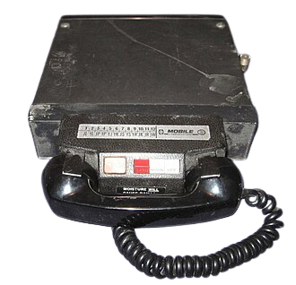
What is mobile technology?
Mobile radio telephone
Mobile technology is technology that goes where the user goes. It consists of portable two-way communications devices, computing devices and the networking technology that connects them.
Mobile radio telephone systems were mobile telephony systems that preceded modern cellular network technology.

Slide 3
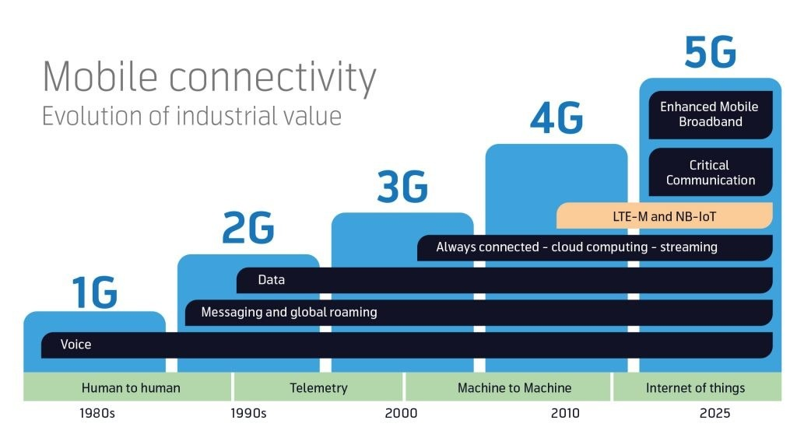

Slide 4
5G
In telecommunications, 5G is the fifth-generation technology standard for cellular networks, which cellular phone companies began deploying worldwide in 2019, and is the successor to 4G technology that provides connectivity to most current mobile phones.

Slide 6
Conclusion

