Slide 1
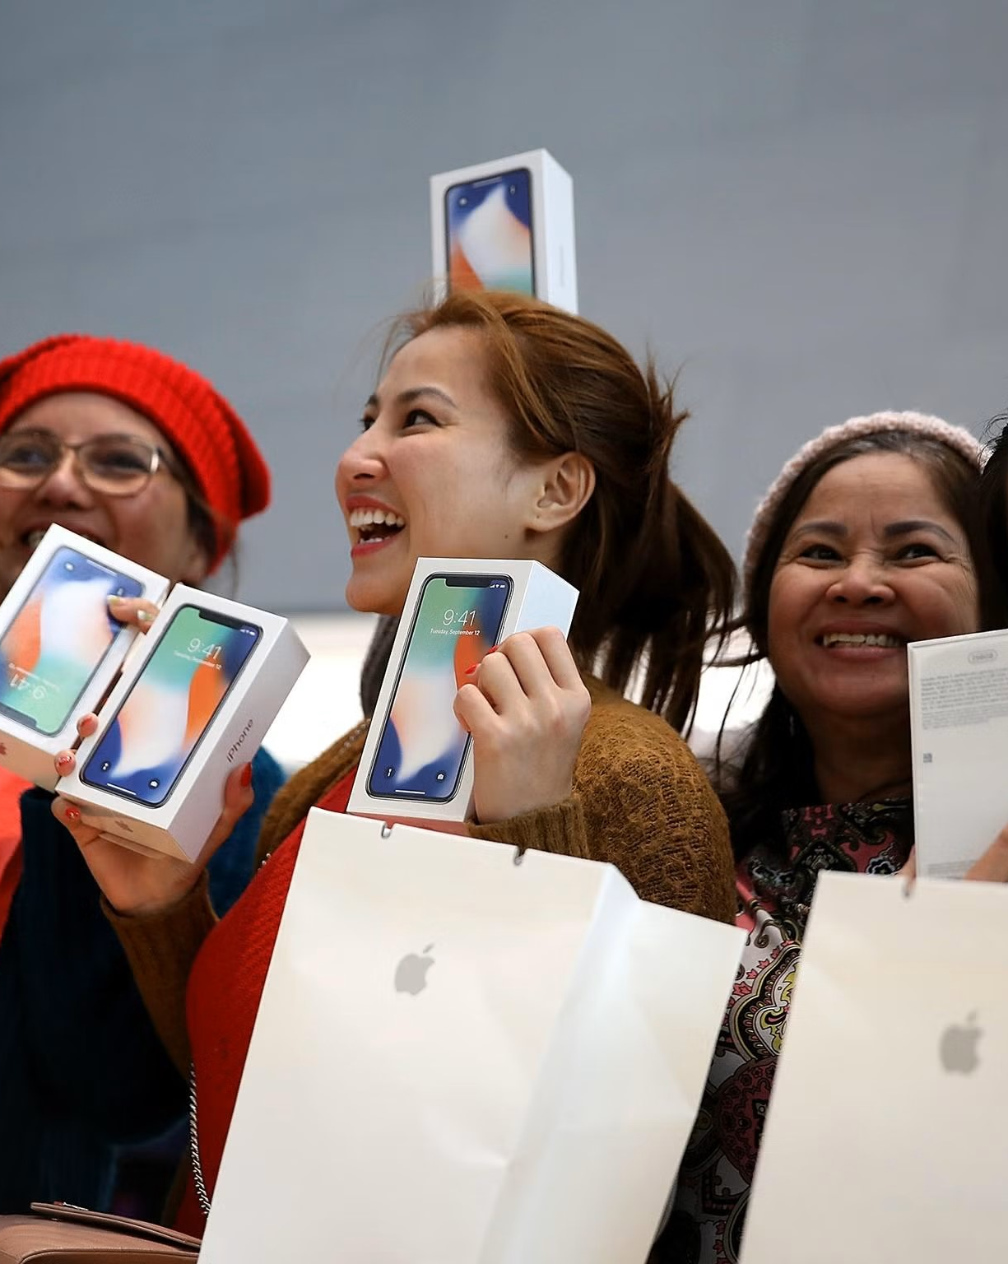
APPLE

Slide 2
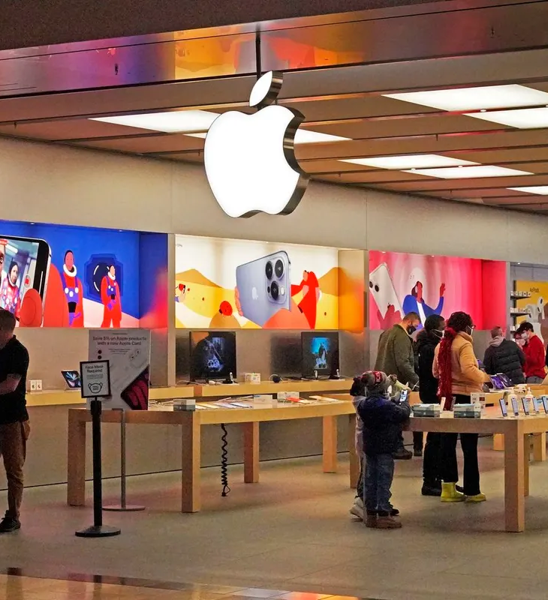
Introduction
Apple Inc. is an American multinational technology company headquartered in Cupertino, California. Apple is the world's largest technology company by revenue, with US$394.3 billion in 2022 revenue. As of March 2023, Apple is the world's biggest company by market capitalization.

Slide 3
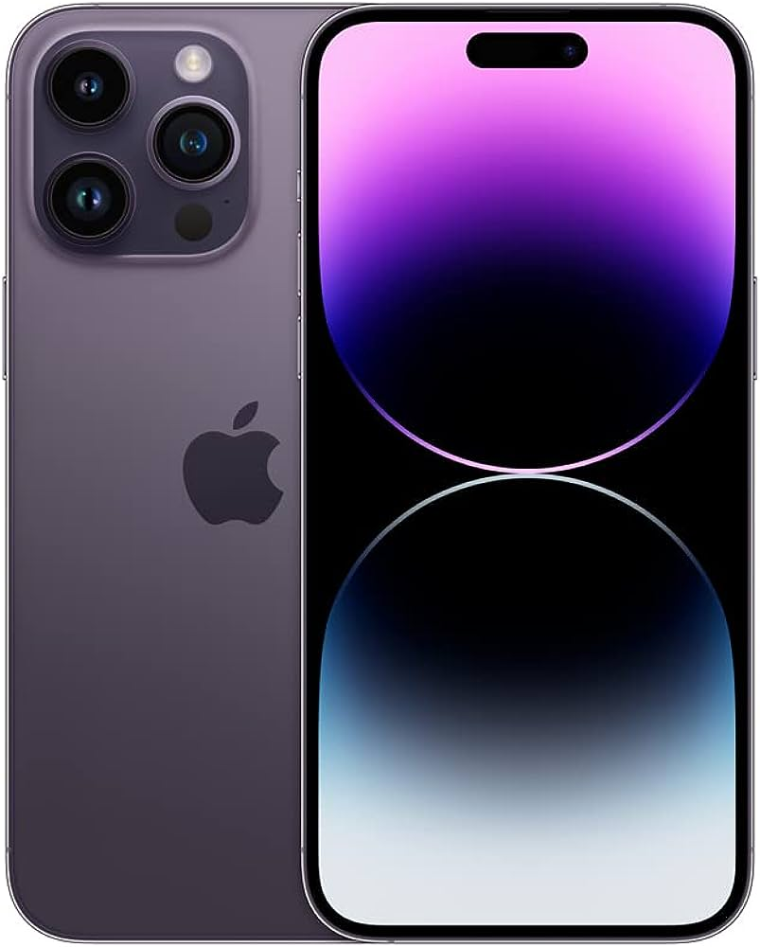
iPhone
The iPhone is Apple's flagship product and has been one of the most popular smartphones on the market for over a decade. With features such as Face ID, wireless charging, and a powerful A14 Bionic chip, the iPhone is a top choice for many consumers. In addition, the iPhone is known for its high-quality camera and a wide range of available apps.

Slide 4
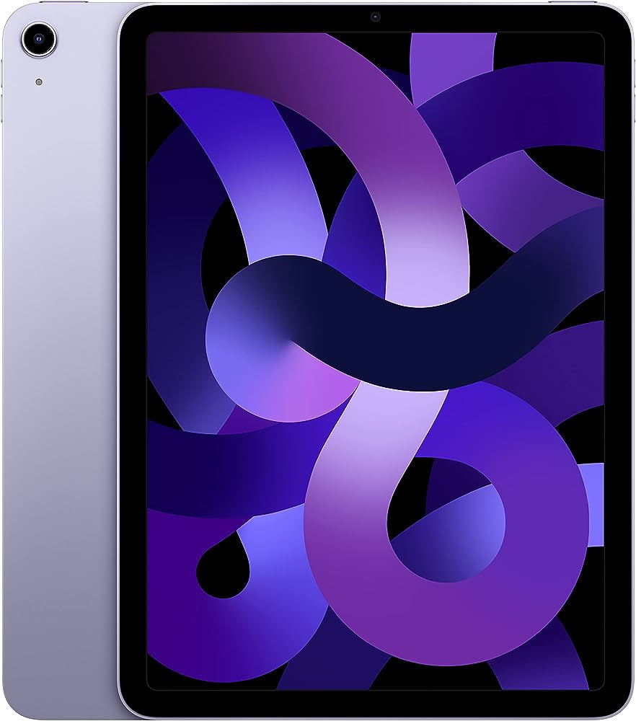
iPad
The iPad is a versatile tablet that can be used for both personal and professional purposes. With features such as the Apple Pencil and Magic Keyboard, the iPad can be used for note-taking, drawing, and even as a laptop replacement. The iPad also has a long battery life and a variety of available apps.

Slide 5
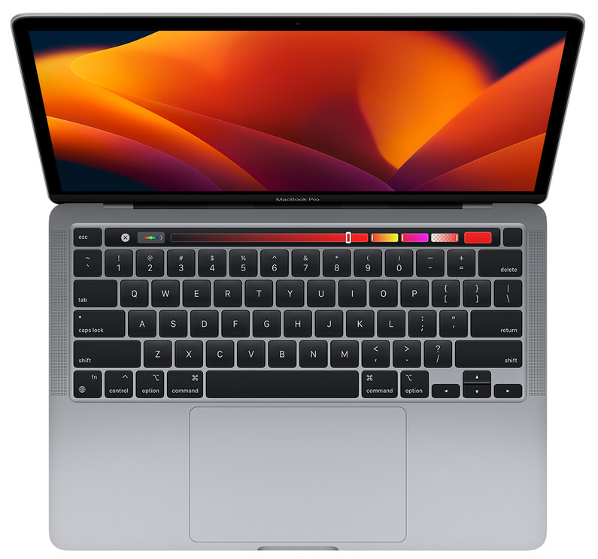
MacBook
The MacBook is a powerful laptop that is popular among professionals and creatives. With features such as the M1 chip, Retina display, and Touch Bar, the MacBook is known for its performance and design. The MacBook also has a long battery life and a variety of available apps.

Slide 6
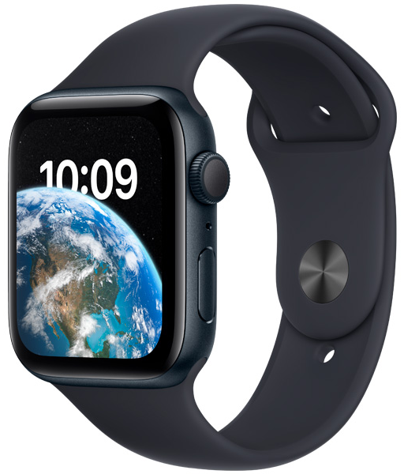
Apple Watch
The Apple Watch is a popular smartwatch that can be used for fitness tracking, communication, and more. With features such as the ECG app, fall detection, and cellular connectivity, the Apple Watch is a top choice for many consumers. In addition, the Apple Watch can be customized with a variety of bands and watch faces.

Slide 7
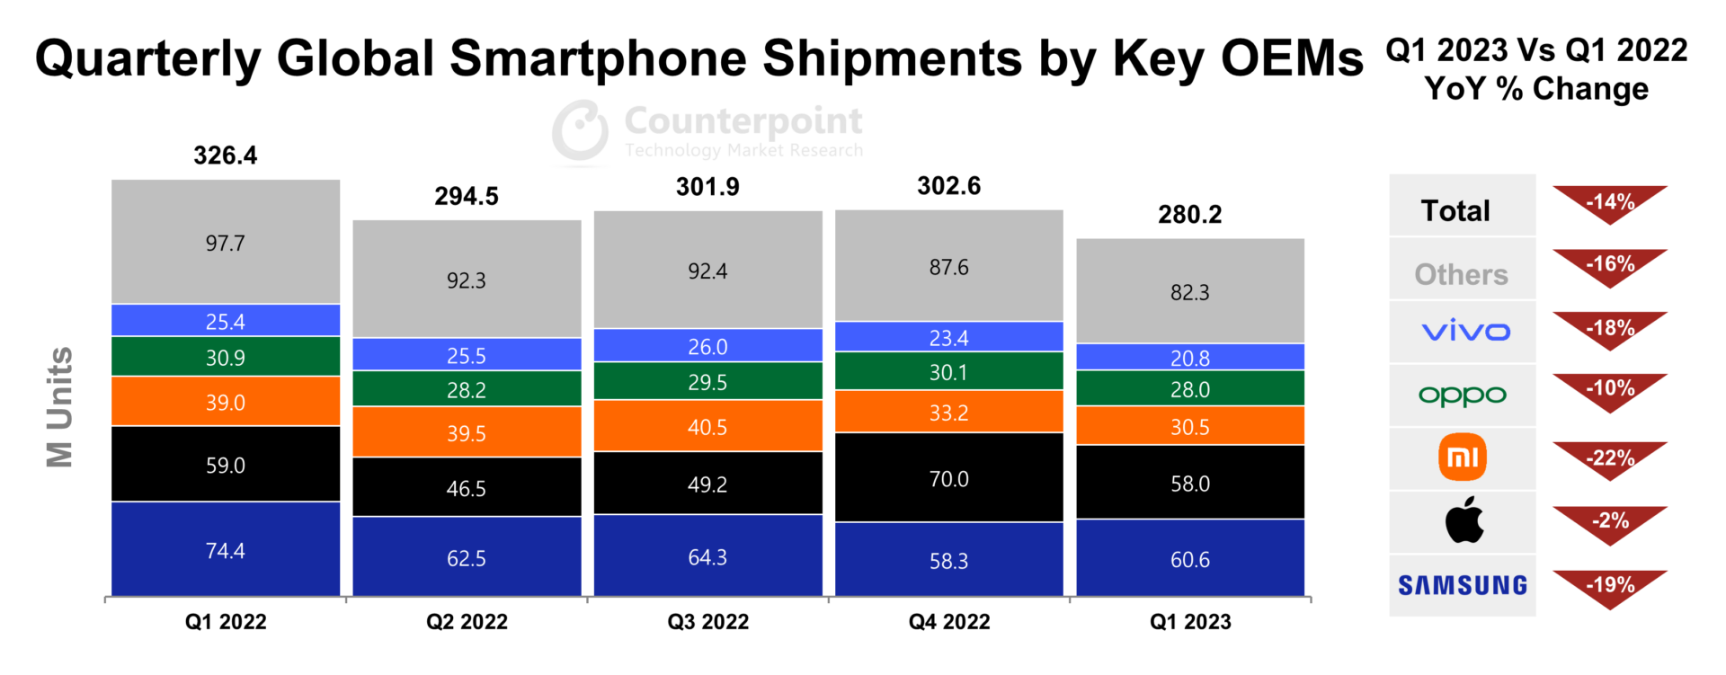

Slide 8
Conclusion
Through this comparative analysis, we have explored Apple's product portfolio and the features and specifications of their most popular products. Whether you are looking for a smartphone, tablet, laptop, or smartwatch, Apple has a variety of products to choose from. By considering your needs and preferences, you can select the Apple product that is best suited for you.

Slide 9
Thanks!
Do you have any questions?

