Slide 1
CPT202 Software Engineering Group Project
Project C: An online meeting booking system
Group 17
Xiangyi Zhu Xinrong Shi Xiaoya Li
Xinyuan Zhang Zimo Zheng Jiayi Wang
Hanqiu Zhang Ziwei Zhou Nan Lin

Slide 2
Content：
Project Introduction
  Background and Requirements
  User Characteristics and Project Scope
  Key Business Processes Flow
  Unique advantages
  Project Risks
Architectural Design
  System Architecture
  Frontend System
  Backend System
  Database Design
Software Design
  Software Modules
  High-level Process Flow
  Software Support Service
  Coding Structure and Convention
  Software Configuration and Production Environmen
Software Testing
  Unit Testing
  Integration Testing
  Acceptance Testing

Slide 3
Project Background
Background and Requirements
1. User-Centered Design
1: Academic and administrative tasks are becoming more complex
2. Intuitive Interface & Simple Booking
2: Schools face increasing scheduling and coordination challenges
3. Real-Time Availability Updates
3. Traditional booking methods are no longer efficient
A robust and user-friendly booking system
Key Features
Aims
4. Automated Notifications
1. Complicated Interface
2. Inefficient Process
5. Integration with Calendars, Payments, Permissions
3. Weak Conflict Management
4. Lack of Real-Time Notifications
6. Enhanced Administrative Efficiency
4: Demand grows for a digital meeting room booking system

Slide 4
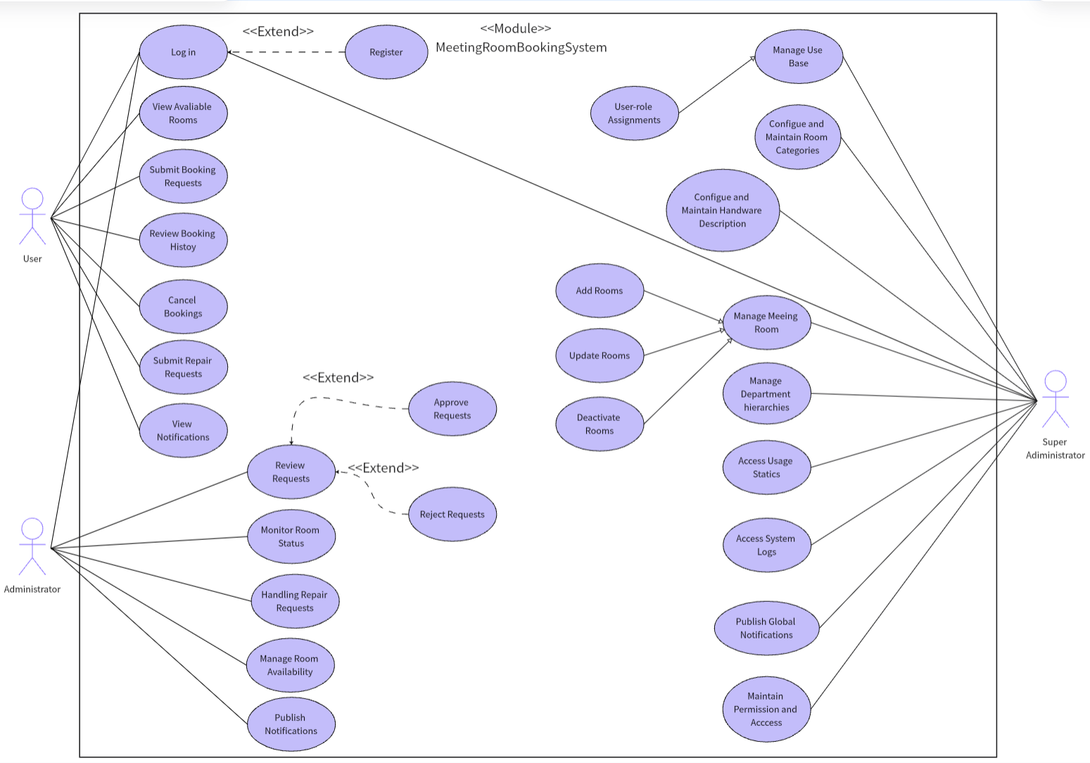
Project Background
  User Characteristics and Project Scope
User Characteristics
view rooms, book/cancel meetings, check history, submit repairs, receive notifications
User
approve bookings, monitor room usage, manage repairs, update room status, post internal notices
Admin
manage users/roles, configure room categories, add/edit/deactivate rooms, maintain permissions, review system logs
Super
Admin

Slide 5
Project Background
  Key Business Processes Flow
1.User registration and login process
User submits registration information ➝ System sends verification email
➝ User clicks activation link ➝ Account activated ➝ User logs into the system
2.Meeting room booking process
User browses meeting room ➝ Select meeting room and time ➝ Fill in booking reason ➝ Submit booking request ➝ Administrator reviews ➝ Booking successful
3.Meeting room management process (administrator)
Administrator adds meeting room information ➝ Maintain meeting room status ➝ Review booking ➝ Update booking status ➝ Handle illegal booking

Slide 6
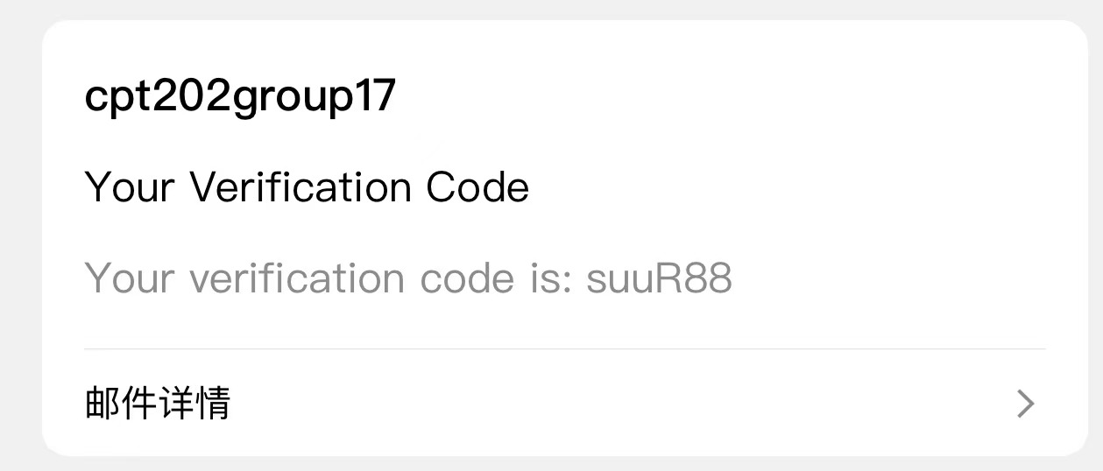
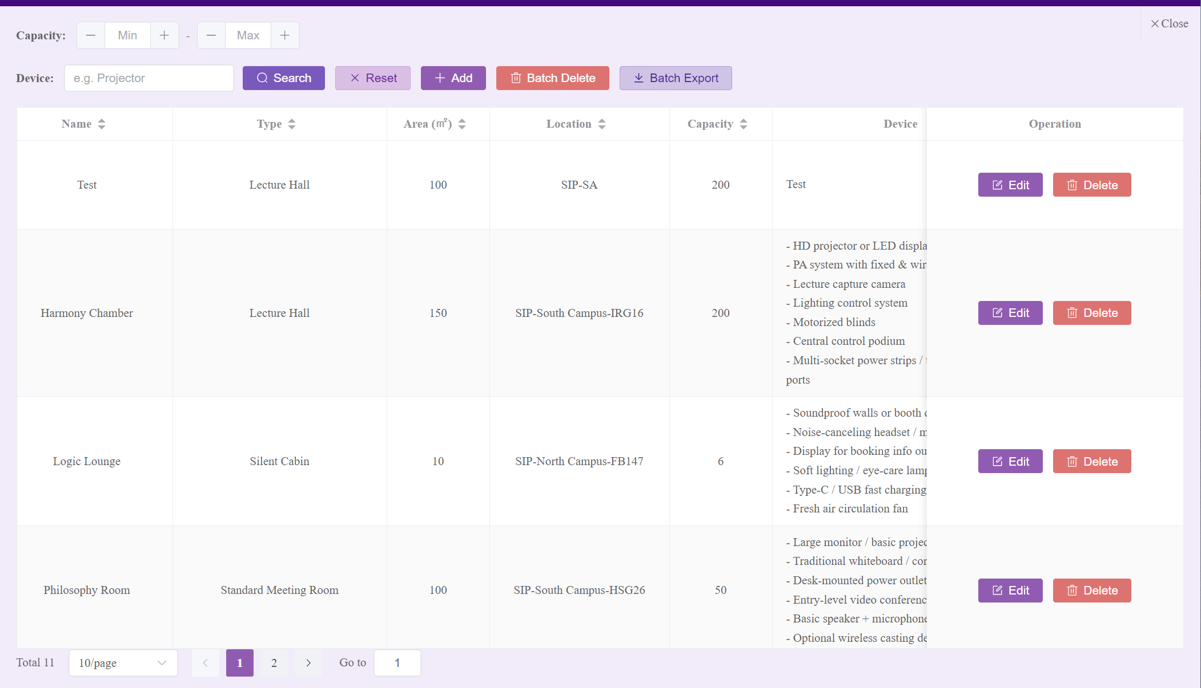
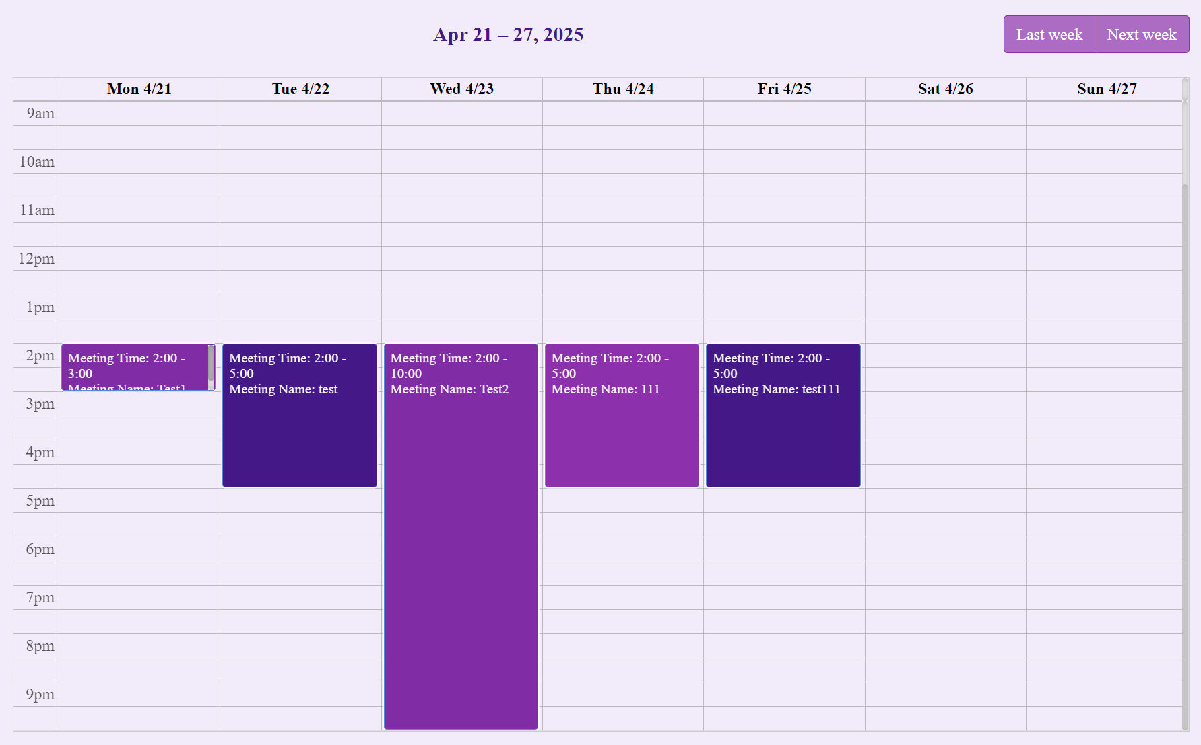
Unique advantages
Figure 2:Verification code in real emailbox
Figure 1:Fixed pane
Figure 3:Calendar in the booking interface

Slide 7

Project Background
  Project Risks
1: Uneven resource allocation
2: Technical challenges (e.g., integration, data handling)
3: Potential security vulnerabilities
4: Testing needs for stability and performance
5: Dependence on team collaboration, resources, and third-party service stability

Slide 8
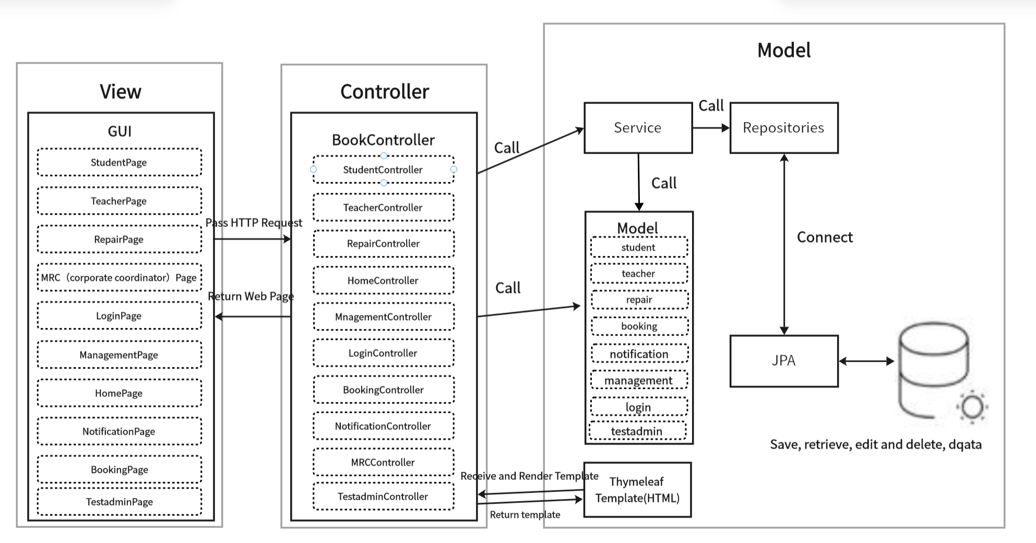
Architectural Design
  System Architecture
Advantages of MVC
1: Clear separation of concerns
2: Modular system design
3: Easy to maintain
4: Better testability
5: Improved team collaboration
6: Scalable development
7: Parallel frontend & backend work

Slide 9
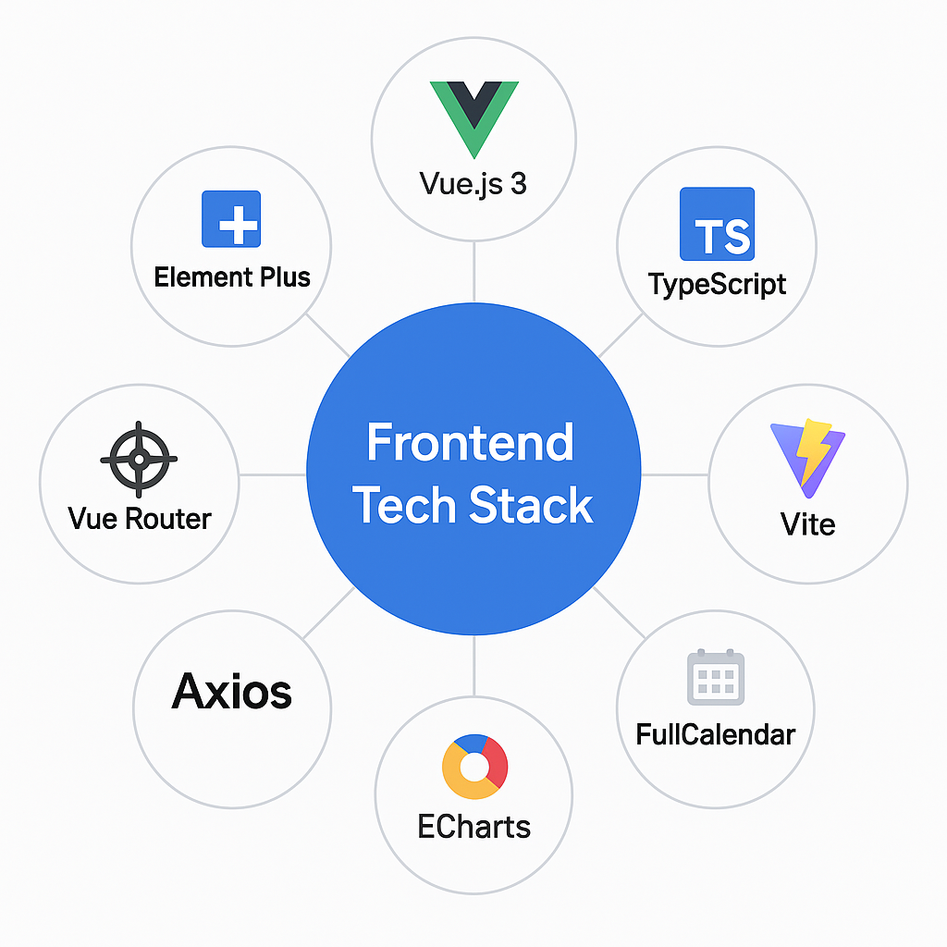
Architectural Design
  Frontend System
Framework/Tools | Description
Vue.js 3 | Core framework for SPA and component-based development
TypeScript | Strong typing for safer and more maintainable code
Vite | Build tool with fast dev and hot module replacement
Vue Router | Routing system with dynamic and role-based navigation
Element Plus | UI library with forms, calendars, modals, tables, etc.
Axios | HTTP client for frontend-backend communication
FullCalendar | Drag-and-drop scheduler for meeting room booking
ECharts | Data visualization with bar, line, and pie charts
Vue-Tippy | Tooltips and guides to enhance user experience

Slide 10




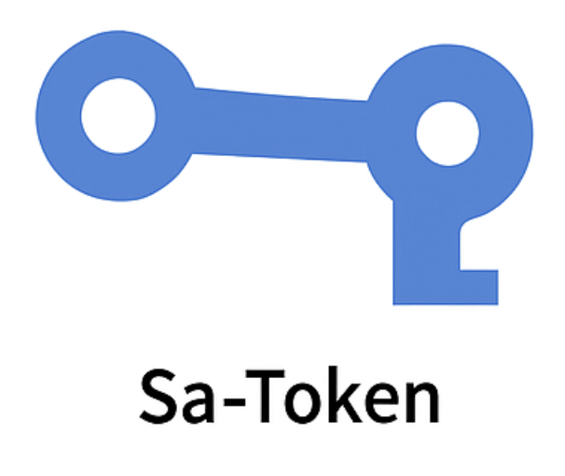
Architectural Design
  Backend System
Controller Layer
1: /api/bookings for managing meetngroom reservations
2: /api/rooms for retrieving availableroom lists and metadata
3: /api/users for role-based user
management
4: /api/repair for repair requet submission and resolution
5: /api/statistics for returning roomusage and booking distribution data
Service Layer
1:Checking room availability before booking
2: Coordinating approval flows for MRC roles
3: User login, session management, andpermission control
4: Generating data for charts using EChartscompatible formats
5: Sending notifications or processing!
repair updates
DAO Layer
1: Defines Java classes correspondling
to database tables
(meeting_category, meeting room, mele!ting book, sys dept, sys _user, sys role and so on)

Slide 11
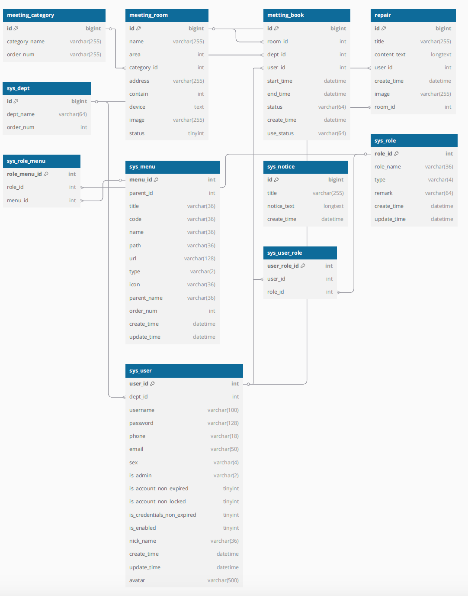
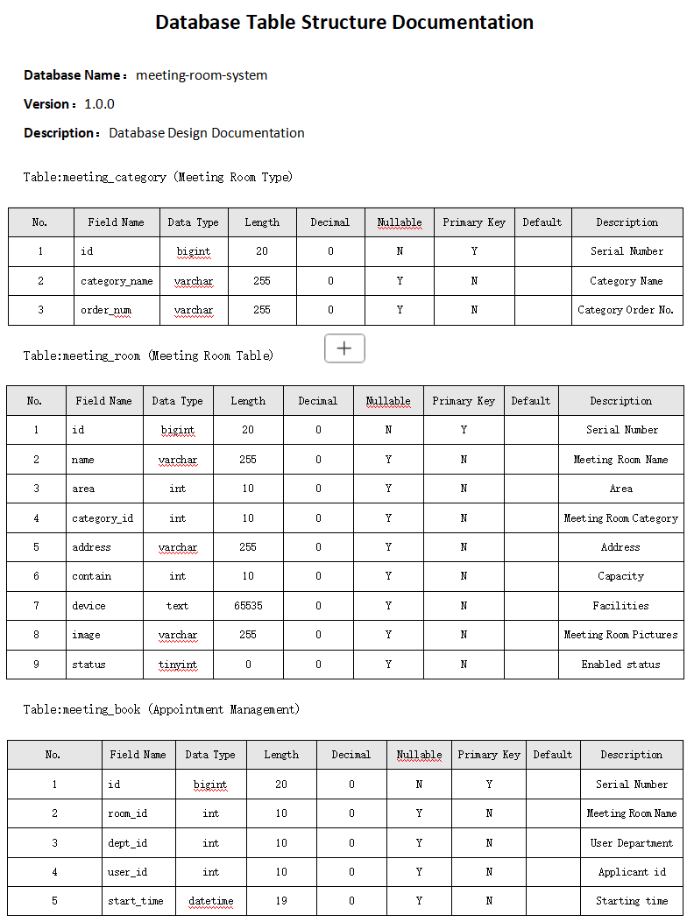
Architectural Design
  Database Design
Unified ERD Design
1: Team adopted a shared schema structure
2: Follows 3NF to reduce redundancy
3: Ensures data integrity and modular scalability
4: Aligned with service endpoints for smooth system evolution

Slide 12
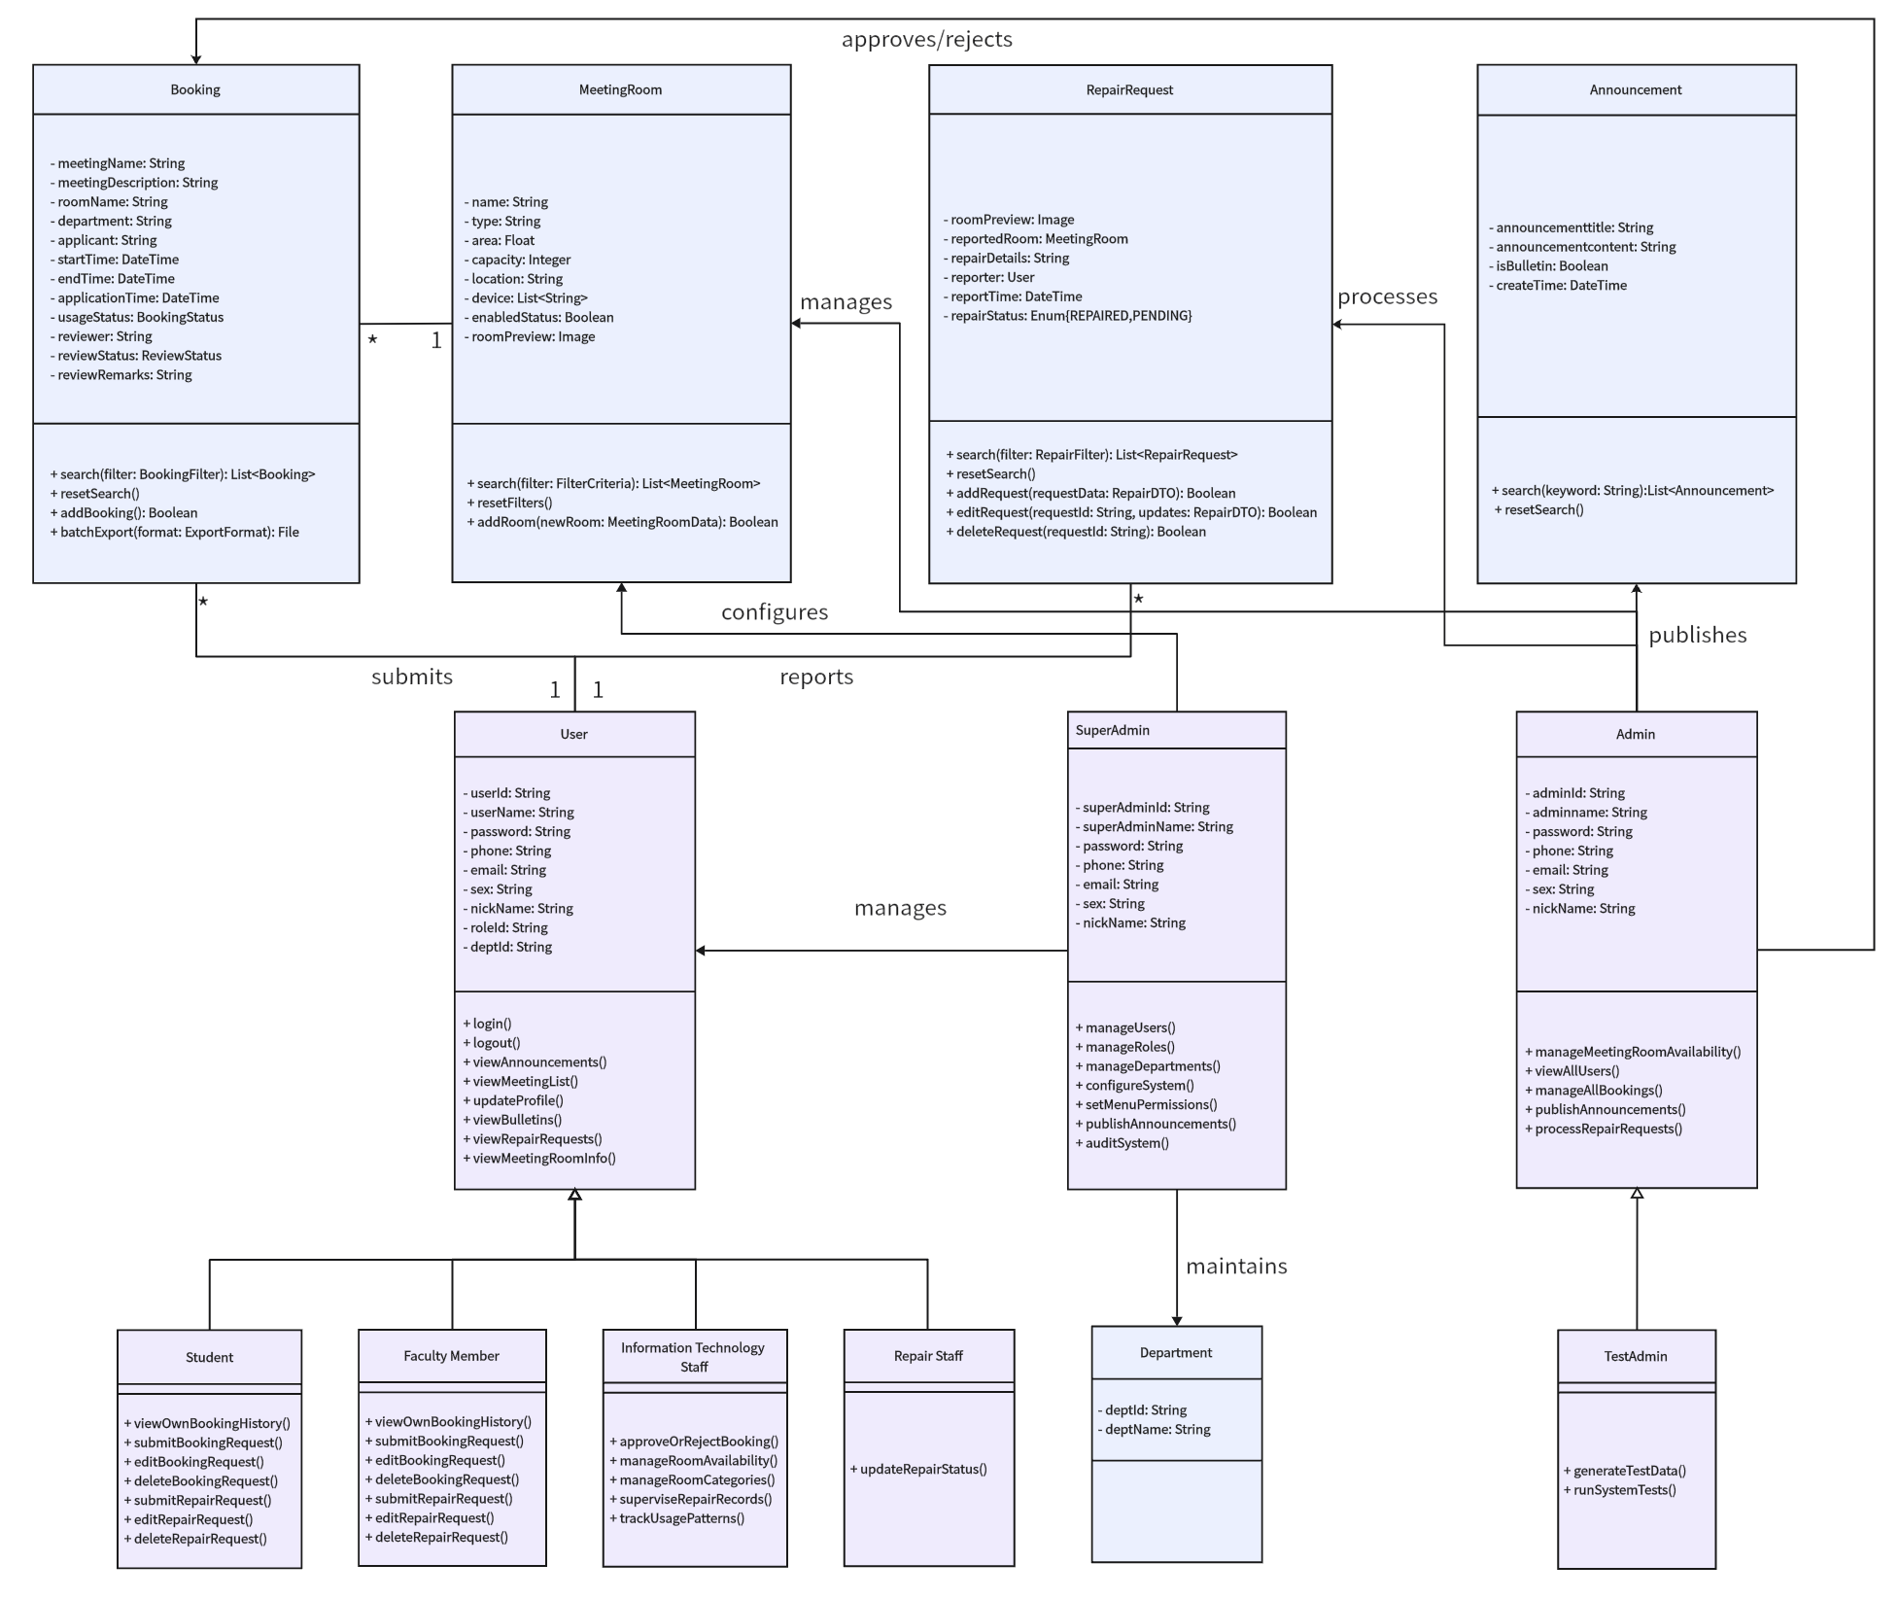
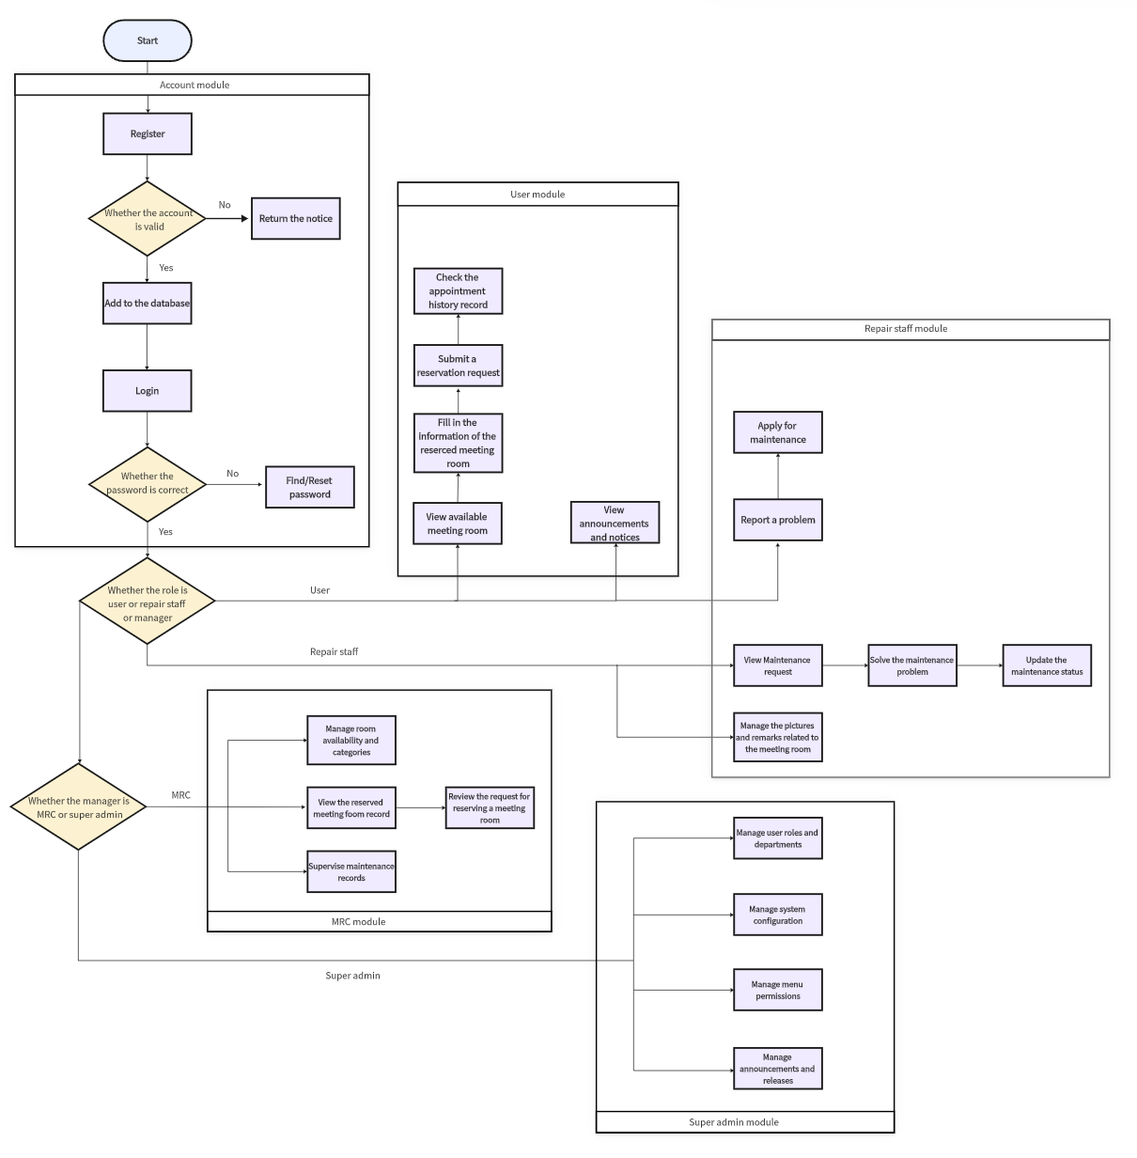
Software Design
  Software Modules
Role-Based Module Function Diagram
Role-Based Login Process Diagram

Slide 13
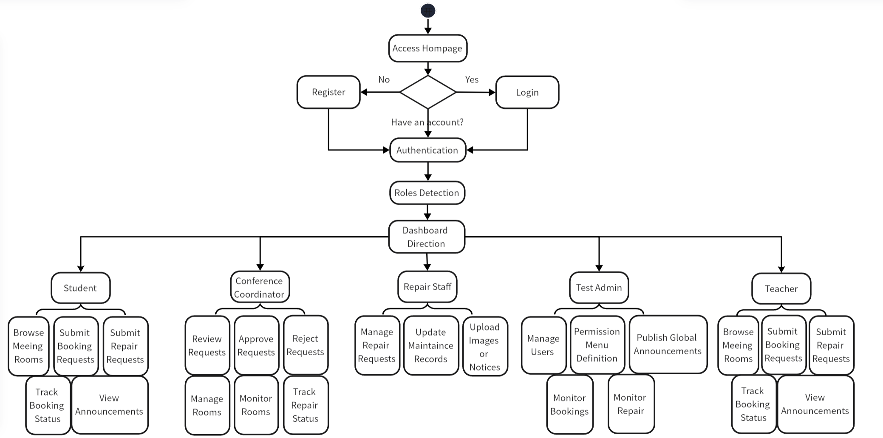
Software Design
  High-level Process Flow
1.User enters the mainpage
2.Login in or register
3.Access to functions according to roles
Student
MRC(Conference Coordinator)
Repair Staff
Tset Admin
Teacher

Slide 14






Software Design
  Software Support Service
Software Tools and Services
Database-Related Services
Web Navigation Services
Other Supporting Services
MySQL V5.7.27
MyBatis-Plus+Join
Vue.js 3+Element Plus
Spring Boot Mail Service
Git+Coding.net
Navicat V11.1.13
Vue Router+
Maven V3.8.1

Slide 15
Software Design
  Coding Structure and Convention--Part 1
1: Project Directory Structure
2: Method Invocation Convention
To promote loose coupling and enhance maintainability, the Controller layer invokes business logic strictly through Service interfaces.
Backend
Frontend
3: Naming Convention
controller
entity
views
assest
1．Methods and variables: camelCase (e.g., createBookingRequest)
2．Class names: PascalCase (e.g., BookingController)
3．Constants: UPPER_CASE with underscores (e.g., MAX_ROOM_CAPACITY)
4．Naming principle: all names are semantically meaningful and follow the "entity + action" pattern when applicable (e.g., getUserPermissionList)
5．Interface implementation classes: suffixed with Impl (e.g., RoomServiceImpl)
service
config
components
store
mapper
utils
router
api

Slide 16
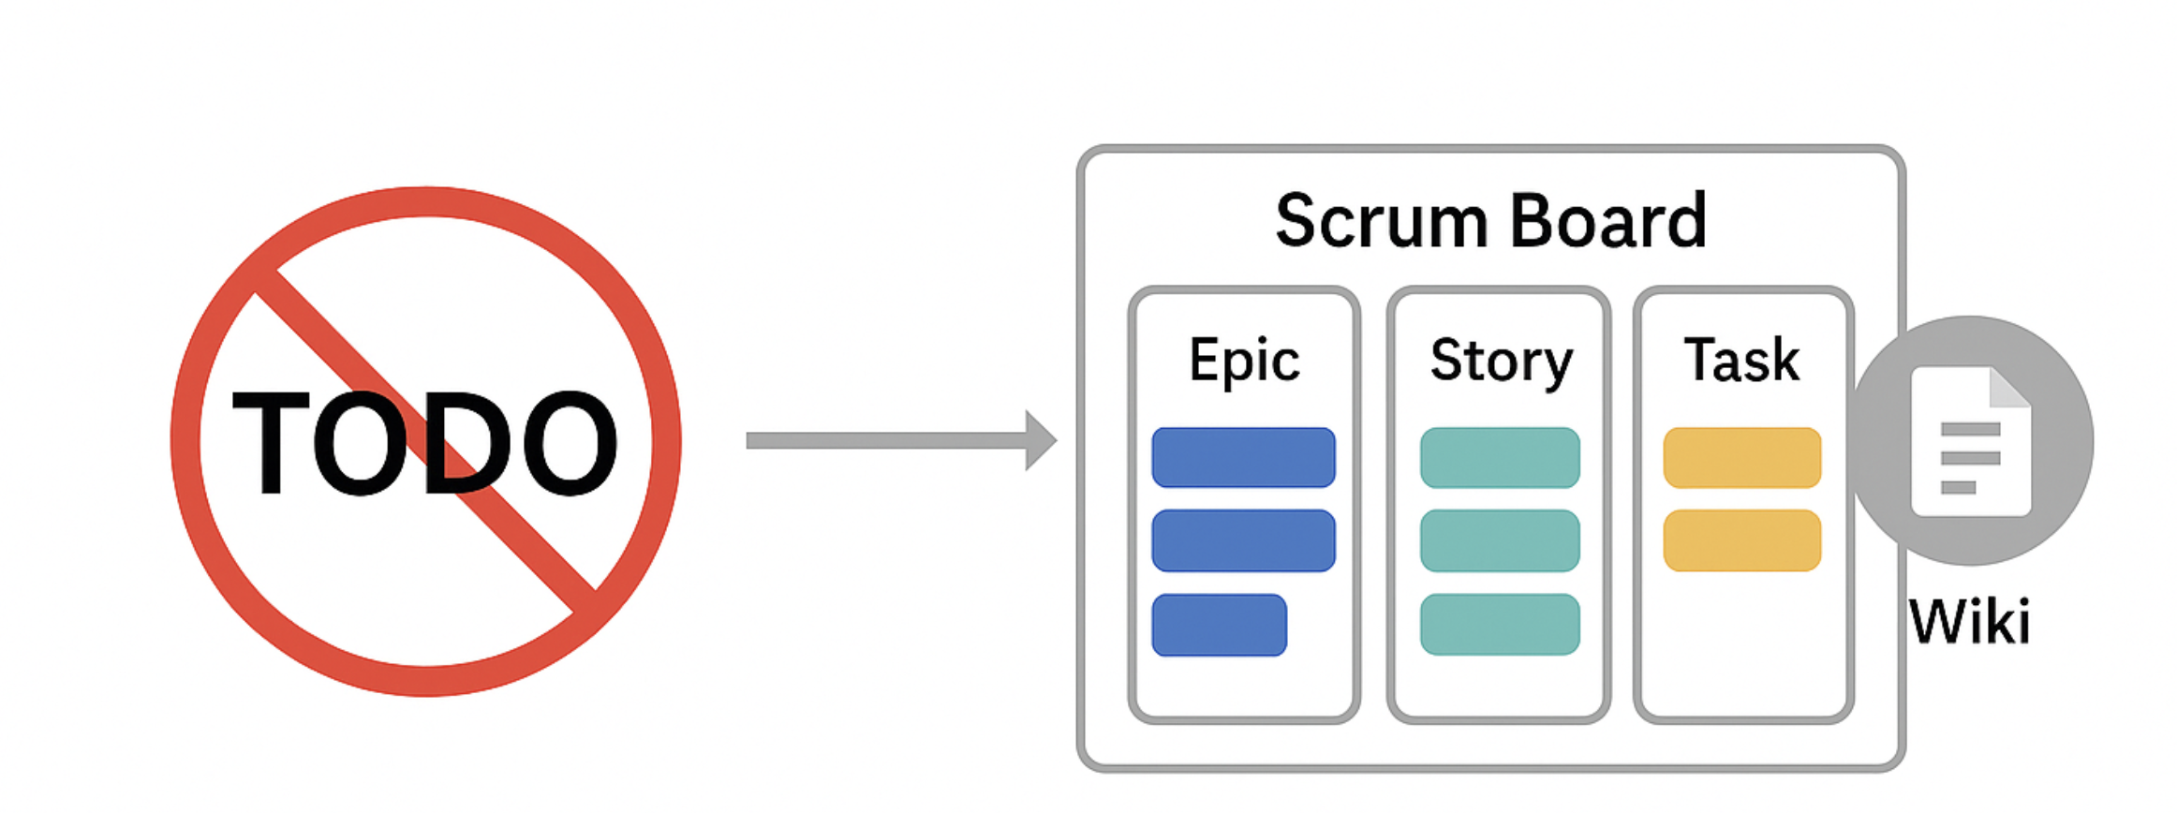
Software Design
  Coding Structure and Convention--Part 2
4: Code Maintenance Standards
5: Task Management and Code Completion
1．Developers are expected to write self-documenting code with concise and relevant inline comments
2．Prior to any Git commits, unused code segments and outdated comments are cleaned up to preserve repository hygiene
3．Code formatting follows IDE-configured style guides across the team to maintain structural consistency
Unfinished features and pending implementations are not marked with inline TODOs. Instead, we adopted a structured task-tracking workflow using Coding.net’s Scrum board and Wiki documentation.

Slide 17
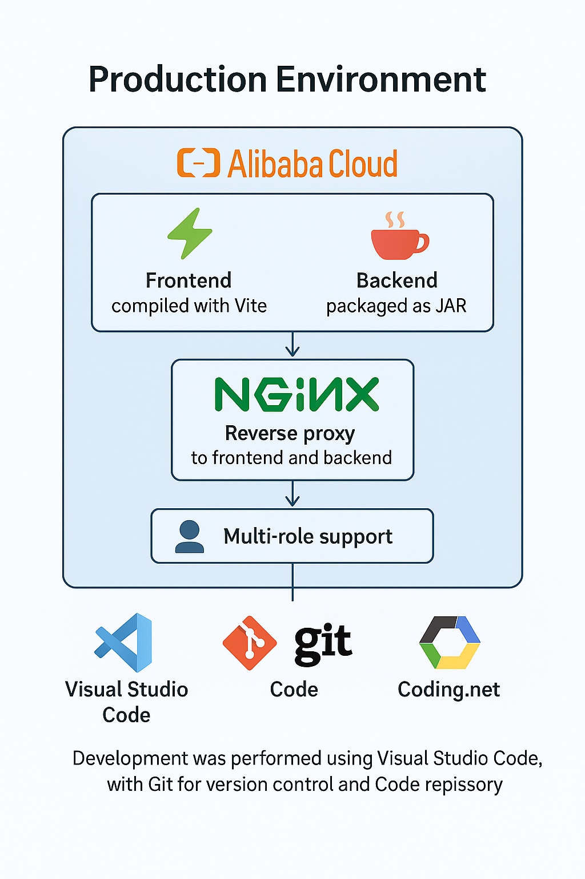
Software Design
  Software Configuration and Production Environmen
Development Environment
1: Local development with Vite hot reload and Maven build
Server Deployment
1: Cloud server (Alibaba Cloud)
2: Nginx reverse proxy
3: Node.js version: 18.20.8
Frontend Deployment
1: Deployed to the dist directory on the cloud server
Backend Deployment
1: Packaged as a JAR file and run as an independent Spring Boot application
Frontend Language
1: HTML & CSS – Basic page structure and styling
2: JavaScript – Interactive functionality
3: TypeScript – Enhances code robustness
Backend Language
1: Java 17 (v17.0.14)

Slide 18
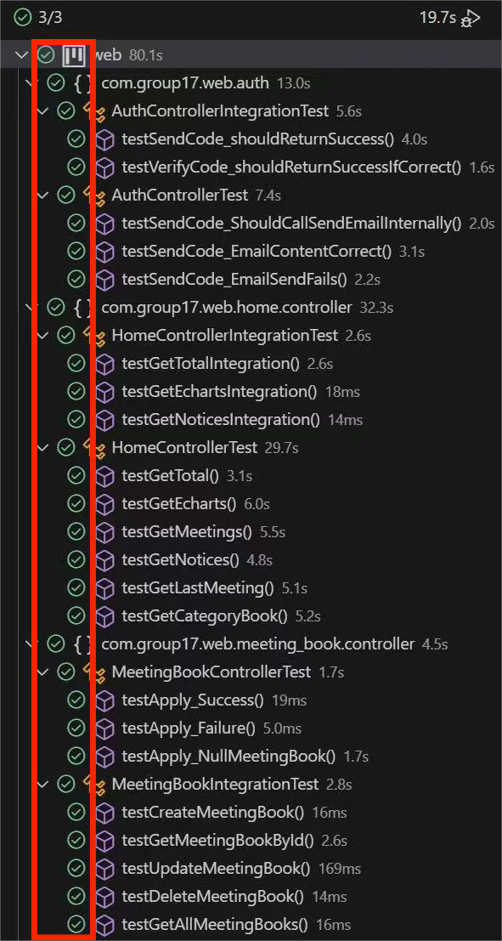
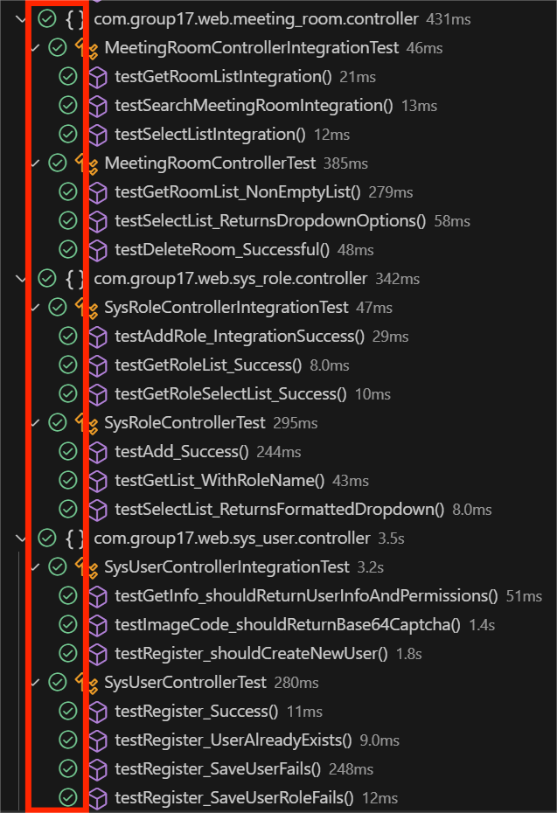
Software Testing-Overview
Test Results : Pass

Slide 19
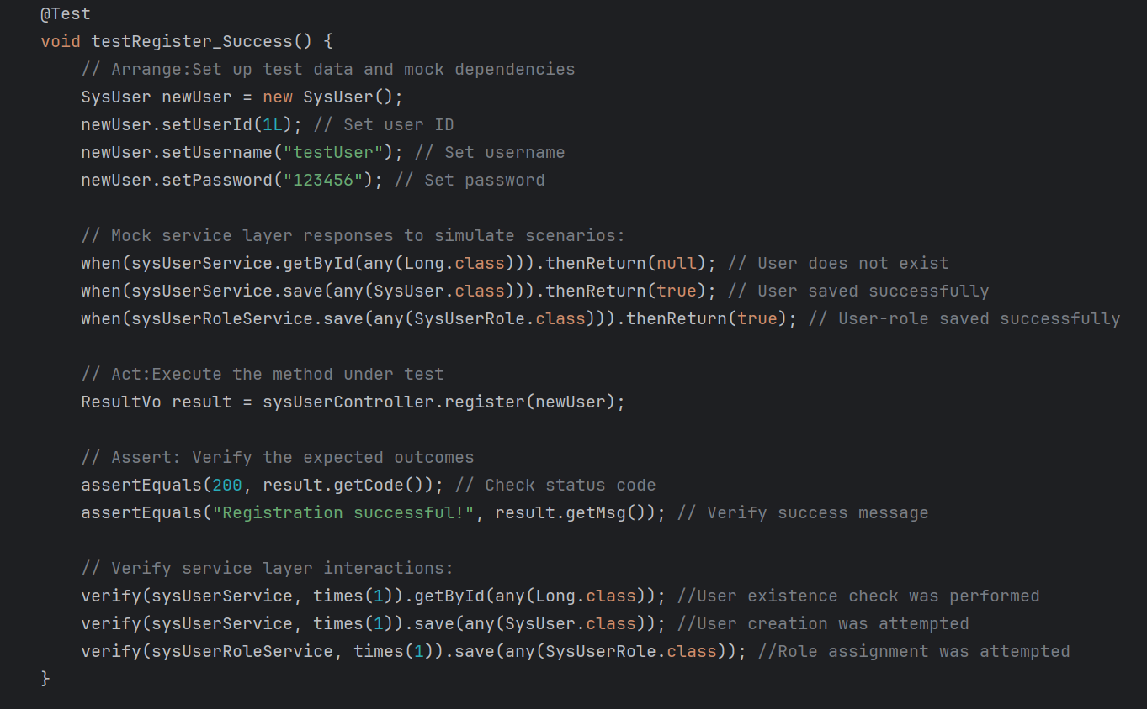
Software Testing-Unit Testing-Register
Test Code:
Framework: Junit
Simulation tool: Mockito
Test Result:

Slide 20
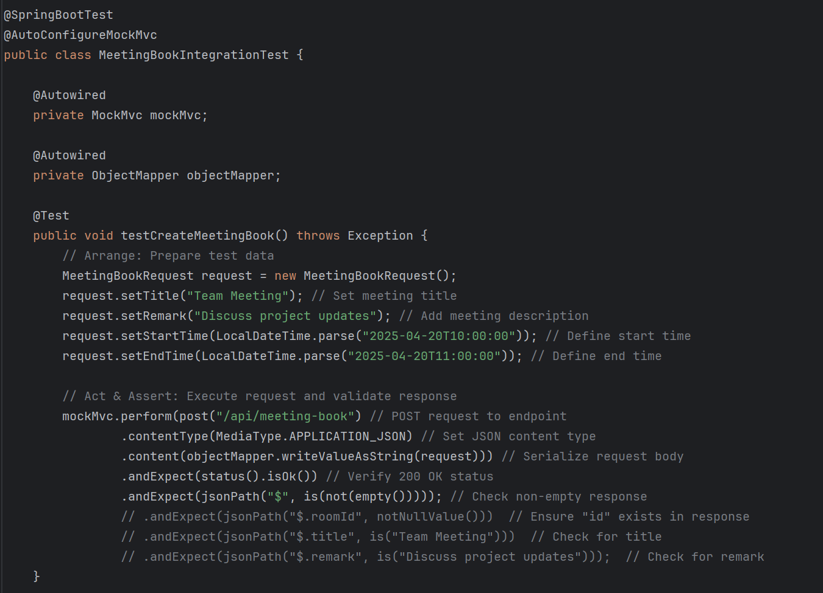
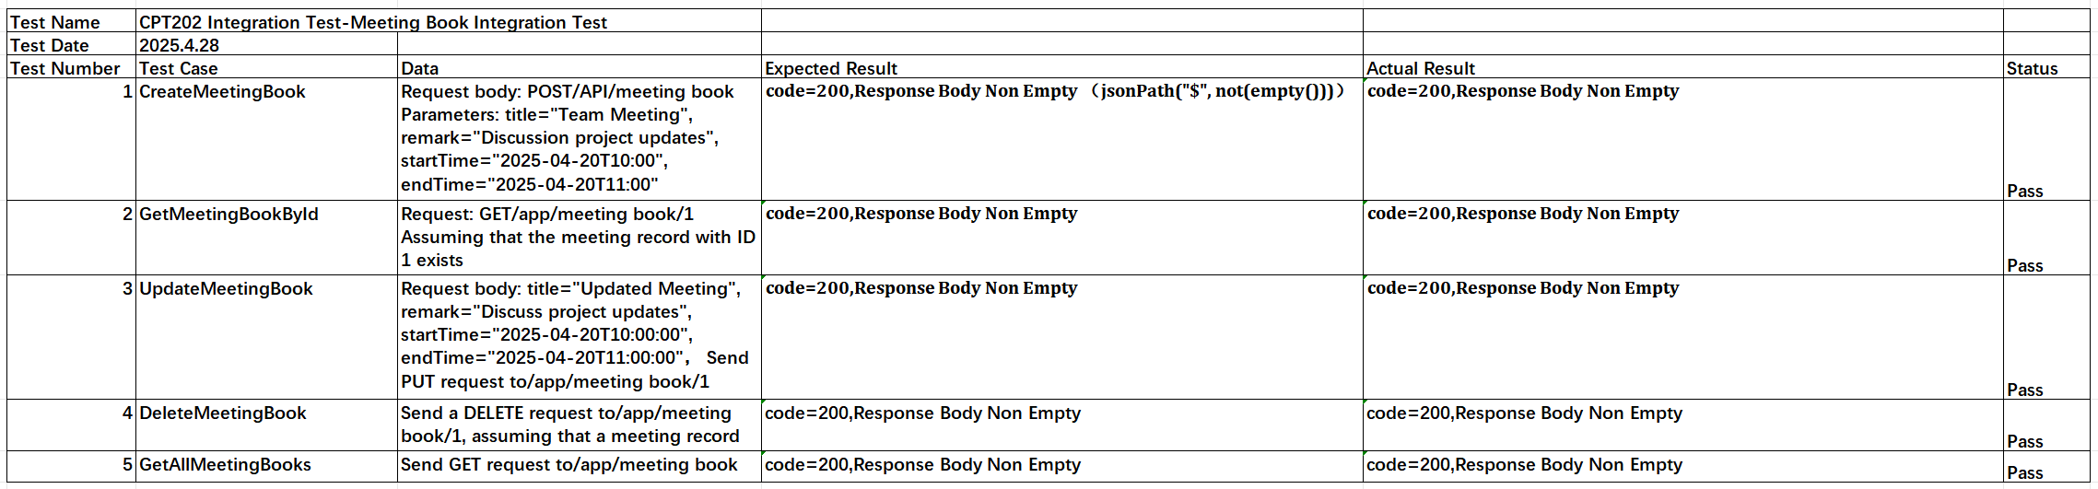
Software Testing-Integration Testing-Create new booking
Test Code:
Framework: JUnit, Spring Test
Simulation tool: MockMvc, ObjectMapper
Test Result:

Slide 21
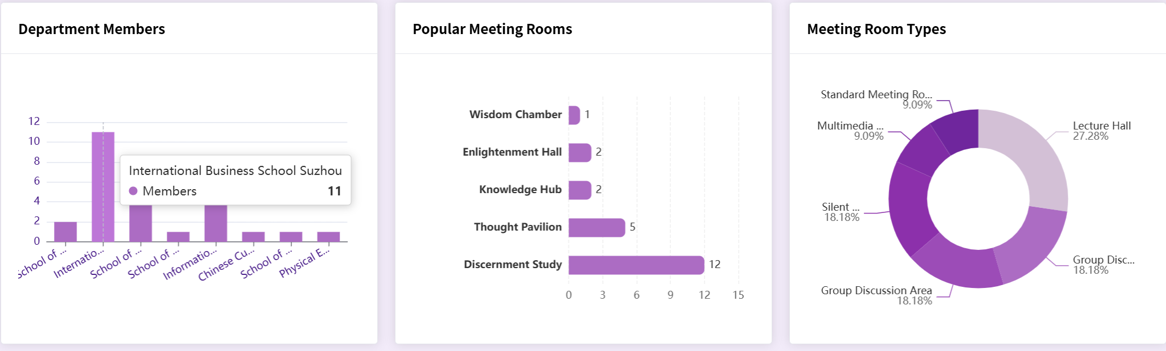
Software Testing
  Acceptance Testing
  PBI-032 Users cannot book for more than 8 hours
  User Interface

Slide 22
URL
http://121.43.36.102/

Slide 23
THANK YOU

