Slide 1




E-business analysis of Amazon
Group 9
Shuxia.Zhong (2254853)
Yunqiu.Li (2253494)
Yihang.Xu (2253841)
Xinyuan.Zhang (2255403)
Nan.Lin (2252173)
Yida.Liu (2251062)

Slide 2
Content
Case Description — Rufus
Rufus Critical Analysis
Application of Rufus in HR of Amazon — Rufusy
Rufusy Critical Analysis
Conclusion

Slide 3
Case Description

Slide 4



Case Description
Generative AI
E-business
Rufus Functions
Generative AI Development
Growing Demand for
Intelligent Services
（Zaczkiewicz, 2024）
Generative AI
Shopping Assistant
  Find Products
Rufus
  Compare Product Information
  Personalized Recommendations

Slide 5
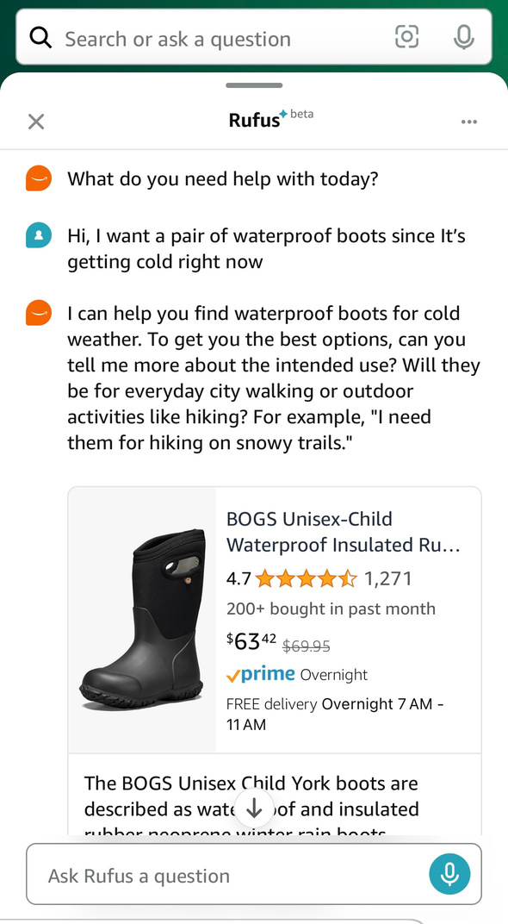
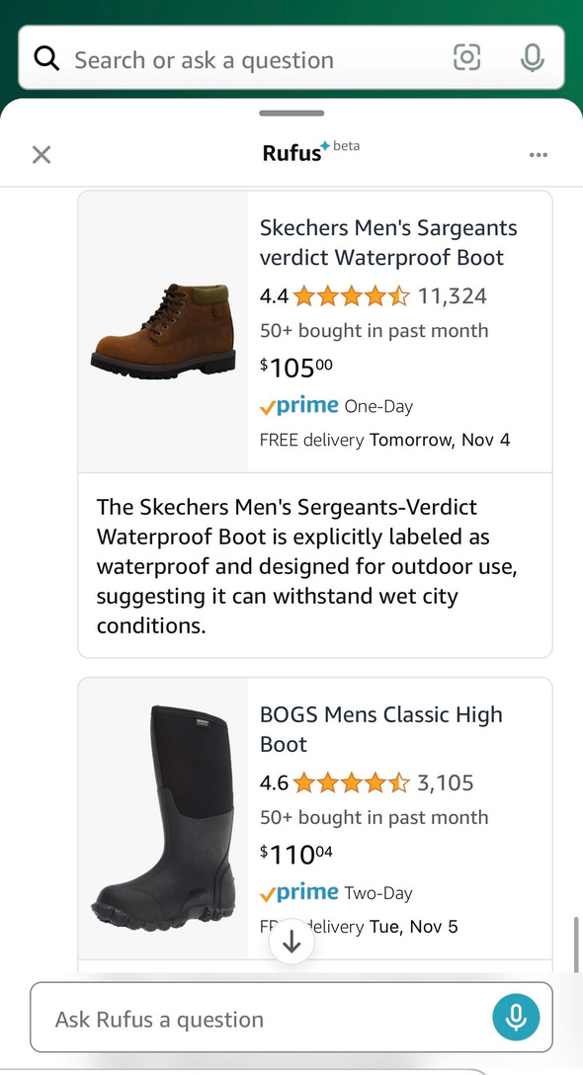
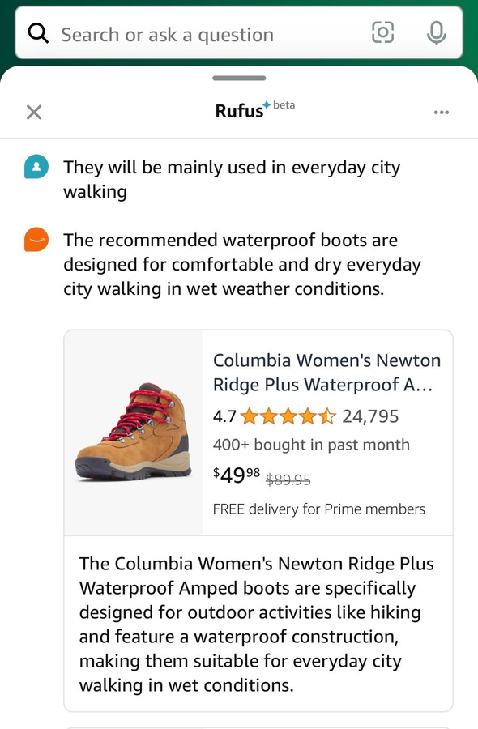
Case Description
Compare Product
Information
Personalized Recommendation
Find Products
GenAI
E-business
Rufus
CRM Strategy

Slide 6
Rufus Critical Analysis
— Personalization and Automation

Slide 7

Personalization
01
Understand what customers want
02
Make tailored advice
03
Improve shopping experience
04
Increase sales and loyalty to Amazon

Slide 8
Automation
Consumer
Full-time Support
Rely less on human customer service
Company Amazon
Reduce Operational Costs
Automated
shopping
assistant
Seller
Attract more shoppers

Slide 9
Buyers and Sellers
Buyer
Limitations of algorithms
Update of technology
Reduce buyer shopping experience
Seller
Keyword Ranking Invalidation
Improve market strategies
Stress seller

Slide 10
Rufus Critical Analysis
— Data-driven Decision-making

Slide 11
Data-driven Decision-making
Massive Customer Base
Marketing Strategies
US consumers really want
Personalization
Automation
Responsive
Data-Driven
Rufus collects
Deep insights
Proactive
Success in America
Amazon Optimizes Product Recommendations
Tons of User Interaction Data
?
Success in worldwide
Smaller customer base
Notes:
6739c040-1f6f-4cf9-848f-b325fa6fe4c5.source.5.zh-Hans

Slide 12



Global Expansion
Solution
Market | United States |  | Amazon is No.1 e-commerce company
 | Asia-Pacific |  | Amazon Market Share
Policy | United States | No Uniform National Law | More State-level regulation
 | Europe |  | Very Strict Data Privacy Regulation
Economy | United States | IDI No.1 (World Internet Development Report, 2023 ) | Well-developed infrastructure
 | South America | Underdeveloped Technology | Underdeveloped Logistics
01
(Statista, 2024)
Invest Money on Localization
02
Data Minimization Principle
03
Education and Guidance

Slide 13
Application of Rufus in HR of Amazon — Rufusy
商|页|计|划|书|演|示|模|板

Slide 14
Rufusy’s Background
External
Sales
Marketing
Consumers
Sellers
Rufus
Rufusy
Internal
HR System
Personalization
Automation
Data-Driven Decision-Making
Employees
Notes:
cc37e974-8798-4f84-92a8-11158047d1af.source.3.zh-Hans

Slide 15
Functions of Rufusy
Employee
Manager
1. Personalization
1. Data-Driving Decision-Making
Generate sentiment trend report
Capture and analyze the emotional state Provide personalized recommendations
2. Automation
Identify potential mental health crises
Implement effective interventions
24/7 Emotional Support
Reduce costs

Slide 16
Rufusy Critical Analysis
1
Employees
2
Managers
3
Expansion of Global Business
商|页|计|划|书|演|示|模|板

Slide 17
Employee Perspective
24/7 emotional support
Improve job satisfaction and mental health
Advantages
Personalized Advice
Rufusy
Differences in emotional expression
1. Extroverted Employee
Limit the effect of the system
Disadvantages
2. Introverted Employee
Notes:
6e146302-a49b-48b3-8c20-c2378a3245fc.source.3.zh-Hans

Slide 18
Manager Perspective
Enhancing team dynamics
Provide managers with report (LMX Theory)
Advantages
(Aggarwal et al., 2020)
Rufusy
If employees feel that they are being monitored
Affect trust, Effciency and Relationship
Disadvantages
Internal team tensions
If team members have different perceptions of these reports

Slide 19
Expansion of Global Business Perspective
Making it a leader in employee care
Strengthened Amazon’s employee-centered image
Advantages
Cultural differences
Rufusy
Asian employees may be less expressive than Western employees
Disadvantages
Costly
Adding complexity to global expand

Slide 20
Conclusion
商|页|计|划|书|演|示|模|板

Slide 21
Rufus：Generative AI Shopping Assistant
Personalized abilities
Buyer:
Limitations of algorithms
Personalization and Automation
Seller:
Automation
Keyword Ranking
Invalidation
Amazon has larger customer base in America
Asia-Pacific
Success
Exploring
Data-driven Decision-making
Europe
South America

Slide 22
Rufusy：Emotional Support in HR
Personalized abilities
Employee
Differences in Emotional Expression
Automation
Data-driven Decision-making
Employees are Being Monitored
Manager
Team Members Have Different Perceptions
Strengthened Employee Centered Image
Cultural Differences
Global Business
Costly

Slide 23
Reference List
Arun Aggarwal et al. (2020) ‘Leader–Member Exchange, Work Engagement, and Psychological Withdrawal Behavior: The Mediating Role of Psychological Empowerment’, Frontiers in Psychology, 11. doi:10.3389/fpsyg.2020.00423.
China Academy of Cyberspace Studies. (2023). World Internet Development Report 2023. Beijing: The Commercial Press.
Top online stores in the United States in 2023, by e-commerce net sales (2024) Available at: https://www.statista.com/forecasts/646030/united-states-top-online-stores-united-states-ecommercedb (Accessed: 25 October 2024).
Zaczkiewicz, A. (2024) ‘AI Can Revolutionize E-commerce, According to Founder of Pixyle.ai’, WWD: Women’s Wear Daily, p. 20. Available at: https://search.ebscohost.com/login.aspx?direct=true&db=bsu&AN=176626744&site=eds-live&scope=site (Accessed: 25 October 2024).
商|页|计|划|书|演|示|模|板

Slide 24
Thank You
商|页|计|划|书|演|示|模|板

