Slide 1
Spatial Reasoning Problems: Help Wanted
Ernie Davis
Cognition Community Forum
August 30, 2024

Slide 2
Synthetic Benchmark
I’ve written code to generate random diagrams of polygonal shapes and “random” questions about them, following 24 templates.
My guess is that most of these are easy for people and many of the will be challenging for current AI.
Details:
https://cs.nyu.edu/~davise/Benchmarks/GeomBenchmark.pdf

Slide 3
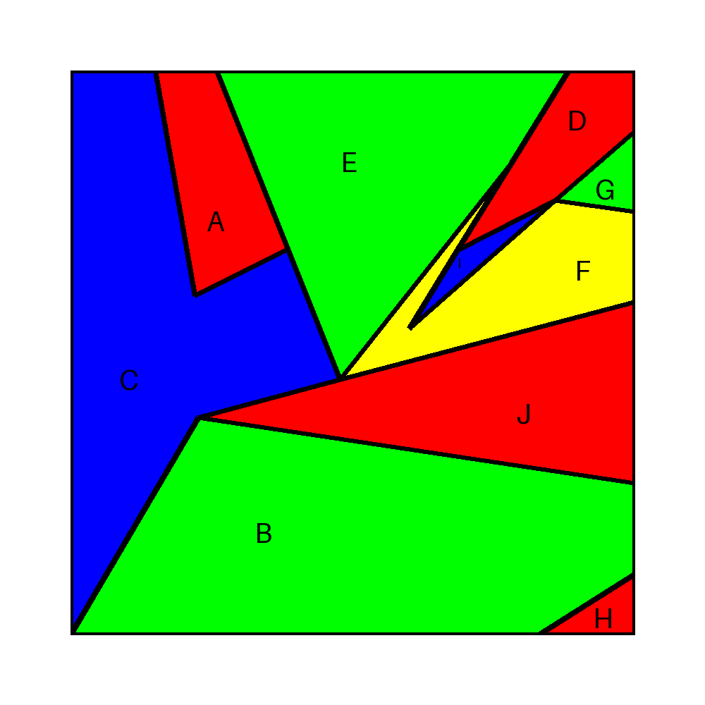
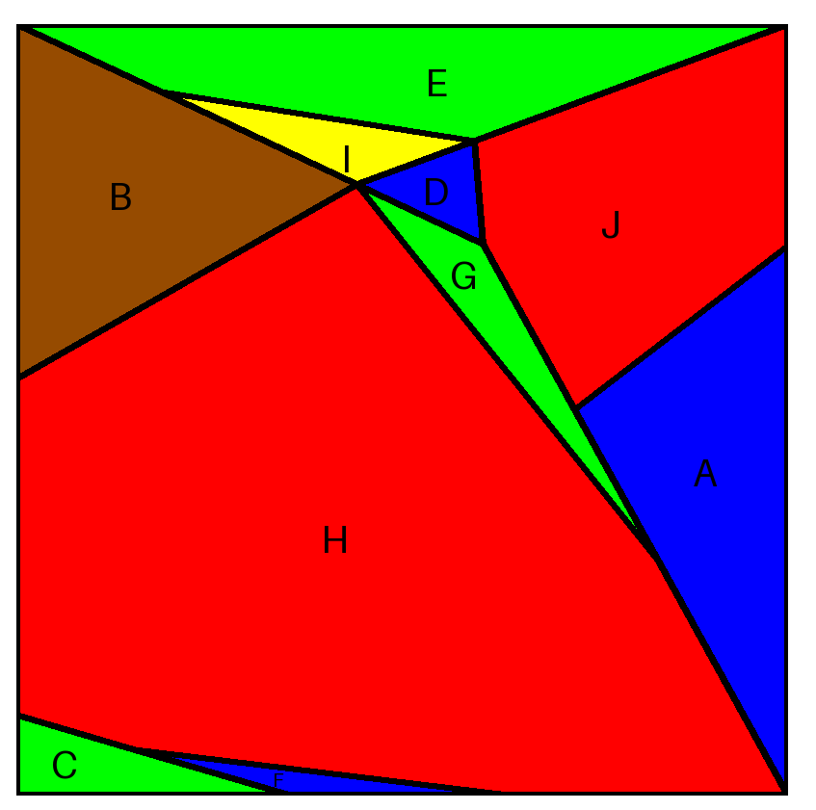
Diagrams

Slide 4
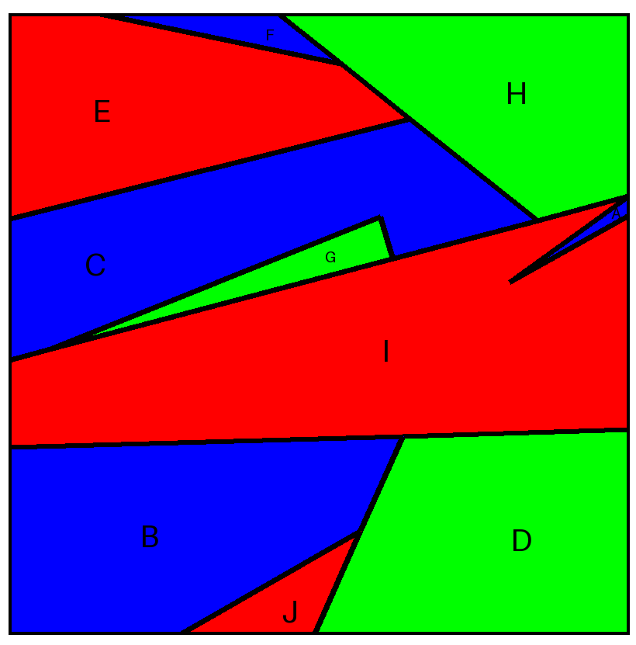
Questions
Question 1: Which regions border region B along an edge?
Answer: I, J, D
Question 2: If you draw a straight line segment from a point in the interior of region E to a point in the interior of B, which other regions might it go through?
Answer: G, I, C
Question 3: Which if any of the regions are not convex?
Answer: I, C

Slide 5
To Be Done
Run tests on AI systems
Get a baseline from human subjects.
To be decided, first:
What would be the most informative AI tests? (Which systems, what training, what prompt, etc.)
What would be the most informative human experiments?
How should tests be evaluated?

Slide 6
HELP!
If you think this would be interesting, let me know.

